Slide 1

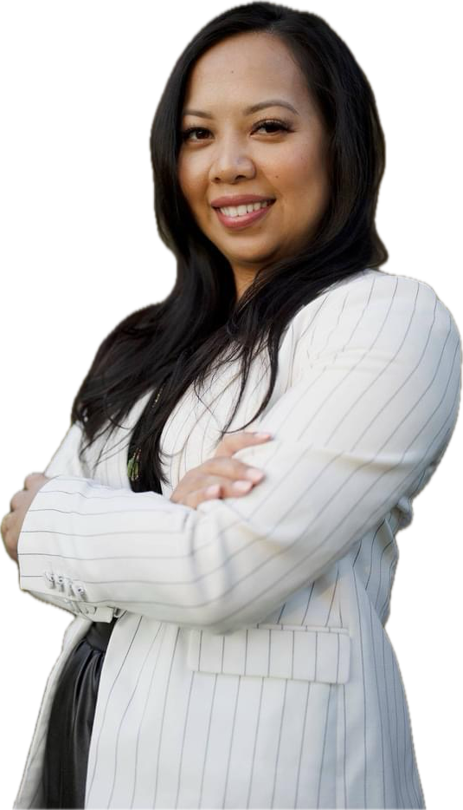
SPEAKER INFO KIT
Celebrity Events
Corporate Meetings
Association Conferences
Executive Retreats
Educational Seminars
Virtual Presentations
Int’l Keynote Speaker
Confidence Specialist
Subject Matter Expert
Leading Authority
Trusted Advisor
Stacy
Phoenix
Worldwide Leading CONFIDENCE Expert
“MAGNITYING SUCCESS IN YOUR PERSONAL & PROFESSIONAL VISION”

Slide 2



CONFIDENCE STRATEGIES THAT MAGNIFY SUCCESS
Learn what Stacy Phoenix teaches major agencies and companies, across the US, North Africa, Italy, traveling internationally delivering the Power of Staying Focused on the goal of delivering CONFIDENCE SUCCESS STRATEGIES.
Stacy Phoenix is CEO of www.stacyphoenix.com
Worldwide Leading CONFIDENCE Expert
Alignment Based Signature Programs
Energy-Based Alignment for Spotlight Souls™
Whether you’re scaling your brand, hosting clients, or speaking on high-visibility platforms, Energy-Based Alignment for Spotlight Souls™ equips you with the internal power to stand out—not just spiritually, but strategically. By mastering energetic alignment, you become the most compelling force in your market: focused, magnetic, and untouchable in your lane.
Healing in the Spotlight™: A Trauma-Informed Journey for Soul-Led Creatives
Healing in the Spotlight™ is a trauma-informed container where your emotional story becomes your superpower. In this sacred space, you’ll align your healing with your leadership identity—so your messaging, presence, and business decisions come from power, not performance.
The Embodied Leader™: Confidence-Based Leadership for Creatives Who Influence
The Embodied Leader™ helps you align your mindset, personal brand, and energetic presence so you lead from wholeness, not hustle. Whether you’re commanding stages, hosting live content, or launching transformative offers, this program ensures you stand out as the leader in your niche—without ever compromising your authenticity.
Ascend into Leadership™: Elevation for Soul-Driven Creatives
Ascend into Leadership™ is a transformational journey for entrepreneurs who are ready to break through internal glass ceilings, build a standout identity, and lead their business from energetic authority. When who you are is aligned with how you show up—you don’t chase success. You attract it.
Rave
Reviews!
What Industry Leaders
And Agencies Are
Saying About Stacy....
To Book Stacy NOW:
stacyphoenixllc@gmail.com
www.stacyphoenix.com
“I had the pleasure of attending one of Stacy's workshops, and it was nothing short of life- changing. She shared practical tools that helped me shift my mindset and improve my selling skills. I left feeling inspired and ready to take action!”
— Tom S., Former Client
“I was skeptical about coaching until I met Stacy. Her genuine care and expertise made all the difference. Through her guidance, I’ve not only improved my professional skills but also healed from past traumas. I now feel equipped to take on the world!”
— Chris W., Former Client
UNMATCHED TRACK RECORD! PROVEN RESULTS!

Slide 3

Professional Biography
Stacy Phoenix is a transformational Confidence Coach, dynamic keynote speaker, and powerhouse mentor for entrepreneurs, solopreneurs, creatives, and leaders who are ready to own the spotlight and embody their full potential. Known as the East Coast’s #1 Confidence Coach, Stacy empowers clients to step into their voice, presence, and power—both on stage and in life—with a deeply human, spiritual, and results-driven approach.
After overcoming a life-altering divorce and rising from the ashes of addiction and self-doubt, Stacy rebuilt her life from the inside out. Her healing journey led her through the world of energy medicine, spiritual awakening, and radical self-reclamation. Along the way, she became certified in over 12 healing and coaching modalities—including NLP, Hypnotherapy, Life Coaching, Reiki Mastery, Chakra Therapy, and Spiritual Counseling. Stacy is an advocate for individualism and equal rights. What began as a personal transformation became her calling to help others break free from fear and fully step into their purpose.
Stacy’s signature coaching style is a fusion of spiritual wisdom, subconscious reprogramming, and unapologetic truth-telling. She creates a nurturing, judgment-free space where her clients feel seen, safe, and activated to take bold action. Whether guiding entrepreneurs, solopreneurs, creatives, or executives, she helps them dissolve inner blocks, ignite self-trust, and radiate confidence that commands attention in any room.
As sought leader and compelling speaker, Stacy Phoenix remains committed to empowering those around her. Whether through her engaging speaking engagements, her book where she is a co-author alongside, Les Brown, her mentors- Jim Britt (Tony Robbins former mentor), and Jim Lutes, called “The Change 23: Insights Into Self Empowerment”, or her heartfelt coaching sessions, she is dedicated to helping others embrace their true selves and lead fulfilling lives.
Outside of her coaching and speaking career, Stacy is a passionate mother, artist, and wellness enthusiast. She loves dancing, painting, nature photography, and living a high-vibrational lifestyle rooted in self-care, creativity, and spiritual alignment. She is proudly sober and pescatarian, living a life of integrity and devotion to personal growth and purpose.
A proud daughter of Cambodian immigrants, Stacy brings a rich, multicultural perspective to her work, weaving resilience, empathy, and cultural depth into her coaching and leadership. Her story resonates with anyone who has ever felt like an outsider—and her presence reminds them that they were born to lead, rise, and shine.
Today, Stacy Phoenix stands as a guiding light for those ready to be fully seen, fully expressed, and fully free. Whether coaching one-on-one, leading group programs, or igniting audiences from the stage, she helps others rise into the most confident, radiant version of themselves—so they can be known, remembered, and paid for who they truly are.

Slide 4
CONFIDENCE STRATEGIES THAT MAGNIFY SUCCESS
Energy-Based Alignment for Spotlight Souls™
For Visionary Entrepreneurs, Solopreneurs & Creatives ready to align their energy, purpose, and public presence—so they can lead their market with authenticity and impact. This is where soul meets strategy. Energy-Based Alignment for Spotlight Souls™ is designed for entrepreneurs, solopreneurs, and creatives who are done with forcing visibility and ready to radiate it. Inside this container, we align your energy with your presence, so you stop second-guessing your voice and start showing up as the magnetic leader you were born to be.
You’ll learn how to anchor your purpose, clear energetic clutter, and embody the version of you who owns every room—online or off. This isn’t just about “feeling good”—it’s about becoming grounded, focused, and unshakably confident in your market. When your energy is aligned, you don't chase impact... you attract it.
Worldwide Leading CONFIDENCE Expert
Stacy Phoenix is CEO of stacyphoenix.com
What Successful Entrepreneurs And Industry Leaders Are
Saying About Stacy...
Keynote title: “Have You
Earned Your Wings To Soar?”
Align with your energetic blueprint to make bold, aligned business moves with clarity and conviction
Clear the emotional clutter that stifles your creativity, confidence, and leadership authority
Activate vocal and breath techniques that ground your energy and project presence in high-stakes moments
Set boundaries that protect your energy while expanding your capacity for clients, content, and cash flow
UNMATCHED TRACK RECORD! PROVEN RESULTS!
“Stacy’s program helped me feel more powerful in my voice. I feel more empowered and motivated to fulfil my dreams as a popstar!”
– Emma Lisa, from Australia
To Book Stacy NOW:
stacyphoenixllc@gmail.com
www.stacyphoenix.com

Slide 5
CONFIDENCE STRATEGIES THAT MAGNIFY SUCCESS
Healing in the Spotlight™: A Trauma-Informed Journey for Soul-Led Creatives
For Entrepreneurs, Solopreneurs & Creatives ready to align their story, presence, and voice—so they can lead with emotional freedom and lead their market with integrity.
Being visible is powerful—but if you’re carrying emotional weight or past wounds, it can feel like a performance instead of true presence. Healing in the Spotlight™ is a trauma-informed space where creatives and leaders come to safely release the internal blocks holding them back from fully owning their voice, worth, and mission.
We blend somatic healing, spiritual tools, and nervous system regulation to help you align with your truth—so you can rise without the emotional crash. You’ll walk away feeling lighter, clearer, and more connected to your message than ever before. This is where your inner healing meets your public power.
Worldwide Leading CONFIDENCE Expert
Stacy Phoenix
is CEO of stacyphoenix.com
What Top Entertainers And Industry Leaders Are
Saying About Stacy....
UNMATCHED TRACK RECORD! PROVEN RESULTS!
Keynote title: “How To Stay Focused On Your Power and Voice”
Emotional and energetic alignment through somatic work, expressive journaling, and integration rituals
Nervous system regulation that supports sustainable leadership in high-pressure markets
Energetic protection tools so your sensitivity becomes an asset—not a liability—in business
Messaging clarity that allows you to speak from your truth, not your trauma
“After working with Stacy, I don’t just sell - I lead. I don’t just speak- I move people. And I just don’t stand in the market - I own it. Every entrepreneur needs to experience what she offers. It’s not a seminar. It’s a spiritual awakening for your voice and spirit.”
– ELT, Global Entertainer and Visionary
To Book Stacy NOW:
stacyphoenixllc@gmail.com
www.stacyphoenix.com

Slide 6

CONFIDENCE STRATEGIES THAT MAGNIFY SUCCESS
The Embodied Leader™: Confidence-Based Leadership for Creatives Who Influence
For Visionary Entrepreneurs, Solopreneurs & Creatives ready to align their voice, energy, and presence—so they can lead their market with clarity and confidence.
You don’t need to shout to be seen—you just need to be aligned. The Embodied Leader™ is a confidence-based leadership program that helps creatives and entrepreneurs speak with power, show up with presence, and lead from deep alignment. You’ll learn how to command attention with your energy, not your ego.
From posture to brand voice, we refine every layer of your presence so that your leadership feels natural, magnetic, and unapologetically authentic. You’ll walk away with a clear message, bold energy, and the kind of grounded confidence that makes you impossible to ignore in your industry.
Worldwide Leading CONFIDENCE Expert
Stacy Phoenix is CEO of stacyphoenix.com
What Top Entertainers And Industry Leaders Are Saying About Stacy....
Keynote Title “Unshakeable Presence And A Clear Vision”
Align your inner world with your public brand through self-compassion and personal power
Set goals that match your vision and market position—not outdated business molds
Master communication tools that make your message crystal clear and market-dominant
Refine your energetic and visual identity so you become instantly recognizable in your space
UNMATCHED TRACK RECORD! PROVEN RESULTS!
“If you’re an entrepreneur - honestly just a human being with something important to say- run, don’t walk! Stacy is the real deal. Her work is next-level, her energy is electric. She doesn’t just prepare you for the market- she helps you become the leader in it.”
-- Patricia, Stacy Phoenix Client from London
To Book Stacy NOW:
stacyphoenixllc@gmail.com
www.stacyphoenix.com

Slide 7
CONFIDENCE STRATEGIES THAT MAGNIFY SUCCESS
Ascend into Leadership™: Identity, Energy & Impact for Soul-Driven Entrepreneurs
For Visionary Entrepreneurs, Solopreneurs & Creatives ready to align their identity, message, and leadership—so they can lead their business market with authenticity and soul.
You’re not here to fit in. You’re here to rise and redefine the space you lead in.
Ascend into Leadership™ is a transformational journey for entrepreneurs who are ready to break through internal glass ceilings, build a standout identity, and lead their business from energetic authority. When who you are is aligned with how you show up—you don’t chase success. You attract it.
Worldwide Leading CONFIDENCE Expert
Stacy Phoenix is CEO of stacyphoenix.com
What Top Entertainers And Industry Leaders Are Saying About Stacy....
Keynote Title “Own Who You Are - Lead The Market.”
Unshakeable confidence rooted in your aligned identity—not external trends
Leadership presence that disrupts your industry without diluting your values
Emotional freedom and energetic flow to navigate expansion with grace
Alignment rituals that sustain your visibility, content creation, and client attraction
UNMATCHED TRACK RECORD! PROVEN RESULTS!
“She doesn’t teach you how to sell. She teaches you how to own who you are, how to walk into any room like you belong there, and how to speak from a place so grounded, magnetic, and powerful that people can’t look away. I walked out of her training feeling 100 feet tall, unapologetically bold, and more aligned with my purpose than ever.”
-- Yasmine, Stacy Phoenix Client from London
To Book Stacy NOW:
stacyphoenixllc@gmail.com
www.stacyphoenix.com

Slide 8
“I’m really grateful my path crossed with Stacy’s. My manifestation is already happening and I’m happy I manifested her.”
-- Natalia, Stacy Phoenix Client from London
“Stacy walked me through every step of the way of the process of regaining my mental strength, rebuilding my confidence and letting go of past experiences.“
-- Daria, Stacy Phoenix Client from Denmark
UNMATCHED TRACK RECORD! PROVEN RESULTS! IMMIDIATE R.O.I.
UNMATCHED TRACK RECORD! PROVEN RESULTS!
What Industry Leaders Are
Saying About Stacy....
“Stacy’s coaching was one I didn’t know I needed and I’m very thankful I went through her course. One can read all about the techniques of the mindset or watch videos. However, Stacy’s proper technique and guidance will help get you there faster.“
-- KC, Stacy Phoenix Client from Massachusetts
“I am very happy because it seems like we are on the same frequency. Stacy gave me so many aha moments and I know this open happens when my mind and soul are open and aligned, which happens in the presence of like minded people. Stacy is professional and sensitive and have the right intuition to help her clients at her best!”
-- Patty, Stacy Phoenix Client from the United Kingdom
To Book Stacy NOW:
stacyphoenixllc@gmail.com
www.stacyphoenix.com

Slide 9
“Stacy has left me speechless. I went in with an open mind and was blown away. I was able to dive into healing in a totally deeper way. I was able to breakthrough and feel the possibilities right in my hands.”
-- Samantha, Stacy Phoenix Client from Arizona
“My goal was to feel less anxious and be more comfortable with learning about myself which is something I was struggling with. After one week of working with Stacy, I felt positive changes! Stacy’s the best in the game.“
-- Caitlin, Stacy Phoenix Client from New Hampshire
UNMATCHED TRACK RECORD! PROVEN RESULTS! IMMIDIATE R.O.I.
UNMATCHED TRACK RECORD! PROVEN RESULTS!
What Industry Leaders Are
Saying About Stacy....
“I was stuck. I was so stuck. I was doing it all myself. Listening to a million meditation and could not break through until I started working with Stacy. She discovered what was keeping me stuck and changed my life.“
-- Yaz, Stacy Phoenix Client from London
“Stacy’s process helped me confront things that I had never been able to before. It was like a weight being lifted and I could finally breathe again as I worked through each experience. Making this connection with Stacy benefitted my life. She knows her stuff and YOU are worth the investment!”
-- Melissa, Stacy Phoenix Client from Washington state
To Book Stacy NOW:
stacyphoenixllc@gmail.com
www.stacyphoenix.com

Slide 10
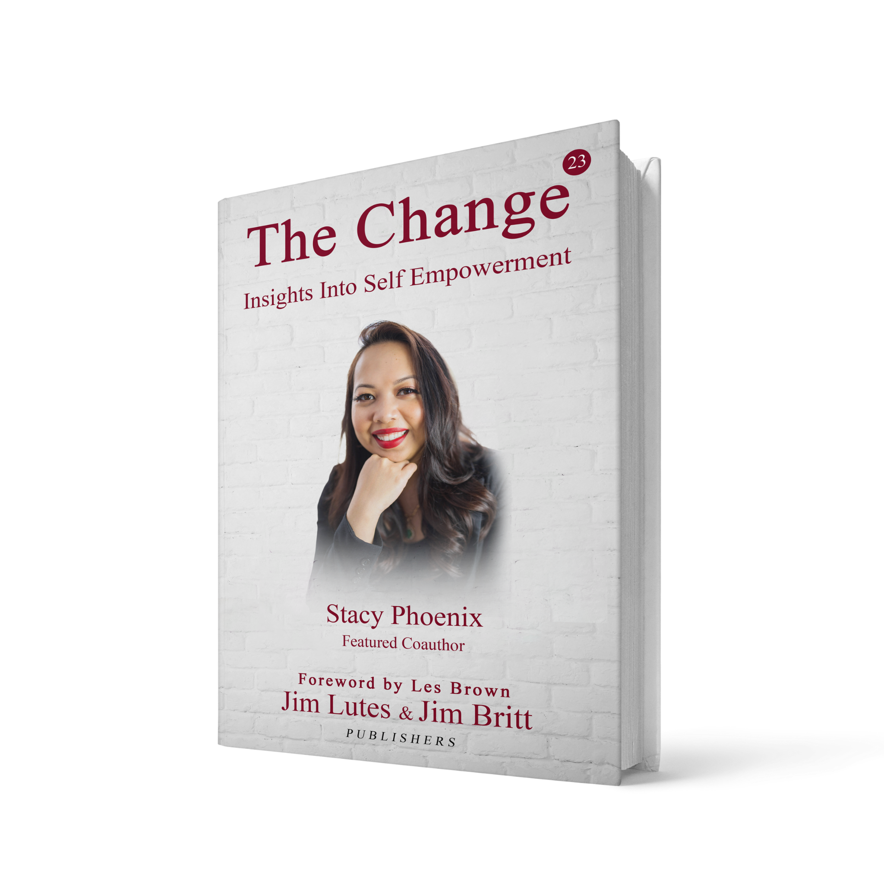
Stacy Phoenix is co-author of the world renown book series, "The Change: Insights Into Self Empowerment" Vol 23 & Foreword by Les Brown.
This book offers powerful thought-provoking self empowering insights, stories and strategies from a diverse lineup of 20 co-authors from around the world.
Chances are this book contains exactly what you need to transform yourself into the top 5% in your category and agency worldwide.
Created by top peak-performance experts and Stacy’s mentors, Jim Britt and Jim Lutes and 20 empowering entrepreneurs and their stories.
Worldwide Leading CONFIDENCE Expert
Stacy Phoenix is CEO of stacyphoenix.com

Slide 11
Stacy has spent the last 5 years as a successful Confidence Coach, public speaker, and entrepreneur
Has studied and researched over 3,500 books in the fields of Communication, Marketing, Cognitive Science, Body & Nero Linguistics, Reiki, Chakra Therapy, Success Habits, Speaking Confidently, and Peak Performance.
Has a Bachelor’s degree in Business and 12 Certifications in spirituality, life coaching and Neuro-linguistic Programming
Has delivered over 2,750 Keynote Speeches, Public & Onsite Seminars, specializing in Customized Topics
Has gained extensive experience working with the hearing impaired and multicultural bilingual interpreters
Stacy has become a master communicator of transferring public confidence and selling strategies to over 76 different nationalities in the worldwide
Has presented confidence presentations to individuals in over 30 countries abroad.
Specializes in delivering customized soft skill topics
Career Highlights
& Achievements
Each year Ms. Phoenix's versatility allows her to address many diverse groups and organizations around the world.
Stacy's business acumen is highly sought out by international media outlets for hundreds of interview request every year on a wide variety of topics and her niche is teaching individuals how to sell with CONFIDENCE and lead the market with integrity.

Slide 12
STACY PHOENIX DELIVERS TRANSFORMATIONAL CONFIDENCE, NOT JUST MOTIVATION
Why Hire Stacy Phoenix?
Unlike typical motivational speakers who provide a temporary boost, Stacy ignites deep, lasting transformation. Her speaking style doesn’t just inspire—it awakens. She helps audiences tap into unshakable confidence rooted in self-acceptance, emotional resilience, and soul-aligned authenticity. Whether she’s addressing a room of entrepreneurs, creatives, leaders, or rising talents, Stacy speaks to the core of her audience. She doesn’t just tell them what to do—she shows them how to embody their greatness, release imposter syndrome, and walk in the room like they own it. Attendees walk away forever changed—speaking louder, standing taller, and ready to take bold, aligned action in their lives and careers.
Worldwide Leading CONFIDENCE Expert
Stacy Phoenix is CEO of stacyphoenix.com
Why Hire
Stacy Phoenix?
EXTREME CUSTOMIZATION AND USABLE CONTENT
SUBSTANCE AND STYLE
What sets Stacy Phoenix apart from the rest of the speaking industry is his professional appeal, ability to connect with any audience, unique charismatic style, blazing lyrical delivery, intelligent awareness, unbelievable memory and recall ability, and full time commitment to her craft to speak from her heart.
Each presentation is tailored to reinforce the theme and purpose of your event goals. Stacy will spend quality time with your organization customizing your presentation to meet the needs of your event.
Stacy’s style is SUPERCHARGED, SHOW STOPPING and completely result driven. Bearing the truth through the power of the spoken word,
Stacy Phoenix has mastered the art and science of understanding what an audience is hungry for and feeding that hunger with a passionate presentation that is tastefully packed with factual dialogue that moves people to immediate confidence and action.
Stacy delivers thought provoking, high quality presentations that reinforce the goals of your event while leading everyone to greatness.
To Book Stacy NOW:
stacyphoenixllc@gmail.com
stacyphoenix.com

Slide 13
YOU PREFER AN INTERACTIVE PRESENTATION
She Brings the Rare Blend of Spiritual Wisdom + Real-World Strategy.
Stacy combines the intuitive wisdom of a spiritual healer with the sharp, actionable tools of a master life and confidence coach. With a business degree and 12 certifications—including NLP, Hypnotherapy, Reiki, and Life Coaching—she doesn’t just inspire people to feel better; she helps them think, speak, and lead better. Her talks are deeply grounded in emotional intelligence, mindset mastery, and somatic awareness—bridging the spiritual with the strategic. She’s the voice for audiences who want more than fluff—they want to heal, grow, and lead with heart. She teaches people how to clear subconscious blocks, use their energy as a tool, and magnetize success with unapologetic authenticity.
Worldwide Leading SPOTLIGHT Expert
Stacy Phoenix is CEO of stacyphoenix.com
Why Hire
Stacy Phoenix?
SCOPE, REACH, AND PARTNERSHIPS
ATTRACT, ENGAGE, AND WIN MORE
Stacy is connected to top-notch CEO’s, entrepreneurial experts, celebrities, other professional speakers and subject matter experts. Under your organization’s banner, you can offer a SPOTLIGHT University seminar series, confidence based webinars, or Fortune-500 caliber Spotlight Bootcamps.
Our network of top-notch speakers have a proven track record of delivering high-impact programs nationwide and can do the same for your agency.
Stacy loves working with entrepreneurs, solopreneurs, and creatives increasing the power of their confidence to accomplish career goals through powerful and attractive learning solutions.
Hire Stacy and she’ll make sure your audience gets the “SPOTLIGHT STRATEGIES” tools, tips and proper techniques to leading the market as an effective industry leader – NOW more than ever!
To Book Stacy NOW:
stacyphoenixllc@gmail.com
stacyphoenix.com

Slide 14
STACY CREATES A JUDGMENT-FREE SPACE WHERE PEOPLE
FINALLY FEEL SEEN AND EMPOWERED
What sets Stacy apart is her presence. She creates a safe, nurturing, and non-judgmental environment where even the most reserved audience members feel seen, heard, and lit up. Her story of rising from divorce, addiction recovery, and personal reinvention resonates deeply—especially with entrepreneurs, creatives, and those who’ve felt unseen in their journey. She is raw, real, and radically empowering. Her vulnerability gives others permission to own their truth, and her mastery gives them the tools to thrive. People leave her events saying things like, “For the first time, I finally believe I’m enough.”
Worldwide Leading SPOTLIGHT Expert
Stacy Phoenix is CEO of stacyphoenix.com
Why Hire
Stacy Phoenix?
Stacy Phoenix is a master at delivering the attitude and discipline to SPOTLIGHT on service excellence and bridges the gap from your current state to attracting the people who skyrocket your career!
Stacy’s goal is to make you #1 and help you move your goals to the finish line of success. She looks forward to speaking with your event planner to discuss relevant details to create a successful program.
LET STACY PHOENIX SET YOUR NEXT CONFERENCE OR COMPANY EVENT ON FIRE!
PROVEN TRACK RECORD AND UNDENIABLE CREDIBILITY
Learn what Stacy Phoenix teaches to major organizations and agencies, across the US, London, Australia, traveling internationally delivering the Power of Staying Confident on the spotlight of creating a Powerful Impact.
To Book Stacy NOW:
stacyphoenixllc@gmail.com
stacyphoenix.com

Slide 15
YOU WANT SOMEONE WHO IS A PLEASURE TO WORK WITH
Her Message Elevates Events, Brands, and Cultures -
Hiring Stacy isn’t just about filling a speaker slot—it’s about elevating your entire event experience. She brings luxury, depth, and soul to every stage she steps on. Her message of confidence, authenticity, and heart-centered leadership aligns perfectly with high-level brands, women empowerment summits, creative industry expos, healing retreats, and corporate wellness programs alike. She helps organizations reimagine leadership from a human-centered lens and inspires attendees to take empowered ownership of their craft, voice, and influence. Her presence adds prestige, value, and unforgettable impact to any event.
Worldwide Leading SPOTLIGHT Expert
Stacy Phoenix is CEO of stacyphoenix.com
Why Hire
Stacy Phoenix?
Time to remove all doubt.
Stacy has done all the research, taken the risk and made the mistakes for you.
Simply follow his “Spotlight Attraction Action Plan” to unlock the power of your focus and leadership Skills...
At Spotlight Attraction Action Plan, we are eager to be of service to your organization. We are sensitive to your event budget goals or concerns you may and we are confident that Stacy’s experience and expertise will create extra value for the guest at your event.
Whether it's 500 or 10,000 people in attendance, Stacy's message is always sincere and delivered with warm regards. Stacy's ability to create in the moment is what audiences marvel at and are attracted to the most. As said by a conference attendee after hearing Stacy do a Keynote Speech, "Like an academy award winning movie, or an amazing live concert, you can’t seem to take your eyes off her, or stop listening to her. Stacy is highly entertaining and knows how to hold your attention the entire time and is so empowering."
Stacy has a proven formula that generates results to peak your performance. She studied and implemented the success habits of the top 5% of entrepreneurs, solopreneurs, creatives, and leaders of the business and entertainment world for the past 20 years, and put the tools in one easy system for you to follow. Stacy has learned to focus on what top achievers focus on. She has done it just as thousands of successful leaders before her, is a consistent performer on the professional speaker circuit inspiring conference attendees worldwide.
To Book Stacy NOW:
stacyphoenixllc@gmail.com
stacyphoenix.com

Slide 16
Audio Visual Set Up
Equipment:
Wireless lavaliere microphone + spare battery
Hand Held microphone + spare battery
Flipchart + fresh markers
LCD projector + screen
When videotaping, professional house lighting is required. Stacy may prefer hand held or lavaliere for presentations.
Room Setup:
Conference/Auditorium Style
Appropriate for short presentations or larger groups that do not require extensive note-taking.
Worldwide Leading SPOTLIGHT Expert
Stacy Phoenix is CEO of stacyphoenix.com
UNMATCHED TRACK RECORD! PROVEN RESULTS!
Summary:
The following professional requirements are necessary to ensure a HIGH QUALITY presentation.
If you have any questions, please call us at
(603) 247-6641
Thanks and we look forward to working with your team!
Classroom/Banquet Style
Appropriate for groups fewer than 40
Stacy is a high-energy speaker who utilizes a participant centered learning style to connect with the audience.
Stacy engages the audience and occasionally will move around often to keep the presentation fun and exciting. Please keep this in mind as you prepare your audio/visual logistics for your event.
To Book Stacy NOW:
stacyphoenixllc@gmail.com
www.stacyphoenix.com

Slide 17
Contact Info
Celebrity Events
Corporate Meetings
Association Conferences
Executive Retreats
Educational Seminars
Virtual Presentations
Int’l Keynote Speaker
Spotlight Specialist
Subject Matter Expert
Leading Authority
Trusted Adviser
Stacy
Phoenix
Worldwide
Leading SPOTLIGHT Expert
To Book Stacy NOW:
stacyphoenixllc@gmail.com
www.stacyphoenix.com
“MAGNITYING SUCCESS IN YOUR PERSONAL & PROFESSIONAL VISION”

