Slide 1


Slide 2
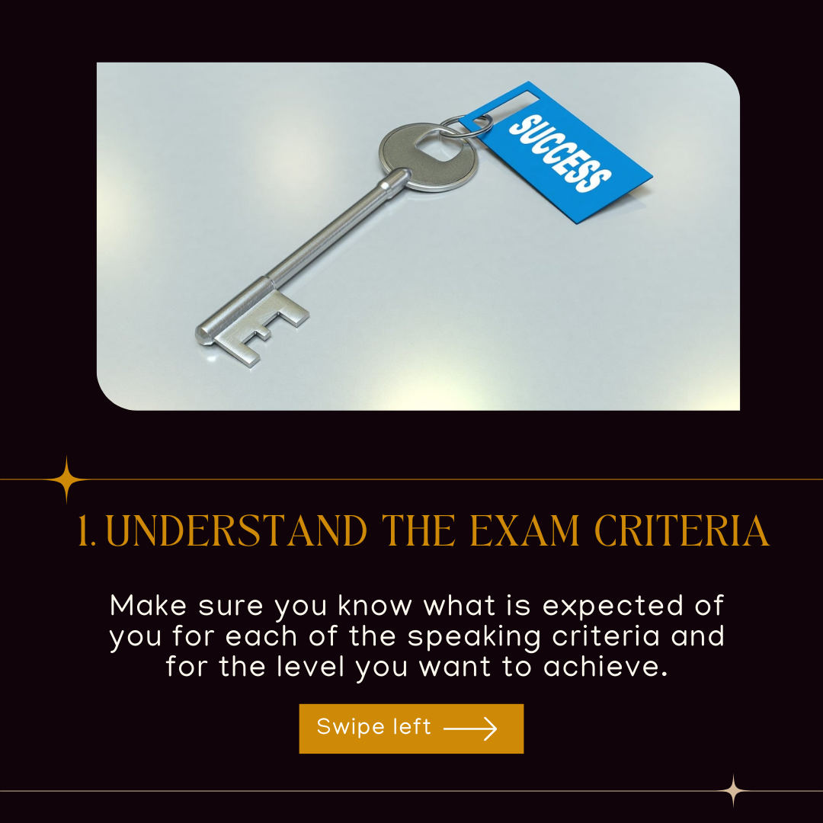

Slide 3


Slide 4
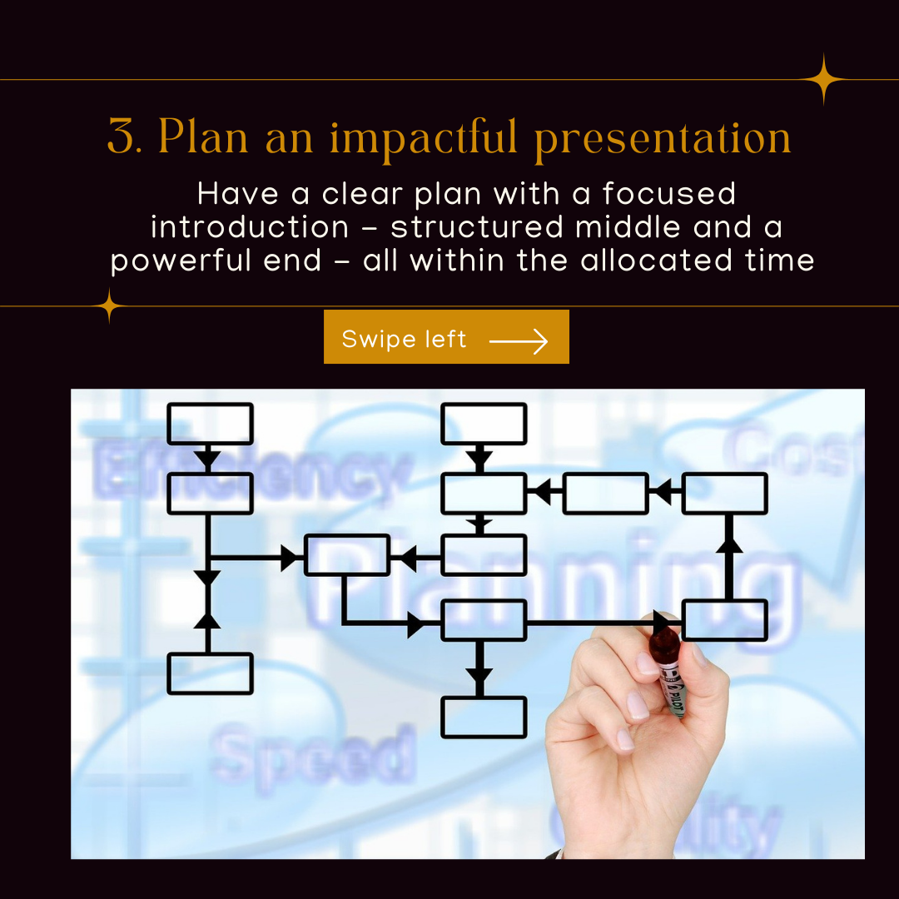

Slide 5
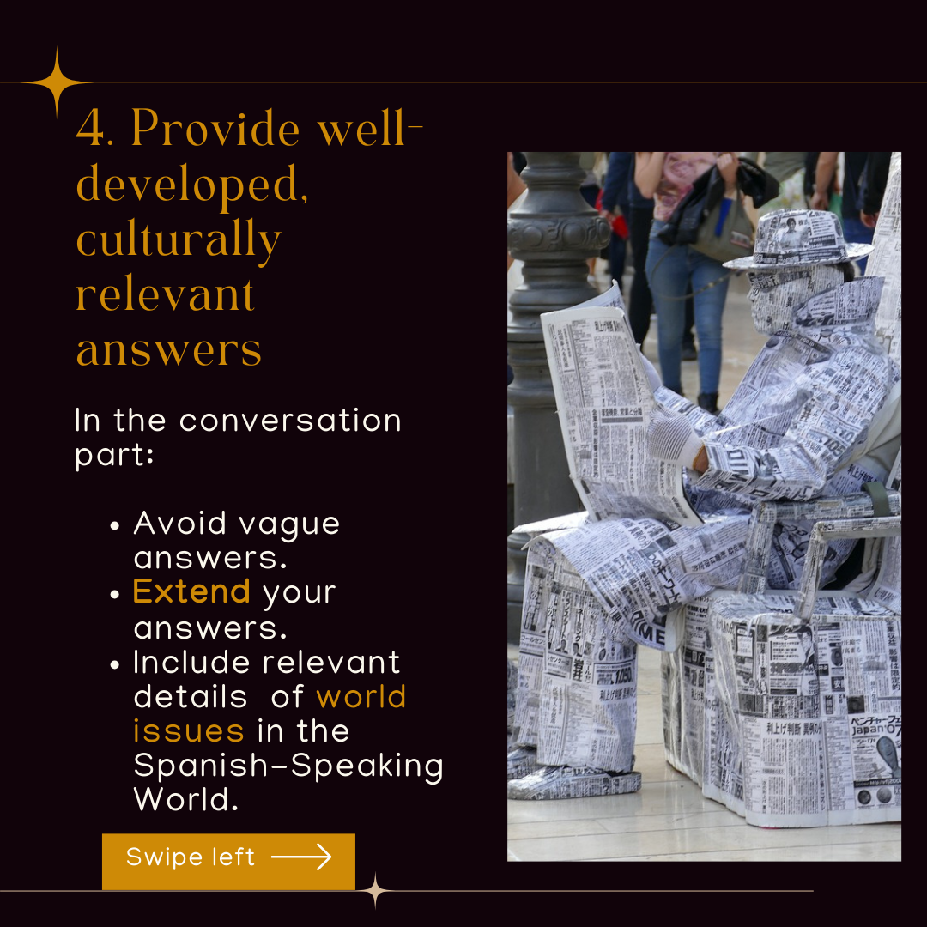

Slide 6
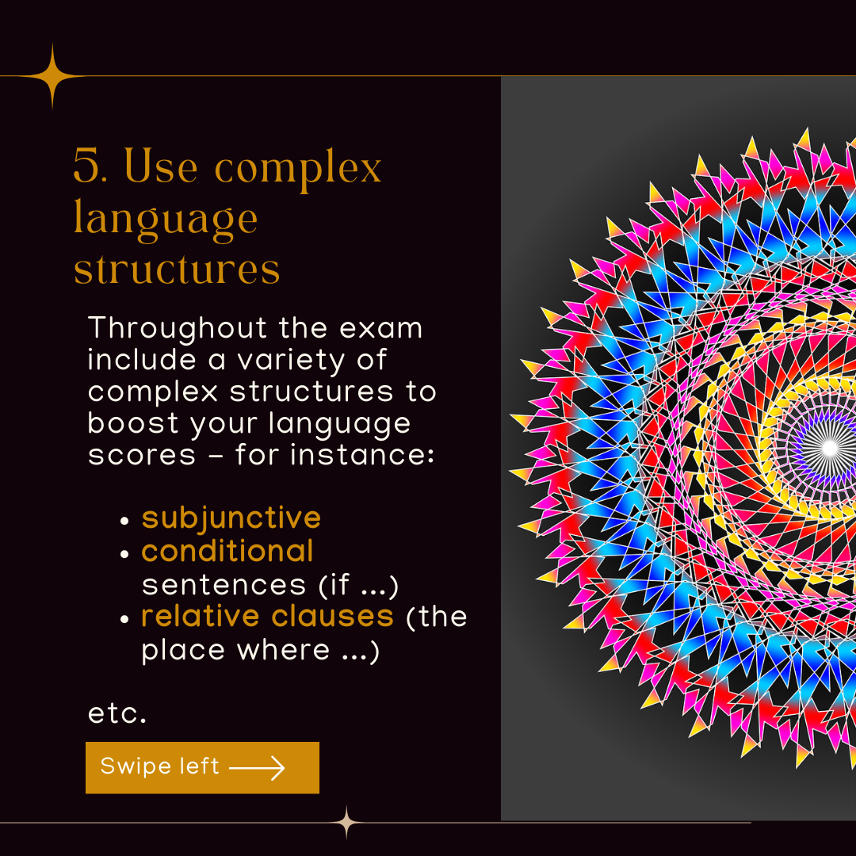

Slide 7


Slide 8
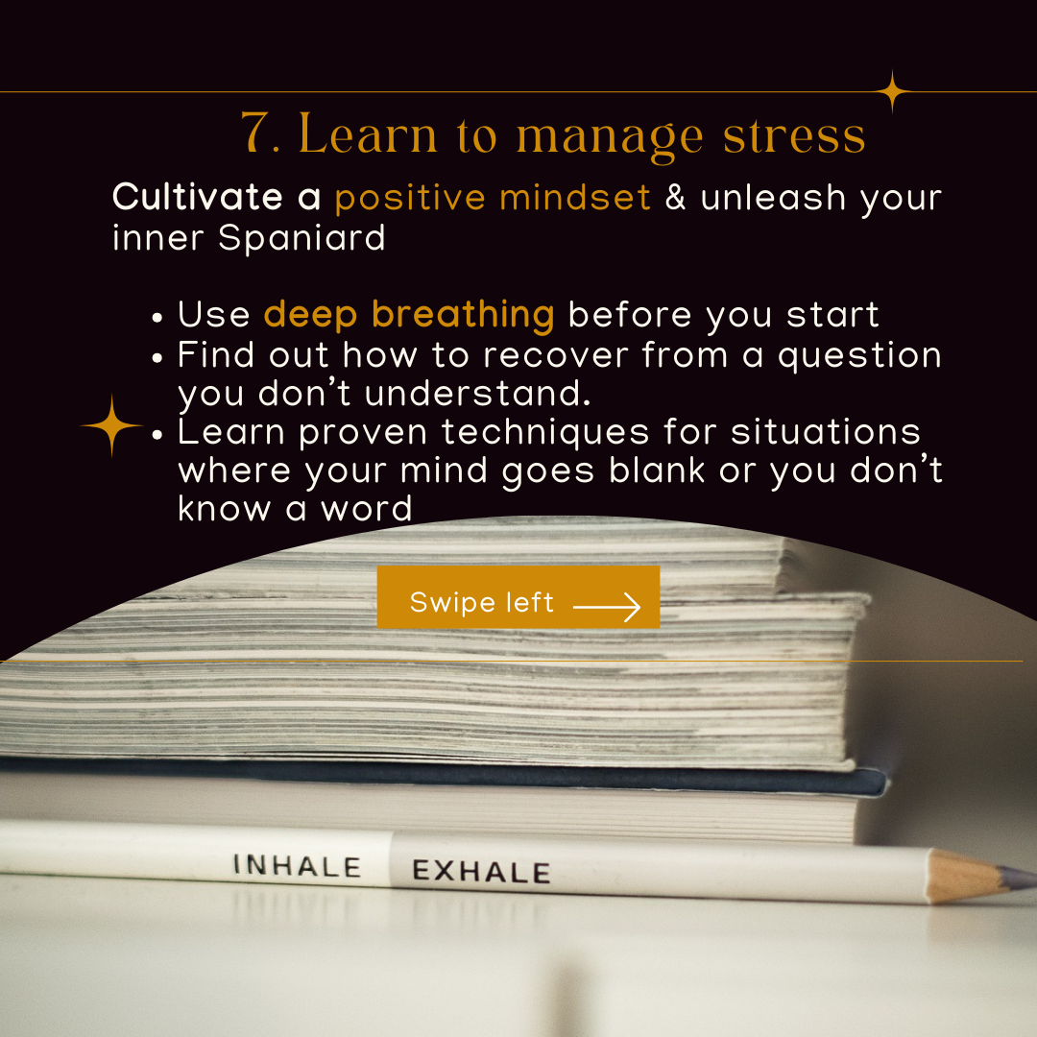

Slide 9
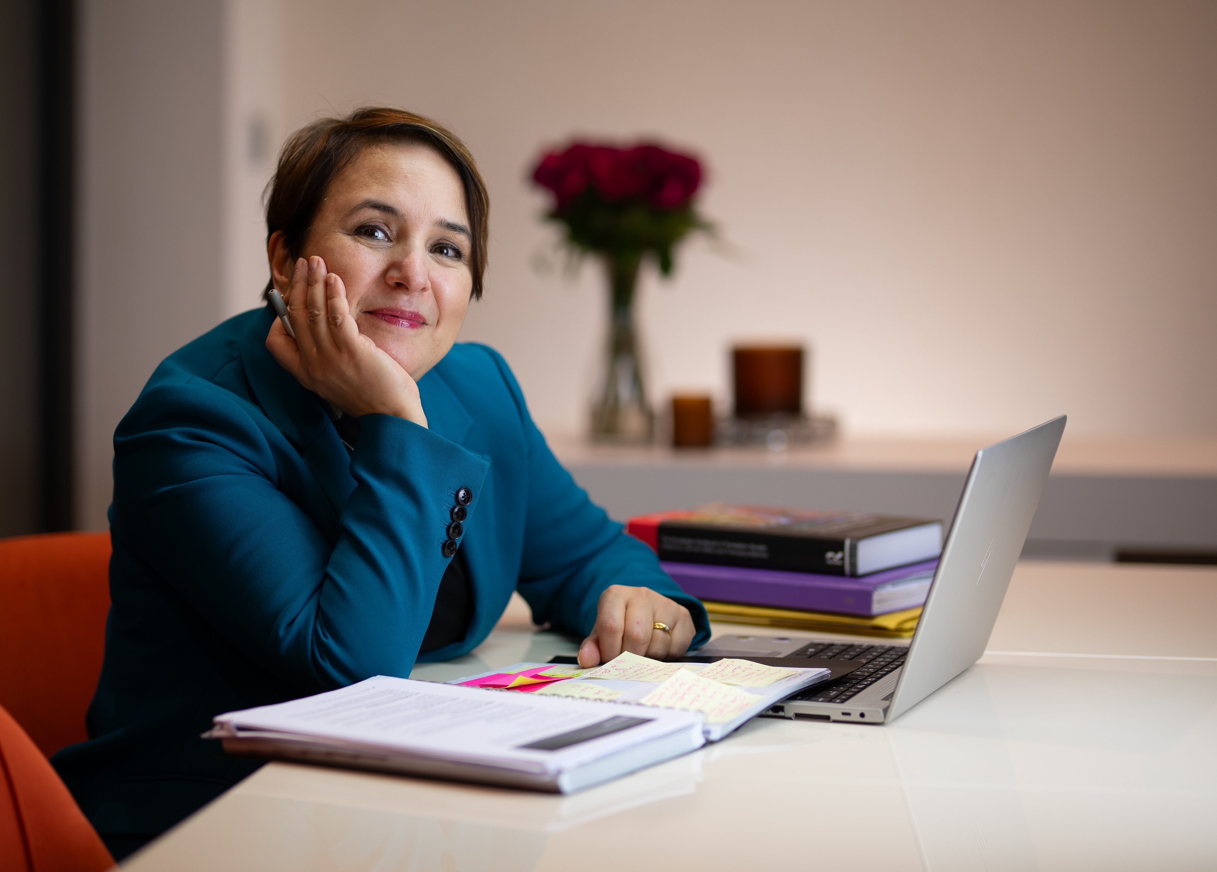
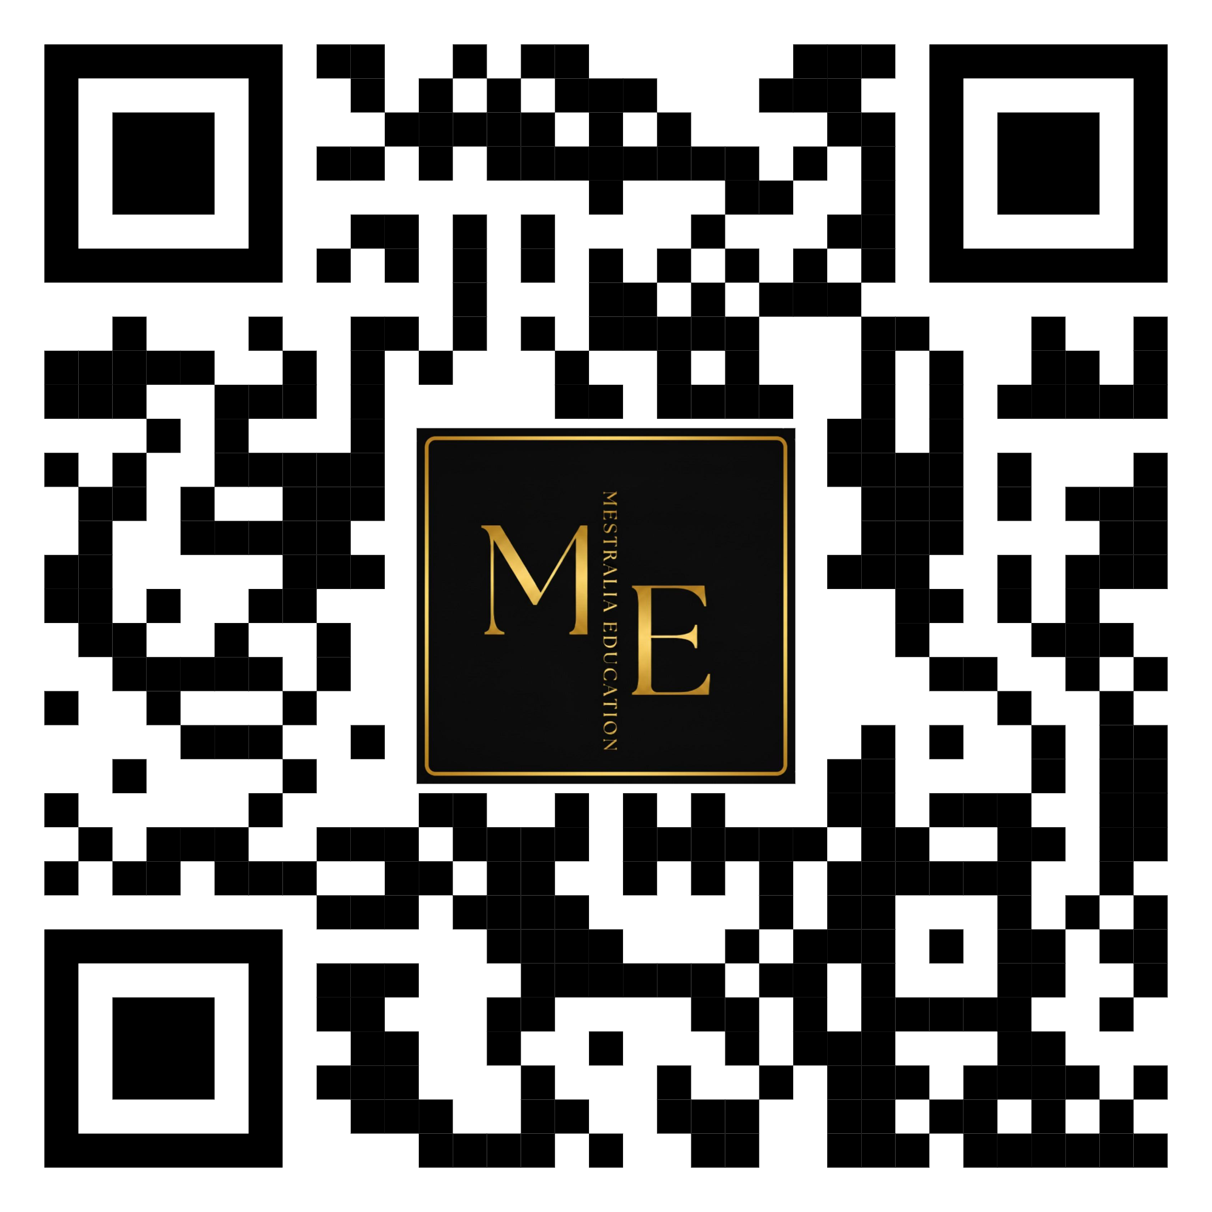
Muchas Gracias
Dr Carmen Millán
Founder & Director of Mestralia Education
carmen.millan@mestralia-education.com

