Slide 1

Name:
10 Steps to Authentic Leadership
Workbook

Slide 2

Authentically You!
Welcome
You won’t be able to find this 10-step workbook to Authentic Leadership in any bookstore, there is no quick guide or video either. Your guide to your authentic you, your instruction manual or quick guide has not been written yet. Only you can write about what makes you tick, who you are, what you need to do to transform, be authentic, feel good and deliver your best.
Go through the research findings, the examples and explanations in this manual and complete the exercises, self-assessments and reflections.. Go deeper, invite a learning partner and reflect together on past experiences, thoughts and typical behaviors. Figure out how you can flourish, feel good about who you are, and improve your personal well-being.
Make small changes that will make you feel better, naturally happier and less stressed. Develop emotional intelligence and improve your performance and resilience. Expand life for yourself and those around you, understand how you are different and can lead others more effectively while being your unique self!
Get ready for a journey of discovery and use this knowledge about yourself to take control of your leadership skills, move ahead, become who you ultimately want to be and leave a legacy.
I feel honored to be your guide on this journey.
Hans Horlings
Welcome

Slide 3

Introduction: A Manual, Workbook, Program and Methodology
We are all unique, have different experiences, deal with life in different ways and have unique personal journeys. This 10-step workbook encourages you to explore, experiment, reflect and dig deep into understanding yourself and find out exactly what works best for you. So you can share this information with those around you, and create an environment which allows you to be yourself, be recognized and accepted for who you are.
This workbook is designed to record your current behaviors, new insights, self-assessment results, personal views, experiences and feelings. This will provide insights into your emotional triggers, typical behaviors improve your ability to cope with what life throws at you. It will guide you, in a step-by-step process, through more than 50 exercises, teaching you what works for you, and what does not.
This is the basis of understanding how to effectively apply the theory of the manual and make tiny tweaks in order to make a big difference to your daily results.
Introduction

Slide 4
Writing things down will clarify your preferences, beliefs, values and what gives you meaning and it will help you to get in touch with feelings, thoughts and emotions. When completed the workbook will clearly describe your talents, skills, strengths, weaknesses, dreams and fears.
It will show how you see the world, what is important to you and how and when you are at your best. It will become a comprehensive reference about you when completed.
The program is a framework for applied human psychology, a framework to increase personal wellbeing and a step-by-step process towards understanding optimal human functioning. It can be completed individually as a self-study exercise, with e-learning components or as part of a face-to-face or virtual group workshop and group and e-coaching sessions, or with a one-on-one individual coaching program.
The most exciting way to go through this workbook is to do it together with someone close to you. As a parent with your teen-aged child, with your life-partner or with a close colleague or friend. Not only will you get to know each other very well, but it will also add more depth, through encouraging each other and by sharing experiences. Doing it together with someone makes it more fun, adds an external view and is ideal for creating a closer and deeper relationship.
The completed workbook will explain exactly what makes you tick, what is important to you and how you are unique and different from others. It will end with new goals, aspirations, intentions, actions and new habits to grow and develop yourself further in the direction you choose and which fits perfectly with who you are. It will help you to transform and become a transformational Leader.
Introduction

Slide 5

Finally, the workbook will include a summary reference or quick guide for yourself or to share with others. It will clearly explain how you see the world and how you work best with others. This will help you to be yourself and help others to understand how to best work with you. This holistic view of yourself will automatically help you to deal better with negative events, increase your resilience, self-compassion, and confidence. In short, it will develop a more positive way of looking at yourself, improve your personal wellbeing and it helps you to feel good about who you are.
People who feel good, who are happy with themselves are better communicators, more stress resilient and higher performers. The program’s main aim is to improve your wellbeing and any productivity gain is seen as a bonus. Extensive research shows that happy workers are much more productive within the same time as their discontented co-workers, with productivity gains of more than twenty percent.
So, just do the exercises, assessments, reflections and journal items and increase your personal well-being through this unique self-development program.
Introduction

Slide 6

Your Learning Partner
A learning partner is a form of social support, a companion. When you do this course with the help of a companion or learning partner you operate together as a unit, monitor and help each other to understand the material, share experiences and insights, learn how we are all unique and understand and appreciate each other’s views, build a better relationship and keep each other accountable for making the most of your life through feeling good about what you do, having great living experiences and delivering optimum performance, just right for you.
Learning partners can be life-partners, friends, colleagues, family members, coaches or even anonymously with a total stranger going through the same process. As learning partners, it is important that you can share your experiences and insights without holding back, without reservation. Because as part of the process you will have the opportunity to discover and share your likes, dislikes, fears, anxieties, hopes, strengths, weaknesses, personal values, emotions and future plans. Therefore, it is important that you can trust the other to keep this information confidential, trust is therefore an important requirement.
The idea behind joining and learning together with a learning partner is that learning is easier and more interesting. Different views will lead to discussions, better understanding and more deeper insights. The other will keep you motivated to achieve your goals and hold you accountable to do what you set out to do.
Your learning partner will become someone with whom you share your struggles and successes, someone who can make the work easier and the mission less intimidating. Face-to-face contact is not always required. Just writing things down in a journal, already provides many benefits,
It is important to stress that a learning partner is most effective when both partners are equally committed, so make sure you choose wisely.
Introduction

Slide 7
The Task of a Learning Partner
If you have not worked with a learning partner before, it is helpful to understand the role you both should play. A learning partner provides:
Support
You support each other as you go through each chapter of the workbook, share and discuss the results of the exercises. Discuss the concepts described, share what you have read, how you see this helping you and how you feel about this. It is always helpful to share with your learning partner how you feel, in terms of the sailboat metaphor. Are you just floating? Do you feel you are moving ahead towards your destination? Experience bad weather or feel lost? Talking in terms of the sailboat metaphor makes it easier to share feelings and emotions. The sailboat metaphor is fully explained in part 2.
Encouragement
Your learning partner will learn with and about you, your strengths, weaknesses, values, beliefs, hopes and dreams. Reminding each other about our strengths, boosting each other’s confidence and providing a listening ear as you work through challenges is all part of encouraging and supporting each other.
Honesty
Your learning partner should always be honest with you. In case you are self-sabotaging, reducing your efforts or losing commitment, your partner will need to be honest when giving feedback and inform you about his or her observations. When your partner does this – just say thank you! Don’t try to defend and instead be honest with yourself.
Accountability
Your learning partner should always be honest with you. In case you are self-sabotaging, reducing your efforts or losing commitment, your partner will need to be honest when giving feedback and inform you about his or her observations. When your partner does this – just say thank you! Don’t try to defend and instead be honest with yourself.
Introduction

Slide 8

Finding Your Learning Partner
When you start looking for a suitable learning partner, it can be helpful to make a short list of people. Start with thinking about people suited to do this – your life partner, business partners, friends, colleagues, trusted family members or a professional coach. In short, a good learning partner is someone who:
You can trust
Aims to learn more about themselves
Is committed to be your learning partner
Has the time to discuss exercises, materials, new insights and progress
Choose a person from your list and talk to each other about your idea to become learning partners. Ask the person if he or she wants to be your learning partner, but do force the other person. You can decide to start a trial period and evaluate its success. If it does not work out, you can always look for someone else.
Preparing for the Collaboration
Now that you’ve chosen a suitable learning partner, you will want to contact each other regularly to review progress, share experiences, discuss materials covered etc. Before deciding on the plan to follow, you will need to ensure that your partnership will be mutually beneficial. Here are 5 guidelines for creating a successful learning partner system.
A. Schedule
For the best results, you will need to meet your partner regularly to check your progress and to ensure you are still on track. The frequency of your meetings depends on several factors, like, for instance, your schedules, the types of goals, time zones, and other factors. Make sure to meet often enough to stay focused and motivated, but not so often that the meetings will become a burden. A weekly meeting should be enough. Note that you can both have “formal” and “informal” meetings with your partner.
Introduction

Slide 9
Formal contact would involve pre-planned meetings, exercise completion, chapter conclusions. Informal contact would involve brief chats, emails, or phone contact when extra support is needed. You should work out a schedule that best fits both your lifestyles and responsibilities.
B. Timing
It is advisable to set up your partnership for a limited time. Create a deadline or an end date on which your goal should be reached. Monitoring progress is easier when there is a fixed endpoint in the future. If you have never worked with a learning partner before, it is advisable to set shorter deadlines, maybe chapter by chapter to avoid losing motivation over time.
C. Expectations
Before you start working with each other, it should be clear what both of you expect from each other. Make sure to agree on things such as extra support. What will happen when the other needs extra support, how confidential is your interaction, what kinds of questions can we ask and what should we avoid, what measures will be taken when one party misses a deadline, and other things you feel are important to agree upon. Make a simple learning partner contract so all parties are clear about expectations – get all parties to sign off on it!
D. Serious and Fun
During meetings with your partner, reserve enough time to discuss: feelings, emotions, insights, obstacles, progress, action plans and schedules. Reflect on new insights, set goals for the next week, create micro celebrations, and review progress. Make it an enjoyable journey and help each other to make progress on their own life journey.
Introduction

Slide 10

E. Continue
When completing your journey, go back, review, look at your workbook, review your new insights, create new habits, build your talents, and enjoy your journey. Share your insights with others, and help them also to live a fulfilling and happy life, experiencing optimum human performance.
Whether you do this program as a team, with a learning partner or just on your own, it does not make a difference to the steps followed. The process of change starts with understanding the science, becoming aware how this applies to you, experimenting and experiencing the differences and based on that making small changes in your life to help you feel better and flourish.
Introduction

Slide 11
Part 1: The Study of Human Behavior
Exercise 1: What is this workbook all about?
What results do you expect from this workbook/program?
What is the theoretical basis, which makes it different from reading a blog or self-help book?
What actions do you need to take now, what are you expected to do before continuing?
1. The results I expect are:
2. This is different from a blog or self-help book because:
3. What I need to do before continuing is the following:
Part 1: The Study of Human Behavior

Slide 12

Journal Entry: My Workbook – my intentions and why I need to do this
This is space to write down new insights, aha moments, reflections and intentions. You might want to write about: Why you are going to do this, What you are planning to do, Who you do this for, Describe your motivation and drive. Take the time to understand your Why, What, Where, Who, When and How.
---------------------------------------------------------------------------------------------------------------------------------------------------------------------------------------------------------------------------------------------------------------------------------------------------------------------------------------------------------------------------------------------------------------------------------------------------------------------------------------------------------------------------------------------------------------------------------------------------------------------------------------------------------------------------------------------------------------------------------------------------------------------------------------------------------------------------------------------------------------------------------------------------------------------------------------------------------------------------------------------------------------------------------------------------------------------------------------------------------------------------------------------------------------------------------------------------------------------------------------------------------------------------------------------------------------------------------------------------------------------------------------------------------------------------------------------------------------------------------------------------------------------------------------------------------------------------------------------------------------------------------------------------------------------------------------------------------------------------------------------------------------------------------------------------------------------------------------------------------
Part 1: The Study of Human Behavior

Slide 13
Part 2: Your Life as a Boat - The Sailboat Metaphor
Exercise 2: Understanding and using the Sailboat Metaphor
Describe the following situations in terms of the sailboat metaphor.
1. Lack of meaning in life
----------------------------------------------------------------------------------------------------------------------------------------------------------------------------------------------------------------------------------------------
2. Inability to deal with difficult events
----------------------------------------------------------------------------------------------------------------------------------------------------------------------------------------------------------------------------------------------
3. Positive beliefs about the ability to reach goals
----------------------------------------------------------------------------------------------------------------------------------------------------------------------------------------------------------------------------------------------
How would you interpret the following responses received from your learning partner?
4. “I don’t feel like my boat is moving, ii is just bobbling on the waves.”
----------------------------------------------------------------------------------------------------------------------------------------------------------------------------------------------------------------------------------------------
5. “I feel like I am sailing in a direction that other sailors want me to sail.”
----------------------------------------------------------------------------------------------------------------------------------------------------------------------------------------------------------------------------------------------
6. “I am afraid that my boat will not withstand the weather that is coming.”
----------------------------------------------------------------------------------------------------------------------------------------------------------------------------------------------------------------------------------------------
Part 2: Your Life as a Boat

Slide 14

Exercise 3: Describe your current life situation
Use the sailboat metaphor to describe your current life situation. What is the current status of your sailboat? How would you describe your current journey? Try to write as much as possible in terms of the different elements of the sailboat and their interaction. Afterwards discuss this with your learning partner or explain the sailboat metaphor to a trusted friend and share your current life situation in terms of the sailboat metaphor.
---------------------------------------------------------------------------------------------------------------------------------------------------------------------------------------------------------------------------------------------------------------------------------------------------------------------------------------------------------------------------------------------------------------------------------------------------------------------------------------------------------------------------------------------------------------------------------------------------------------------------------------------------------------------------------------------------------------------------------------------------------------------------------------------------------------------------------------------------------------------------------------------------------------------------------------------------------------------------------------------------------------------------------------------------------------------------------------------------------------------------------------------------------------------------------------------------------------------------------------------------------------------------------------------------------------------------------------------------------------------------------------------------------------------------------------------------------------------------------------------------------------------------------------------------------------------------------------------------------------------------------------------------------------------------------------------------------------------------------------------------------------------------------------------------------------------------------------------------------
Part 2: Your Life as a Boat

Slide 15

Exercise 4: What does a good life look like for you?
How would you describe a full and fulfilling life, where you flourish and feel good about yourself?
------------------------------------------------------------------------------------------------------------------------------------------------------------------------------------------------------------------------------------------------------------------------------------------------------------------------------------------------------------------------------------------------------------------------------------------------------------------------------------------------------------------------------------------------------------------------------------------------------------------------------------------------------------------------------------------------------------------------------------------------------------------------------------------------------------------------------------------------------------------------------------------------------------------------------------------------------------------------------------------------------------------------------------------------------------------------------------------------------------------------------------------------------------------------------------------------------------------------------------------------------------------------------------------------------------------------------------------------------------------------------------------------------------------------------------------------------------------------------------------------------------------------------------------------------------------------------------------------------------------------------------------------------------------------------------------------------------------------------------------------------------------------------------------------------------------------------------------------------------------------------------------------------------------------------------------------------------------------------------------------------------------------------------------------------------------------------------------------------------------------------------------------------------------------------------------------------------------------------
Part 2: Your Life as a Boat

Slide 16
Journal Entry:
This is space to write down new insights, aha moments, reflections and intentions. Maybe you want to share new insights, reflections on your life so far, and where you want to go.
-------------------------------------------------------------------------------------------------------------------------------------------------------------------------------------------------------------------------------------------------------------------------------------------------------------------------------------------------------------------------------------------------------------------------------------------------------------------------------------------------------------------------------------------------------------------------------------------------------------------------------------------------------------------------------------------------------------------------------------------------------------------------------------------------------------------------------------------------------------------------------------------------------------------------------------------------------------------------------------------------------------------------------------------------------------------------------------------------------------------------------------------------------------------------------------------------------------------------------------------------------------------------------------------------------------------------------------------------------------------------------------------------------------------------------------------------------------------------------------------------------------------------------------------------------------------------------------------------------------------------------------------------------------------------------------------------------------------------------------------------------------------------------------------------------------------------------------------------------------------------------------------------------------------------------------------------------------------------------------------------------------------------------------------------------------------------------------------------------
Part 2: Your Life as a Boat

Slide 17
Part 3: Element 1- The Boat as a Whole,
Your Personality
Exercise 5: Do the STAR - Personality Preference Quiz
Link: https://www.fulloflifebooks.com/Personality_quiz
Record your scores:
Structured Gold
Technical Green
Action Orange
Relationship Blue
Describe Yourself: What typical behaviors, stressors, strengths, weaknesses, skills do you recognize – and what do others recognize in you? (just ask your learning partner).
Part 3: Element 1 - The Boat

Slide 18
Showing Differences
When on a boat, sailing in places far away from any light pollution, the night sky is amazing to look at. We are like the stars in the sky, so many and each one unique, in their own environment, with unique characteristics. Each one of us is a like a STAR. We all are different. Deep down what really drives you? Is it the urge to know, understand, and show competence, or are you driven by feeling safe, secure and like predictability, thus interested in structure and planning? Or are you driven by action, freedom, excitement and achieving something each day, or is your core need to care for people, have good relationships and ensure that people are looked after and can make the most of their lives.
It is not easy to find out why you do what you do. What is driving you from within and what is influenced by forces around you. What core need comes first for you, why are some things stressing you out, while they are not stressful for others. Reflecting on your uniqueness gives insight into who you are and how you are different from others. The following exercise might help to see how people respond differently and have different needs.
Exercise 4: Imagine your perfect holiday.
(Assume you are in total control).
1. When will you plan the holiday, and in what detail?
(how many days/weeks before you go)
----------------------------------------------------------------------------------------------------------------------------------------------------------------------------------------------------------------------------------------------
2. When will you start to prepare/pack your bags?
(how many hours/days before you go)
----------------------------------------------------------------------------------------------------------------------------------------------------------------------------------------------------------------------------------------------
3. What would absolutely ruin the holiday for you?
----------------------------------------------------------------------------------------------------------------------------------------------------------------------------------------------------------------------------------------------
Part 3: Element 1 - The Boat

Slide 19

Compare your answers with answers from other people around you, how are they different? You will see that these can be very different!
Try and figure out what behavior style the other person is. Focus on core needs: - need for order, predictability, security and safety
- need to know, understand why, be competent, perfectionist, smart
- need for action, impact, energetic, enthusiastic, fun, liking change
- need for good relationships, care for others, have friends, idealistic.
Whatever it is, whatever you prefer, just remember we are all unique!
How are you different from others?
-----------------------------------------------------------------------------------------------------------------------------------------------------------------------------------------------------------------------------------------------------------------------------------------------------------------------------------------------------------------------------------------------------------------------------------------------------------------------------------------------------------------------------------------------------------------------------------------------------------------------------------------------------------------------------------------------------------------------------------------------------------------------------------------------------------------------------------------------------------------------------------------------------------------------------------------------------------------------------------------------------------------------------------------------------------------------------------------------------------------------------------------------------------------------------------------------------------------------------------------------------------------------------------------------------------------------------------------------------------------------------------------------------------------------------------------------------------------------------------------------------------------------------------------------------------------------------------------------------------
Part 3: Element 1 - The Boat

Slide 20

What would your ideal environment look like both at work and at home?
My preferred work-environment / work-style:
My preferred home-environment / life-style:
Part 3: Element 1 - The Boat

Slide 21
Exercise 7: Where do you get your energy?
An important element of your typical behavior and personality is the preference for Introversion or Extraversion. Introversion and Extraversion impacts all four personality preferences and plays an important role in our interpersonal communications and when we feel good. Most people think of an Introvert as a shy person and an Extravert as an outgoing, sociable person. However, personality theorists like Carl Jung, Isabel Myers and Katharine Briggs define Introversion and Extraversion as terms to describe where you get your energy.
Do the Social Energy Quiz Online
Link: https://www.fulloflifebooks.com/Social_energy_quiz
Or answer the questions below by selecting option A or B.
1. | My best ideas come from ______.
 | A) talking to others | B) thinking by myself
2. | I learn new material best ______.
 | A) when talking about it | B) when I spend time alone
3. | I am re-charging my batteries ______.
 | A) when I spend time with other people | B) when I spend time alone
4. | Talking with new people ______.
 | A) is exciting and gives me energy | B) is hard work and tiring
5. | Most of the time, I ______.
 | A) tell people what I am thinking | B) think quietly before I speak
6. | After a good day, with others, I usually ______.
 | A) go home excited and with energy | B) go home tired and need quiet time
7. | I prefer solving problems by ______.
 | A) talking about them with other people | B) working things out on my own
Total A: _________ Total B: _________
Mark your score: A – Extraverted B – Introverted
A score of 7/0, 6/1, 5/2 means a more extroverted energy focus
A score of 4/3 or 3/4 means an ambivert energy focus
A score of 0/7, 1/6, 2/5 means a more introverted energy focus
Part 3: Element 1 - The Boat

Slide 22

Exercise 8: How do you recharge?
Extraverts tend to seek their energy from the outside world. They thrive on being around people and/or interacting with them, they direct their energy outwards in the form of action.
Introverts tend to seek their energy from within themselves. They need time alone to recharge their batteries and they direct their energy inwards in the form of reflection.
Ambiverts have a mix, sometimes they get energy from being with others and other times they get energy from within. Too much of either is not a good thing for them.
Remember – very few people are extreme extraverts or introverts. Just reflect on how you prefer to recharge, when and where and how and share examples.
What consumes energy and what gives you energy?
Give clear examples of each.
---------------------------------------------------------------------------------------------------------------------------------------------------------------------------------------------------------------------------------------------------------------------------------------------------------------------------------------------------------------------------------------------------------------------------------------------------------------------------------------------------------------------------------------------------------------------------------------------------------------------------------------------------------------------------------------------------------------------------------------------------------------------------------------------------------------------------------------------------------------------------------------------------------------------------------------------------------------------------------------------------------------------------------------------------------------------------------------------------------------
Part 3: Element 1 - The Boat

Slide 23
B. Describe what a perfect day would look like
(at work or at home, or both).
Part 3: Element 1 - The Boat

Slide 24
Key Personality Traits (OCEAN)
A similar approach to personality preferences is the description of personality traits. Personality traits theory describes, the frequency or intensity of a person's feelings, thoughts, or behaviors relative to other people. Possession of a trait is therefore a matter of degree. We might describe two individuals as extraverts, but still see one as more extraverted than the other. A particular level on any trait will be neutral or irrelevant for many activities, helpful for accomplishing some things, and detrimental for accomplishing other things. After seeing your scores, you can judge for yourself how helpful this test is. If you do not want to rely on self-assessment only, it is a good idea to show and discuss your scores to people who know you well.
John Johnson wrote descriptions of five main domains, Openness, Conscientiousness, Extraversion, Agreeableness and Neuroticism (OCEAN), and also described thirty subdomains. These descriptions are based on an extensive reading of the scientific literature on personality measurement.
They are available free as a full 120 question assessment in this http://www.personal.psu.edu/j5j/IPIP/ipipneo120.htm. You can find a simplified much shorter version in the next page.
E
Extraversion
C
A
Key
Personality
Traits
Conscientiousness
Agreeableness
Openness
O
A
Neuroticism
Part 3: Element 1 - The Boat

Slide 25
Exercise 9: Your Personality Traits
Below are 20 phrases describing behaviors. Use the rating scale below to describe how accurately each statement describes you. Describe yourself as you generally are now, not as you wish to be in the future. Be honest and rate yourself, in relation to other people in your age group. Read each statement and put a number from 1 to 5 next to it to describe how accurately the statement describes you.
Very Inaccurate
1
Moderately Inaccurate
2
Neutral
3
Very Accurate
Moderately Accurate
5
4
______ 1. | Am the life of the party (E)
______ 2. | Sympathize with others’ feelings (A)
______ 3. | Get chores done right away (C)
______ 4. | Have frequent mood swings (N)
______ 5. | Have a vivid imagination (O)
______ 6. | Don’t talk a lot (E)
______ 7. | Am not interested in other people’s problems (A)
______ 8. | Often forget to put things back in their proper place (C)
______ 9. | Am relaxed most of the time (N)
______ 10. | Am not interested in general ideas and concepts(O)
______ 11. | Talk to a lot of different people at parties (E)
______ 12. | Feel others’ emotions (A)
______ 13. | Like order (C)
______ 14. | Get upset easily (N)
______ 15. | Have difficulty understanding general concepts and abstract ideas (O)
______ 16. | Keep in the background (E)
______ 17. | Am not really interested in others (A)
______ 18. | Make a mess of things(C)
______ 19. | Seldom feel down(N)
______ 20. | Do not have a good imagination (O)
Part 3: Element 1 - The Boat

Slide 26
Scoring Instructions:
The first thing you must do is to reverse the items that are worded in the opposite direction (marked in red). In order to do this, subtract the number you put for that item from 6. So, if you put a 4, it will become a 2. Cross out the score you put when you took the scale, and put the new number in representing your score subtracted from the number 6. Items to be reversed in this way are statements: 6, 7, 8, 9, 10, 15, 16, 17, 18, 19, 20 (displayed in red below)
Next, you need to add up the scores for each of the five OCEAN scales. Each OCEAN score will be the sum of four items. Place the sum next to each scale below.
Score:
19 – 20
17 – 18
14 – 16
11 – 13
8 – 10
6 – 7
4 – 5
=
=
=
=
=
=
=
Extremely High
Very High
High
In the Middle
Low
Very Low
Extremely Low
__________ Openness (Add items 5, 10, 15, 20)
__________ Conscientiousness (Add items 3, 8, 13, 18)
__________ Extraversion (Add items 1, 6, 11, 16)
__________ Agreeableness (Add items 2, 7, 12, 17)
__________ Neuroticism (Add items 4, 9,14, 19)
Part 3: Element 1 - The Boat

Slide 27
Compare your scores to the norms below to see where you stand on each scale. If you are low on a trait, it means you are the opposite of the trait label. For example, low on Extraversion is Introversion, low on Openness is Conventional, low on Agreeableness is Assertive, low on Neuroticism is Calm.
Trait | Description | Low Examples | High Example
Openness | The tendency to appreciate new thought, ideas, values, feelings, and behaviors. | Prefers not to be exposed to alternative moral systems; narrow interests; set-traditions, not analytical; down-to-earth | Enjoys seeing people with new types of haircuts or fashion; curious; imaginative; untraditional
Conscientiousness | The tendency to be careful, organized, to follow rules, and to be hard working | Prefers spur of the moment action to planning; unreliable; hedonistic; careless; lax | Pre-planned, organized, hard-working; neat; persevering; punctual; self-disciplined, duty focused.
Extraversion | The tendency to be talkative, sociable, enjoy company of others, active, often assertive or even dominant. | Preferring a quiet evening reading to a loud party; sober; aloof; un-enthusiastic, enjoys being by themselves. | Being the life of the party; active; optimistic; fun-loving; initiating and loud.
Agreeableness | The tendency to agree and go along with others rather than assert one's own opinions and choices. Similar to compassion, cooperative, warm and caring, | Quickly and confidently asserts own rights and opinions; quickly irritable; manipulative; uncooperative; rude, hostile, pursues own interests over others’ interests. | Agrees with others about political opinions; good-natured; forgiving; gullible; helpful, agreeable, will give in quickly.
Neuroticism | The tendency to frequently experience negative emotions such as anger, worry, and sadness, as well as being interpersonally sensitive | Not getting irritated by small annoyances; calm, unemotional; hardy; patient; secure; self-satisfied. | Constantly worrying about little things; insecure; hypochondriacal; feeling inadequate.
Honesty/Humility (hexaco addition) | The tendency to value authenticity, honesty and modesty | Uses manipulative, narcissistic, and self-centered behaviors | Authentic, sincere, fair, and modesty focused behaviors
Part 3: Element 1 - The Boat

Slide 28

What new insights into your traits do you have?
Describe what you agree/disagree with and share with your learning partner.
-----------------------------------------------------------------------------------------------------------------------------------------------------------------------------------------------------------------------------------------------------------------------------------------------------------------------------------------------------------------------------------------------------------------------------------------------------------------------------------------------------------------------------------------------------------------------------------------------------------------------------------------------------------------------------------------------------------------------------------------------------------------------------------------------------------------------------------------------------------------------------------------------------------------------------------------------------------------------------------------------------------------------------------------------------------------------------------------------------------------------------------------------------------------------------------------------------------------------------------------------------------------------------------------------------------------------------------------------------------------------------------------------------------------------------------------------------------------------------------------------------------------------------------------------------------------------------------------------------------------------------------------------------------------------------------------------------------------------------------------------------------------------------------------------------------------------------------------------------------------------------------------------------------------------------------------------
Part 3: Element 1 - The Boat

Slide 29
Exercise 10: My Personal Portrait
Your Turn - Your Portrait
So now it is your turn. Look and review your core needs, extraversion and introversion, your strong behavior variables and start drafting your self-portrait. What is important for you? How do you like to work, socialize, get things done? When do you feel good?
Create your own portrait, include examples of habits, behaviors that could give others a clue what your preferred behaviors are and how you are most effective and what makes you feel good about yourself.
My personality – this is who I am:
My personality – this is how I like to get things done:
Behaviors that make me feel bad or I would like to change:
(Awareness and acceptance are the normally the first steps):
Part 3: Element 1 - The Boat

Slide 30
Journal Entry:
This is space to write down new insights, aha moments and reflections. Some things you might want to write are: awareness how you are different from others, reflection on how you see others, typical behaviors and maybe what you should do more to work with your natural tendencies.
-------------------------------------------------------------------------------------------------------------------------------------------------------------------------------------------------------------------------------------------------------------------------------------------------------------------------------------------------------------------------------------------------------------------------------------------------------------------------------------------------------------------------------------------------------------------------------------------------------------------------------------------------------------------------------------------------------------------------------------------------------------------------------------------------------------------------------------------------------------------------------------------------------------------------------------------------------------------------------------------------------------------------------------------------------------------------------------------------------------------------------------------------------------------------------------------------------------------------------------------------------------------------------------------------------------------------------------------------------------------------------------------------------------------------------------------------------------------------------------------------------------------------------------------------------------------------------------------------------------------------------------------------------------------------------------------------------------------------------------------------------------------------------------------------------------------------------------------------------------------------------------------------------------------------------------------------------------------------------------------------------------------------------------------------------------------------------------------------------
Part 3: Element 1 - The Boat

Slide 31
Part 4: Element 2 - The Water, Your Life
Domains
A boat moves through different parts of water, the ocean, sea, inlets, lakes, canals. In much the same way you also operate in different parts of your life. Your life domains include physical, social and psychological environments, like your health, family, work or finances. Changing the course of the boat by steering to a different segment of water is comparable to switching attention to different parts of your life.
Exercise 11: Your Life Domains – ‘Wheel of Life’
The original idea behind the Wheel of Life came from industry pioneer Paul J. Meyer in the 1960’s to help people realize their goals “The Wheel of Life” is frequently used as a coaching tool to provide a snapshot of how a client feels about their life. It offers great insight into areas of your being that are flourishing or struggling. Its beauty is its simplicity, the tool involves going through three simple steps:
Step 1 | Identify your most important specific life domains
Step 2 | Rate each domain on a scale of one to ten (from ‘not at all satisfied’ to ‘completely satisfied’)
Step 3 | Identify opportunities to increase satisfaction for each domain.
Part 4: Element 2 - The Water

Slide 32
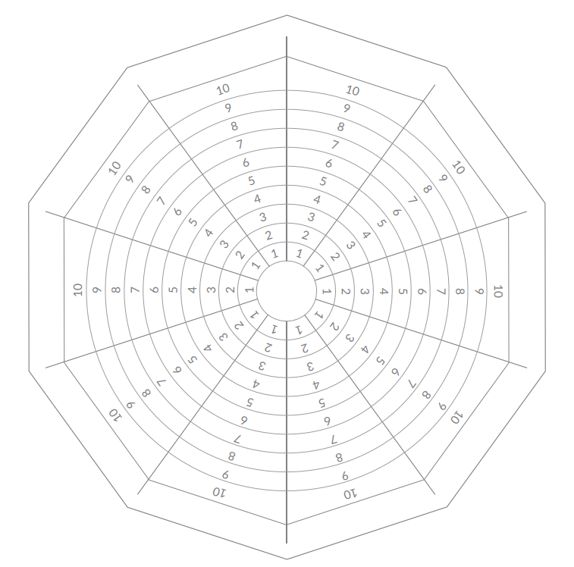
Step 1 | Identify your most important specific life domains
The wheel typically consists of between eight and ten categories or life domains which are most important for you and essential for a fulfilling life. Life domain names vary, but the themes are usually similar and often include: Money & Finances, Career & Work, Health & Fitness, Fun & Recreation, Environment (home/work), Community & Contribution, Family & Friends, Partner & Love, Personal Growth & Learning, Spirituality. You can of course use different ones like Marriage, Mental Health, Sex Life, Safety, Education, Independence, choose whatever is important to you.
Now: Select your top 10 Life Domains and write the description on the outside ring of the graphic, just above the number 10 in figure 5
Figure 5: Wheel Of Life Graphic
Part 4: Element 2 - The Water

Slide 33
Step 2 | Rate each domain on a scale of one to ten (from ‘not at all satisfied’ to ‘completely satisfied’)
Rate each domain according to how satisfied you are with that domain from 1-10. (1=not satisfied, 10= highly satisfied). Since it is a subjective measure, focus on what you would like from each segment and to what extend does it does do this. Before you score yourself ask yourself some basic questions like:
Health & Fitness: Do you have enough energy? Do you maintain a healthy weight? Are their people who you admire as being full of health and vitality? What part of health is important to you?
Career & Work: Are you excited to go to work? Are you learning and growing in your career? Is your career rewarding in different ways? What part of career & work is important to you?
Money & Finances: Do you feel financially secure? Are you able to do what you want to do without too many constraints? Are there things you would do if you have larger financial resources? What part of finance is really important to you?
Family & Friends: Do you have people you care about (and who care about you) in your life? Do you have meaningful experiences with others? Do you feel loved? What part of family & friends is really important to you?
Community & Contribution: Are you part of a community? Do you give (time, money, etc.) to others freely? Do you feel like you are contributing to making the world a better place? Is there a good cause you would like to support in a bigger way? What part of community & contribution is really important to you?
Personal Growth & Learning: Are you learning new skills? Are you maturing? Do you have clear and highly motivating goals for your life? What part of growth & learning is really important to you?
Fun & Recreation: Do you laugh a lot? Do you have fun experiences on a regular basis? Do you make time to relax and rest? What part of fun and recreation is really important to you?
Part 4: Element 2 - The Water

Slide 34
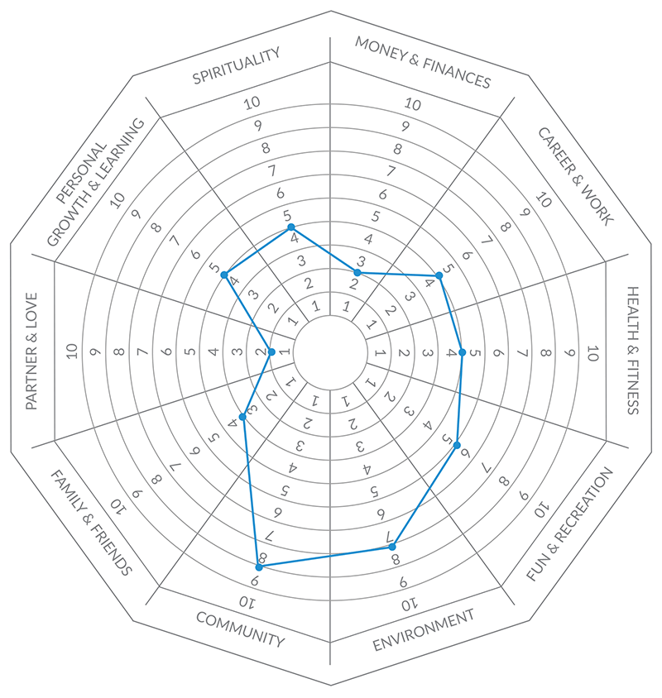
Spirituality: Do you know what you stand for as a human being? Do you have a deep meaning or motivation for your life? Do you feel connected to the environment/planet/others in a real way? What part of spirituality is really important to you?
Environment: Are you happy with your home or work environment? Would you want to live or work somewhere else? Do you feel comfortable in your environments? What part of home & work environment is really important to you?
After rating create an inner wheel like shown in figure 6. This will give you a visual snapshot of how satisfied you are with your life.
Figure 6: Sample Completed Wheel of Life
Part 4: Element 2 - The Water

Slide 35
Step 3 | Identify opportunities to increase satisfaction for each domain.
Look at the completed wheel of life and ask yourself what domains draw your attention. How would you want to reshape your inner wheel? What would you like to work on? Why does this domain need attention? What would it take to raise the level of satisfaction in this domain? What actions can you take to increase the level of satisfaction in this domain? How would these actions affect other domain satisfaction?
A. What domains draw my attention?
B. What would you like to work on and why?
Part 4: Element 2 - The Water

Slide 36

C. What practical actions can you take to increase the level of
satisfaction in this domain?
Part 4: Element 2 - The Water

Slide 37
Journal Entry:
This is space to write down new insights, and reflections. Some things you might want to write are: awareness how little time you spend with certain areas, how this affect you, what you would love to do if possible, what needs are fulfilled and which ones are not so much and how small changes could help.
--------------------------------------------------------------------------------------------------------------------------------------------------------------------------------------------------------------------------------------------------------------------------------------------------------------------------------------------------------------------------------------------------------------------------------------------------------------------------------------------------------------------------------------------------------------------------------------------------------------------------------------------------------------------------------------------------------------------------------------------------------------------------------------------------------------------------------------------------------------------------------------------------------------------------------------------------------------------------------------------------------------------------------------------------------------------------------------------------------------------------------------------------------------------------------------------------------------------------------------------------------------------------------------------------------------------------------------------------------------------------------------------------------------------------------------------------------------------------------------------------------------------------------------------------------------------------------------------------------------------------------------------------------------------------------------------------------------------------------------------------------------------------------------------------------------------------------------------------------------------------------------------------------------------------------------------------------------------------------
Part 4: Element 2 - The Water

Slide 38
Part 5: Element 3 - The Compass, Emotions,
Feelings and Intuition
Emotions and feelings are represented by the compass of the boat, the compass provides feedback about the current state, position and direction of the boat. In real life, emotions and feelings provide feedback about your current state. Feelings of fear, nervousness, excitement or butterflies in your stomach, provide feedback about your state, how you feel, and they influence your mood. Listening to your emotions and understanding what you feel and why, is like checking the compass from time to time making sure you are still heading in the right direction.
We all experience both positive and negative emotions and feelings. Life is full of highs and lows, and without the lows the highs would not be the same, so we need both. Positive emotions are emotions that we typically find pleasurable to experience, while negative emotions are those that we typically do not find pleasurable to experience, they tend to drag us down and have a negative effect towards an event or person. Academics separate feelings, emotions and sensations, but for our purpose we do not need to make that distinction.
Exercise 12: List the most common emotions you can think of
Negative Emotions
Positive Emotions
__________________
__________________
__________________
__________________
__________________
__________________
__________________
__________________
__________________
__________________
__________________
__________________
__________________
__________________
__________________
__________________
__________________
__________________
__________________
__________________
Part 5: Element 3 - The Compass

Slide 39

Exercise 13: Describe a negative emotion you recently experienced.
Try and label or name the exact emotion/feeling, where in the body did you feel this, how did it feel, how did it affect you in terms of thinking, acting, mood. Did this negative emotion lead to a narrowing or focus? Please explain in as much detail as you can.
--------------------------------------------------------------------------------------------------------------------------------------------------------------------------------------------------------------------------------------------------------------------------------------------------------------------------------------------------------------------------------------------------------------------------------------------------------------------------------------------------------------------------------------------------------------------------------------------------------------------------------------------------------------------------------------------------------------------------------------------------------------------------------------------------------------------------------------------------------------------------------------------------------------------------------------------------------------------------------------------------------------------------------------------------------------------------------------------------------------------------------------------------------------------------------------------------------------------------------------------------------------------------------------------------------------------------------------------------------------------------------------------------------------------------------------------------------------------------------------------------------------------------------------------------------------------------------------------------------------------------------------------------------------------------------------------------------------------------------------------------------------------------------------------------------------------------------------------------------------------------------------------------------------------------------------------------------------------------------
Part 5: Element 3 - The Compass

Slide 40
Exercise 14: Describe a positive emotion you recently experienced.
Try and label or name the exact emotion/feeling. Where in the body did you feel this, how did it feel, how did it affect you in terms of thinking, acting, mood. Did this positive emotion lead to a widening or broadening focus? Please explain in as much detail as you can.
--------------------------------------------------------------------------------------------------------------------------------------------------------------------------------------------------------------------------------------------------------------------------------------------------------------------------------------------------------------------------------------------------------------------------------------------------------------------------------------------------------------------------------------------------------------------------------------------------------------------------------------------------------------------------------------------------------------------------------------------------------------------------------------------------------------------------------------------------------------------------------------------------------------------------------------------------------------------------------------------------------------------------------------------------------------------------------------------------------------------------------------------------------------------------------------------------------------------------------------------------------------------------------------------------------------------------------------------------------------------------------------------------------------------------------------------------------------------------------------------------------------------------------------------------------------------------------------------------------------------------------------------------------------------------------------------------------------------------------------------------------------------------------------------------------------------------------------------------------------------------------------------------------------------------------------------------------------------------------
Part 5: Element 3 - The Compass

Slide 41

Exercise 15: Recognizing and Labelling Emotions
Developing emotional self-awareness takes practice. Over time, this exercise can become an intuitive, powerful tool to acknowledge and accurately label emotional states. This exercise develops the skills of recognizing and labelling your emotions so that you may live a healthier, more productive, and fulfilling life. This tool is also available as an app. - http://moodmeterapp.com/ The app is great to use as a daily reflection and helps build your emotional self-awareness skills.
Step 1
Connect to the Emotion
Take a moment and connect to your current emotional experience. Sit comfortably, gently close your eyes, tune in to your body’s emotional charge. Focus all of your attention on the physical sensations that you feel like tingling, agitation, anger, sadness. Allow yourself to remain in this state for a moment and observe it.
Step 2
Rate Pleasantness of the Emotion
Rate how pleasant this emotion is for you on a scale from 1-10 where 1 = very unpleasant and 10 = very pleasant
Part 5: Element 3 - The Compass

Slide 42
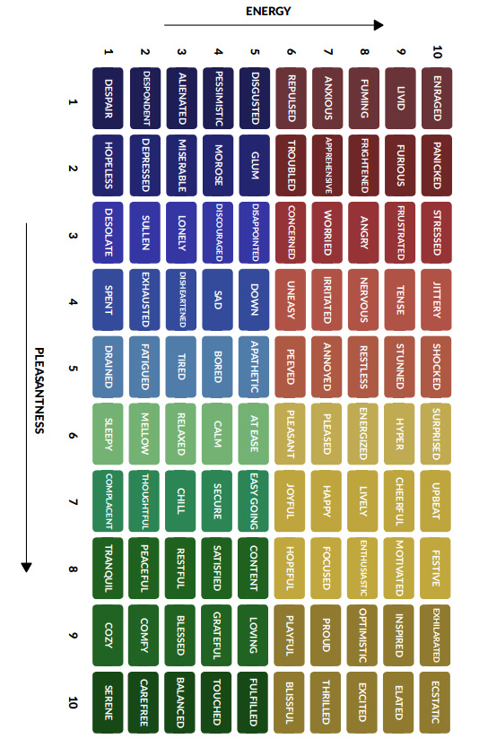
Step 3
Rate Energy of the Emotion
Rate how high your energy is at this moment on a scale from 1-10 where 1= very low amount of energy and 10 = a very high
Step 4
Plot the Emotion on the Emotion Meter Fig 3 – Match with Emotion
Use your scores from steps 2 and 3, and find the matching emotion in the emotion meter below.
Step 5
Reflect on the Reason for the Emotion
Reflect on why you are feeling the way that you are feeling right now. Write about why this emotion is here with you.
Part 5: Element 3 - The Compass

Slide 43
Exercise 16: Stop, Pause and Reflect – What are you feeling?
A Simple Tool to Increase Emotional Awareness
A very helpful and simple tool to increase emotional awareness is the introduction of a few regular checks, a number of times throughout the day. Just set your alarm a few times a day and when it goes off:
Focus on breathing
Connect to the present moment
Reflect on a few brief reflective questions like:
  What is the emotion I am experiencing?
  What kinds of thoughts are present?
  What do I feel in my body?
  What am I inclined to do because of this emotion?
Just observe what you feel and start using the information received and you will become just like the captain who checks the compass regularly during the journey. The captain who regularly looks at the compass can use its feedback during the journey. The compass provides valuable information about the current course of the boat, it is arguably the most important tool for determining the boat’s future direction. A captain who does not pay attention or even ignores the compass is likely to feel lost during the journey. In a very similar way, if you are unable to connect to your emotions, you miss the inner-guide that provides you with invaluable information about the world around you and how you interact with it.
----------------------------------------------------------------------------------------------------------------------------------------------------------------------------------------------------------------------------------------------------------------------------------------------------------------------------------------------------------------------------------------------------------------------------------------------------------------------------------------------------------------------------------------------------------------------------------------------------------------------------------------------------------------------------------------------------------------------------------------------------------
Part 5: Element 3 - The Compass

Slide 44
Exercise 17: Describe the 5 factors of an emotion you experienced.
Briefly compare two separate emotions/feelings (imagined or real) and describe the emotion or feeling related to the activity - its duration, magnitude of bodily changes, frequency of recollection, strength and severity of action tendency, magnitude of belief changes and long-term influence. Discuss the differences with your learning partner.
You visited someone you respect and who made a difference in your life
Just say thank you to your learning partner for doing this program together with you (or imagine you visited one of your most respected teachers). Just say thank you for everything they did and explain what this meant to you and why you respect them so much.
You bought something for yourself, rewarding yourself
Like you just rewarded yourself, bought an ice-cream or coffee because you feel you deserve it.
Situation A
Situation B
Situation A Description:
Duration:
Strength of action tendency:
Magnitude of bodily changes:
Magnitude of belief changes:
Frequency of recollection:
Long term influence:
Situation B Description:
Duration:
Strength of action tendency:
Magnitude of bodily changes:
Magnitude of belief changes:
Frequency of recollection:
Long term influence:
Part 5: Element 3 - The Compass

Slide 45

Exercise 18: Extracting Needs from Emotions
The goals of this exercise are:
Identify the personal needs that are satisfied, as indicated by the experience of positive emotions.
Identify the personal needs not satisfied, as indicated by the experience of negative emotions.
Many people have difficulties dealing with emotions, because of their negative relationship with emotions. Negative emotions are typically perceived as inappropriate or unwanted and consequently avoided or suppressed. This exercise helps you to understand that emotions are useful because they contain valuable information about yourself. Rather than suppressing emotions, this exercise explains why it is important to “listen” to emotions.
STEP 1: Daily Need Analysis
In the following week, whenever you experience an emotion, try to identify it. Do you feel joy or relief? Do you feel anger, confusion, disappointment, or simply sadness? Don’t worry about labelling it ‘correctly’ - go with your instinct about what you’re experiencing.
If the emotion is positive, list the emotion in the first column of Table 1.
If the emotion is negative, list the emotion in the first column of Table 2.
Next, ask yourself what the emotion is telling you about your needs. If you experience a positive motion, which needs are being satisfied, as indicated by this emotion? List the needs in the second column of Table 1.
If you experience a negative emotion, which needs may not be satisfied, as indicated by this emotion? List the need(s) in the second column of Table 2.
Part 5: Element 3 - The Compass

Slide 46
Table 1. Positive emotions as indicators of need fulfilment
Positive Experience | Need that is satisfied
Table 2. Negative Emotions as indicators of need thwarting
Positive Experience | Need that is satisfied
Part 5: Element 3 - The Compass

Slide 47
STEP 2: Evaluation
What stood out most for you from this exercise?
What did you learn about yourself?
How can you use this exercise in the future?
Part 5: Element 3 - The Compass

Slide 48
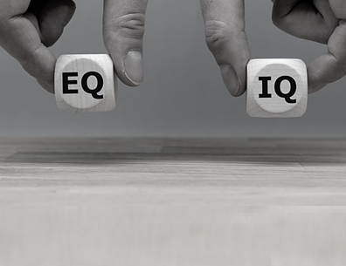
Green
Exercise 19: Self-Reflecting on Emotional Intelligence
If you score high on emotional intelligence you are better able to handle the stress of everyday life, find it easier to foster meaningful and close relationships, and are more socially competent in general. As a result, you tend to experience higher levels of wellbeing or ‘optimal psychological functioning and experience’
Goal: The goal of this exercise is to reflect on your current level of emotional skills and systematically assess these skills through an emotionally intelligent lens.
Instructions: The following questions refer to different parts of emotional intelligence. Choose one or more questions to reflect upon and write down your responses. For best results focus on one part and repeat over a period of a few weeks - keep track of progress.
Focus Area 1: Appraisal and Expression of Emotions in Yourself
Being highly skilled in this area means you can sense, acknowledge and express your own emotions better than most people.
Questions to reflect on:
How good am I at identifying how I am feeling?
How well do I know whether I am happy?
How well am I able to notice when I am angry, sad, bored, etc.?
How good am I at identifying emotional swings in myself?
How well do I know why I have certain feelings?
How good am I at finding the right word(s) to use to express my feelings?
In which ways do I express my emotions (e.g., write, talk, paint, etc.)?
Part 5: Element 3 - The Compass

Slide 49
Write down your current appraisal of your abilities in this first focus area of emotional intelligence.
What do you think you might try to do to strengthen your skills here?
Part 5: Element 3 - The Compass

Slide 50
Focus Area 2 : Appraisal and Expression of Emotions in Others
Being highly skilled in this area means you can sense the emotions of others and can predict others’ emotional responses.
How good am I at identifying how others are or might be feeling?
How well do I know whether others are happy?
How good am I at identifying emotional swings in others?
How sensitive am I to the feelings and emotions of others?
How well am I able to notice when others are angry, sad, bored, etc.?
How well do I understand the emotions of the people around me?
Write down your current appraisal of your abilities in this second focus area of emotional intelligence.
What do you think you might try to do to strengthen your skills here?
Part 5: Element 3 - The Compass

Slide 51
Focus Area 3 : Regulation of Emotion in Yourself
Being highly skilled in this area means you can return quickly to “feeling normal” again after being upset. You have better control over your emotions and are less likely to lose your temper.
How well am I able to prevent my emotions from taking over?
How well am I able to control my temper so that I can handle difficulties rationally?
How well am I able to control my emotions?
How well am I able to calm down quickly when I am angry or upset?
How good am I at responding to an unexpected event when I am ‘‘caught off-guard?”
How well am I able to self-regulate my behavior even under difficult circumstances?
In what situations do I respond differently than I would like to respond?
Write down your current appraisal of your abilities in this third focus area of emotional intelligence.
What do you think you might try to do to strengthen your skills here?
Part 5: Element 3 - The Compass

Slide 52
Focus Area 4 : Use of Emotion to Facilitate Performance
Being highly skilled in this area means you are able to encourage yourself to continuously do better. You can direct your emotions in positive and productive directions.
How do emotions influence my performance?
How often do I try to do creative and interesting projects when in a highly positive state?
How often do negative emotions after a setback cause me to stop trying?
How often do positive emotions encourage me to keep doing what I am doing?
How often do I effectively generate positive emotions to obtain better results?
Write down your current appraisal of your abilities in this fourth focus area of emotional intelligence.
What do you think you might try to do to strengthen your skills here?
Part 5: Element 3 - The Compass

Slide 53

Exercise 21: Self Expressive Writing
Writing therapy is remarkably effective for many different conditions, including: Post traumatic stress, anxiety, depression, grief and loss, chronic illness issues, substance abuse, eating disorders, interpersonal relationship issues, communication skill issues and low self-esteem. Writing your feelings in a journal leads to increased feelings of well-being, reduced physician visits, reduced absenteeism from work, improved academic grades and enhanced immune system functions. (Lepore & Smyth, 2002; Pennebaker, 1997, 2004). Writing regularly in a journal has not just great benefits and is helpful, it is also an extremely low-cost, easily accessible, and very versatile form of therapy. It can be done individually, practiced as a group and even added as a supplement to other forms of therapy, and it can be done just by yourself or guided by a professional. The potential positive outcomes of self-expressive writing therapy reach much further and deeper than simply writing in a diary if you follow the following basic instructions.
Part 5: Element 3 - The Compass

Slide 54
Basic Instructions for Self-Expressive Writing
Here are some basic instructions to get you started. You’re not writing to be read. You’re not writing for fame or fortune. You’re not writing to break through creatively, you’re not writing with a hidden agenda, you’re not writing for anyone else, you’re not writing to make money and not to win a prize. You’re not writing to satisfy your high school English teacher, you’re not writing because anyone told you to, you’re not writing in order to stop.
You’re just writing to write, to express yourself. To write about the good, the bad and the ugly. To write about life as you experience it. You’re writing to be honest, especially when being honest is painful.
When writing, it’s possible to learn something about yourself and gain insight into the thought process behind your choices and decision making. These insights will motivate you to write more often and enter the upward spiral that is self-expressive writing. Write from your heart, tell yourself the truth, trust the process and enjoy.
How to write?
Professor James Pennebaker stumbled on a finding in 1980 that prompted him to explore further. People who reported having a highly traumatic experience, and who kept the experience a secret showed far more health problems than people who openly talked about their trauma. Pennebaker found that the more people used positive emotions while writing about emotional upheavals, the more their physical and mental health improved in the weeks and months after the experiment.
Pennebaker’s research concluded that people whose health improved the most from writing used only a moderate number of negative emotion words. This means that your writing should not just focus on the negative, but be a healthy mix of positive and negative emotions.
Try to describe each day, each situation from both a positive and negative point of view, or just include what good things a certain negative experience can lead to later in life. When writing do not be concerned about spelling or grammar, the words used, consistency, flow, whether the writing is “any good”, writing too little or too much, succeeding or failing - just write. Know that you tend to carry not just your problems inside you, but also the solutions to your problems. Writing is a way to extract both the problems and the solutions.
Part 5: Element 3 - The Compass

Slide 55

What to write?
Many people don’t really know where to start. Some writing prompts and suggestions are listed below, add your own favorite items to the list, pick one each day and start writing. Just see it as an exercise to increase self-reflective writing skills.
What keeps you lying awake at night?
What don’t you want to talk about? Why not?
What don’t you admit to yourself? Why not?
Real freedom is the freedom from fear. What are you afraid of?
If you were to be free from fear, what would you be doing differently?
Has anything been bothering you, if so, why?
What is currently your biggest priority?
What currently are you proud of yourself for?
What are you ashamed off and why?
Are there any decisions you could currently make that would improve your health?
The best advice you could give someone at the moment is...
What does your perfect day look like….
What are you most grateful for this year?
Did you overreact to anything this week?
How do I think my partner feels about me currently?
Do you have a current habit that you would like to correct?
What are you most disappointed in yourself about recently?
Currently, your sleeping patterns are…
What is your biggest inspiration at the moment?
Right now, you could not live without
The best thing you have got going on right now is
The best thing that happened today was?
How have you been feeling lately?
Where would you like to travel to on your next holiday?
I really value my relationship with......
What qualities of your personality have been dominate lately?
Part 5: Element 3 - The Compass

Slide 56
You are thankful for……….
What are you most grateful for today?
What is your biggest strength at the moment
What would you like to learn?
Right now, what do you feel?
One thing that is nagging you at the moment is….
What do you need in my life right now is/are…...
You really shouldn’t have
You felt really good when…..
What will you do on your next day off?
You really appreciate…..
You will never…..
Are there currently any hobbies or interests that you would like to pursue?
What caused you the most stress or anxiety lately?
you could definitely improve my….
What is your main priority this year?
If tomorrow where your last day on earth, what would you do?
You smiled when….
This weekend you would like to......
You are so happy that……. is a part of my life, because…..
A perfect morning starts with…..
Have you generally been on time lately?
What made you laugh today?
You noticed lately that you have been really good at…..
It’s so awesome that…..
Name one thing that you need to currently improve on?
-----------------------------------------------------------------------------------------------------------------------------------------------------------------------------------------------------------------------------------------------------------------------------------------------------------------------------------------------------------------------------------------------------------------------------------------------------------------------------------------------------------------------------------------------------------------------------------------------------------------
Part 5: Element 3 - The Compass

Slide 57

Exercise 22:
Dealing with Other People’s Complaining
We all have someone in our lives who seems to enjoy complaining about something, the weather, work, traffic, relationships; the list is endless. Some people complain to make small talk, warn others about a negative experience, or receive moral support. Others complain because nothing is ever right or good enough. Complaining can also make us feel closer to other people because we have a mutual dislike in common. Generally, complaining is more about getting attention, reassurance, and sympathy than solving problems. After all, it is much easier to complain about something than to fix it.
Listening to other people’s negative talk can leave you feeling drained, as your mood changes to match that of the complainer. We often deal with complainers by trying to cheer them up, offering advice that never gets accepted, or even complaining alongside them. Responses like these can make matters worse not just for them but also for us. This exercise will help you respond to the complaining of others more helpfully and effectively.
STEP 1: Acknowledge the complaint
In this step, you will briefly acknowledge the complaint and the complainer’s experience. It is important to note that this does not mean that you agree with what they say and feel, just that you acknowledge their plight. Remember, your body language also lets people know that you are listening, so nod your head and make eye contact to signal that you are paying attention.
Part 5: Element 3 - The Compass

Slide 58
Some phrases that may help you acknowledge the experience include:
  I hear what you are saying.
  I’m really sorry that you’re having such a difficult time.
  That must be very frustrating.
  That must be tough.
  I understand. If I were you, I would feel the same way.
What other things might you say to acknowledge a complaint?
-------------------------------------------------------------------------------------------------------------------------------------------------------------------------------------------------------------------------------------------------------------------------------------------------------------------------------------------------------------------------------------------------------------------------------------------------------------------------------------------------------------------------------------------------------------------------------------------------------------------------------------------------------------------------------------------------------------------------------------------------------------------------------------------------------------------------------------------------------------------------------------------------------------------------------------------------------------------------------------------------------------------------------------------------------------------------------------------------------------------------------------------------------------------------------------------------------------------------------------------------------------------------------------------------------------------------------------------------------------------------------------------------------------------------------------------------------------------------------------------------------------------------------------------------------------------------------------------------------------------------------------------------------------------------------------------------------------------------------------------------------------------------------------------------------------------------------------------------------------------------------------------------------------------------------------------------------------------------------------------------------------------------------------------------------------------------------------------------------
Part 5: Element 3 - The Compass

Slide 59
STEP 2: Increasing complainant’s awareness of their emotions
This step is all about helping complainers notice and name the negative emotions they are experiencing. Labelling their feelings will help validate their experience and increase awareness of their emotions. For instance, saying something like, “You seem to be feeling frustrated/angry/upset right now,” will help the complainer recognize and acknowledge how they feel in the moment. Some statements to help direct attention to the complainer’s feelings include:
  I notice that you seem quite angry.
  I’m so sorry to hear that you feel upset about this.
  I see that this has really upset you.
  I hear what you are saying; you must feel so overwhelmed.
  I can see that this has really annoyed you.
  You seem disappointed.
  I know this is frustrating. It must be affecting you quite strongly.
What else might you say to help the complainers notice and name their emotions?
--------------------------------------------------------------------------------------------------------------------------------------------------------------------------------------------------------------------------------------------------------------------------------------------------------------------------------------------------------------------------------------------------------------------------------------------------------------------------------------------------------------------------------------------------------------------------------------------------------------------------------------------------------------------------------------------------------------------------------------------------------------------------------------------------------------------------------------------------------------------------------------------------------------------------------------------------------------------------------------------------------------------------------------------------------------------------------------------------------------------------------------------------------------------------------------------------------------------------------------
Part 5: Element 3 - The Compass

Slide 60
STEP 3: Interrupting the complainant’s negative talk
No matter how much people complain, there are many things which just cannot be changed. While you might naturally want to give advice or share your own stories, the goal of complaining is often just to vent frustrations. This step, therefore, is not about offering solutions or calming the situation, but it is about interrupting the complainers’ negative talk by asking simple questions that draw the attention towards their responsibility for dealing with the situation. Even if there is nothing the complainer can do to change the situation, there is always the opportunity to deal with the feelings that result from it. For example, asking, “Is there anything you can do to make the situation better?” or “How will you deal with your frustration?” will encourage complainers to shift from a passive victim mindset to a more active solution-focused mindset. Other examples include:
  Is there anyone you can ask to help you solve this?
  Have you already thought about ways to fix this?
  I can imagine these feelings are quite intense and require a lot of energy.
  How are you dealing with them right now?
  What will you do to change this situation?
  Is anything stopping you from fixing this right now?
What else might you say to interrupt the complainant’s negative dialogue?
-----------------------------------------------------------------------------------------------------------------------------------------------------------------------------------------------------------------------------------------------------------------------------------------------------------------------------------------------------------------------------------------------------------------------------------------------------------------------------------------------------------------------------------------------------------------------------------------------------------------------------------------------------------------------------------------------------------------------------------------------------------------------------------------------------------------------------------------------------------------
Part 5: Element 3 - The Compass

Slide 61
STEP 4: Practice with your partner - roleplay
One has the task to be negative, complain about anything, weather, work, traffic, relationships.
The other has the task to make the other person aware of their negative emotions and re-evaluate.
STEP 5: Reflection Questions
  How did you feel after completing the exercise?
  What did you learn from this exercise?
  What part of this exercise did you find most rewarding?
  What did you find most challenging about this exercise?
  In what ways do you feel more able to deal with the complaining of others?
  How has this exercise changed the way you approach other people’s complaining?
  How has this exercise changed how you think about your complaining?
--------------------------------------------------------------------------------------------------------------------------------------------------------------------------------------------------------------------------------------------------------------------------------------------------------------------------------------------------------------------------------------------------------------------------------------------------------------------------------------------------------------------------------------------------------------------------------------------------------------------------------------------------------------------------------------------------------------------------------------------------------------------------------------------------------------------------------------------------------------------------------------------------------------------------------------------------------------------------------------------------------------------------------------------------------------------------------------------------------------------------------------------------------------------------------------------------------------------------------------
Part 5: Element 3 - The Compass

Slide 62
Journal Entry:
This is space to write down new insights, aha moments and reflections. Some things you might want to write are: increased awareness of specific emotions, feeling you are trying to hide or that seem ever present or any new insights or intentions?
--------------------------------------------------------------------------------------------------------------------------------------------------------------------------------------------------------------------------------------------------------------------------------------------------------------------------------------------------------------------------------------------------------------------------------------------------------------------------------------------------------------------------------------------------------------------------------------------------------------------------------------------------------------------------------------------------------------------------------------------------------------------------------------------------------------------------------------------------------------------------------------------------------------------------------------------------------------------------------------------------------------------------------------------------------------------------------------------------------------------------------------------------------------------------------------------------------------------------------------------------------------------------------------------------------------------------------------------------------------------------------------------------------------------------------------------------------------------------------------------------------------------------------------------------------------------------------------------------------------------------------------------------------------------------------------------------------------------------------------------------------------------------------------------------------------------------------------------------------------------------------------------------------------------------------------------------------------------------------
Part 5: Element 3 - The Compass

Slide 63
Part 6: Element 4 - The Steering Wheel,
Your Purpose and Values
Exercise 22: Meaningful Photography
In this exercise, you take time to recognize and appreciate things that matter most to you in life.
Take photographs for one week
Over the next week, take photographs of things that make your life feel meaningful or full of purpose. These can be photographs of people, objects, places, pets, and the like. If you are not able to take photos of these things – for instance, because they are not nearby—you can take photos of reminders, souvenirs, websites, or even other photos. Try to take at least nine photographs each day.
Upload your photos
At the end of the week, upload your photos to a computer. Select the top 20 most meaningful topical photos, delete the ones you no longer want.
Reflect
Reflect on each photo, write down for each photo, a response to the following question: “What does this photo represent, and why is it meaningful?”
------------------------------------------------------------------------------------------------------------------------------------------------------------------------------------------------------------------------------------------------------------------------------------------------------------------------------------------------------------------------------------------------------------------------------------------------------------------------------------------------------------------------------------------------------------------------------------------------------------------------------------------------------------------------
1
2
3
Part 6: Element 4 - The Steering Wheel

Slide 64
Exercise 23: Meaning Diagrams
PART 1: Current Life Slices
Divide the circle below into slices, each representing the amount of time you spend on different elements or areas of your life. The larger the slice, the more time you spend on that area. Typical areas of life include: Work, Immediate Family, Community, Neighborhood, Extended Family, Spirituality, Fun & Recreation, Creativity, Personal Development, Goals & Values, Romance & Love, Volunteering, Money, Health and Exercise. Feel free to add or remove any of the above items.
This represents your Current Life
Part 6: Element 4 - The Steering Wheel

Slide 65
PART 2: Ideal Life Slices
Now complete the same exercise but, using the second circle below, think about where you would want to spend your time. What makes you happy? What gives you peace of mind?
This represents your Ideal Life
Part 6: Element 4 - The Steering Wheel

Slide 66

PART 3: Take some time to reflect on the following questions:
What prevents you from taking action to make your “current life” closer to your “ideal life”? Are there internal or external barriers? Which barrier is the biggest one for you right now?
How can you align your life with your true priorities? It takes changing and reframing habits to change your life. What small and manageable new practices could you implement to work towards your ideal values circle?
To help you get closer to your ideal, make copies of your ideal wheel and hang it in a place you will see every day. It will remind you and help you make values-based decisions daily.
Part 6: Element 4 - The Steering Wheel

Slide 67
Exercise 24: The Sixty Second Value Pitch
In this exercise, you will make a pitch and try to ‘sell’ your values by explaining why these particular things are important to you and to the way in which you live your life.
STEP 1: Select Values
First identify three of your core values. Your core values are your ideas about what you consider to be most meaningful and important to you at your very ‘core.’ You want to live by and live for your values. Your values are your answer to the question: “What is most important to you in life”? You may have held these values for a long time, or they may be newly adopted. Take a moment to reflect on your top three core values. If you need some inspiration, please look at the list of values in the next page. Once you have identified your three core values, write them down in the box below.
My top 3 core values are:
1
2
3
STEP 2: Create Your Value Pitch
Now create your personal values pitch. A typical pitch is punchy, to-the-point, interesting, and engaging. The aim is to convince listeners and get them on board. Your task, therefore, is to get your audience to buy-in to your core values so they can see the ‘value’ in living a life based on such values. You might like to use the following themes/prompts to guide your writing.
Why do you believe you could not live without these values?
What would happen if you would no longer be able to live in line with these values?
How has holding these values benefited you in your life?
Where do these values come from?
What past experiences helped you discover these?
Part 6: Element 4 - The Steering Wheel

Slide 68
Core Values
Acceptance
Affection
Beauty
Compassion
Connectedness
Creativity
Discovery
Economic Security
Elegance
Ethics
Expertise
Family
Fun
Harmony
Honesty
Independence
Integrity
Leadership
Making a Difference Money
Openness
Peace
Play
Purity
Relationships
Risk Safety & Security
Serenity
Spark
Status
Thrill
Winning
Achievement
Altruism
Challenge
Competence
Cooperation
Decisiveness
Diversity
Education
Entertainment
Excellence
Exhilaration
Fast Pace
Grace
Health
Humour
Influencing Others
Intellect
Learning
Mastery
Morality
Originality
Personal Development
Pleasure
Quality
Religion
Self-Respect
Service
Speculation
Success
Unity
Wisdom
Advancement
Arts
Change
Competition
Collaboration
Democracy
Environmental
Effectiveness
Enlightenment
Excitement
Fairness
Freedom
Growth
Helping Others
Imagination
Inner Harmony
Involvement
Loyalty
Meaningful Work
Mystery
Order
Personal Expression
Power
Radiance
Reputation
Sensibility
Sexuality
Spirituality
Teaching
Variety
Adventure
Awareness
Community
Completion
Country
Design
Awareness
Efficiency
Equality
Experiment
Fame
Friendship
Happiness
Helping Society
Improvement
Inspiration
Knowledge
Magnificence
Ministering
Nature
Passion
Planning
Privacy
Recognition
Responsibility
Sensuality
Sophistication
Stability
Tenderness
Wealth
STEP 3: Make Your Pitch
Now share your pitch with your learning partner or in a group. Take turns to stand up and read aloud what you wrote in the previous step. Your pitch should be approximately 60 seconds long. Reflect on the values shared and take a note of those that resonated most with
Part 6: Element 4 - The Steering Wheel

Slide 69

The Impact
of Values
Values help to differentiate
between what is important and
worth investing in, and what is relatively
unimportant and not worth investing in.
In this way, values influence which goals and intentional efforts are chosen to pursue from
day to day. Values have been found to predict the buying of environmentally friendly products, political voting, and choosing a university course as well as many other choice decisions.
Values also relate to well-being. The pursuit of extrinsic values, like power and wealth, is associated with lower levels of subjective well-being compared to the pursuit of intrinsic values, like friendship and personal development. Carefully examining your values leads to deeper reflection. Like by asking questions like: “Who are your role models – why do you see them as such? “What did your parents believe to be good values and how did they act accordingly?”
Values provide a sense of direction that guide toward greater meaning and purpose, which in turn leads to life satisfaction and happiness. Unfortunately, many people are unaware of their personal values; and even those that are aware of their values often spend little time reflecting on them. People who have little awareness of their values typically experience apathy or feelings of detachment. On a behavioral level, they tend to lack a sense of commitment. Because there is little awareness of their own view of what is important, people often rely on the opinion of others. When decisions often do not reflect what is believed to be important, people may experience high levels of discontent regarding these decisions.
Part 6: Element 4 - The Steering Wheel

Slide 70
The table below summarizes the above-described characteristics.
Lack of insight into personal values | Clear insight into personal values
Apathy (a lack of interest for life’s activities) | Purposefulness, enthusiasm, interest
Lack of commitment | Committed, sticking to goals set
Over-conforming (go along with the group) | Critical thinking, personal opinions and independent decision making
Choices made end up in unsatisfying results | Choices made result in satisfying results for the self and / or for others)
Exercise 25: A Value Tattoo
Many people chose tattoos because it serves as a reminder or symbolize something that the owner cares deeply about. If you got a tattoo that would serve as a reminder of what you would like your life to be like, what would it be and why?
Create an actual visual representation of the tattoo (by drawing or collecting images)
Consider your values and find a personally relevant symbol that matches them, which in turn can be used as a regular reminder.
Visual of the tattoo
Part 6: Element 4 - The Steering Wheel

Slide 71
Exercise 26: Identifying Personal Rules
Rules can be defined as “shoulds” that strongly influence our behaviors and our feelings. Examples of rules are, “I should work hard,” “I should be kind to other people,” “I should always be on time,” “I must not show that I am afraid.” Although these rules can help you make choices and guide your behavior, they may also cause negative emotions, like shame and stress, when you break them. It is important to develop the ability to use your rules flexibly so that your life will not be dictated by rules that may not always serve you.
STEP 1: Identifying Rules
This week, note as many personal rules as possible. Use a notebook, or your phone to register these rules. Become aware of thoughts like, “I should…,” “It would be better if…,” “I should not…,” etc. Note that certain questions can also point to a personal rule, for example, “Why am I not more spontaneous?” may refer to the rule “I must be spontaneous.”
STEP 2: Analyzing Rules
Now look at all the rules you have written down. For each rule, answer the following questions:
How rigidly do you apply this rule (1-10)?
How important is this rule to you?
To what extent does this rule contribute to your well-being?
To what extent does this rule allow you to follow your aspirations?
-----------------------------------------------------------------------------------------------------------------------------------------------------------------------------------------------------------------------------------------------------------------------------------------------------------------------------------------------------------------------------------------------------------------------------------------------------------------------------------------------------------------------------------------------------------------------------------------------------------------------------------------------------------------------------------------------------------------------------------------------------------------------------------------------------------------------------------------------------------------
Part 6: Element 4 - The Steering Wheel

Slide 72
STEP 3: Breaking Rules
Now look again at the list of your rules.
Which of these rules are currently having the most negative effect on your well-being?
How do these rules negatively affect your well-being?
How do they hinder your aspirations?
Breaking rules or challenging them by not always following them is a very powerful way of reducing their effects. What can you do to break/challenge these rules or reduce their effects?
STEP 4: Evaluation
When you have successfully managed to break or challenge one or more rules, evaluate this process.
What did you experience when you broke/challenged the rule(s)?
What happened or what thoughts and/or emotions did you experience as a result?
How did you deal with these results/thoughts/emotions?
How rigidly will you apply the rule(s) from now on (0-10)?
What did you learn from this exercise?
---------------------------------------------------------------------------------------------------------------------------------------------------------------------------------------------------------------------------------------------------------------------------------------------------------------------------------------------------------------------------------------------------------------------------------------------------------------------------------------------------------------------------------------------------------------------------------------------------------------------------------------------------------------------------------------------------------------------------------------------------------------------------------------------------------------------------------------------------------------------------------------------------------------------------------------------------------------------------------------------------------------------------------------------------------------------------------------------------------------
Part 6: Element 4 - The Steering Wheel

Slide 73

Exercise 27:
Your Bucket List
A bucket list is a list of things that
you want to do before you die. Creating
a bucket list is a valuable exercise for
Identifying what is important to you in your
life and for guiding you to live more in line with
your values. The following steps will help you create a meaningful bucket list for your life.
Step 1
What do you want to do before you die?
For the next few minutes, close your eyes and consider how you would feel if you received news that you only had one year to live. What would you do with that year? What activities would you want to do - what is on your ‘before-you-die bucket list’? Spend some time, imaging that this is your reality. When you are finished, open your eyes and write down what you came up. In the first column, make a list of all the things you want to do or experience before you die. Come up with as many things as you can, and don’t worry about priority or practicality.
Step 2
Rate Why is this item meaningful?
Consider what each of your bucket list items means to you by asking yourself the following questions, “Why would this be meaningful to me?” and “How would this increase the meaning in my life?” Write down your answers in the second column of the table.
Part 6: Element 4 - The Steering Wheel

Slide 74
Step 3
How important is this item?
In the third column, rate how meaningful each item would be to you. Ask yourself the question, “How important or significant is this item to me?
Example of bucket list:
Item Things I want to do before I die | Reason Why would this be meaningful to me? | Meaningfulness Rating 0 -10
Visit Paris with my spouse | Opportunity to spend quality time together experience culture, broaden my understanding and experience of France. Sense of adventure - enjoy new foods & flavours, spark romance | 8
YOUR BUCKET LIST
Item Things I wan to do before I die | Reason Why would this be meaningful to me? | Meaningfulness Rating 0 -10
Part 6: Element 4 - The Steering Wheel

Slide 75
Step 4
Identify Values
Now see if you can notice any value patterns within your bucket list, particularly in those items scored as highly meaningful. For example, numerous items may involve connecting with others. In the space below, write down the values that appear to be present.
My Personal Values Are:
Step 5
Reflection
Which item on your bucket list inspires or excites you the most? Why?
Which item on your bucket list could you complete first?
Now that you have a better understanding of some of the values underlying your bucket list items, can you think of ways you could integrate these values into everyday life?
Step 6
Everyday Bucket List
Consider your list of values from Step 4 and come up with at least one concrete action that you can take this week to live in line with one, or more of these values. For example, if you identified connecting with others as one of your bucket list values, you might choose to set a date night where connect with your partner. In the space below, write down a potential valued action, including as much detail as possible (i.e., who, what, where, when, why).
Part 6: Element 4 - The Steering Wheel

Slide 76

Exercise 28:
What do you care about?
What do you currently spend your time caring about?
What things do you devote a lot of time and attention to?
STEP 1: List the items and attention to
Using the questions below as a guide, look back over the past seven days and think about all the things - big and small - which you have spent time, effort, money, and attention on. Make a list.
What did I care about that kept me up at night?
What did I care about that made me happy and fulfilled?
What things did I spend my time complaining about?
What did I care about that I have no control over?
What things did I worry about happening in the future?
What did I care about that happened in the past?
What did I care about that made me anxious?
What did I care about that made me worry throughout the day?
What are the extrinsically and intrinsically motivated things in your list
Part 6: Element 4 - The Steering Wheel, Your Purpose and Values

Slide 77
STEP 2: Do you care about these things?
It is now time to take an honest look at what you currently spend your time caring about and decide whether these fit in with your values. To do this, you will link the values listed in previous exercises to the activities in the right column. Take some time to look at the completed worksheet and ask yourself, do any of the things I currently devote attention to align with any of my core values? If the answer is yes, draw a line to connect the two. See example below:
What did I devote time and
attention to this week
My Top Values
Finishing new song
Planning my sister’s birthday party
Worry about my appearance – what others think of me (Facebook/Insta postings and chat)
Work – just getting things done
How to work I like and career move
Worried about job security after comments at work
Covid issues with my mother
Family
Creativity
Freedom
STEP 3 Let go of what does not matter and start caring about the
things that do matter
You may find that certain activities are not connected to any of your top five values: these are examples of things you have devoted time and attention to that do not align with what you value the most. Take a step back and work out what truly matters. You now have the power to choose: Is this worth caring about? Rather than caring about everything, decide what is most important and let go of the things that are simply not worth your time.
Part 6: Element 4 - The Steering Wheel

Slide 78
STEP 4 Reflect
Reflect on this exercise by answering all or some of the following questions.
What did you learn about yourself during this exercise?
What values are you living in line with?
When you care too much about things that do not matter, what is the cost to you emotionally?
Can you see a pattern concerning the unimportant things you care about?
Why do you think you care about these things when they are not really important to you?
What actions can you take to refocus, when caring too much about unimportant things.
What emotions do you notice when caring too much about things that do not matter?
How do you feel when you care about things that do matter to you?
Part 6: Element 4 - The Steering Wheel, Your Purpose and Values

Slide 79

Exercise 29: Core Values in Romantic Relationships
Step 1
Understanding the idea of core values in romantic relationships
Your core values are the things you care about and consider important: they reflect what you want to stand for in life and how you want to behave in the long term. Values drive your actions and add meaning and authenticity to your life. When people consider the kind of partner they would like to be, values such as loving, kind, committed, honest, caring, supportive, sensual, and affectionate are all commonly held in high regard within intimate relationships.
Perhaps you prioritize family, resourcefulness, and spirituality, or respect, generosity, and compassion. No matter what your core values are, only you can identify the things that matter most to you. Values are the cornerstone of your relationships and determine your beliefs about money, work, friends, intimacy, politics, family, and spirituality. Within intimate relationships, living in harmony with our values can reduce tension and conflict, while providing a greater sense of fulfilment, happiness, and contentment. This exercise will help you connect with your values so that you can reflect on the sort of partner you want to be and translate your core values into ongoing action.
Step 2
Imagining a relationship celebration
Close your eyes and take a few moments to picture a scene in your mind: You and your partner are celebrating an anniversary or perhaps a special birthday sometime in the distant future. Your partner has gathered your closest friends and family and stands up to make a speech about the life you have shared, including what you stand for, what you mean to them, and the role you have played in their life.
Part 6: Element 4 - The Steering Wheel

Slide 80
Now, visualize your partner saying the things that you would like to hear him/her say about you. In an ideal world, what would you most love your partner to say? What could your partner say that would make you feel happy and proud of the person you are? Remember, this exercise is not about what your partner would actually say, rather it is about what, in an ideal world, you would hope to hear your partner say about you.
If you need some more guidance, you may find the following questions useful.
How do you want to treat your partner?
What do you want to stand for as a partner?
What qualities do you want to bring to the relationships?
How do you want your partner to see you?
How do you want to behave or act on an ongoing basis?
What kind of person do you want to be in your relationship?
How would you interact with your partner if you were the ‘ideal you’ in this relationship?
Step 3
Extract three core values
Now select the top three values from the answer you provided in the previous step. Look closely at your answer and consider the following questions. Which of your values are recognized in the speech? Which values stand out to you the most from your story? Do any values occur more often in your story than others? If so, what are they? You should now rank your values in order of importance, starting with the most important at the top. What are your top 3 core values?
My top 3 core values are:
1
2
3
Part 6: Element 4 - The Steering Wheel

Slide 81
Now look back over the past month and evaluate the extent to which you have acted in ways that are in line with your top three core values. In the table below, write your rating for each value and answer the following questions. Remember to answer honestly.
Core Value | Behavior aligned with value score (1-10) | Should I add more ways to integrate these values in my life? | If yes, what actions can I take?
Part 6: Element 4 - The Steering Wheel

Slide 82

Green
Exercise 30: Learn to Say “No”
1. Tap into your values
Saying no to someone can be made easier by tapping into our values and doing what feels right in the situation. Living our lives according to our values is beneficial for our health and wellbeing. Therefore, saying yes to someone or something that commits you to do something that feels “wrong” is doing yourself a disservice. For example, being asked on a date on the same night that you have a friend’s birthday dinner. If the friendship was something that you valued highly, you might remind yourself of this and thus more easily decline the invitation to go on a date.
2. Separate the request from the relationship
Saying no to someone’s request can often feel like we are saying no to the person rather than the request. This misconception can lead us to feel greater personal pressure to ‘be a decent person’ because we don’t want to hurt the other person or our relationship by saying no. Learning to recognize that declining the request is not the same as declining the person enables us to do what’s right for us without fearing that we are hurting someone’s feelings.
3. Say no without saying the word “no”
We do not have to use the word “no” to convey the message that we are declining a request. For example, “I would love to attend, but unfortunately I’m overcommitted,” or “I’m afraid I don’t have the
availability at the moment,” and “thank you, but unfortunately I am not available” convey the message “no” clearly and politely without using the word.
Part 6: Element 4 - The Steering Wheel

Slide 83
Green
4. Focus on what you will gain by saying no
Rather than focusing on what you will lose by saying no, consider what you will gain by saying no. For example, you have planned to cook dinner at home with your girlfriend when your friends invite you to go out for dinner. You can choose to either focus on what you are potentially missing out by staying in with your girlfriend (laughs, jokes, friendly banter, and bonding), or you can reorient your attention to what you are gaining (a loving evening, closeness, and feeling proud of yourself for sticking to your word).
5. Recognize your personal cost of saying yes
When someone asks us for something, they are asking us to give them something. This is a cost. Recognizing what it is that you are giving away by saying yes can help you to say no.
6. Choose for being respected over being popular
While you may lose some popularity by saying no, you will likely gain respect. Saying no shows others that you value your time, that you stand up for yourself, and that you choose to do what is right for you.
7. Be clear rather than vague and non-committal
Sometimes we attempt to ‘soften the blow’ of saying no by giving a vague, non-committal response, such as “I’ll do my best to come” or “I’ll try and get out of work early to make it.” When we respond in this way, when actually we have no intention of going, and the person on the receiving end who we are trying to ‘save’ from saying no to is worse off. Being vague and non-committal also only delays your eventual “no,” which makes it that much harder on you.
Part 6: Element 4 - The Steering Wheel

Slide 84
Journal Entry: My Values and Meaning in My Life
This is space to write down new insights, aha moments and reflections. Some things you might want to write are: what new awareness about values and meaning in your life. New intentions, anything you will start to do differently, change of focus? Where will you spend more / less time?
--------------------------------------------------------------------------------------------------------------------------------------------------------------------------------------------------------------------------------------------------------------------------------------------------------------------------------------------------------------------------------------------------------------------------------------------------------------------------------------------------------------------------------------------------------------------------------------------------------------------------------------------------------------------------------------------------------------------------------------------------------------------------------------------------------------------------------------------------------------------------------------------------------------------------------------------------------------------------------------------------------------------------------------------------------------------------------------------------------------------------------------------------------------------------------------------------------------------------------------------------------------------------------------------------------------------------------------------------------------------------------------------------------------------------------------------------------------------------------------------------------------------------------------------------------------------------------------------------------------------------------------------------------------------------------------------------------------------------------------------------------------------------------------------------------------------------------------------------------------------------------------------------------------------------------------------------------------------------------
Part 6: Element 4 - The Steering Wheel

Slide 85
Part 7: Element 5 - The Leaks in your Boat,
Your Weaknesses
Weaknesses are represented by leaks in the boat. Most old wooden boats have small leaks, and bilge pumps to pump out the leaking water. A leak in a boat can affect the boat’s journey in a number of ways. It may prevent the boat from sailing in a personally valued directions, or slow the boat down so that important destinations are not reached in time. Or in a worst-case scenario, the boat may not reach the destination at all or even sink.
Exercise 31: My Top Three Weaknesses
Every job interview will have a question about weaknesses. You don’t need to highlight a long list but you should show that you are aware of your weaknesses and be able to tell how you deal with them or use your problem-solving strengths to make improvements. It is healthy to understand and accept your weaknesses, so have a look at the list below, add to it if you like, and see if you can identify your top three weaknesses.
Not taking criticism well | Impatient | Lazy
Quickly bored | Procrastinating | Always persistent
Taking things personally | Strongly willed | Too passive
Hating conflict | Shy and quiet | Lethargic
Long term planning | Too strict | Short sighted
Not handling pressure well | Too detailed focus | Taking the blame for others
Being blunt | Very greedy | Always delegating task
Need to be right | Very stubborn | Always multitasking
Close-minded | Very emotional | Too impulsive
Too bossy | Taking on too much | Too aggressive
Too critical | Too passive | Work too much
Too perfectionistic | Too fearful | Too self-critical
Very selfish | Unorganized
Part 7: Element 5 - The Leaks

Slide 86
Exercise 32: Difficulty in Accepting Compliments
Many of us have no problem handing out compliments but have great difficulty accepting compliments. This exercise is a roleplay so requires a partner – person A and B. Find someone you can do this with and start practicing receiving compliments and explore how you react to it.
Partner A explains the exercise
Step 1
Person A explains how the role-playing works by saying something along the lines of:
In this exercise, we are going to role-play giving and receiving compliments, and see how good you are at receiving and giving compliments. Many of us have problem handing out compliments, and even more difficulty accepting compliments. This may be because we want to remain humble and not boast, something many of us learn when young, seeing older people in our lives do the same. I am going to compliment you, and I would like you to notice your initial reaction to this compliment. Notice what happens in your body and your mind. Then, I would like you to accept the compliment by saying something like, Thank you, that’s nice. - OK, ready?
Partner A gives person B a compliment
Step 2
Person A compliments person B, such as “You did a great job with your homework this week” or “I am so impressed that you were able to give that presentation” or “I like your shoes.”
Partner B accepts the compliment
Step 3
Allow person B time to accept the compliment in whichever way they want to.
Part 7: Element 5 - The Leaks

Slide 87
Person A shares his or her experience
Step 4
Person A provides feedback to person B about how it felt to have his or her compliment received by saying something like, “It felt good to know that you took the compliment on board, as though you accepted a little gift from me. If you would have dismissed it, I might have felt as though you had rejected this gift, which would have left me feeling a little exposed.”
Reflect on the role-play
Step 5
Reflect and discuss:
What happened first when I complimented you? Did you have an urge to deflect or dismiss it?
Did you feel a sense of discomfort, what part made you feel uncomfortable?
What did your mind say just after receiving the compliment?
Downloading compliments in everyday life
Step 6
Reflect on receiving compliments in your life
Are there any types of compliments that you find difficult to give or accept?
Do you dismiss compliments about appearance, professional accolades, or personality traits?
Name the kinds of compliments that you have difficulty accepting
What kind of feelings and thoughts arise when you receive these compliments?
Part 7: Element 5 - The Leaks

Slide 88

Exercise 33: Exploring Your Self-Worth
The goal of this exercise is to become aware of your self-worth and what it is based on. It is a valuable starting point for developing more unconditional self-acceptance. Self-acceptance involves the acceptance of the self, including weaknesses and strengths without pre-conditions. Cultivating more self-acceptance, means learning to build a relationship with yourself in which your self-worth is not reduced by your mistakes, weaknesses, or failures.
Self-esteem is about self-worth. When people are said to have high self-esteem, they believe they have worth as a human being. In contrast, people with low self-esteem believe that they are not worth much. How can we objectively evaluate the worth of something so complicated as a human being? Is that even possible? The answer is NO!. Yet, most of us are constantly evaluating our worth against all kinds of different standards like appearance or achievements or others. If we feel we are living up to the standard, we are worthy and self-esteem is high, however, if we feel that we are not reaching some personal standard, self-esteem drops.
There is nothing wrong with evaluating our actions, because it means we learn from our mistakes and grow as individuals. However, evaluating actions should be separated from evaluating personal worth. In this exercise, we will explore what occurs when you evaluate your self-worth.
Part 7: Element 5 - The Leaks

Slide 89
STEP 1: Reflecting on your perceived worth
Look at the questions below. Choose five questions and try to answer them truthfully. Do not worry about spelling or grammar. Just write down what comes up first.
When do you feel most insecure?
In what areas are you most critical of yourself?
Describe some situations in which you were pretending to be someone you are not so others would like and accept you.
What kind of judgments from other people make you feel the worst about yourself?
What kind of feedback from others makes you feel as if there is something wrong with you?
When do you feel less compared to others?
What is the thing you fear the most that people would say of you?
What is it that you are most afraid that others would disapprove of you?
When do you experience the feeling of not being enough?
In which situations do you tend to compare yourself with others?
When do you feel like your sense of self-worth increases?
When do you feel worthwhile?
When do you feel like your sense of self-worth decreases?
When do you feel worthless?
Question 1
My Response:
Part 7: Element 5 - The Leaks

Slide 90
Question 2
My Response:
Question 3
My Response:
Question 4
My Response:
Question 5
My Response:
Part 7: Element 5 - The Leaks

Slide 91
STEP 2: Domains of self-worth
Consider all the things in your life that you are using to evaluate yourself as a person. Some common examples include: appearance, financial status, creativity, athletic ability, artistic ability, spirituality / religious practice, weight, performance at work / school, role as a mother / sister / partner / mentor, competence / knowledge, achievements.
These are your ‘domains of self-worth.’ Look at your answers in the first part of this exercise. Are there common themes that relate to a specific domain of self-worth? For instance, perhaps your appearance or financial status is mentioned more than once.
These are likely to be domains in your life on which you base your self-worth. Now, look at the circle below. Identify all your different domains of self-worth and draw a wedge into the pie to represent each domain. The size of the wedge represents the importance of that domain when you are evaluating yourself as a person. A larger wedge means that that domain is a relatively more important source of self-evaluation.
Draw Your Wedges of Self-Worth
Part 7: Element 5 - The Leaks

Slide 92
STEP 3: Evaluation
Now, look at the different parts of the circle you completed and answer the following questions.
How was it to complete the exercise? What did you notice?
Why do you think some wedges (domains) are bigger than others?
What are the standards that you feel you have to meet in these domains?
How do you feel when you are unable to meet these standards?
Are there wedges that are big today, but were not so prominent in the past? Why did this happen?
Are there wedges that are currently not so big, but were bigger in the past? Why did this happen?
What would life be like if you no longer had to live up to the norms and standards in these domains? If you could learn and develop in these domains without the fear of “not being enough”?
Part 7: Element 5 - The Leaks

Slide 93

Exercise 34:
Learning to Rate
Behavior – Instead of
the Self
We all make mistakes, and we all do
things that we are not proud of from
time to time. However, how people evaluate
their mistakes or regrettable actions can differ.
While some people may see such actions as proof of being a “flawed” or “unworthy” human being, others may see them as inevitable occurrences that are merely a part of being human. In this exercise, you will explore these two ways of evaluating mistakes or regrettable actions.
STEP 1: Identify past mistakes
Make a list of 5-10 things in your past that you are not proud of or that you wish you did differently. For
example, you may have forgotten a close friend’s birthday, said something unkind to someone, became
overly angry at some driver, made a mistake, or treated someone unfairly. List each of these past regrets in the first column of the table in the next page.
Part 7: Element 5 - The Leaks

Slide 94
Past mistake or regrettable action | Evaluation of the self | Evaluation of behavior
I forgot my friend’s birthday | I am a lousy friend; I am careless | Forgetting the birthday was not very thoughtful of me
Part 7: Element 5 - The Leaks

Slide 95
STEP 2: Evaluate yourself as a person
For each of the actions listed in the first column, evaluate yourself as a person for making a mistake. What personal characteristics could explain the mistake? Write down this global evaluation of yourself in the second column.
STEP 3: Evaluate your behavior
Now, in the third column, evaluate your behavior concerning the mistake. What actions or behaviors could explain the mistake?
STEP 4: Reflection
How was it to do this exercise?
Do you feel differently about yourself when you consider your responses in the second column versus the third column? If so, how?
Which responses (second or third column) are more motivating in terms of improving yourself to do better next time?
Going forward, will you aim to evaluate yourself or your behavior concerning mistakes or regrettable behavior? Why?
Part 7: Element 5 - The Leaks

Slide 96
Exercise 35: Seeing Through the Illusion of Self-Rating
Are people either worthwhile or worthless, superior or inferior? If we were to define a “worthless” or “inferior” human being, we would find that we are, in fact describing all humans. For example, a worthless or inferior person is someone who cannot do anything right or someone who makes many mistakes; however, everybody does some things right, just as everybody makes mistakes. Thus, according to these definitions, all human beings are worthless.
Step 1
Countering definitions
The table below lists a set of definitions describing a worthless or inferior person. Your task is to read the definition and rebuttal of each of these definitions – which one do you agree with?
Definition of a worthless or inferior person | Rebuttal
1. Someone who does bad things | We must all be worthless then because everyone does bad things from time to time.
2. Someone who fails or make mistakes | Failing and making mistakes is part of life
3. Someone who is unattractive | People have different views on what is beautiful.
4. Someone who does mean, hateful things on purpose to hurt other people. | We all do things that are somewhat mean or hateful at times, especially when we feel hurt and angry. The urge to get back at someone who has wronged us is an undesirable but virtually universal human characteristic.
5. Someone who has no value to society because he/she is lazy, self-centered, and unproductive. | Everyone can be lazy and unproductive at times; therefore, we must all be worthless.
6. Someone who is unpopular, even our greatest heroes, like Abraham Lincoln, had many enemies. | Some of the most destructive people, like Saddam Hussein, Hitler, and Charles Manson, were idolized by many people. Does this mean that Lincoln was worthless whereas Hitler was worthwhile?
7. Someone who is unintelligent | No one knows everything about everything; everyone has areas in which they lack knowledge (e.g., knowing a particular foreign language).
8. Someone who is untalented | We all are reasonably talented at many things, e.g., reading, writing, gardening, cooking, talking, listening to music, and general mathematics.
9. Someone with low self-esteem | Low self-esteem is a symptom of depression. Does this mean that all depressed people are worthless? Many serial killers like themselves intensely. Does this make them worthwhile?
Part 7: Element 5 - The Leaks

Slide 97
Journal Entry: My Weaknesses
This is space to write down new insights, aha moments and reflections. Some things you might want to write are: your insight into core weaknesses and how they affect your self-view. What do you need to do to accept yourself and improve your self-view?
--------------------------------------------------------------------------------------------------------------------------------------------------------------------------------------------------------------------------------------------------------------------------------------------------------------------------------------------------------------------------------------------------------------------------------------------------------------------------------------------------------------------------------------------------------------------------------------------------------------------------------------------------------------------------------------------------------------------------------------------------------------------------------------------------------------------------------------------------------------------------------------------------------------------------------------------------------------------------------------------------------------------------------------------------------------------------------------------------------------------------------------------------------------------------------------------------------------------------------------------------------------------------------------------------------------------------------------------------------------------------------------------------------------------------------------------------------------------------------------------------------------------------------------------------------------------------------------------------------------------------------------------------------------------------------------------------------------------------------------------------------------------------------------------------------------------------------------------------------------------------------------------------------------------------------------------------------------------------------
Part 7: Element 5 - The Leaks

Slide 98
Part 8: Element 6 - The Sails of your Boat,
Your Strengths
Strengths are the sails of the boat. Without the sails, the boat would float aimlessly in the water, not going anywhere. Just like the sails allow the boat to move in any direction you want, strengths allow us to flourish and move ahead in life in a direction we want to go. The sails generate the momentum of the boat, helping the captain create a journey that is worth traveling. In the same way, using your strengths optimally makes you feel energized, engaged, enjoying your life and the direction you are moving to, just like a boat that is sailing with the wind in its sails.
Your strengths define who you are more than anything else and form a key part of what makes each of us unique. Your strengths reflect your potential, helping you to achieve goals across your personal and professional life. There are many benefits to understanding your inherent strengths, including increased performance at work and greater life satisfaction and well-being. Given the benefits, there is clear value in taking the time to explore your strengths.
Exercise 36: Assess Your Strengths
Use one or more of the strengths assessment tools to define your top character strengths.
TOOLS TO ASSESS YOUR STRENGTHS
1. Signature Strength Questionnaire
The first useful tool for the assessment of character strengths is the Signature Strength Questionnaire. The assessment is a shortened alternative to the VIA Youth Survey, so it was originally called the Signature Strengths Assessment of Youth Survey. In line with this focus, the developers of the scale defined ‘strengths’ as they related to the needs of school-aged children, defining them as: emotional and behavioral skills, competencies, and characteristics that foster a sense of personal accomplishment, contribute to supportive and satisfying relationships with family members, peers, and adults, enhance one’s ability to cope with challenges and stress, and promote one’s personal, social, and academic development.
Part 8: Element 6 - The Sails

Slide 99

The site will allow you to do the Adult or Youth version. Another good idea is to just read the short descriptions of the 24 defined character strengths. You can complete the full SSQ-72 assessment for free via the University of Toronto’s website - https://strengthsbasedresilience.com/assessment or go to the viacharacter website http://www.viacharacter.org/
2. Wing-finder by Red Bull
The Red Bull Wing-finder test is a free strength assessment tool that helps you identify the things you are naturally talented at. It also provides a range of tools and coaching materials to help you develop your strengths. The test takes approximately 35 minutes to complete, contains around 280 questions, and instantly returns a 19-page feedback report upon completion. Wing-finder offers a playful, light-hearted approach to exploring four influential factors for determining employability and career success: Connections, Drive, Thinking style, and Creativity. The test itself is challenging, timed, and highly interactive. It requires quick-thinking and creativity as it tests your abilities using real-life problems and scenarios faced by leaders. The feedback provided at the end of the assessment will compare your results to those of high-profile athletes, making the tool particularly engaging for young people or those in the early stages of their careers. You can complete the full Wing-finder assessment for free via Red Bull’s Wing-finder website. https://www.redbull.com/int-en/wingfinder
3. The HIGH-5 Strengths Assessment
The HIGH-5 is a free online strength assessment rooted in the principles of positive psychology and dedicated to helping people better understand themselves and appreciate themselves more. The test assesses 20 applicable strengths across four different domains. Examples of strength profiles identified by the test include Problem Solver, Empathizer, and Winner, to name a few.
Part 8: Element 6 - The Sails

Slide 100
The test takes approximately 15 minutes to complete and comprises 100 questions. Upon completion of the test, you will receive a brief summary of your top-five strengths, with the option to receive a detailed report for a fee. There is also an option to do this as a team and to get others to evaluation you. You can discover your top five strengths for yourself by completing the test at the HIGH-5 website. https://high5test.com/
Other Strengths Assessments
If you are interested in only the most psychometrically sound tests. It is recommended to explore the three most accurate character strength assessments mentioned earlier, the VIA Character Strength Model, The Cliftons https://www.gallup.com/cliftonstrengths/en/252137/home.aspx, and Strengths-Profile https://langleygroup.com.au/strengths-profile-assessment/
My Key Character Strengths Are:
Part 8: Element 6 - The Sails

Slide 101

Exercise 37:
Strengths Awareness
do a personal strength SWOT
Understanding your strengths is
critical for self-growth and ongoing
improvement. Using your strengths optimally
means leveraging them in all your life domains, personal and professional life to maximum effect.
Most importantly, understanding your strengths will
contribute to forming a healthy sense of self, enabling you to
operate in the world feeling effective, grounded, and self-confident. Be sure to take some time to complete the exercises below to discover and reflect on how to make the most of your strengths.
A. Personal SWOT analysis
SWOT is an acronym for strengths, weaknesses, opportunities, and threats. Strengths and weaknesses center around internal factors, such as pre-existing competencies or skills we are lacking or do not possess. In contrast, opportunities and threats regard factors in our environments that may facilitate our ability to put our strengths to use or threaten to expose our weaknesses.
To get some ideas about how to conduct a Personal SWOT Analysis, take a look at some of these example questions to prompt your thinking about each of the four parts:
Part 8: Element 6 - The Sails

Slide 102




S
Strengths
What do you have that others don’t?
What do you do better than others?
How do others describe your strengths?
What values are unique to you?
W
Weaknesses
What are the tasks that you avoid because you don’t think you can do them?
What do you think you are not good at?
How do others describe your weaknesses?
What are the personality traits that hold you back?
What do you think are your negative/bad habits?
O
Opportunities
Do you consider yourself to be part of a growing industry?
If so, how can you use your resources to take advantage of this growth?
Is your company failing to do something?
Is there something that your clients and customers complain about?
T
Threats
What are the roadblocks in your professional life?
Are you a part of an unhealthy competitive environment?
Is changing technology a threat to your current position?
Do you feel threatened by any of your character weaknesses?
Part 8: Element 6 - The Sails

Slide 103

Complete a SWOT analysis yourself, answering the above-mentioned questions. You can find an example on the mind tools website https://www.mindtools.com/pages/article/newTMC_05.htm. Just scroll down for the strengths example.
Part 8: Element 6 - The Sails

Slide 104
Exercise 38: Strengths Exploration
Those who know their strengths and use them frequently tend to have more success in several areas. They feel happier, have better self-esteem, and are more likely to accomplish their goals. To use your strengths effectively, it’s important to have a clear idea of what they are, and how they can be used. Some of your greatest strengths might be easy to recognize, while others go unnoticed because they feel ordinary to you, even if they aren’t.
Step 1
Tick your strengths from the choices below, or add your own at the bottom.
Wisdom | Artistic Ability | Curiosity | Leadership
Empathy | Honesty | Open Mindedness | Persistence
Enthusiasm | Kindness | Love | Social Awareness
Fairness | Bravery | Cooperation | Forgiveness
Modesty | Common Sense | Self-Control | Patience
Gratitude | Love of Learning | Humour | Spirituality
Ambition | Creativity | Confidence | Intelligence
Athleticism | Discipline | Assertiveness | Logic
Optimism | Independence | Flexibility | Adventurousness
Answer the following questions
List the things that you are good at:
Part 8: Element 6 - The Sails

Slide 105
List the things that you enjoy doing.
In what areas of your life have you been most successful?
Be sure to hone in on core strengths, rather than specific skills. For example, basketball isn’t a strength, but athleticism and discipline are. You can do this by asking questions such as - What makes you good at basketball? One good way to spot strengths is to ask questions about what you enjoy, what activities you gravitate toward, and when you are happiest. The answers usually point toward their strengths. What sort of activities fill you with energy? What are the best experiences you remember having? What makes a day really good for you? When do you feel you were at your best during the past week? What are your goals for the future? What traits do you admire in other people? None of these prompts ask directly about strengths, but their answers will often provide clues. Other signs of strengths are: being drawn to things that allow for use of the strength; desiring to use the strength and feeling drained if not using it; prioritizing tasks that require use of the strength; desire to learn new information related to the strength; sense of energy and engagement when using the strength; having success when using the strength.
Now have another look at the strengths you circled, if you found some strengths that are not in the list, just add them to the bottom. Because understanding your strengths is so important the next sections will show different ways to spot strengths in yourself and others.
Part 8: Element 6 - The Sails

Slide 106

Exercise 39: Strengths Spotting
Have you ever had the experience of learning a new word, then hearing it everywhere? Learning to spot strengths works in a similar way. When a person learns to spot strengths, they’ll begin seeing them everywhere. By learning to spot strengths in others, you will also start to notice strengths in yourself, along with several other benefits.
Step 1
Strength Spotting Exercise
List three strengths for each of the following people. How do their strengths reveal themselves? Share the list with the people involved.
1. A close friend or family member
2. Someone you admire
3. A colleague or acquaintance
Part 8: Element 6 - The Sails

Slide 107
Examples could be:
My partner has a great sense of humor. I had a bad day at work, but she helped me see the absurdity of the situation. I saw Lewis Hamilton in an interview after a F1-race, and I noticed that he's exceptionally media savvy and socially aware. My son must have asked me 100 questions today. He is very curious, which I believe is a strength.
Examples of strength spotting done – what strengths do you spot in your learning partner?
Part 8: Element 6 - The Sails

Slide 108
Exercise 40: Strengths Identification
- have a closer look at your strengths
Step 1
Answer the following questions
List the strengths you possess that help you in your relationships.
Describe a specific time your strengths were able to help you in a relationship.
Describe two new ways you could use your strengths for your relationships.
1.
2.
Part 8: Element 6 - The Sails

Slide 109
List the strengths you possess that help you achieve personal fulfilment.
Describe a specific time your strengths were able to help you with personal fulfilment.
Describe two new ways you could use your strengths for personal fulfilment.
1.
2.
Part 8: Element 6 - The Sails

Slide 110
List the strengths you possess that help you in your profession.
Describe a specific time your strengths were able to help you in your profession.
Describe two new ways you could use your strengths in your professional life.
1.
2.
Part 8: Element 6 - The Sails

Slide 111

Step 2
Developing and Enabling Strengths
After you have discovered your strengths, the next step is to further develop and use them. Finding toward new situations where you can use your strengths, or toward new ways your strengths can be used to deal with current problems. This could be a new hobby or project, a career change, or any number of other ideas. Again, be specific about how this would be accomplished.
Think of a new way to deal with an existing problem using your strengths
Problem:
How to deal with it differently:
Part 8: Element 6 - The Sails

Slide 112
Exercise 41: My Strengths and Qualities Worksheets
The strengths and qualities worksheet is another way to identify your strengths. Since understanding our strengths is essential for building strong self-esteem and a good overall self-image it is important to dig deep. When you use your strengths every day, it is easy to become desensitized to them and see them as ordinary, while other people’s strengths feel novel and extraordinary. The Strengths and Qualities Worksheet will help you identify and appreciate your strengths by thinking carefully about compliments you have received, times you felt happy, challenges you have overcome, and more. To complete the worksheet just fill in the blanks below.
My Strengths and Qualities Worksheet
Things I am good at… | Compliments I have received…
1. | 1.
2. | 2.
3. | 3.
What I like about my appearance… | Challenges I have overcome…
1. | 1.
2. | 2.
3. | 3.
I have helped others by… | Things that make me unique…
1. | 1.
2. | 2.
3. | 3.
What I value the most… | Times I have made others happy…
1. | 1.
2. | 2.
3. | 3.
Part 8: Element 6 - The Sails

Slide 113
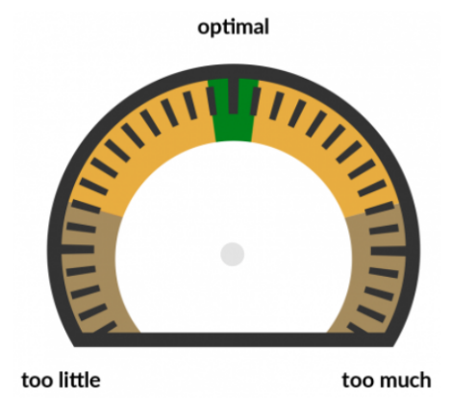
Exercise 42: Strength Regulation Worksheet
The best way to play to your strengths in day-to-day life is to manage the way we use them mindfully because sometimes, overplaying or underplaying a strength can lead to problems. Take, for example, your best friend asking you whether you think her wedding dress is pretty moments before she walks down the aisle. At this moment, if you happened to dislike the dress, overplaying your strength “honesty” could have dire consequences. You, as well as your best friend, would benefit most from regulating your ‘honesty’ at this moment. Like the volume knob on a stereo, playing to your strengths can be dialed-up or dialed-down for the best result in a given situation. In the strength regulation worksheet, you choose a personal strength and explore the consequences of overplaying and underplaying it in a particular context. You will explore what it would be like to use this strength in an optimal way. Let’s try:
Step 1
Select a strength
First, select a personal strength for this exercise. You might like to choose one of your strengths that you wish to use more of or that you know you tend to underuse or overuse in your life (honesty, creativity, perseverance, assertiveness, curiosity, logic, thrifty etc.).
My strength to focus on :_________________________________
Step 2
Overplaying the strength
Can you think of an example when you overplayed this strength?
What did you do (i.e., what did overplaying this strength look like)?
What were the consequences?
In the dial on the right draw an arrow to indicate the extent to which you were overusing your strength
Part 8: Element 6 - The Sails

Slide 114
Describe the example below
Step 3
Overplaying the strength
Can you think of an example when you underplayed this strength?
What did you do, what did underplaying this strength look like?
What were the consequences?
In the dial on the right draw an arrow to indicate the extent to which you were overusing your strength in this situation
Describe the example below
Part 8: Element 6 - The Sails

Slide 115
Step 4
Optimal use of the strength
Can you think of an example when you used this strength optimally?
What does the optimal use of this strength look like?
What was/would be the outcome?
Step 5
Reflection
Do you tend to misuse this strength in your day-to-day life?
Is it your tendency to overuse or underuse it?
What triggers you to misuse this strength?
What could you do to use this strength more optimally in the future?
Part 8: Element 6 - The Sails

Slide 116

Green
Exercise 43: Job Crafting – a non-threatening way to change your job
Job crafting is something that you decide to do, in order to change aspects of your current job, so that it suits you better. There are four basic steps:
Decide what you want to change
Look for a win-win solution
Put the changes into practice, and
Make sure they become a habit
An important element of successful job crafting is that it's you who takes the initiative: you don't need to wait for your manager or supervisor to give you instructions. The benefits from crafting your job include boosting results, increasing enjoyment, building skills and increasing your general ability to cope with your work. Job crafting may seem like a simple idea, but what makes it really powerful is that it allows you to increase the control you have over your own professional life, while "wowing" your employer at the same time. Practically any job can be crafted to some extent, and you can start whenever you want, without necessarily consulting managers or having to wait for their approval.
Job crafting doesn't involve any actual changes in the content of your work, but it will add to your enjoyment of your work. The benefits of job crafting can include: Giving you greater enjoyment from what you do at work. Helping you approach your work with more energy and enthusiasm. Encouraging real personal development by improving skills. And of course, perfecting the skill of job crafting can, in itself, lead to career enhancement opportunities. So how do you do this? Follow these four steps:
Part 8: Element 6 - The Sails

Slide 117
Decide what you want to change
Step 1
You can make changes in one or more of the following areas to craft the way you work, so that it's closer to your "ideal" job.
Task content: This involves improving the way that things are done, using skills that you already have; or using your knowledge to change working methods, so that you can generate better results. In short, it's about creating opportunities to play to your strengths.
Relationships: Here, you might look for ways to have more satisfying interactions with other people during the course of your work each day, for example you might volunteer to mentor new hires, or join new initiatives and/or groups at work.
Purpose: You can also redefine your existing work to reflect what you see as being the real impact of what you do at work. For example, a programmer working in the IT department of an airline could reframe his or her work from "writing code" to "helping people enjoy trouble-free travel."
Evaluate how the change will impact you
and your work environment
Step 2
Next, assess the potential impact of these possible changes on your wider work environment. Take into account your clients, your colleagues, your supervisor or manager, and the organization as a whole. Remember that effective job crafting depends on finding a win-win solution. For example, you may have significant experience in using your organization's internal accounting system. You could volunteer to train new-hires on the system, or provide updates on system changes for your colleagues. What you get out this could be simple enjoyment because you enjoy teaching people things, or a boost to your own self-esteem, or more interaction with people from other departments. What your organization gets from this is a better-trained, more effective workforce. Avoid any temptation to turn a job crafting exercise into a win-lose situation.
Part 8: Element 6 - The Sails

Slide 118
For example, if you dislike having meetings with your supervisor, you might be tempted to craft your job so that you spend more time in the test lab, where she's less likely to find you! You might achieve your short-term goal of avoiding these meetings, but the overall impact may well be negative. So make sure you're heading for a mutually beneficial outcome, or at least that your job crafting is compatible with your work environment. If this isn't the case, go back to Step 1, and see if other job crafting changes might work better! If you have any managerial responsibilities, you need to take them into account when you consider any job crafting. When you have a number of other people to supervise, even small changes in how you work can have significant effects on the people who depend on you.
Things I will do / change
Part 8: Element 6 - The Sails

Slide 119
Act to put positive change in place
Step 3
At this stage, the key is to get rid of any symptom of what is called - learned helplessness - the phenomenon whereby people have become so used to indifference to their contributions that they believe that no matter what they do, nothing will come of it. Job crafting gives you the chance to turn this situation around. By refocusing your job in this way, you decide what's going to make you feel better valued and more productive, and you decide to make the necessary changes. The only condition is that your decisions must have positive outcomes for your organization, as mentioned in Step 2.
Initial reflection – first reactions
Check on progress, adjust and continue
Step 4
Having gone through Steps 1, 2 and 3 above, it's time to put your job crafting into practice, check that it gives you what you want; ensure that your boss and clients are happy with what's going on; and make sure that it really is compatible with your wider work environment. If everything checks out, and you feel good about what's happening, you can let your changes become a habit.
Part 8: Element 6 - The Sails

Slide 120
Reflection – what did you do and how did it make you feel?
Tip 1
You can always ask your manager's opinion about how you're crafting your job. But don't wait for, or expect, managerial input or approval before you start. In job crafting, you take the initiative!
Tip 2
Don't expect to be able to redefine your job completely. After all, your employer wanted someone to carry out your duties, and you accepted that when you were hired! Make absolutely sure that, within your recrafted job, you're fully meeting the objectives you've been set.
Tip 3
For pointers on how you might set about job crafting, compare notes with other colleagues who are appreciated at work and who clearly enjoy their jobs. By categorizing their experiences according to the list in Step 1, you may uncover some interesting ideas, and so find out what might also work for you.
Part 8: Element 6 - The Sails

Slide 121
Journal Entry: My Strengths
This is space to write down new insights, aha moments and reflections. Some things you might want to write are: your insight into core strengths and how you are using them and will use them in the future. What do you need to do to use your strengths more often?
--------------------------------------------------------------------------------------------------------------------------------------------------------------------------------------------------------------------------------------------------------------------------------------------------------------------------------------------------------------------------------------------------------------------------------------------------------------------------------------------------------------------------------------------------------------------------------------------------------------------------------------------------------------------------------------------------------------------------------------------------------------------------------------------------------------------------------------------------------------------------------------------------------------------------------------------------------------------------------------------------------------------------------------------------------------------------------------------------------------------------------------------------------------------------------------------------------------------------------------------------------------------------------------------------------------------------------------------------------------------------------------------------------------------------------------------------------------------------------------------------------------------------------------------------------------------------------------------------------------------------------------------------------------------------------------------------------------------------------------------------------------------------------------------------------------------------------------------------------------------------------------------------------------------------------------------------------------------------------
Part 8: Element 6 - The Sails

Slide 122
Part 9: Element 7 – Other Boats, Your
Social Relationships
Relationships are represented by other captains and their boats, as a captain you will see some boats many times, why travel in a similar direction, while others you only see once. In the same way some people are present in our life for a long time, and fulfil a central role with daily interaction, while contact with others is limited. During a captain’s journey, the water is shared with numerous other captains and their boats. Some of these boats may pass the captain’s boat shortly while others may travel alongside the boat for many miles. With some captains, the captain has a positive, constructive relationship. These captains greatly contribute to the pleasantness of the journey and offer support during difficult weather or situations. In contrast, other captains may prevent the captain from sailing in a valued direction
Exercise 44: Social Support Analysis
Increase awareness of your or your partners social environment strengths. The insights that result from this exercise can be used to help cope with difficulties and realize goals.
STEP 1: Analyze your supportive social network
Identify which people in your social network provide environmental strengths by offering emotional, instrumental, informational, and/or companionship support. The four types of support are listed below, including a description of each type and possible questions that can be used to identify people in your network who offer each type of support.
On the social network analysis form, use Table 1, “social support network analysis,” to list the names of people who can offer one or more types of support.
A. Emotional support
Emotional support refers to the people in your social network who offer empathy, concern, affection, love, trust, acceptance, intimacy, encouragement, or caring. They provide warmth and nurturance and let you know that you are valued.
Part 9: Element 7 – Other Boats

Slide 123
With whom can you share your most private worries and fears?
With whom can you be yourself?
Who is genuinely interested in you?
When you feel lonely, who can you talk to?
Who do you feel appreciates you as a person?
Who can you count on to help you feel more relaxed when you are under pressure or tense?
Who will comfort you when you need it by holding you in their arms?
Who accepts you totally, including both your worst and your best aspects?
Who can you count on to listen openly and uncritically to your innermost feelings?
Who do you feel truly loves you?
Who can you count on to care about you, regardless of what is happening to you?
B. Information support
Informational support refers to the people who provide advice, guidance, suggestions, or useful information to you. The information they provide can help you solve your problem or reach your goal.
Who can you turn to for advice about handling problems?
Who can you turn to for advice about how to reach your current goals?
Who can you count on to give you useful suggestions that help you avoid making mistakes?
Who may share useful insights that can help you reach your goals? This might, for example, be a person who has already reached this goal.
C. Instrumental support
Instrumental support refers to the people who provide financial assistance, material goods, or services. This form of social support encompasses the concrete, direct ways in which these people assist you. To achieve your goal or solve your problem, you may need to take care of some practical things. For instance, you may need a ride to the hospital or need help fixing your computer, or you may need financial assistance to realize a plan.
Part 9: Element 7 – Other Boats

Slide 124
Who can you turn to for help with these practical issues?
Consider the practical issues that you find difficult or burdensome to do yourself.
Who can help you with this?
D. Companionship support
Companionship support refers to the people who give you a sense of social belonging. These people are your companions: you can engage with them in shared social activities.
Who do you enjoy spending time with?
Who are the people with whom you (regularly) go out and do things?
Who are the people you can have fun with?
Who do you share a passion or interest with?
Who are the people who enjoy the same things you do?
STEP 2: Link the four types of supportive relationships to personal goals
Think of a goal that you are trying to reach. Which of the four types of support is/are considered most helpful in the pursuit of this goal? Who are the people that are able to provide this type of support? How might they assist in realizing your desired changes?
Example: your goal is to start your own business.
Aspect of the goal / problem | Type of support needed | Who can help me with this? | How can she / he help me?
I tend to get stressed easily | Emotional support | Brother | My brother is calm and emotionally stable. I can call him or visit him when stressed
I don’t feel I am well informed about the financial risks of running a company | Informational support | Marianna Silsbee | She has been running her own company for years. She can tell me she managed the financial risks.
Part 9: Element 7 – Other Boats

Slide 125
STEP 3: Actively involving your social network
Now look at Table 2. Discuss what concrete steps you can take to involve these people more actively in order to deal more effectively to reach your goal. List these concrete action steps in the social network analysis form. The following questions may help you generate these action steps:
Which elements of the problem/goal are most compelling for you to address?
What would help making the first step easier?
--------------------------------------------------------------------------------------------------------------------------------------------------------------------------------------------------------------------------------------------------------------------------------------------------------------------------------------------------------------------------------------------------------------------------------------------------------------------------------------------------------------------------------------------------------------------------------------------------------------------------------------------------------------------------------------------------------------------------------------------------------------------------------------------------------------------------------------------------------------------------------------------------------------------------------------------------------------------------------------------------------------------------------------------------------------------------------------------------------------------------------------------------------------------------------------------------------------------------------------------------------------------------------------------------------------------------------------------------------------------------------------------------------------------------------------------------------------------------------------------------------------------------------------------------------------------------------------------------------------------------------------------------------------------------------------------------------------------------------------------------------------------------------------------------------------------------------------------------------------------------------------------------------------------------------------------------------------------------------
Part 9: Element 7 – Other Boats

Slide 126
Social Network Analysis Form
Goal Description:
------------------------------------------------------------------------------------------------------------------------------------------------------------------------------------------------------------------------
Table 1: Social support network analysis
A. Emotional Support (People who provide love and care)
B. Informational Support (People who provide information and advice needed to solve problems or reach goals)
C. Instrumental Support (People who provide financial assistance, material goods or services)
D. Companionship Support (People who engage in shared social activities)
Part 9: Element 7 – Other Boats

Slide 127
Table 2: Contributions of the social network to the resolution of the problem or the achievement of the goal
Goal aspect | Support needed | Who can help? | Hoe can they help?
Action steps
The following action steps will be taken to actively involve my social network to help me resolve my problem/reach my goal:
1.
2.
3.
4.
5.
6.
7.
8.
Part 9: Element 7 – Other Boats

Slide 128

Exercise 45:
Ending Friendships That
No Longer Work
Step 1
Understanding friendships and why they end
All relationships have their ups and downs, and while no relationship is perfect, friendships should generally make life better. Nevertheless, what happens when you feel like a friendship is no longer working for you? We often find ourselves connected to others by circumstances such as school, work, or having children. However, as our circumstances change throughout life, we discover that we no longer have the same common connections that were once so strong. Even if you have been friends with someone for a long time, sometimes friendships fade and fizzle out as people gradually drift apart or no longer put the same effort and care into the relationship.
Friendships end for various reasons, and sometimes for no reason at all. In many cases, we instinctively know that we have outgrown a friendship. Maybe there was a distinct turning point or, on the contrary, a slow build. Perhaps you no longer share common goals or enjoy each other’s company. Realizing that friendship is no longer working, regardless of why, is a completely normal part of life. While you have no obligation to maintain an unsatisfying friendship, the decision to end it can be a difficult one to make. However, when the main connection between two people is memories of times gone by, you may have to choose to remain friends or let go.
Part 9: Element 7 – Other Boats

Slide 129
Step 2
Recognizing a friendship that is no longer working
It can be easy to overlook the signs of an unsatisfying friendship, and so this step will help you recognize some common signs that a friendship is no longer working. Below you will find a list of characteristics that are often present in unhealthy friendships. Take some time to look at the list and think about the relationship in question, placing a tick beside each statement you feel describes this particular friendship.
- You no longer enjoy spending time with
them
- They are judgmental about your choices
- They only want to meet up when
convenient for them
- They mostly talk about themselves
- You no longer have common interests
- You feel manipulated
- You feel obliged to spend time with
them
- You dread checking your phone
- They are jealous and/or controlling
- You feel used
- You feel like they do not listen to you
- They are dismissive of your feelings
- You do not know why you are friends
with them
- They do not respect your boundaries
- They only initiate contact when they
need something
- You dread the thought of meeting up
- You cannot depend on their advice
- You cannot trust them with a secret
- You feel emotionally drained in their
presence
- You cannot turn to them for emotional
support
- They do not support you or congratulate
you on your achievements
- You feel pressured to do things you do not
want to
- They are unreliable
- You do not like yourself when you are with
them
- They discourage you from your goals
- They often cancel the plans you make
together
- They gossip about you behind your back
- You often want to cancel the plans you make
with them
- You have little to talk about
- They put you down
- They behave in ways that make you
uncomfortable
- They take more than they give You feel
down after spending time together
- You find it difficult to relax and be yourself
around them
Part 9: Element 7 – Other Boats

Slide 130
Step 3
Validate your choice
Recognizing that a friendship has run its course can be difficult. It is, therefore, helpful to reflect on the relationship in question and identify the specific reasons you feel it will be beneficial for you to end it. Take some time to think about this friendship and answer the following questions honestly, paying close attention to any emotions or sensations you experience as you complete this step.
Think about your friendship as it stands right now. What five words would you use to describe the time you spend together?
1
2
3
4
5
If you met each other for the first time today, do you think you would be friends? Why?
Describe in detail how you feel while spending time with this friend.
Do you feel better or worse after spending time with this friend? Describe in detail how you feel after spending time together.
Part 9: Element 7 – Other Boats

Slide 131
What are your reasons for maintaining this friendship?
Describe in as much detail as possible what you think is missing from this friendship.
What are the main benefits of ending this friendship?
Using your responses to the questions above, complete section two of the break-up plan (Appendix A), labelled: ‘Why we should break-up.’
Part 9: Element 7 – Other Boats

Slide 132

Step 4
The break-up action
Now that you have spent some time reflecting on the friendship in question, it is time to decide your next course of action. Detailed below are three healthy approaches to ending a friendship. You may prefer to use a combination of these strategies as you complete your break-up plan.
Ending a friendship can be difficult and may cause uncomfortable feelings, but you should remember that you have made this choice for a reason. Remember, at one time, this person meant a lot to you; therefore, it is important to be respectful and attempt to end the friendship gracefully. If you have decided that ending this friendship is the best option, take your time to plan and handle the situation appropriately and compassionately.
Option 1: Let the friendship fade out
If you do not see any way to resolve issues, you may find it easier to allow the friendship to fade out. More often than not, friendships end due to people gradually growing apart: if the friendship has run its course, then let it fade away. This does not mean you should immediately end all contact; rather, you should let the friendship come to a natural end by gradually reducing social interactions. For instance, if you are in contact once each week, reduce this to once every two to three weeks.
The gradual fading out of a friendship may help avoid confrontations and potential hurt feelings. Rather than laying your feelings on the line, you appear too busy to spend time together and generally hard to reach, and, over time, the friendship fades away.
Part 9: Element 7 – Other Boats

Slide 133
Option 2: Take a break from the friendship
Rather than immediately ending the friendship, you might decide that taking a break from the friendship provides an opportunity to calm down if you are upset and gives you time to re-evaluate the friendship in a less pressured way. It is beneficial to inform them that you will not be in contact for a while. You can give any number of reasons for taking a break, for example, ‘I have so much going on at the moment and won’t be able to stay in touch for a few weeks.’
Option 3: Have ‘the talk.’
If you would rather be upfront about ending the friendship, having a direct conversation to clear the air maybe your preferred course of action. This approach involves sitting down in a mutually agreed location and letting them know that the friendship is over and why. While this is probably the most difficult way to end a friendship, it will give you both the opportunity to discuss your thoughts and feelings openly.
Perhaps you might begin with a statement like, “I’ve noticed some patterns in our friendship recently that have been bothering me. I wondered if we could talk about it.” Try to talk about how you feel, but do not use this conversation as an opportunity to assign blame. It is important to be gentle and compassionate: there is a real possibility that the other person might react negatively, and you should be prepared to hear him/her out in return.
Part 9: Element 7 – Other Boats

Slide 134

Exercise 46:
Managing Toxic Relationship
Considering the significant effect
that negative relationships can have
on well-being, this tool helps to
identify whether any of your close
relationships are toxic in this way, and
offers guidance on how to manage such negative, toxic relationships.
Instructions
All too often, we hang on to relationships that do not serve us. For whatever reason, we put the relationship or the other person before ourselves or our well-being. In this exercise, we will have a look at some of your difficult close personal relationships and work out whether it is in your best interest to continue having these people in your life.
STEP 1: Identify difficult personal relationships
Make a list of up to 5 personal relationships that you find challenging. In Table 1 below, in the left column, write down the person’s name. In the second column, describe your relationship (e.g., stepmother).
Part 9: Element 7 – Other Boats

Slide 135
Table 1. My toxic relationships
Name | Relationship | Reasons for toxicity
STEP 2: Identify why the relationship is toxic
Consider what makes each of the above relationships toxic. You might like to use one of the list below or come up with your own. For each relationship, come up with as many reasons or examples as you can think of, and write these down in the third column of Table 1.
This person makes me feel unsafe
Being around this person is emotionally distressing for me
I feel nervous and on guard when I am around this person
This person is manipulative or conniving
I have felt this person push moral, ethical, or legal boundaries
I feel as though this person adds unnecessary challenges to my life
I feel emotionally drained after dealing with this person
I feel obliged to spend time with this person
I feel bad about myself when I am with this person
I do not want to spend time together
Within this relationship, I give far more than I get in return
My needs take a back seat to the needs of this person
I do not feel listened to nor cared about in this relationship
This person does not have many (if any) of the qualities I look for in a friend
I feel like I am walking on eggshells when I am around this person
I am unhappy with the way this person treats me or talks to me
Other
Part 9: Element 7 – Other Boats

Slide 136
STEP 3: Choose a relationship to focus on
Consider the relationship that is most toxic for you at this point in your life. That is, which of the above-mentioned relationships is causing you the most stress at the moment? Write down this person’s name in the space below:
Name:
STEP 4: In what ways do you devote time and energy to this
person/relationship?
We devote time and energy to our relationships both directly (through physical contact and communication) and indirectly (through thinking about the relationship and reacting emotionally to it). In the space below, write down how you, directly and indirectly, invest in this person/relationship.
Direct: time and energy spent emailing, talking on the phone, messaging/texting, talking face-to-face, physical contact, and so on.
Indirect: time and energy spent thinking about and/or feeling upset (or other negative emotions) over the person/relationship.
Part 9: Element 7 – Other Boats

Slide 137
STEP 5: What does this relationship cost you?
Now consider what you are missing out on because of the amount of time and energy you spend on this relationship. Common costs include: missing out on some sleep, quality time with family, difficulty concentrating on work or study, less time available to spend with friends and loved ones, financial costs like, meals out, phone bills, feeling physically drained, lack of sleep, feeling jealous, having negative emotions like resentment, sense of injustice, lack of presence/mindfulness, increased negativity bias, lack of gratitude, less time and energy to exercise or engage in other self-care. Come up with as many costs as you can think of, and do not hold back! You need to identify just how much this relationship is interfering with your life and your well-being.
Part 9: Element 7 – Other Boats

Slide 138
STEP 6:: Decide how to best manage this relationship
Ask yourself, what is the best action forward concerning this negative relationship in your life? You can take several actions to manage this relationship. You could:
a. Do nothing
This means the relationship will stay the same; you will likely continue to feel the way you feel now, as well as miss out on those things that the relationship costs you.
b. Take a step back
Reducing the amount of direct contact you have with this person - take fewer phone calls, catching up less frequently, reducing the degree of indirect influence, spend less time thinking or agonizing about the relationship, learn to manage your emotional reactivity. This option is about setting healthy boundaries to put yourself and your well-being first.
c. Leave
This option involves ending the relationship, meaning that you will no longer invest in this relationship at all. At this moment, which option is most feasible for you? Why?
STEP 7: Take action
What steps can you take to follow through on your decision regarding this relationship (Step 6)? To help with this, look back on how you, directly and indirectly, invest in this person/relationship (Step 4), and for each of these, come up with at least one actionable step. For example, if you have decided to take a step back from the relationship (Option 2, Step 6), and you are currently spending one evening every week catching up with this person, an actionable step could be to meet with this person once a month to catch up. In the space below, write down every possible thing that you could do to follow through your decision regarding this relationship.
Part 9: Element 7 – Other Boats

Slide 139
Exercise 47: Asking for Support
Instructions
The goal of this exercise is to help you to expand your social capital by paying attention to the four main components of high-quality relationships: quantity, strength, intensity, and density of social connections. This tool works especially well for people who believe they lack support from others in times of need. This tool helps to examine these beliefs and compare them with actual support.
Step 1
List the most important people in your social network.
Think of the most important people that you consider to be part of your social network. These can be “virtual” online connections and real-life connections. The main thing to remember is that these are the people you consider important enough to be part of your social network. List them below.
Close Friends
Romantic Relationships
Friendly co-workers
Family members
Neighbours
Sports teams
Professional Organizations
Other (please specify)
Part 9: Element 7 – Other Boats

Slide 140
Step 2
Analyzing relationship quantity
The ideal number of connections is highly personal - what counts as “enough” for you person might not be the same for someone else. Some people prefer to have a large social network, while others are happy with a few close relationships.
The following questions and statements are related to the number of social connections you have in your network. Please answer as honestly as possible, there are no right or wrong answers. Consider the people you listed in step 1, and answer the following questions:
1a. Do you feel you do not have enough connections?
1b. If so, what do you consider to be a reason for this?
1c. What do you consider to be the consequences of having too few connections?
1d. What steps can be taken to increase your number of connections?
2a. Do you feel you have too many connections?
2b. If so, what do you consider to be a reason for this?
2c. What do you consider to be the consequences of having too many connections?
2d. What steps could you take to decrease the number of connections?
Part 9: Element 7 – Other Boats

Slide 141

Step 3
Analyzing relationship strength
The strength of social connections is the extent to which the people in your network provide you with support, affection, and a sense of closeness. People with strong social bonds tend to spend more time together and are more likely to help others in their network. The following questions are about the strength of your social connections. Please answer as honestly as possible, there are no right or wrong answers.
Consider the people you listed in step 2. Who are the people you feel most strongly connected with? These are the people you trust, who appreciate you and who you would turn to if you needed support. Simply put, these are the people you feel closest to.
Do you feel you have enough strong connections?
If not, what do you consider to be a reason for this?
If not, what actions can you take to strengthen your connection with others?
Part 9: Element 7 – Other Boats

Slide 142
Step 4
Analyzing relationship intensity
The intensity of social connections is about how often you and other members of your network interact with each other. You may find that you spend more time with people who offer little in return while committing less time to those you value most. When this happens, your connections can become weakened. The following questions are related to the intensity of your social connections. Please answer as honestly as possible, there are no right or wrong answers. As you complete the questions, think about the people in your network who you feel most connected to.
1. Who are the people in your network that you spend the most time with?
2a. Are there people in your network that you currently do not spend a lot of time with, but you would like to spend more time with? If so, who?
2b. If so, what do you consider to be a reason for not spending enough time with them?
2c. What could you do to spend more time with them?
3a. Are there people in your network that you currently spend a lot of time with that you would like to reduce?
3b. If so, what do you consider to be a reason for spending too much time with them?
3c. What could you do to spend less time with them?
Part 9: Element 7 – Other Boats

Slide 143
Step 5
Analyzing relationship density
The density of social connections is all about how each person in your network is connected to you and also to each other. The more people in your social network who know and interact with one another, the stronger your network will be. Put simply, the connections you have in common with others are the glue that holds social networks together.
An added benefit of having common connections is that it is much easier to spend time with multiple people at once. When people in your network are already connected to each other, meeting up as a group rather than meeting individually is much more likely. The following questions are about how members of your social network are connected to one another. Please answer as honestly as possible; there are no right or wrong answers. Consider the people you listed in step 2, and please answer the following questions:
1. On a scale of 1 to 10 - How would you rate your network? In other words, how strong is the “glue” in your social network? (1 means that none of your social connections know or interact with each other and 10 means that all of your social connections know or interact with each other)
Network Density Score: _____
2a. Would you like the people in your network to be more connected, so that they would know each other better?
2b. If so, what could be the benefits of the people in your network being more connected with each other?
3. What could you do to increase the connection among your network members?
Part 9: Element 7 – Other Boats

Slide 144
Step 6
Overall Evaluation
Looking back at all the four elements answer the following questions:
How would you rate your social capital?
If you feel you could increase your capital, which element(s) need(s) attention?
What is the smallest step that you can take this week to increase your social capital?
Part 9: Element 7 – Other Boats

Slide 145

Exercise 48: Evaluating Beliefs about Romantic Relationships
We all have beliefs about relationships. We get these ideas from the media or stories around us. We learn them by witnessing the relationships of our parents or caregivers as well as other role models throughout our lives. Romantic movies portray a very idealized image of romantic relationships, love and happy endings. We seldom see how prince charming deals with having kids, juggle multiple careers, handle their moody manager or tackle any of the other many life challenges and how eternal love evolves in those circumstances. We grow up with an idea about how love should be, and once we develop a relationship with a partner our picture does not match this idealized image. Being single can also be one of the factors that keep us from connecting deeply with someone, if that is our goal. This exercise is intended to help you explore and uncover what unconscious or conscious beliefs or “myths” you may be holding about relationships and explore the effects of holding these beliefs on your life and your wellbeing. The goal is to help you see that you have more control over your feelings and your satisfaction in your relationship than you may believe you do.
Part 9: Element 7 – Other Boats

Slide 146
Identify a challenging aspect of your relationship
Step 1
Think of a challenging aspect of your current relationship. This can be something that causes frequent arguments between you and your partner or something that causes you a lot of stress and worry or any other form of discomfort in your relationship. If you are single, this can be something that frustrates you or challenges your current circumstance. Examples of common issues that arise in relationships:
I do all the work around the house
We don’t have enough sex
My partner and I don’t agree on this core value
I can’t seem to meet a nice partner
I constantly compare my relationship to others around me
I’m worried I will be single forever
Love should be easy; we fight or disagree too much
Take a moment to write one challenging aspect under “Challenging aspect of my relationship” in the worksheet.
Identify the actions you take in response to this aspect
Step 2
What can you do about the challenging situation? How do you currently deal with this issue? What actions do you take? Examples of common responses:
I avoid my partner
I overcompensate and try to do everything they want
I constantly go on first dates but cannot seem to get past that problem
I fight with my partner frequently
I keep a mental “tally” of the things I do and those that my partner does
I put a lot of effort into trying to influence or change my partner
Take some time to write down your actions under “How do you respond?” column in the worksheet.
Part 9: Element 7 – Other Boats

Slide 147
Identify the feelings present
Step 3
Describe any feelings you have as a result of this aspect. Examples of common feelings:
Dissatisfaction
Fear of failure
Anger
Frustration
Fear of abandonment
Write down your feelings under “What feelings are present” column in the worksheet.
Identify the beliefs about this challenge
Step 4
We all hold beliefs about how things should be. Are there any beliefs you hold about the aspect that you have chosen? Take a moment to explore any beliefs you may have about this challenging aspect or this aspect in relationships in general. This can be a tricky step. A good indicator that we have a belief is that we use the word “should” when thinking of it.
Examples of common beliefs:
A healthy relationship means we should have a lot of sex.
We should be passionately in love with one another throughout the whole relationship
Once I find my perfect partner, I will feel whole.
If I cannot find a perfect partner, maybe there is something wrong with me.
If I cannot find a perfect partner, maybe there is something wrong with everyone else.
If my partner is attracted to someone else, then this must mean they do not love me.
Men and women cannot agree on this issue.
We should not fight as much as we do, maybe it means we are not “meant” for each other.
Write down your beliefs in the “Beliefs you hold” column of the worksheet.
Part 9: Element 7 – Other Boats

Slide 148
Is this belief helpful?
Step 5
Regardless of whether the beliefs you mentioned in step 4 are true or not, how helpful is this belief in helping you feel good? On a scale from 0 to 10, where 0 represents not helpful at all and 10 indicates very helpful, rate each belief in terms of how helpful it is in allowing you to feel better about this challenging aspect of your relationship. Rate each belief in the column on the worksheet.
Consider how you would like to feel?
Step 6
Imagine that this issue is no longer a problem, or it magically resolved or fixed. How would you feel? What kinds of feelings would you like to experience instead of the ones you listed in step 3?
Examples:
Satisfied
At peace/content
Grateful
Appreciative
Appreciated
Acceptance
Write down the feelings you would like to have in the “How you would feel” column of the worksheet.
Helpful alternatives beliefs
Step 7
For each belief you listed in step 4, come up with an alternative, more helpful, and positive belief. What belief would help you to achieve the feelings you listed in step 5? These beliefs should be reasonable, and you should be able to identify with them. Examples:
Part 9: Element 7 – Other Boats

Slide 149
Examples:
Original belief: If I can’t find the perfect partner, maybe there is something wrong with me.
Alternative: I may not find a perfect partner, but if I’m honest, I’m not perfect myself. But that’s okay, maybe I can love someone because they are imperfect, like me.
Write these alternative beliefs in the “Alternative beliefs” column of the worksheet.
Possible alternative consequences
Step 8
If you could magically replace your original beliefs about this issue with these positive alternatives, what do you think the consequences would be? Examples:
I might feel more secure in my relationship.
I might be able to look past people’s immediate flaws and go on consecutive dates, building something deeper and long-lasting.
I might have more time to develop myself rather than focusing on my frustrations with my relationship.
I might feel more pride rather than shame.
In the “alternative consequences column of the worksheet, take some time to reflect on and write down how your actions might change.
Reflection and debrief
Step 9
Now that you have taken some time to untangle some of your feelings and beliefs about a chosen issue in your relationship, how do you feel about it? Take some time to reflect on this experience using the questions below as a suggested guideline:
How did doing this exercise make you feel?
What did you notice about your feelings or initial beliefs about your selected issue?
Did your beliefs or feelings change while completing this exercise?
What parts of this exercise felt challenging or difficult?
What aspects of this activity surprised you?
What reactions do you have when looking at your “consequences” section? How might you respond to your belief or myth about relationships now when you encounter it in your life?
Part 9: Element 7 – Other Boats

Slide 150
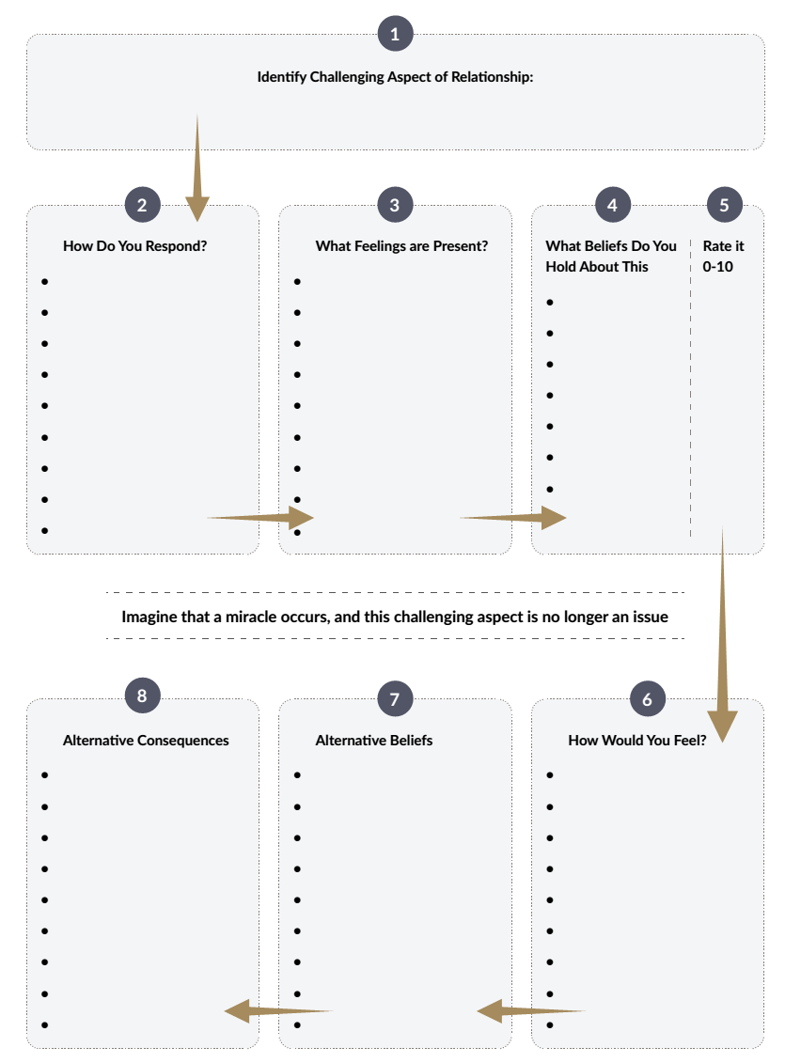
Part 9: Element 7 – Other Boats

Slide 151
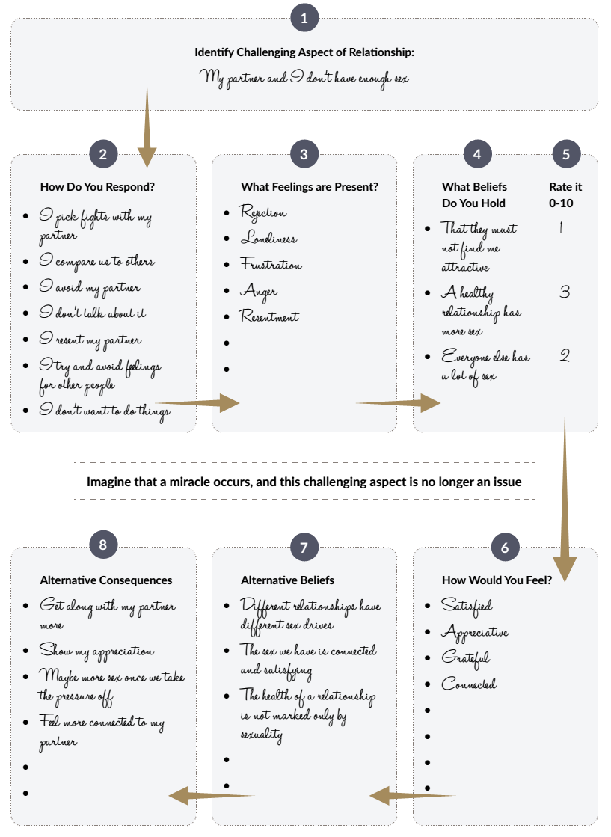
Part 9: Element 7 – Other Boats

Slide 152

Green
Exercise 49: Apologizing Effectively
The goal of this exercise is to assist in making an effective apology. The elements described in this exercise are likely to create an effective apology because they satisfy the psychological needs of the offended person. It is a good idea to practice this with your partner and provide feedback to each other on the nature and perceived effectiveness of the apology. You can choose to apologize face to face or in written form, both types have their own advantages and disadvantages.
Instructions
Follow the structure offered to create an affective apology.
Step 1. Acknowledge
Acknowledge the offense and take responsibility. Show the other person that you recognize:
1. Who was responsible
“I’m sorry, I made a mistake” (using the pronoun “I” is important here)
2. Who was harmed
“I realize that I hurt you...”
3. The nature of the offense
“… by making that insensitive joke”
Part 9: Element 7 – Other Boats

Slide 153
Green
Note that this is in sharp contrast with the way apologies are often made:
A. Failing to allocate responsibility
“Yes, mistakes were made”
B. Vague statements about who was hurt
“I see that some people may feel offended”
C. Failing to acknowledge the specific offense
“... by whatever I said”
Step 2. Provide an explanation
Provide an explanation for the offense that makes clear that:
1. It was not your intention to hurt the other person
“It was never my intention to hurt you and make you feel this way”
2. It will not happen again
“I will do everything to net let this happen again”
It is important to note that explanations should not sound like excuses (“I was really busy and had a tough day at my work”). Many excuses come across as shallow defenses and can be counterproductive. Also, explanations should not sound like attempts to blame the victim (“I just could no longer stand the way you were acting”).
Part 9: Element 7 – Other Boats

Slide 154
Green
Step 3. Express remorse
When hurting someone, it is common to feel shame, embarrassment, regret humiliation, or remorse. By expressing these feelings, you communicate to the victim that you recognize your mistake and the suffering it caused (“I feel really badly about what happened. For days I have felt embarrassed about how I let you down”).
Step 4. Make amends
An effective apology reflects an effort to repair the damage done. It is important to first ask the offended person what a possible reparation may look like before engaging in actions to restore the relationship or to alleviate personal feelings of guilt. Reparation of damage may include compensation for lost resources (financial) or behavioral actions (e.g. being more honest).
------------------------------------------------------------------------------------------------------------------------------------------------------------------------------------------------------------------------------------------------------------------------------------------------------------------------------------------------------------------------------------------------------------------------------------------------------------------------------------------------------------------------------------------------------------------------------------------------------------------------------------------------------------------------------------------------------------------------------------------------------------------------------------------------------------------------------------------------------------------
Part 9: Element 7 – Other Boats

Slide 155
Exercise 50: Eight Steps to Forgiveness
Helping others learn how to forgive those who have hurt them is a valuable undertaking. Holding onto interpersonal resentment has a significant and lasting impact on our wellbeing. Each time we are reminded of wrongdoing by a person in our life, negative thoughts and feelings arise, which impact mood, personal relationships, and daily functioning. Process-based forgiveness exercises are effective in increasing forgiveness and decreasing negative psychological effects. This tool offers an eight-step process-based guide to forgive those who have hurt or betrayed us. These eight steps were developed by renowned forgiveness researcher, Dr. Robert Enright, who recommends that you move through them at your own pace.
Step 1
Make a list of people to forgive
Make a list of people who have hurt you or betrayed you in your life. This hurt or betrayal must be enough to warrant the effort to forgive. So, for instance, a partner cheating on you or a close friend spreading vicious gossip about you would likely warrant the effort to forgive, whereas the supermarket clerk ignoring your attempt to make small talk would not. Once you have your list of people, rate your level of hurt associated with each person on a scale of 1 to 10, with 1 being the least pain and 10 being the most pain.
Name | Rating (10/10)
Part 9: Element 7 – Other Boats

Slide 156
Step 2
Describe the impact of betrayal
Starting with the person who has caused you the least pain, describe a time where this person hurt or betrayed you in the space below. Allow yourself to feel any difficult emotions that come up as you do this.
How did this person negatively impact your life? What psychological / physical harm did it cause?
How has your view of the world, and of people generally, changed as a result of this incident?
Part 9: Element 7 – Other Boats

Slide 157

Step 3
Consider the other person’s pain points
Have a think about this person’s life prior to hurting you. What was life like for them while growing up? In what way have they been hurt or betrayed themselves? Could these wounds have made them more likely to hurt you? What kinds of extra pressures or stresses were happening in this person’s life at the time he or she betrayed you? These are this person’s pain points; those areas that make him or her vulnerable and human. Awareness of these pain points may help you understand why or how this person could have humiliated you. Write down as may pain points as you can think of in the space below.
Part 9: Element 7 – Other Boats

Slide 158
Step 4
Welcome the feeling of compassion
Become aware of any slight change in your heart toward this person as a result of Step 3. Often times when we consider that which makes a person vulnerable, we feel a sense of compassion for their pain, even when they have unjustly caused us pain. It is less likely that this person acted entirely maliciously and more likely that he or she was confused, misguided, or even mistaken. He or she may deeply regret his or her actions. If you notice a feeling of compassion, welcome it and allow it to arise.
Step 5
Own your pain
See if you can bear the pain that this person has caused you so that you do not end up projecting that pain back onto the person who betrayed you. We must realize that our pain is ours to work through, and should not be thrown back onto others.
Part 9: Element 7 – Other Boats

Slide 159
Step 6
Decide to forgive
It is now time to decisively forgive this person. Make the decision to forgive this person, understanding that to forgive is to extend mercy toward him or her; that is, to offer kindness, compassion, warmth, and generosity in order to reduce your feelings of resentment. Remember that forgiveness does not mean that you are excusing this person’s actions or tossing justice aside; forgiveness and justice can be practiced together. In the space below, state your forgiveness by saying something along the lines of “I choose to forgive X.”
Step 7
A gift of forgiveness
Offer the person who hurt you a gesture of your forgiveness. This does not need to be a physical gift; a smile, a returned text, or a good word about him or her to others, would suffice. In the space below, write down at least one thing that you would feel comfortable offering the person you are forgiving.
Part 9: Element 7 – Other Boats

Slide 160
Journal Entry: My Relationships
This is space to write down new insights, aha moments and reflections. Some things you might want to write are: your insight into your social connections and relationships. Are you intending to make changes? In what way, what will you do?
--------------------------------------------------------------------------------------------------------------------------------------------------------------------------------------------------------------------------------------------------------------------------------------------------------------------------------------------------------------------------------------------------------------------------------------------------------------------------------------------------------------------------------------------------------------------------------------------------------------------------------------------------------------------------------------------------------------------------------------------------------------------------------------------------------------------------------------------------------------------------------------------------------------------------------------------------------------------------------------------------------------------------------------------------------------------------------------------------------------------------------------------------------------------------------------------------------------------------------------------------------------------------------------------------------------------------------------------------------------------------------------------------------------------------------------------------------------------------------------------------------------------------------------------------------------------------------------------------------------------------------------------------------------------------------------------------------------------------------------------------------------------------------------------------------------------------------------------------------------------------------------------------------------------------------------------------------------------------------
Part 9: Element 7 – Other Boats

Slide 161

Part 10: Element 8 – The Weather, Your
Uncontrollable Events
At sea the weather can change quickly and change everything. Just like the weather, events in life are external, constantly changing and sometimes extremely challenging. Sometimes, the captain faces storms and heavy rain that make it very difficult to sail. Other times, the sun is shining, and the sea is quiet, making it relatively easy for the captain to navigate and enjoy the journey. How we deal with positive and negative life events is called resilience. A person with a high level of resilience is like a captain who is able to ride out a storm at sea, by handling the boat effectively, adjusting quickly to the changing weather. Although the storm may initially cause the boat to divert from its intended direction, the captain is able to adjust the sails, take charge of the boat and guide it back to its original course. A resilient captain knows how to immerse himself in the positivity of good weather, which gives him the strength to deal with upcoming challenges. A resilient person can quickly bounce back from adversity and positively adapts to the demands of the new situation.
Exercise 51: Measuring Your Resilience
The Brief Resilience Scale - assesses the original and most basic meaning of the word resilience. The root of the English word “resilience” is the word “resile,” which means “to bounce or spring back” In line with this definition, this scale assesses the ability to bounce back or recover from stress. The scale was developed to assess a unitary construct of resilience, including both positively and negatively worded items. Higher scores on the scale are negatively related to anxiety, depression, negative affect, and physical symptoms.
Part 10: Element 8 – The Weather

Slide 162
Instructions
Under rating indicate how much you agree/disagree with each of the statements, using the following scale:
1. Strongly Disagree, 2. Disagree, 3. Neutral, 4. Agree, 5. Strongly Agree
Statement | Rating 1 to 5 | Score 1 to 5
I tend to bounce back quickly after hard times.
I have a hard time making it through stressful events.
It does not take me long to recover from a stressful event.
It is hard for me to snap back when something bad happens.
I usually come through difficult times with little trouble.
I tend to take a long time to get over setbacks in my life.
TOTAL
Scoring:
Note that items 2, 4, and 6 are negatively worded. The scores for these need to be reversed. For questions 1, 3, and 5: Score is 1 for Strongly Disagree, 2 for Disagree, 3 for Neutral, 4 for Agree, 5 for Strongly Agree.
For questions 2, 4, and 6 Score is 5 for Strongly Disagree, 4 for Disagree, 3 for Neutral for 2 for Agree, 1 for Strongly Agree.
Add the scores for all six items and divide the total by 6 to get the Brief Resilience Scale score.
Interpretation
Low resilience: 1.00-2.99
Normal resilience: 3.00-4.30
High resilience: 4.31-5.00
Part 10: Element 8 – The Weather

Slide 163

How will you increase your resilience?
Part 10: Element 8 – The Weather

Slide 164
Exercise 52: The Cycle of Thoughts and Emotions
Sometimes we get stuck in a negative cycle of feeling and thinking. Imagine you receive a bad evaluation (situation). An immediate result of this news is a feeling of sadness or frustration (feeling or emotion). We tend to automatically start thinking about the feeling (“This is no good, I don’t want this, this must stop”) or the situation (“How could this ever happen?”) or the self (“Maybe I am just not good enough”). These thoughts cause feelings or emotions, which can lead to thoughts again, and in this way, we can get caught in a cycle of thinking and feeling. We lose awareness of what is happening: we are caught in a game of feelings and thoughts. This exercise can be used to become aware of this negative cycle.
You can do this exercise daily and just keep notes to report what you experience. Although it is possible to complete the exercise at the end of the day, it is better to complete the exercise in real-time because the dynamics of the thought-feeling cycle are captured better.
Instructions
List your thoughts, indicate whether they are positive or negative, and list the emotion or feeling that emerged due to these thoughts. The worksheet below can be used daily to report emotions and thoughts. Discuss the experiences and what you learned from this exercise with your partner at the end of one week.
What was the thought? | Positive or Negative | Feeling or Emotion experiences as a result of the thought
Part 10: Element 8 – The Weather

Slide 165
Exercise 53: Walking Down the Street
The ability to observe allows individuals to take a step back and realize there is a difference between an event and the thoughts that the event triggers. This awareness creates room for choice between stimulus and response and allows the individual to cope with the situation more effectively and intentionally. The goal of this exercise is to let you experience how thoughts shape and trigger feelings. By becoming aware of this causal relationship and observing thoughts, a negative cycle of thinking and feeling can be prevented.
Instructions
List your thoughts, indicate whether they are positive or negative, and list the emotion or feeling that emerged due to these thoughts. The worksheet below can be used daily to report emotions and thoughts. Discuss the experiences and what you learned from this exercise with your partner at the end of one week.
Step 1: Imagining a scenario
Sit comfortably and try to imagine the following scenario as vividly as possible: “Imagine strolling along a street that you know well. As you look up, you notice that there is someone you know on the other side of the road. You smile and wave; however, the person does not respond. The person continues to walk without giving you the slightest reaction.”
Step 2: Review the exercise
As you were imagining, did you notice any of your thoughts? As you were imagining, did you notice any of your emotions? It can sometimes be challenging to differentiate between our thoughts and emotions as they can play off each other quite rapidly. Share the results with your partner.
Part 10: Element 8 – The Weather

Slide 166
Below are some sample thoughts and emotions that may have occurred during this exercise:
Thoughts | Emotions
I was not even noticed… what did I do to upset her? | Worried
Why did that happen? | Intrigued
How rude, she clearly saw me – well be that way! | Anger
He must not like me all that much | Sadness
He is probably in a rush -I hope he makes it on time | Concerned
Step 3: Discuss
Which of the above thoughts and emotions do you most relate to?
Are there any thoughts and emotions you would add?
How helpful was this exercise for you?
What might you do next with your actions as a result of those thoughts/feelings?
Part 10: Element 8 – The Weather

Slide 167
Exercise 54: Benefit Finding
The goal of this exercise is to create awareness of the possible benefits of challenging life events. This explicit focus on the positive characteristics of negative life events can help boost resilience. When doing this as pairs each of you will be asked to recall a traumatic life event. Be extra attentive during the exercise since for most thinking of a difficult event will trigger negative thoughts and/or feelings. The exercise works best when the event that is chosen lies far enough in the past to allow time to also consider positive aspects, like personal growth, renewed friendship, and so on. Be aware that benefit finding may not work for everyone.
Instructions
Step 1:
Describe about a traumatic event (e.g., loss, severe physical injury, etc.) in as much detail as possible for a few minutes. Try to freely express any and all emotions and thoughts you have about the experience.
Step 2:
Now focus on the positive aspects of the experience. Below are some questions to help guide you.
How has the experience changed you?
What has the experience taught you?
How has the experience made you better equipped to meet similar challenges in the future?
How do you feel that this experience has made you grow as a person?
Part 10: Element 8 – The Weather

Slide 168

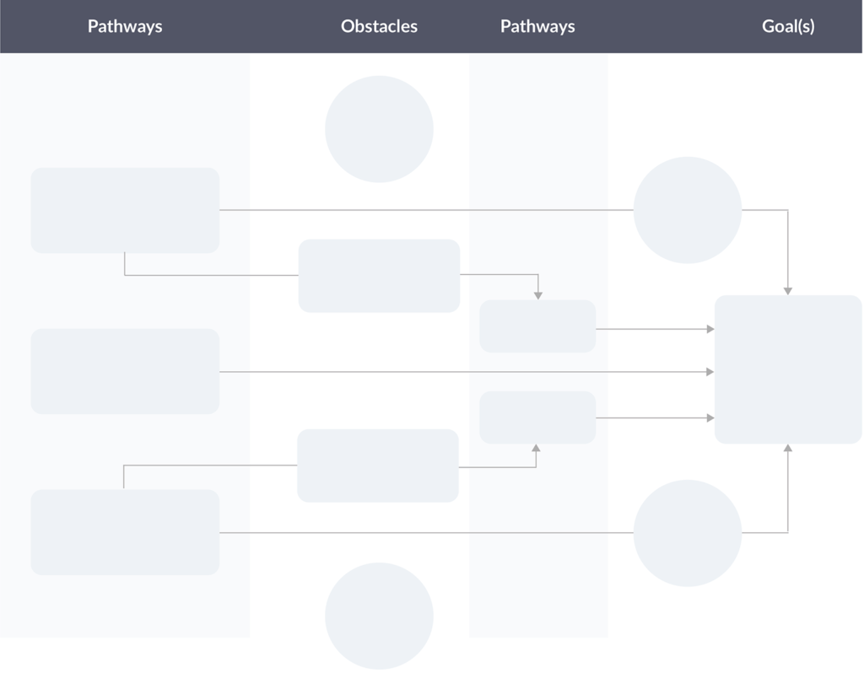
Exercise 55: Map of Hope
This exercise is designed to teach ‘pathway thinking’ to help unlock your motivating energy of hope. Hope works because it broadens our thinking and fuels our persistence. This activity helps to articulate your high expectations for the future and develop a clear-eyed view of the obstacles you will need to overcome to get there.
Instructions:
To complete the following procedure, us the drawing below or create a mind map.
Part 10: Element 8 – The Weather

Slide 169
STEP 1: Goal setting
Determine a clear and exciting vision of a goal that you would like to achieve. Write your goal in the big box displayed in the last column of the Hope Map.
STEP 2: Goal setting
In column 1 - Write down several actions, pathways, or steps you will take to pursue the goal. Use one action per box.
STEP 3: Identifying obstacles
In column 1 - Write down several actions, pathways, or steps you will take to pursue the goal. Use one action per box.
STEP 4: Overcoming obstacles
Moving back to the Pathways section, review your existing pathways, including strategies to overcome the obstacle identified. In column 3 write the new pathways or building additional steps to your existing pathways. For any new pathways identified, repeat Steps 3 and 4 to overcome any obstacles that will block your progress.
STEP 5: Ideas for maintaining motivation
In the circles around the edges of the page, write down ideas for maintaining your energy and motivation while you move toward the goal box along the selected pathways. Be particularly mindful of the situations and obstacles that are likely to sap your willpower and be sure to come up with ideas for countering those challenges.
Part 10: Element 8 – The Weather

Slide 170
Reflection
Review your almost completed hope map several times. Determine which pathway you will commence first, understanding that you have to pursue various strategies to achieve your identified goal.
Finally, take a few minutes to imagine what it would look like to pursue and reach your goal. Once you have a vivid image of reaching the goal in your mind, mentally rehearse all the steps you need to take to get there in real life, creating a sense of energy and excitement to commence the first step on your journey to your goal.
Part 10: Element 8 – The Weather

Slide 171
Exercise 55: The Best Possible Self
The Best Possible Self (BPS) exercise is a popular exercise to change your mindset and increase optimism. It requires people to envision themselves in an imaginary future in which everything has turned out in the most optimal way. This exercise has repeatedly shown to increase people’s mood and well-being, as well as increasing optimism in terms of expecting favorable outcomes.
Instructions
Set a timer or stopwatch for 10 minutes. During this time, think about your best possible future self and write it down on paper. Imagine your life the way you always imagined it would be. Imagine that you have performed to the best of your abilities and achieved all the things you wanted to in life. While writing, do not worry about grammar or punctuation. Just focus on writing all your thoughts and emotions in an expressive way. You may want to have several sheets of paper for this exercise.
Reflection
After completing the initial exercise, reflect on your feelings. Answer the following questions:
What effects did this exercise have?
How did this exercise affect you emotionally?
How did this exercise affect your current self-image?
Did this exercise motivate or inspire you?
How did this exercise affect you overall?
How did this exercise open you to possibilities?
Part 10: Element 8 – The Weather

Slide 172
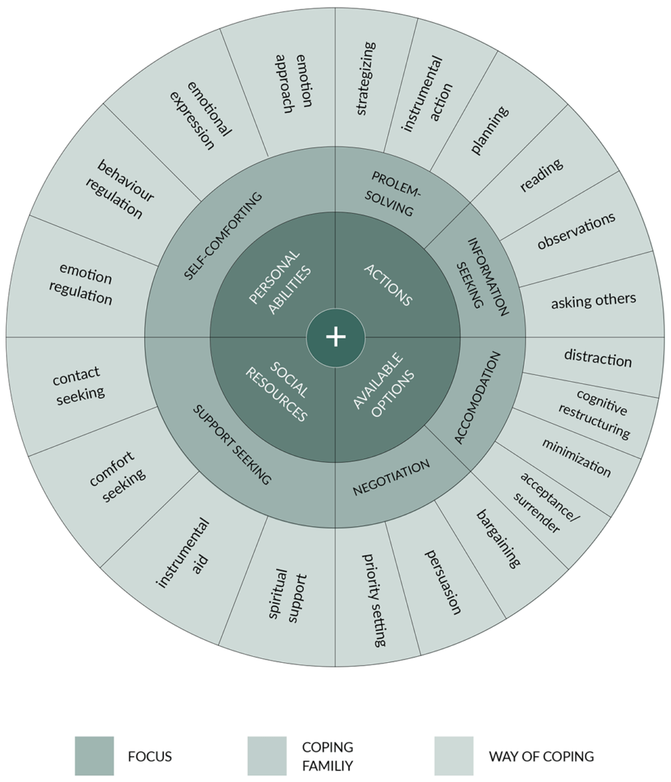
Exercise 56: The Coping Strategy Wheels
The goal of this tool is to provide a clear categorization of the most commonly used coping strategies. The categorization presented here can be used to detect your unhelpful coping strategies and introduce more effective alternatives.
Instructions
Understanding the coping wheels. The next two figures displayed below provide an overview of 41 common ways of coping (outer rim of the wheel) and the twelve families to which these coping strategies belong (the second rim of the wheel). The green picture below shows helpful, adaptive coping styles while the red one shows not helpful maladaptive styles.
Part 10: Element 8 – The Weather

Slide 173
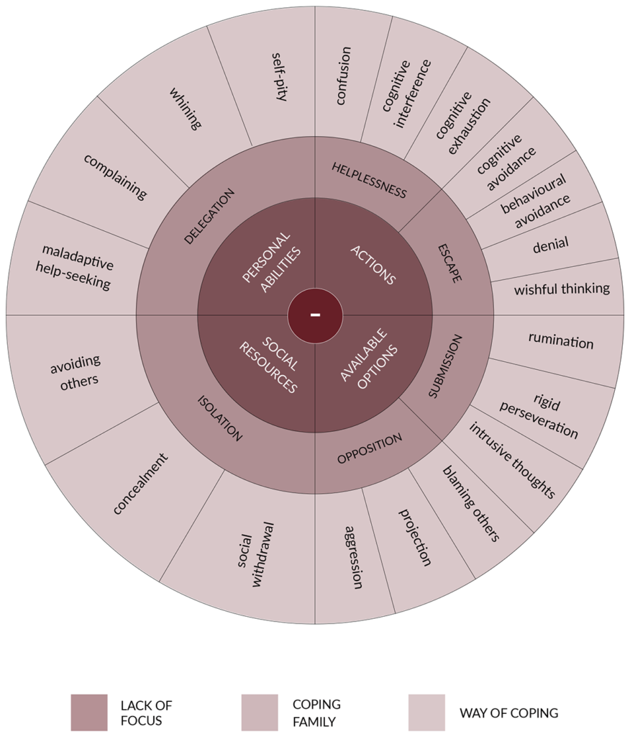
The red picture below shows not helpful maladaptive coping styles.
The green wheel can be seen as the opposite of the right wheel. For instance, while the coping strategies in the green wheel with the focus on “personal abilities” all involve a form of self-reliance, the coping strategies in the red wheel with this focus all involve a form of delegation, the opposite of self-reliance.
Part 10: Element 8 – The Weather

Slide 174
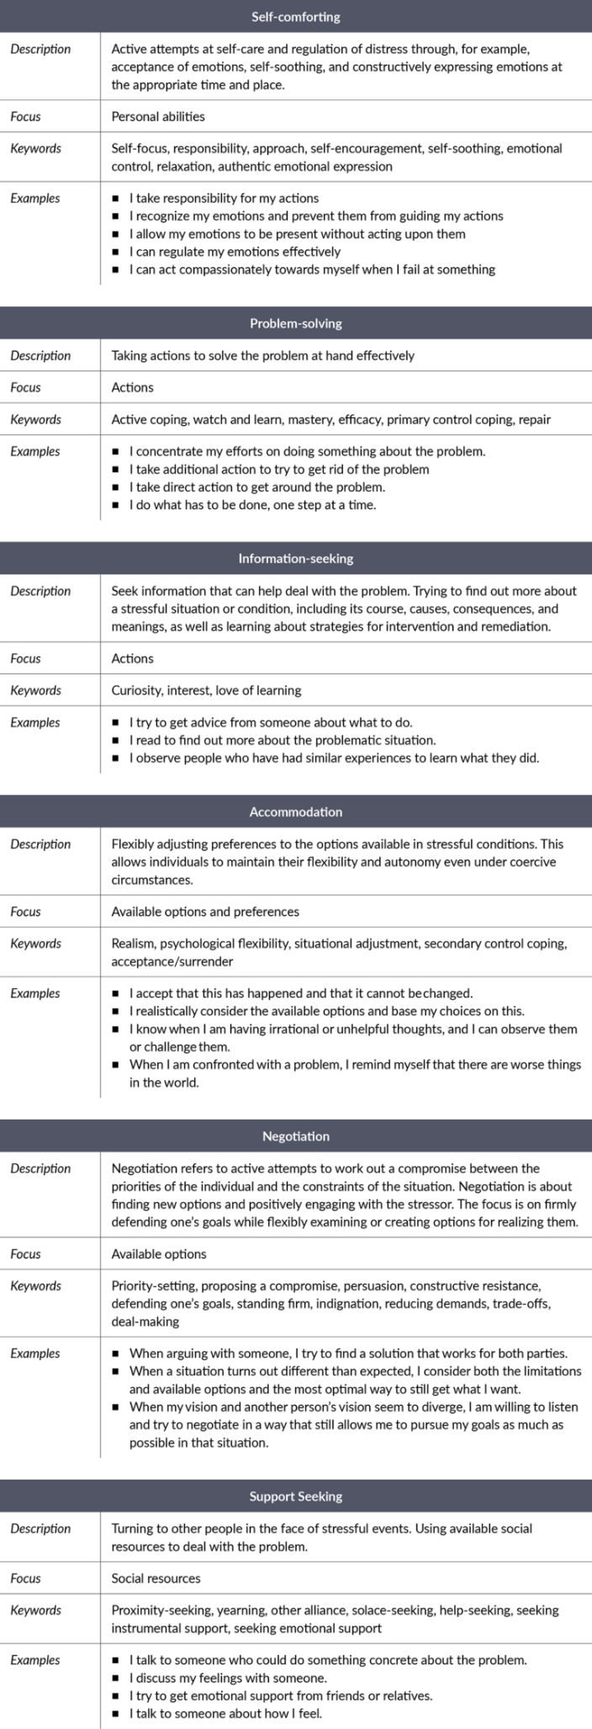
This means that when you are using an unhelpful coping strategy that is listed under one of the four quadrants of the red wheel, you may consider the same quadrant of the green wheel to see which of the strategies listed under this quadrant may be considered a healthier alternative. For instance, if you are using rigid perseveration (continuing to exert control despite a lack of result) as a coping strategy. This maladaptive coping strategy falls under the “available options” focus, belonging to the “under-control/over-control” coping family. By looking up the adaptive coping family that is shown at the same location in the green wheel, in this case, “accommodation,” you may consider the coping strategies listed under this family. For instance, it may be more adaptive to surrender to uncontrollable circumstances rather than to persist.
When doing so, it is important to realize that changing an ineffective coping strategy to the polar opposite might be very hard and requires a process rather than a “quick fix,” a considerable amount of time may be required to make the shift effectively and allow learning to internalize the new coping behaviors.
See below the key descriptions of the six adaptive and six non-adaptive coping families.
Part 10: Element 8 – The Weather

Slide 175
Part 10: Element 8 – The Weather

Slide 176
Part 10: Element 8 – The Weather

Slide 177
Journal Entry: My Uncontrollable Events
This is space to write down new insights, aha moments and reflections. Some things you might want to write are: your insight into your uncontrollable environment, your resilience and how these events affect you. What do you need to do to improve your resilience?
--------------------------------------------------------------------------------------------------------------------------------------------------------------------------------------------------------------------------------------------------------------------------------------------------------------------------------------------------------------------------------------------------------------------------------------------------------------------------------------------------------------------------------------------------------------------------------------------------------------------------------------------------------------------------------------------------------------------------------------------------------------------------------------------------------------------------------------------------------------------------------------------------------------------------------------------------------------------------------------------------------------------------------------------------------------------------------------------------------------------------------------------------------------------------------------------------------------------------------------------------------------------------------------------------------------------------------------------------------------------------------------------------------------------------------------------------------------------------------------------------------------------------------------------------------------------------------------------------------------------------------------------------------------------------------------------------------------------------------------------------------------------------------------------------------------------------------------------------------------------------------------------------------------------------------------------------------------------------------
Part 10: Element 8 – The Weather

Slide 178

Part 11: Element 9 – Your Destination,
Goals and Motives
Every journey has an intended destination. A good captain will prepare a passage plan, what ports to visit on the way to the final destination and what ports to shelter if the weather suddenly changes. Captains differ in this approach. In the same way people differ greatly in their ability to plan and look ahead. While some people live their life with a clear vision and plan towards the future, others wander through life almost aimlessly. Decades of research shows how much the types of goals people set matter. Some goals are better for people’s mental health, personal growth, and wellbeing than others, because they better express a person’s underlying interests, values, talents, needs, and motives.
Setting goals affect performance through three key mechanisms. First, goals help the individual focus and direct attention and effort toward goal-related activities and away from goal-irrelevant activities. Second, goals have an energizing function. Setting a goal creates a sense of urgency, motivating people to make an effort to move towards the desired situation. Third, goals increase learning, pursuing a new goal, often involves gaining new insights, gather new information, and learn to apply new strategies.
Part 11: Element 9 – Your Destination

Slide 179
Exercise 57: The Miracle Question
The goal of this exercise is for you to connect with your strengths and cope with a problem you are facing. The exercise is an effective tool because it can help you set goals even when you are in crisis and feel stuck. You will be asked to close your eyes and vividly imagine yourself thinking, feeling, and behaving in ways that would demonstrate that you were resolving your problems. This exercise consists of several steps. After completing each step, write what you imagined. When asked to identify specific things or actions that you would be doing, describe concrete, observable, and detailed behaviors. Like, rather than saying, “I will be friendly,” describe it as “I will be smiling, saying hello, and shaking hands.” Always construct an image/picture on your part. Do not describe things that you would not do like “I will not frown or look angry”.
Step 1
Identifying a recurring problem
Identify and write down a recent recurring problem that you would like to overcome: something you would like to do, stop doing or avoid or avoid doing.
Write down a recent recurring problem that you would like to overcome:
Rate the severity of this problem from 0 (non-existent) to 10 (extremely high): ____ /10
Step 2
Describing the problem
Describe what you would do, what behaviors you would show in an ideal situation that would resolve the issue. So, if the problem is procrastination describe what no longer procrastinating would look like, as if it were a video – what would you do instead of procrastinating.
Part 11: Element 9 – Your Destination

Slide 180
Step 3
The miracle
Imagine a miracle happened tonight while you were sleeping, and this miracle solved your problem. Since you were sleeping, you didn’t know this miracle had occurred, and when you woke up, you realized that you no longer had your problem. What would be the first small sign (specific observable behavior) that would show you were doing something different the next day? Construct an image / picture of a behavioral action on your part.
Step 4
Identify who would notice this different thing you would be doing and describe how you imagine they would act when they notice this different behavior. Construct an image/picture of a behavioral action on their part.
Step 5
Indicate what you would do (specific observable behavior) in reply to the person’s response described above.
Part 11: Element 9 – Your Destination

Slide 181
Step 6
What else would you notice that you would be doing (specific observable behavior) differently after this miracle occurred? Construct an image/picture of a behavioral action on your part.
Step 7
Identify who else would notice this different thing you would be doing and describe how you imagine they would act when they notice this different behavior. Construct an image/picture of a behavioral action on their part.
Step 8
Indicate what you would do in reply to the person’s response described above. Construct an image of a behavioral action on your part. Do not describe something you would not be doing.
Part 11: Element 9 – Your Destination

Slide 182
Step 9
Describe a time when some of this miracle has already happened, even if only a little bit, during problematic times.
Step 10
How did you make this part of your miracle happen during this problematic time? Things you thought or did differently, the commitments you made, new behavior you tried, etc.
Step 11
Recall your thoughts about how pleased you were with your efforts at the time.
Part 11: Element 9 – Your Destination

Slide 183
Step 12
Where do you think you were at that time on the scale? ________/10
Step 13
Describe how did you get yourself to that number? What did you do - behavioral action on your part.
Step 14
Imagine you are going to be even one number lower, what will you and what will others see you do (specific observable behavior) differently that you’re not doing now?
Step 15
Write yourself a short note describing what you discovered or rediscovered about yourself and your situation. You can use the back of this sheet if needed. Rate the severity of this problem from 0 (non-existent) - 10 (extremely high): _______________
Part 11: Element 9 – Your Destination

Slide 184
Exercise 58: Your Performance / Learning Goals Emphasis
The goal of this tool is for you to measure goal orientation in terms of performance.
Learning goals are associated with higher levels of intrinsic motivation, which is, in turn, associated with optimal performance. Learning goals are also associated with diverse positive processes, including greater absorption in actual task performance perception of a complex task as a positive challenge rather than a threat, and enhanced memory and well-being. The Performance Goal Orientation and Learning Goal Orientation Scales are two different scales that aim to assess performance and learning aspects of goal orientation. This five-minute assessment below, will give you an indication which type of learning you prefer or use frequently.
Instructions
Circle one number for each statement to indicate how much you disagree or agree with each of the statements in the next two quick assessment sheets.
 | Strongly Disagree | Disagree | Slightly Disagree | Neither Agree or Disagree | Slightly Agree | Agree | Strongly Agree
 | 1 | 2 | 3 | 4 | 5 | 6 | 7
The opportunity to do challenging work is important to me.
When I fail to complete a difficult task, I plan to try harder the next time I work on it.
I prefer to work on tasks that force me to learn new things.
The opportunity to learn new things is important to me.
I do my best when I’m working on a fairly difficult task
I try hard to improve on my past performance.
The opportunity to extend the range of my abilities is important to me
When I have difficulty solving a problem. I enjoy trying different approaches to see which one will work.
Total Performance Score Orientation: ______ Average Score: Total /8 = ______
Part 11: Element 9 – Your Destination

Slide 185
 | Strongly Disagree | Disagree | Slightly Disagree | Neither Agree or Disagree | Slightly Agree | Agree | Strongly Agree
 | 1 | 2 | 3 | 4 | 5 | 6 | 7
The opportunity to do challenging work is important to me.
When I fail to complete a difficult task, I plan to try harder the next time I work on it.
I prefer to work on tasks that force me to learn new things.
The opportunity to learn new things is important to me.
I do my best when I’m working on a fairly difficult task
I try hard to improve on my past performance.
The opportunity to extend the range of my abilities is important to me
When I have difficulty solving a problem. I enjoy trying different approaches to see which one will work.
Total Learning Score Orientation: ____ Average Score: Total /8 = ______
Which score is higher for you? ___________________________________________________
What does this mean for you? ___________________________________________________
___________________________________________________
___________________________________________________
___________________________________________________
Part 11: Element 9 – Your Destination

Slide 186

Exercise 59:
Moving from Goals to Process
The goal of this tool to experience
the difference between process- and
goal-oriented mind modes, explore how
much time you spend in process-versus goal-oriented modes, and learn how to move from goal-oriented to process-oriented mode when needed.
Instructions
Step 1: Operate from a goal-oriented mode
Drinking a cup of tea or coffee or eat a piece of chocolate/fruit, from a goal-oriented mode. Focus on reaching the end-goal, which is to finish consuming the drink or food. Monitor your level of progress, evaluate where you are at repeatedly and where you need to get to.
Step 2: Operate from a process-oriented mode
Now do the same activity and this time focus on the process. Rather than focus on the goal of finishing the food or drink, remain present and curious, simply allow the experience of eating or drinking to unfold as it will, without any pressure or desire to come to an end and finish the food or drink.
Step 3: Evaluate the experience
What was it like for you to do this with the focus on the goal, during step 1 and how was it different from step 2, with a focus on the present moment, the process? How do you describe the differences between the two modes?
Part 11: Element 9 – Your Destination

Slide 187
Step 4: Debrief
In the goal-oriented mode you are entirely focused on reaching a goal, and what is needed to complete this goal. In the second step the focus is on the present moment, the process, the way to the goal. While a goal-oriented mode can sometimes be necessary, it can also result in negative outcomes, such as stress, because you are constantly noticing that the goal is not achieved yet, and the inability to fully enjoy the activity at hand, and lower performance, because you are not devoting all attention to the activity at hand.
Step 5: Explore typical modes throughout everyday life
Now explore how much time you spend in a process-oriented mode versus a goal-oriented mode in your daily life. Reflect on a typical day and recount which mode of mind you operate from throughout. When waking up, getting dressed, eating breakfast, brushing teeth, and so on. Include all key daily activities, from waking up until falling asleep.
Activity | Mind Mode
Waking Up – morning stretch | Process Mode
Taking a shower | Goal Mode
Part 11: Element 9 – Your Destination

Slide 188
Step 6: Assess the balance of daily process- and goal-oriented focus
Determine whether you spend the majority of your day in a process- or goal-oriented mode of mind (just look at the second column). What causes my focus? How balanced is my focus?
Step 7: Restore the balance of process- and goal-oriented focus
If you feel you spend too much time operating in a goal-oriented rather than process-oriented mode of mind, start to choose to engage in at least one typical goal-oriented activity from a process-oriented mode on a daily basis for the next week, like having a shower each morning. Describe how you will do this – in your journal, like described below.
Example: Morning shower – rather than using this time to think about my to-do list for the day, I will try and be fully aware of and focus on being in the shower, I will notice the temperature, the feel of the water against my skin, the smell of the shampoo and soap, the water pressure, and so on. When I notice my mind wandering to the day ahead, I will do my best to shift attention back to being in the shower.
My intentions for next week
Part 11: Element 9 – Your Destination

Slide 189
Exercise 59: Selection of Goals
The goal of this tool is for you to define and examine your goals, and replace unhelpful or ineffective goal description with better alternatives.
List 5 goals that you are currently pursuing. This can be small goals or large goals, anything that you are aiming to accomplish. Use the form below to list your goals. An example of a completed form is also shown at the end of this exercise.
Your Personal Goals
List your goals
Step 1
GOAL 1
GOAL 2
GOAL 3
GOAL 4
GOAL 5
Part 11: Element 9 – Your Destination

Slide 190
Review the different types of goals
Step 2
Review the different categories of goals, like vague vs specific, long-term vs short-term, etc. Take some time to study the table below.
Dimension | Type of goal | Description | Example
Proximity | Short-term | Can be achieved in the near future | Tomorrow, I will write chapter X.
 | Long-term | Can be achieved in the distant future. | At the end of this year, I have written two books.
Specificity | Clear | Have a clearly defined end-state | I will write 1 chapter.
 | Vague | Are ambiguous in the exact level of performance required to achieve | I will do some writing.
Action Orientation | Approach | Defined as being focused on moving towards a positive outcome | I will finish writing chapter 4
 | Avoidance | These goals are defined as being focused on moving towards a positive outcome | I will try to avoid not finishing chapter 4
Purpose | Learning | Purpose is developing an attribute, such as knowledge or skills | I will complete this course so that I can improve my writing skills.
 | Performance | Purpose is validating personal attributes, such as ability, and seeking positive evaluations of those attributes from others | I will complete this course cum laude so that others will praise me.
Duration of involvement | Process | Require continuous action. | I will write three pages every day
 | End-State | Once achieved, do not require additional action | I will finish writing this book.
Part 11: Element 9 – Your Destination

Slide 191
Goal Analysis
Step 3
Use the five dimensions and classify each of your goals. Are they short-term or long-term? Approach or avoidance? Learning or performance? Use the scoring form to score each goal. If it is hard or impossible to categorize a goal along a certain dimension, you can decide to leave this dimension open. Use the completed form one as an example.
 | Proximity |  | Specificity |  | Action - orientation |  | Purpose |  | Duration of Involvement
 | Short term | Long term | Clear | Vague | Approach | Avoid-ance | Leaning | Perfor-mance | Process | End state
Goal 1
Goal 2
Goal 3
Goal 4
Goal 5
Goal Evaluation
Step 4
Each type of goal has advantages and disadvantages. While some types of goals should be avoided, such as vague goals, other types of goals work best in particular situations or particular combinations. By understanding the pros and cons of the different types of goals, you can formulate goals in a way that is most likely for them to be realized. In this step, you are going to examine step 3 of your goal analysis and determine how effective and helpful each goal is. Look at the example table – it provides an overview of all the benefits and drawbacks of each type of goal, including advice. Use this table to evaluate each of your goals.
After analyzing and evaluating each goal think of reframing the goal description. Are there goals that could be improved? Reframe or combining them with other goals, or maybe even abandoning some goals. Use the form below and briefly describe how you might improve them.
Part 11: Element 9 – Your Destination

Slide 192
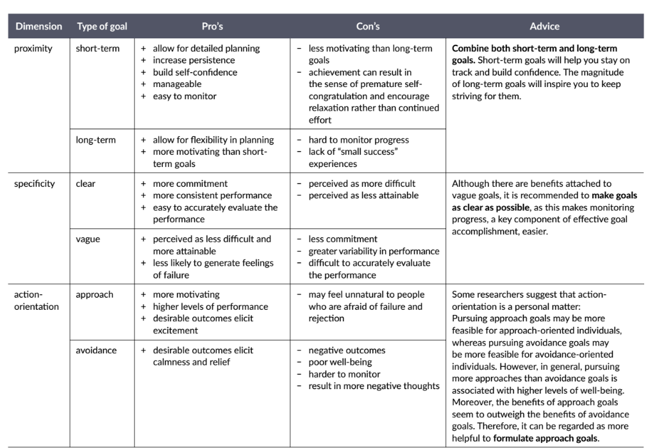
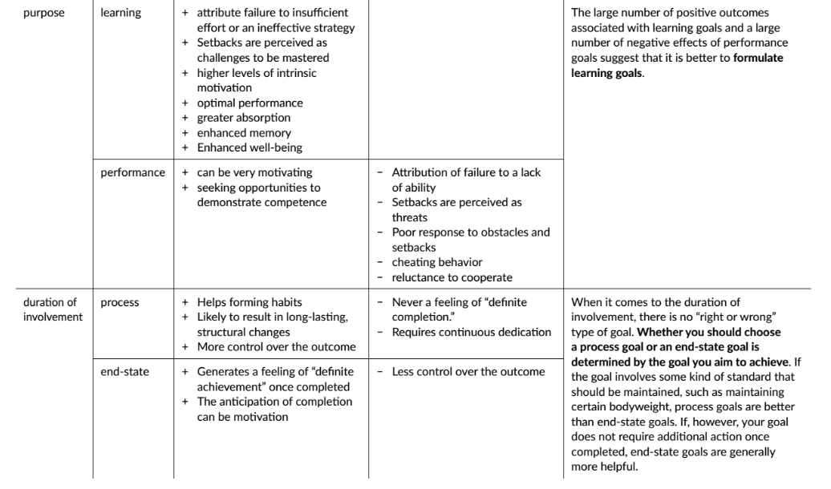
Part 11: Element 9 – Your Destination

Slide 193
GOAL 1
Brief Description:
Could be improved by:
GOAL 2
Brief Description:
Could be improved by:
GOAL 3
Brief Description:
Could be improved by:
GOAL 4
Brief Description:
Could be improved by:
GOAL 5
Brief Description:
Could be improved by:
Part 11: Element 9 – Your Destination

Slide 194

Exercise 60: Developing Self-Efficacy
The goal of this exercise is to help you move closer to your goals by taking small steps. In this way, you can enter and experience a positive spiral of success and growing self-efficacy. All you need to do is take the first small step. Many fail to enter a positive spiral of learning and building confidence simply because they focus on steps that are too big, change too many things at once or try to make too drastic changes in a short time. We all have behaviors that we would like to change. It often takes only a small change to get things moving in a positive direction. In this exercise, you will work towards changing a particular behavior pattern by learning to take small, achievable steps.
Part 1: Preparation
Use the worksheet on the next page. An example of a completed worksheet is also shown.
A. Describe what you would like to change:
Describe something that you would like to change like you might want to start cooking, do more exercise, learn to meditate, read more, quit smoking etc. Write it in the box describe what to change.
Part 11: Element 9 – Your Destination

Slide 195
B. Identify the smallest step in the right direction
Identify a very small step that you could take to help you get just a little bit closer to where you want to be? So, you could start by frying eggs in the morning, walk for just 5 minutes or meditating for only one minute. Try to think of something specific that is not too difficult and can be done in the next few days. Describe in the square underneath the first circle of your Pathway to Change.
C. Plan the step
When, in the next week, could you take the step you described in 1b? Write down this date in the square box under the first step in your Pathway to Change.
Part 2: Action
Use the worksheet on the next page. Track your actions and insights
A. Checkmark Completion
After you have completed your step, place a checkmark in the upper right corner of the square box under step 1 in your Pathway to Change.
B. Next Small Step
Now that you have started, it is important to keep moving! Now, think of another thing that you can do that will help you move a bit closer to where you want to be. Add to the next box and check when completed.
C. Complete the week, ensure only very small steps
Repeat this process for every small step you take, gradually complete more and more steps on your Pathway to Change.
Part 11: Element 9 – Your Destination

Slide 196
Part 3: Reflection
Throughout your pathway to change, reflect on your journey so far. In the pathway to change worksheet, you will find space next to the diamond shapes with the light bulb illustration. Reflect on the following sample questions:
What have I learned about myself?
Can I see that I have what it takes to make changes?
How much do I believe in myself?
How do I feel about myself?
Does this help to become the person I want to be?
Part 11: Element 9 – Your Destination

Slide 197
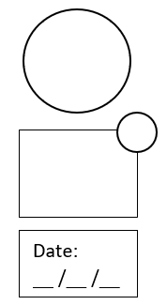
Pathway to Change Worksheet
1
2
3
4
52
10
9
8
7
6
11
12
13
14
15
Part 11: Element 9 – Your Destination

Slide 198
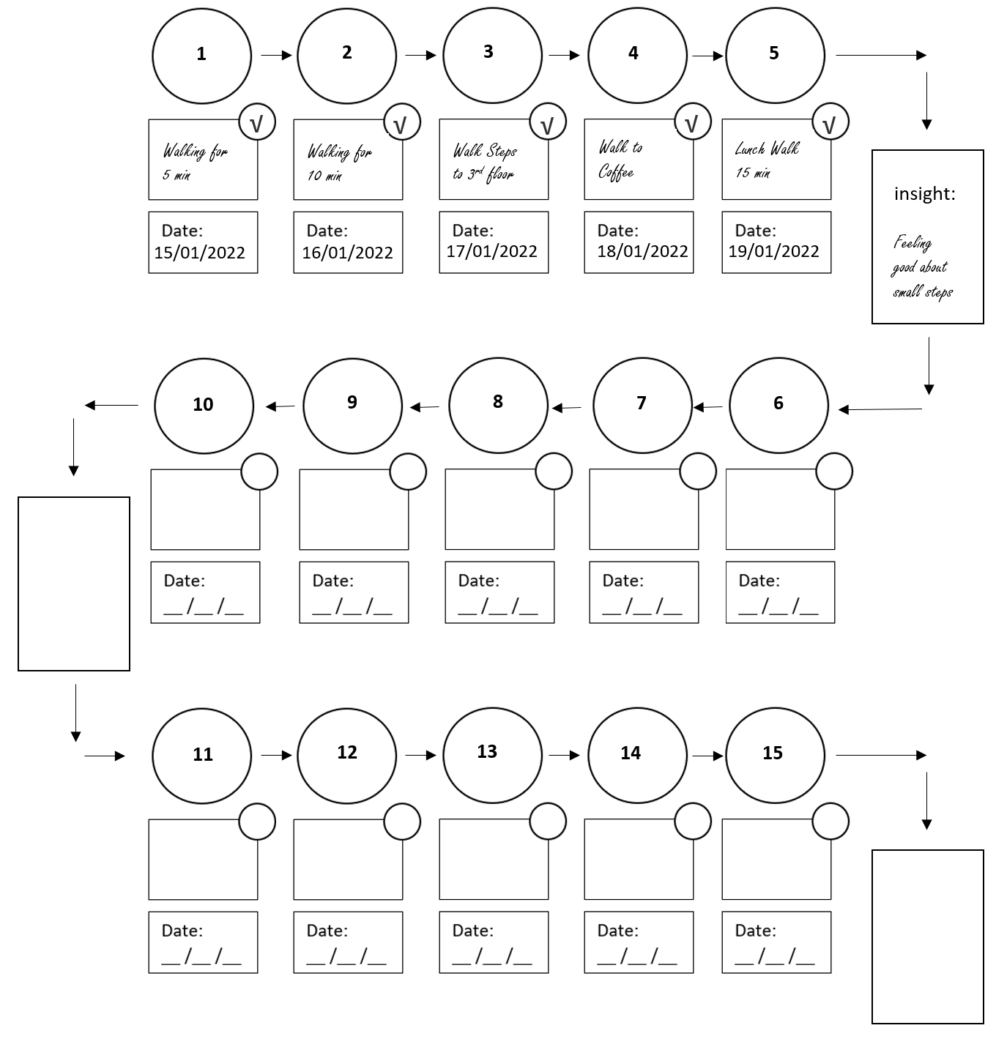
SAMPLE : I want to be someone who is fit and healthy – exercise every day
Part 11: Element 9 – Your Destination

Slide 199

Exercise 61: The Effects of Fear on Goal Achievement
The goal of this exercise is to help you understand and deal with fear-based beliefs for goal achievement and personal growth. It helps to make you aware of fear-based avoidance of goals.
Step 1
Identify a goal
Think of a goal that you would like to reach but are currently not pursuing because you are afraid that you might not successfully reach this goal. Try and think of something that is meaningful for you.
Step 2
Consider the possible outcomes
Look at the table on the next page. As you can see, two dimensions are worth considering when evaluating the possible outcomes of your thoughts and actions.
Part 11: Element 9 – Your Destination

Slide 200
My Belief | Successful | Not Successful
I can achieve this goal, I will try and reach it. | Option 1 An exciting journey as you move in the direction of your goal. Along the way, you develop new skills and experience personal growth. You achieve your goal and feel great! | Option 2 A rewarding journey as you move in the direction of your goal. Along the way, you develop new skills and experience personal growth. Although you feel disappointed that you did not achieve your goal, you do have the satisfaction of knowing you gave it your best shot.
I cannot achieve this goal I will not even start trying to reach the goal. | Option 3 There is no exciting journey, no new skills learned, and no personal growth. No goal is achieved, and you will always wonder whether you were ever able to reach the goal. | Option 4 There is no exciting journey, no new skills learned, and no personal growth. No goal is achieved. The only price you win is that you saved yourself from the disappointment of failure.
Part 11: Element 9 – Your Destination

Slide 201
Step 3
Reflect on the possible options
Take some time to read through the possible options.
Which option appeals most to you?
Why does this option appeal to you?
Consider the following scenario.
Your life is almost over. Someone asks you about the goal you listed in Step 1. Which of these two possible answers appeals most to you?
Option 1: “I wanted to reach this goal, but I was too afraid to try.”
Option 2: “I dared to try to achieve this goal, but I did not reach it.”
Why does this option appeal to you?
What did you learn from this exercise?
Part 11: Element 9 – Your Destination

Slide 202
Exercise 62: Motivation in the ‘Classroom’
The motivation you bring is critical in determining how much and how well you learn. This activity is to assess and reflect on the quality of your motivation to learn.
Instructions:
Look at the questionnaire below and think about why you are here and trying to do well. Rate each of the possible reasons below. You might give high ratings to more than one of the questions since you can have different reasons. (originally used in classrooms)
Please rate the following 5 questions between 1-5:
1 2 3 4 5
Not at all for this reason
Somewhat
Very much for this reason
Question | Rating | Reason
1 |  | I don’t know why. I don’t really have any goals for this course and don’t expect to do very well.
2 |  | Because I have to. Circumstances necessitate it. To get good grades, impress teachers, friends, or parents, or keep my scholarship, I must do well in this course.
3 |  | Because I should. I’d feel guilty if I didn’t do well, and would worry that I was wasting myself or my abilities. Rather than feeling compelled by circumstances to try to do well, I compel myself.
4 |  | Because I want to. I fully agree with the value of this class and do not have to force myself to try to do well. Even at times when the material or exercises are not very interesting, I have no trouble keeping going because I believe in what I am doing.
5 |  | Because I enjoy it. I am interested and engaged while trying to do well. I feel a sense of competence and mastery while doing it, and the sense that I am expanding my understanding of topics that deeply interest me.
Part 11: Element 9 – Your Destination

Slide 203

Exercise 63:
Motivation
Awareness
The goal of this very simple and
short exercise is to increase your
awareness of motivation.
The goal is to become aware of the extent to
which the motivation to perform daily activities is characterized by your autonomy.
Instructions
Take some time to notice what motivates you throughout the day. Notice what factors influence your motivation. What gets you excited? How do you decide what actions to do? This can help you develop motivational awareness. At random times throughout the day, think of your responses to the following three “awareness” questions:
What am I doing?
Why am I doing this?
Where is it taking me?
Part 11: Element 9 – Your Destination

Slide 204
Date:
Activity:
Reflection:
Date:
Activity:
Reflection:
Date:
Activity:
Reflection:
Part 11: Element 9 – Your Destination

Slide 205
Exercise 64: Inspiration in Dealing with Challenges
The goal of this exercise is to help you identify those who inspired you and help you reach your goals.
Instructions:
People who inspire you can be fictitious like a character in a book, someone who is famous or someone you know in real life. Who do you admire and inspires you?
1. Think of one or two people who inspire you.
Person 1
Person 2
2. What specifically inspires you about this person. List at least five reasons per person.
Person #1 inspires me because:
--------------------------------------------------------------------------------------------------------------------------------------------------------------------------------------------------------------------------------------------------------------------------------------------------------------------------------------------------------------------------------------------------------------------------------------------------------------------------------------------------------------------------------------------------
Person #2 inspires me because:
--------------------------------------------------------------------------------------------------------------------------------------------------------------------------------------------------------------------------------------------------------------------------------------------------------------------------------------------------------------------------------------------------------------------------------------------------------------------------------------------------------------------------------------------------
Part 11: Element 9 – Your Destination

Slide 206
3. In the space below, write about a goal that you are currently pursuing.
4. In the space below, write about a challenge or potential challenge that you will try to over.
5. How would the person that inspires you handle and think about your challenge.
Person #1’s perspective on my challenge:
Person #2’s perspective on my challenge:
Part 11: Element 9 – Your Destination

Slide 207
6. Reflect on the questions below and discuss with your partner.
How do others inspire you?
Can their views help change your mindset regarding the challenge you are facing?
What would the people who inspire you say about your mindset and approach regarding the future?
Part 11: Element 9 – Your Destination

Slide 208
Exercise 65: Living in Line with Your Values
The goal of this exercise is to help you identify those who inspired you and help you reach your goals.
The goal of this exercise is to take steps to generate feasible goals that enable you to live in line with your values, translate values into committed actions and live an authentic, purposeful, and intentional life.
Step 1
Choosing a life domain
The domain of life I choose to work on is
Work, Financial, Health, Education, Social, Parenting, Intimate partner, Family, Spiritual, Community, Environment, Leisure, Personal growth, etc.
Step 2
Desired change
Now think of what you would like to change in this domain. Ask yourself: “What would I like to do differently in this area of my life?”.
Step 3
The importance of change
Take a look at the things you wish to change in the life domain. Ask yourself: “Why is it important for me to change these things?” You may list several reasons you would like to change for each thing.
Part 11: Element 9 – Your Destination

Slide 209
Step 4
Connecting change with values
Values are the things we consider to be important in life. “Values are our heart’s deepest desires for the way we want to interact with the world, other people, and ourselves. They’re what we want to stand for in life, how we want to behave, what sort of person we want to be, what sort of strengths and qualities we want to develop.” Some examples of values are creativity, honesty, freedom, authenticity, achievement, adventure, autonomy, balance, beauty, compassion, challenge, competency, curiosity, determination, fairness, fame, relationships, growth, humour, justice, kindness, love, loyalty, leadership, peace, optimism, respect, success, trustworthiness, wisdom, wealth and others.
Now consider the reasons you provided for the desired change. Try to translate these reasons into values. For example, you have chosen to work on the life domain “intimate partner.” You decide that you need to spend more quality time together because you love your partner, you like spending time with him/her, and spending more time with him/her would create a more healthy balance between work and private life. The values underlying these reasons maybe love, positive experiences, and work/private-life balance,
Example:
Domain to change: My Partner (intimate relationship)
Things I would like to change in this domain | Why is this important to me? | Underlying Value
Spend more “quality time” with my partner | I love her; she is important to me I like spending time with her It creates more balance between private life and work | Love Positive Experiences Work/private-life balance
Part 11: Element 9 – Your Destination

Slide 210
Step 5
Goal-setting advice
In the next step, you will set some concrete goals for the future. Before continuing to the next step, please read the guidelines below. These guidelines will help you set proper goals. Use a SMART acronym for goal setting here. Goals need to be: S = Specific, M = Meaningful, A = Adaptive, R = Realistic, T= Time-framed
S Specific | Create both short-term and long-term goals. Long-term goals are more abstract, fuzzy visions of the future. An example of a long-term goal is: “I will spend more time with my kids.” Short-term goals, on the other hand, are more direct and concrete compared to long-term goals. Short-term goals specify actions you will take, when and where you will do so, and who or what is involved. This is a short-term goal: “I will take the kids to the park on Saturday afternoon to play baseball.”
M Meaningful | Your values should genuinely guide the goal instead of following a rigid rule, trying to please others, or avoiding some pain. Make sure the goal has a sense of meaning or purpose.
A Adaptive | The goal should not be formulated as a movement away from an undesirable state. For example, “I will be less stressed about work.” Avoidance goals do not provide a specific outcome target. Instead, the goal should be formulated as a movement toward a specific state or objective - “I will enjoy a fulfilling balance between work demands and personal relaxation”.
R Realistic | The goal should be realistically achievable. When setting goals, consider your health, competing demands on your time, financial status, and whether you have the skills to achieve it.
T Time-framed | The goal should be specific. Therefore, it is important to set a day, date, and time for it. If this is not possible, set as accurate a time frame as you possibly can.
Part 11: Element 9 – Your Destination

Slide 211
Step 6
Setting value-based goals
Take a look at the values you listed in Step 4. How can you translate these values into concrete goals? For instance, if “positive experiences” is a value that underlies the desired change in your intimate relationship, you may set the concrete long-term goal of regularly engaging in fun activities with your partner and set both long-term and short-term goals. Underneath every long-term goal, formulate a number of short-term goals. Think of something small, simple, and easy that you can do in the next twenty-four hours, and think of things you can do over the next few days and weeks. For instance, to realize the goal of regularly engaging in fun activities with your partner, you may plan to go to the movie theatre or have dinner, go for a beach walk, picnic etc. Make your short-term goals specific enough to easily tell whether you’ve achieved them.
LT Goal | Description
1
ST Goal A
ST Goal B
ST Goal C
ST Goal D
ST Goal E
2
ST Goal A
ST Goal B
ST Goal C
ST Goal D
ST Goal E
Part 11: Element 9 – Your Destination

Slide 212
Step 7
Evaluation
Take a look at the values you listed in Step 4. How can you translate these values into concrete goals? For instance, if “positive experiences” is a value that underlies the desired change in your intimate relationship, you
Answer and discuss the following with your partner.
Discuss the following questions with your client.
Are these really ‘your’ goals (or is it something someone else thinks you should achieve)?
Are these goals important to you, and if so, why?
Do these goals excite, energize, or inspire you?
What will you feel as if you have gained something when you have achieved them?
On a scale of 1-10, how confident are you that you will achieve your goals?
How confident are you in your motivation to achieve your goals?
How are the goals moving you in the direction of the bigger picture you have for your life?
Part 11: Element 9 – Your Destination

Slide 213
Journal Entry: My Destination, My Goals
This is space to write down new insights, aha moments and reflections. Some things you might want to write are: your insight into where you want to go, your destination your goals and ambition.
-------------------------------------------------------------------------------------------------------------------------------------------------------------------------------------------------------------------------------------------------------------------------------------------------------------------------------------------------------------------------------------------------------------------------------------------------------------------------------------------------------------------------------------------------------------------------------------------------------------------------------------------------------------------------------------------------------------------------------------------------------------------------------------------------------------------------------------------------------------------------------------------------------------------------------------------------------------------------------------------------------------------------------------------------------------------------------------------------------------------------------------------------------------------------------------------------------------------------------------------------------------------------------------------------------------------------------------------------------------------------------------------------------------------------------------------------------------------------------------------------------------------------------------------------------------------------------------------------------------------------------------------------------------------------------------------------------------------------------------------------------------------------------------------------------------------------------------------------------------------------------------------------------------------------------------------------------------------------------------------------------------------------------------------------------------------------------------------------------
Part 11: Element 9 – Your Destination

Slide 214
Part 12: Your Quick Guide
A. Your final exercise
This is your final exercise and it involves looking back through the previous exercises and insights and create a quick guide to you. The quick guide to you can be used to explain to others who you are, what you believe, what makes you tick. It includes your key strengths, your doubts or weaknesses, your aims and philosophy, your preferred type of work and work habits. It should describe in one page how you like to work and what makes you most effective.
To help with this reflect on your best day at work/home or just look back through this workbook, reflect on the previous answers and complete the following headings:
My characteristics:
My emotional sensitivity:
My values/philosophy, what really matters to me:
Part 12: Your Quick Guide

Slide 215

My weaknesses, stressors, what stops me being effective and positive:
My strengths, what drives me and makes me effective, positive and enthusiastic:
My work preferences
enhancers, (in)dependence required, preferred breaks, preferred work organization, habits, deadlines
My work stressors
detractors, interrupters, procrastinators, dislikes, dis-communicators
Part 12: Your Quick Guide

Slide 216
My preferred work environment, home, office, people, team:
My preferred way of dealing with bad news:
My goals at work and home:
Now format this summary and print your quick guide, show it at home on the fridge or display in your office or workplace, make it available to others who can help you to be more effective and feel good about who you are. It can be used to let others know about your preferred work environment and expectations. If they know what makes you tick, when you perform at your best, you can influence them to deliver this environment as much as possible.
Part 12: Your Quick Guide

Slide 217
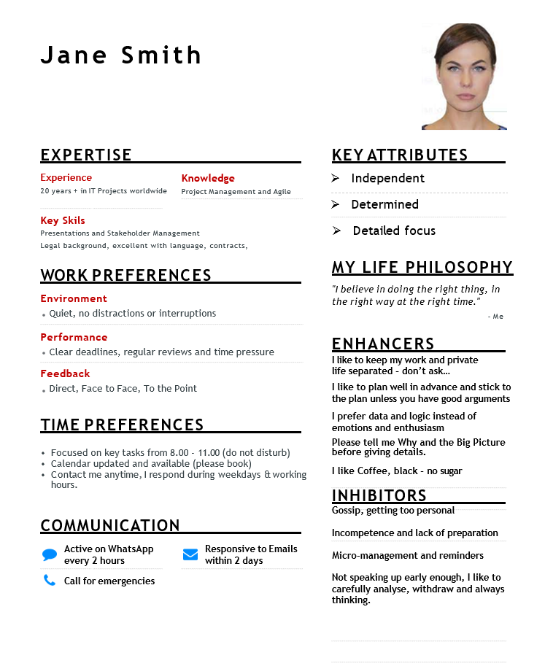
The format of a Quick Guide might look like this, depending on what information you are willing to release:
Part 12: Your Quick Guide

Slide 218
B. Intentions and Actions
After reading the book, watching the video’s and doing the exercise, what are your top 5 actions that will help you increase your wellbeing and performance. What are your new intentions, new habits, new initiatives that you are going to work on? Go through each part, each exercise and list what you would like to take on board and implement, what will improve your wellbeing the most? Pick out of the created list 5 items – describe the action you will take for each one, and tick it on the fridge or somewhere where you see it every day, to remind you.
When creating new habits, remember to make them part of who you are or want to become, your identity. Every time you do the new habit, even if it is a small step, you tell yourself I do this because this brings me closer to the person I want to be. Commitment to do every day is more important than the size of the step taken. Take small steps, just turning up every day will eventually create a habit.
Most people try to do too much and quit after a while, just focusing on showing up, doing what you promised yourself and keep making small steps is the best way. Start with one or two items, you do not have to do all five items at the same time. Start with one, make it the highlight of the month and a month later you focus on the next one. Tell people close to you what you are doing or meet with your learning partner and discuss the progress on a regular basis for accountability.
My number 1 initiative
actions, new behaviors, changes I will make
Part 12: Your Quick Guide

Slide 219
My number 2 initiative
actions, new behaviors, changes I will make
My number 3 initiative
actions, new behaviors, changes I will make
My number 4 initiative
actions, new behaviors, changes I will make
My number 5 initiative
actions, new behaviors, changes I will make
Part 12: Your Quick Guide

Slide 220
C. Your Expected Results
After defining your new actions, new behaviors and changes you intend to make, the last step is to create a deliverable plan for each one and give yourself reminders and make yourself accountable. Who can help you to clearly focus on the destination, stay the course and encourage you to do it?
You can! Be your own coach - just write some emails to yourself, encouraging you to continue to aim for the results you want. You can create regular emails, or just a reminder each month or a review each quarter, like a mentor or coach would. What would the email to yourself say? What would your future-self write to ensure you would persevere with the changes made? Create multiple emails as per the suggested format below – different time frames – use the website: http://futureme.org
Create encouraging emails to self
What would you expect to have done next week or next month? Just remind yourself and congratulate yourself on the progress made. Celebrate what results you achieved and continue and adjust what still needs to be done. Use a reminder which motivates you to challenge yourself, a positive affirmation or reminder why you started this in the first place. Do this for each new initiative.
For Initiative 1: What deliverables will you aim for?
Deliverable | Achievement Date
 | Planned | Actual
1.
2.
3.
Email(s) to self
Subject: ___________________ Send Date: ___ /___ /____
Part 12: Your Quick Guide

Slide 221
For Initiative 2: What deliverables will you aim for?
Deliverable | Achievement Date
 | Planned | Actual
1.
2.
3.
Email(s) to self
Subject: ____________________ Send Date: ___ /___ /____
For Initiative 3: What deliverables will you aim for?
Deliverable | Achievement Date
 | Planned | Actual
1.
2.
3.
Email(s) to self
Subject: ____________________ Send Date: ___ /___ /____
Part 12: Your Quick Guide

Slide 222
For Initiative 4: What deliverables will you aim for?
Deliverable | Achievement Date
 | Planned | Actual
1.
2.
3.
Email(s) to self
Subject: ____________________ Send Date: ___ /___ /____
For Initiative 5: What deliverables will you aim for?
Deliverable | Achievement Date
 | Planned | Actual
1.
2.
3.
Email(s) to self
Subject: ____________________ Send Date: ___ /___ /____
Part 12: Your Quick Guide

Slide 223
What Actions did you take?
Reflective emails to self
Email(s) to self
Subject: ___________________ Send Date: ___ /___ /____
Send a future email to yourself - what actions did you take 6 months ago, what promises did you make to yourself and encourage yourself to reflect what you managed to stick to. Congratulate yourself on taking steps to live a better life for you, discuss with yourself what improved your life and made you feel proud of yourself.
Part 12: Your Quick Guide

Slide 224
Congratulations!
You have completed the Transformation Leadership program.
Smile, now you are starting to live in line with your values, showing up every day by using your strengths, and accepting yourself for who you are. You love yourself and take responsibility for your happiness and work to find a perfect balance in your life.
Make the most of every day, savor the many good times and small blessings and learn from the tough times in your life, be resilient and bounce back quickly. Listen carefully to your feelings and start to act on them. Take time to reflect, be mindful and don’t rush through life, but sample what it serves you and savor each experience, that is how you can make the most of each day.
Focus on what is important to you, stay active by working towards your dreams, read and write more to deal with ups and downs and stay aligned, spend time with those close to you, people you love, and take care of your mental and physical health and wellbeing. After all happiness and feeling good about yourself is really quite simple – Find:
Something to do - that gives you energy and purpose
Someone to love - to spend good and bad times with
Something to hope for - to dream and look forward to
All the best and take care!
Hans Horlings
Part 12: Your Quick Guide

Slide 225
Hans Horlings
hans.horlings@rtpeople.com
+971 504776908

