Slide 1
Embracing change – tips for finding purpose during life’s ‘turning points’
Sharon Bell

Slide 2
Context
We all face ‘turning points’
Sometimes foreseen, sometimes not
Emotional reaction
Sometimes we feel in control …. Sometimes definitely not ☹
Do we need to reframe them – as crossing a ‘threshold’
As an opportunity to experience MORE of God

Slide 3
Being kind to ourselves …..
Not about making the best of a difficult season
Not about downplaying the impact of a really difficult time we are facing or have faced
Not about comparing ourselves to others
It is about not getting ‘stuck’ or letting our world, our view of God or our hope and dreams shrink

Slide 4


What kind of life changes/ seasons / challenges come to mind?

Slide 5
Examples …
Illness
Moving house
Job change (by choice or not)
Divorce
Children growing up
Bereavement
Friends moving away
Retirement
‘Big’ birthdays
.... You will have others

Slide 6


Slide 7


Slide 8






HINTS AND TIPS

Slide 9

HAVE YOU EXAMPLES OF WHERE HAVING NAVIGATED THE HARDSHIP THERE WAS MORE?
AS YOU THINK BACK TO THOSE SITUATIONS WHAT HELPED?

Slide 10
HINTS AND TIPS

Slide 11
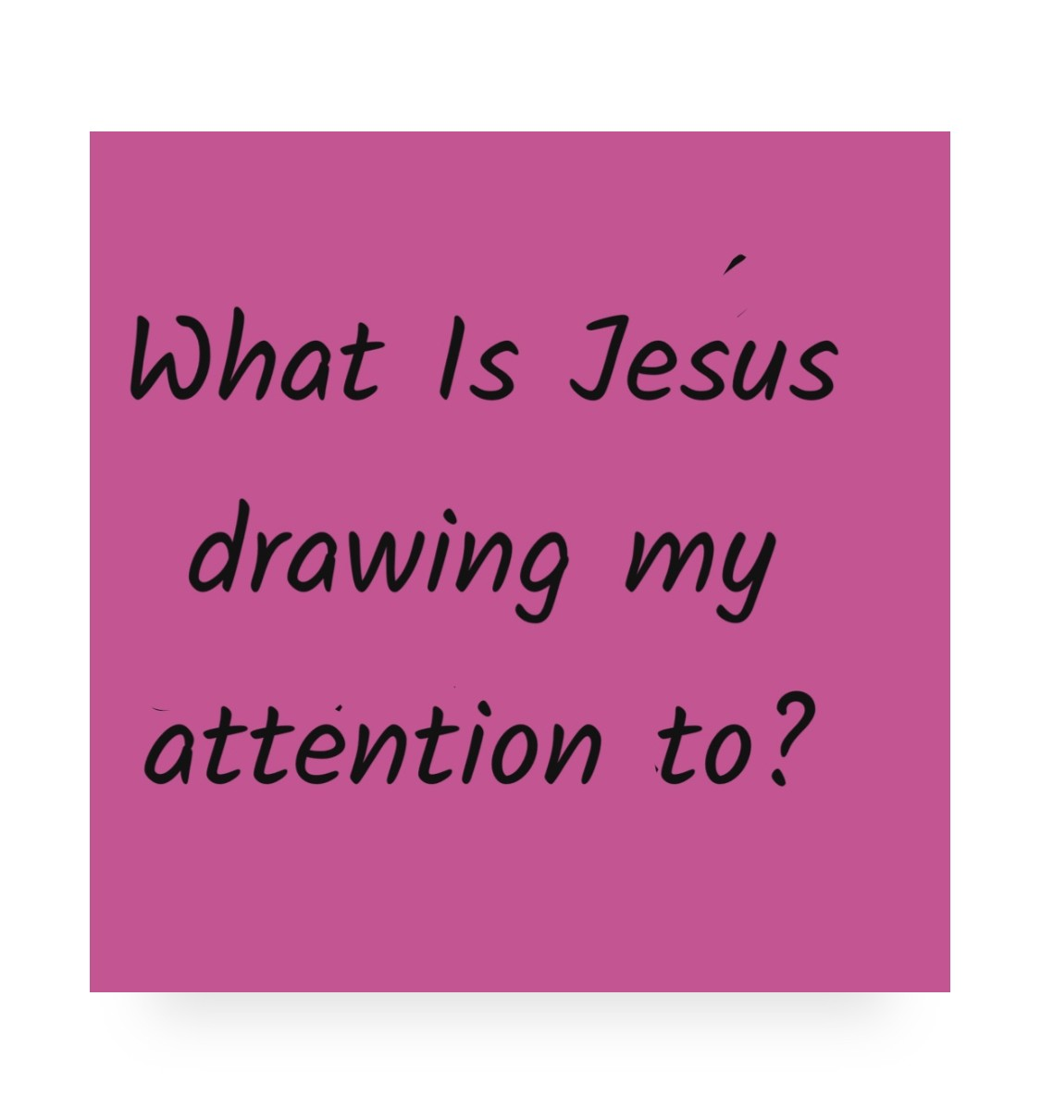

Slide 12

#1: How full are your tanks?
Emotional Spiritual Physical
BE GENTLE!

Slide 13

#2: How often do you play? (when are you ‘in the flow’?)

Slide 14

#3: What energises v what drains?

Slide 15

#4: Where is your accountability / support (informal or formal)?

Slide 16
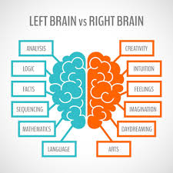
#5: How well do you know yourself?

Slide 17

LEFT BRAIN THINKERS!
Exercise right brain muscles:
  Play more!
  Notice your emotions and try to give them a language
  Notice the things that tap in to your emotions (tv, music, films, art & crafts)
  Talk to right brain friends … be curious, be brave!

Slide 18
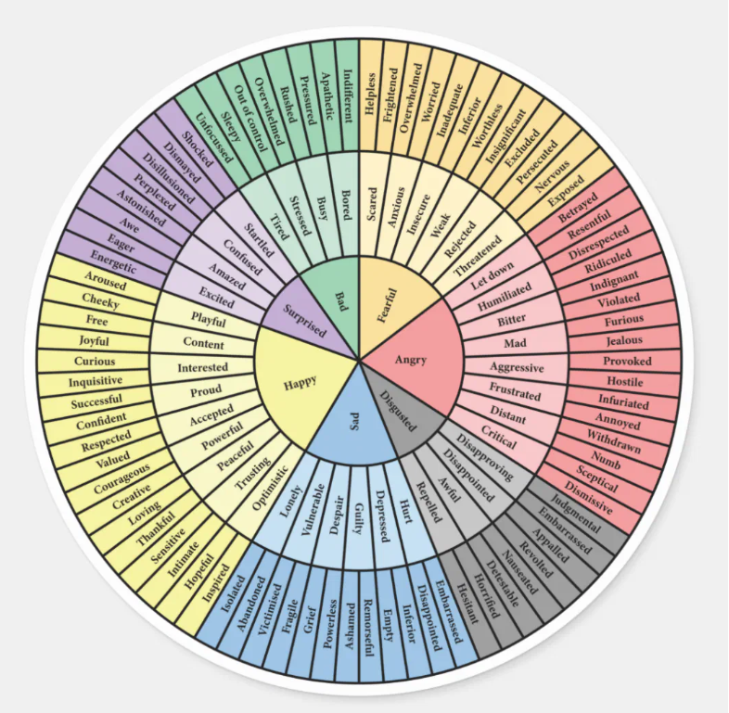

Slide 19
RIGHT BRAIN THINKERS!
Exercise left brain muscles:
  Add some structure to your week
  Make appointments with yourselves
  Create a list – and then a mini list (what do you want to do, change, be different today)
  Talk to left brain friends … be curious, be brave!

Slide 20
#Tip 6: Be intentional
What does MORE look like for you?
What do you want to be different?
What’s the dream?
Why is this important?
How will you know something has changed?
What might get in the way?
What one small thing could you resolve to do today?
Take time to notice (weekly, monthly, quarterly) – create the space
Tell someone

Slide 21
How full are your tanks?
How often do you play?
What energises v what drains?
Where is your accountability/support?
Left brain v right brain thinking?
Be intentional

Slide 22
What have you found that has helped?

Slide 23
Questions?

