Slide 1
Welcome to Coffee and Conversation Jan 2026! starting at 10am
We’ll see you in a few minutes with your coffee and journal to hand
In the meantime pop in the chat where you are joining us from … AND IF THERE IS A WORSHIP SONG THAT BLESSED YOU IN 2025, ALSO PUT IT IN THE CHAT
Gaynor & Sharon x

Slide 2

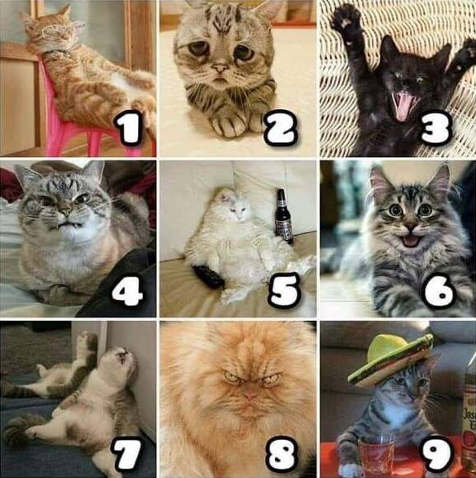
How are you feeling this morning – pop the number in the chat

Slide 3
Stepping intentionally into 2026
Look after yourself
Only reflect at the level you would like to – this isn't a mass counselling session (you may want to speak to a professional about some of the things that emerge)
Only share what you would like to in the chat (but do chat to me!)
Some questions may be better worked through together with a friend or in your small group
Lots of material – we add to it each year, the idea being to give you lots of prompts for thought. You may find worship music helpful
Apologies if we go 10 mins over!
If we can help, you have Gaynor's contact details, Sharon's on the last slide – and we will share these slides

Slide 4





As I enter prayer now, I pause to be still; to breathe slowly; to re-centre my scattered senses upon the presence of God.
Prayer above taken from the Lecti 365 app

Slide 5
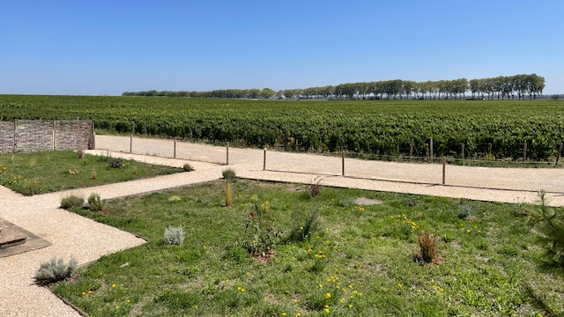
John 15 v 1-8

Slide 6
Reflecting Back
WHAT STANDS OUT AS YOU THINK BACK OVER 2025

Slide 7


Slide 8
Reflecting Back – some questions to consider
WHAT FEELINGS SURFACE FOR YOU AS YOU THINK BACK?
WHERE Have THERE BEEN MOMENTS OF JOY? WHAT ARE YOU CELEBRATING FROM 2025?
WHERE HAVE THERE BEEN LOSSES OR DISAPPOINTMENTS?
WHAT HAS JESUS BEEN TEACHING YOU?

Slide 9
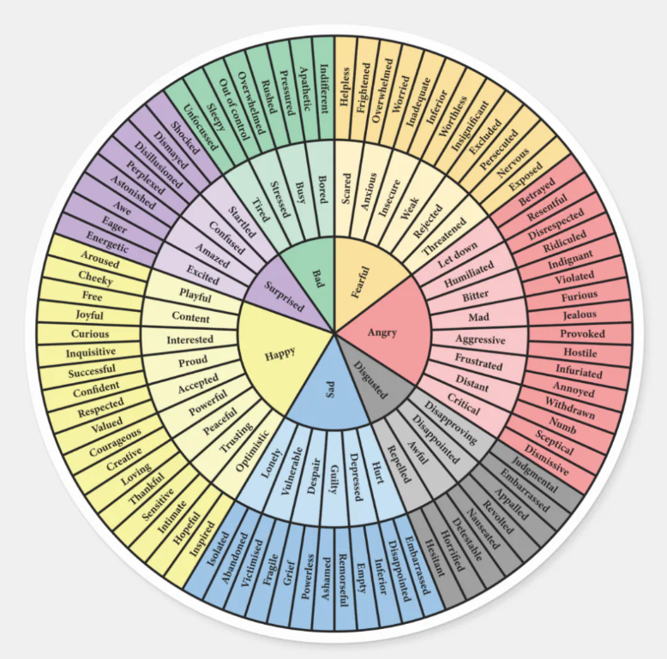
Feelings wheel – helps with finding a language for feelings

Slide 10

​Other tools ...

Slide 11
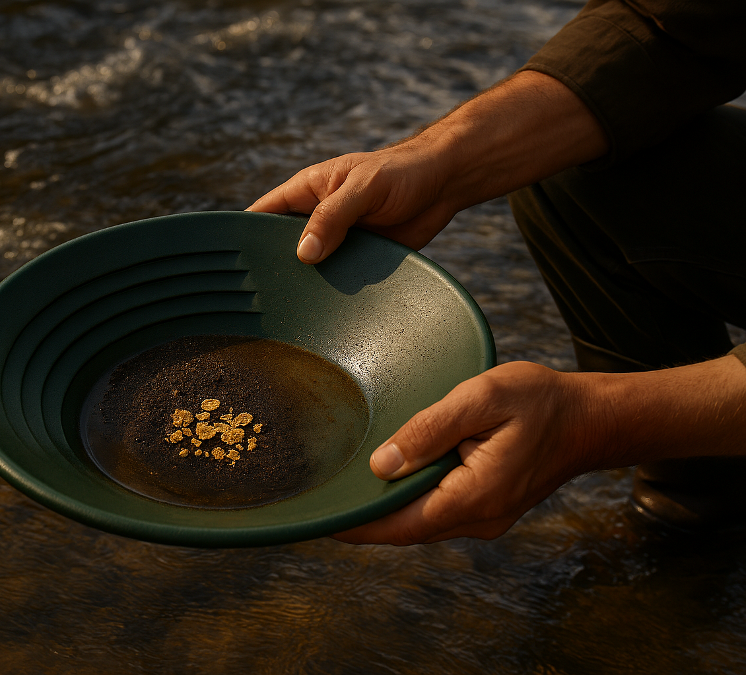
What is Jesus drawing my attention to?

Slide 12
Reflecting Back
We have used this tool in previous years' January coffee mornings – included in follow up information in case useful to you. When you do this exercise it can be helpful to have camera or diary to hand
Draw a line across a page in your journal (Jan – Dec)
Think back through 2025:
  ‘Word(s)’ for the year
  Things to celebrate and give thanks for
  Any insights into core values?
  Key bible verses or nudges from God?
  Career / personal life highlights?
  Key people / mentors /influencers
  Big challenges
  Big opportunities
  Life incidents
  Areas of sadness
  Areas of growth

Slide 13
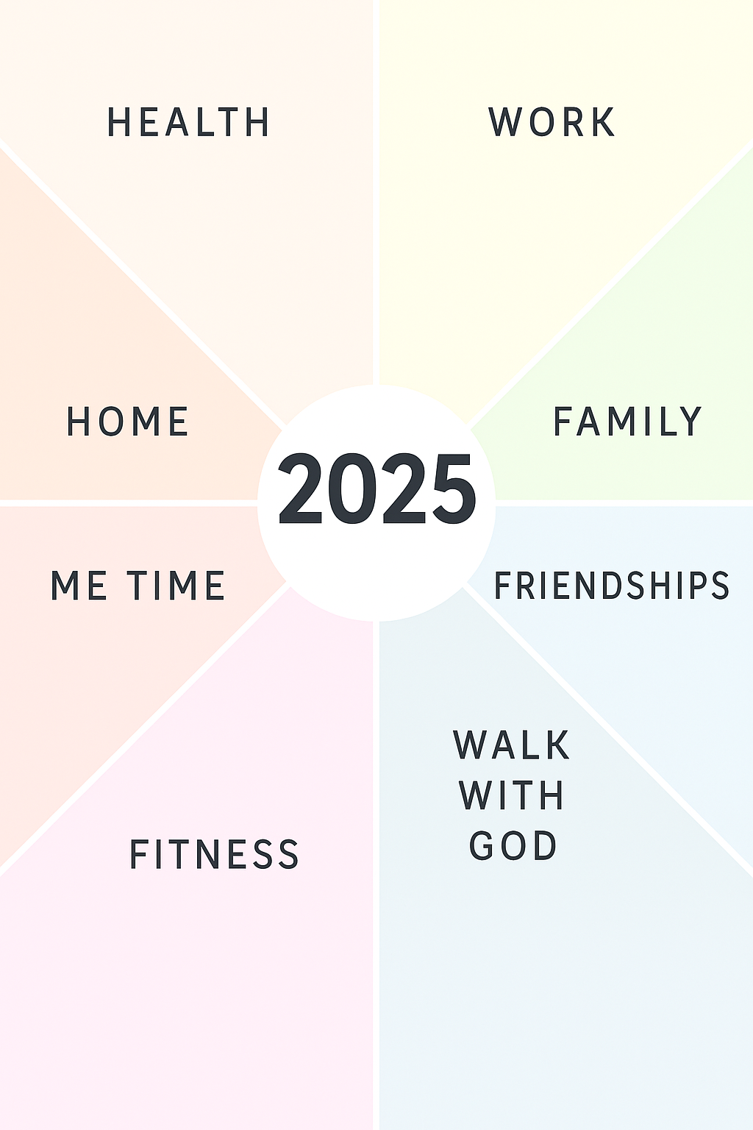
Think about different areas of your life (you may want to choose other labels eg) food, habits, relationships, eating … (whatever feels helpful to you, whatever God is nudging) ….
Think about what went well - notice what was more challenging
Be aware of any perfectionist tendencies!

Slide 14
Other questions to consider
Have you been given any words, verses or prophesies in the year?
DID YOU FIND JOY and laughter IN UNEXPECTED PLACES OR ACTIVITIES?
WHERE did I notice heaviness, tension or pain?
Are there places or patterns of sin I need to repent of?

Slide 15
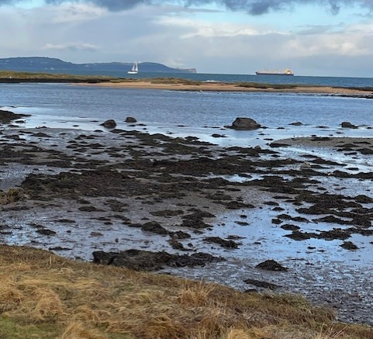
surrender
When you have taken some time to reflect on 2025 … whatever is bubbling up for you, surrender it to God

Slide 16
Stepping into 2026
POP ONE WORD IN THE CHAT TO DESCRIBE HOW YOU ARE FEELIING GOING INTO THE NEW YEAR

Slide 17
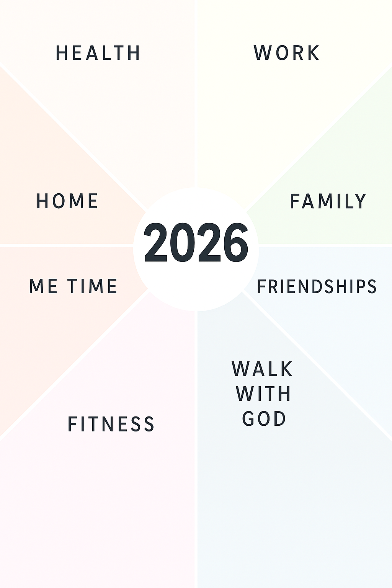
How do you want to 'be' at the end of 3, 6, 9 or 12 months?
What do you want to prioritise or change?
Notice which of the segments you are drawn to (or add your own)

Slide 18

Stepping into 2026
What from 2025 are you taking into 2026? What are you saying goodbye to?
What are your best hopes for 2026?
What would you prioritise this year if there were no constraints? Are those real constraints?
Do you have a word for the year? Could you talk to Jesus about that?
Which (tiny) steps might you need to take? (which might include saying no to something if we are saying yes to something else)
What boundaries do I need to put in place to prioritise my wellbeing?

Slide 19
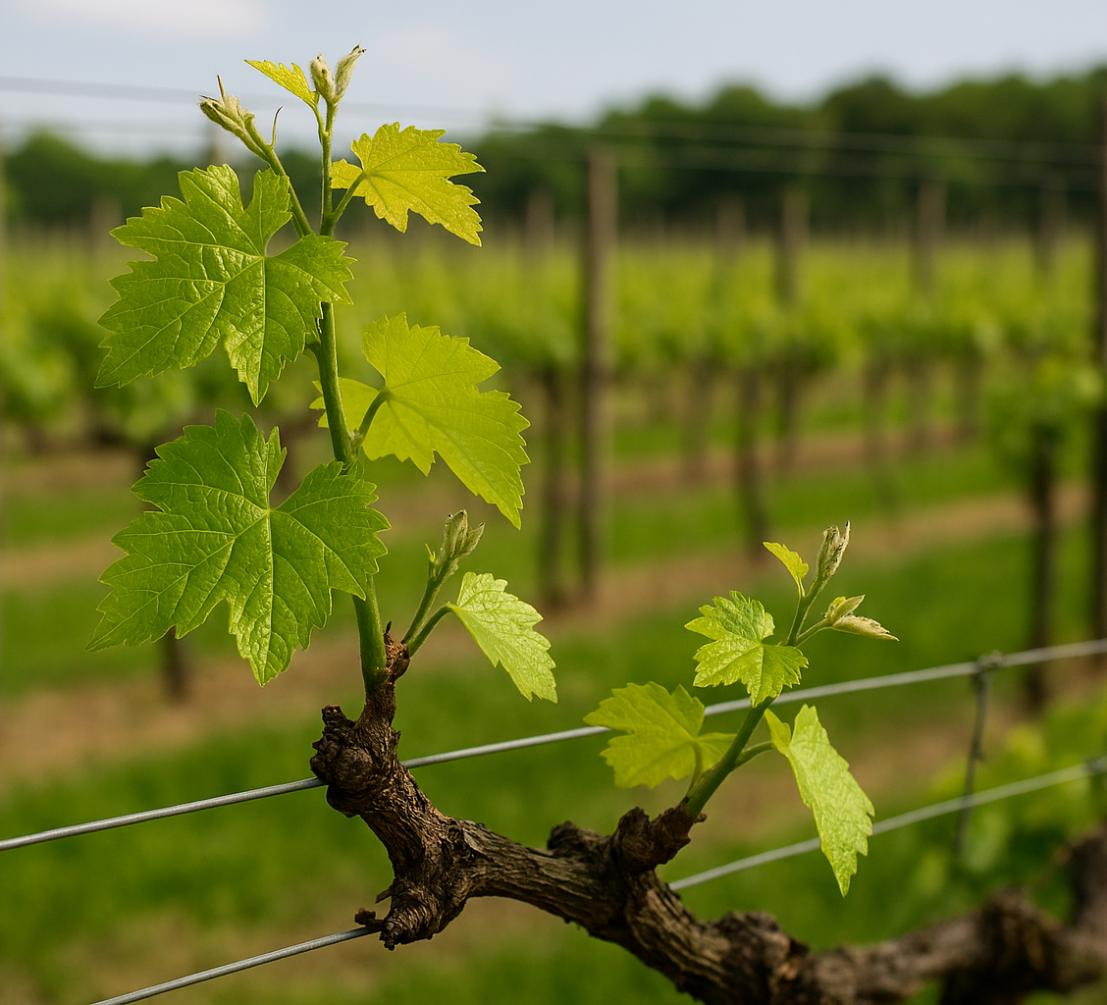
What are your non negotiables each day, week, month?
Think about what fills your tank (habits, people, activities)

Slide 20

What do you need for the journey?
Alongside those habits …
Is anything going to get in the way?
How will you cultivate gratitude?
How do check in with yourself monthly, quarterly etc?
Who can you be accountable to?
How to cultivate play and creativity?

Slide 21
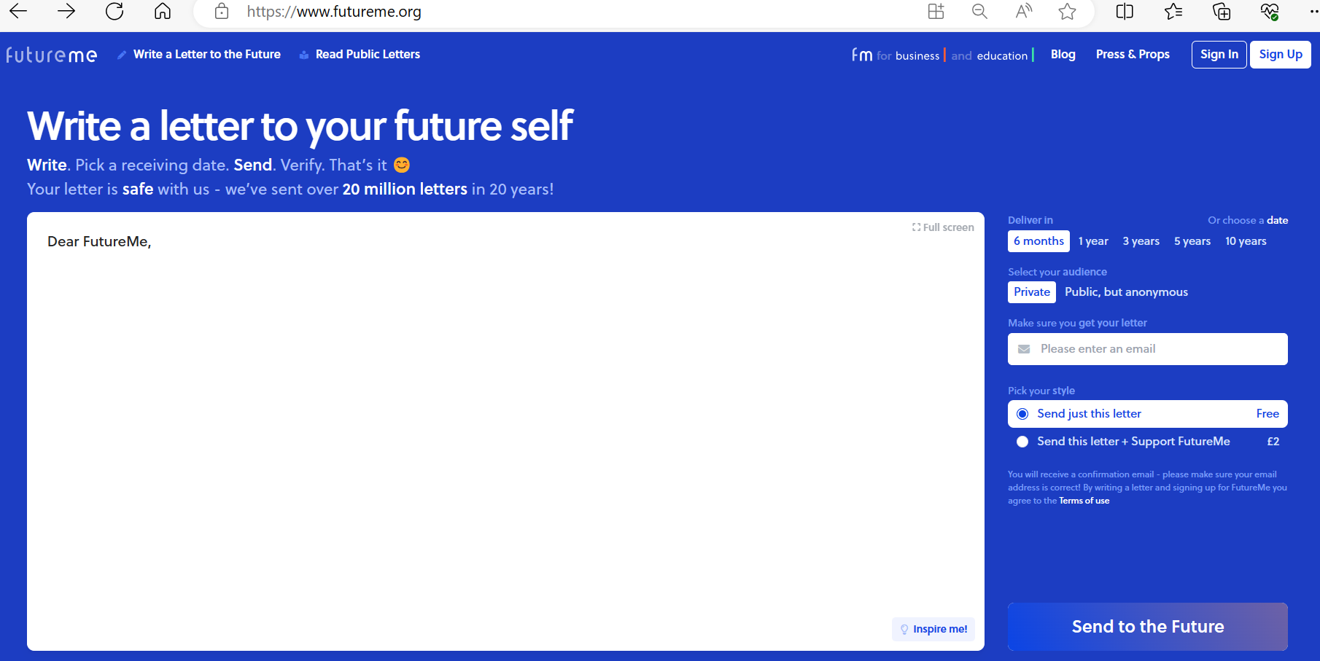
Next steps – take some time this wend
Or schedule an email ….

Slide 22
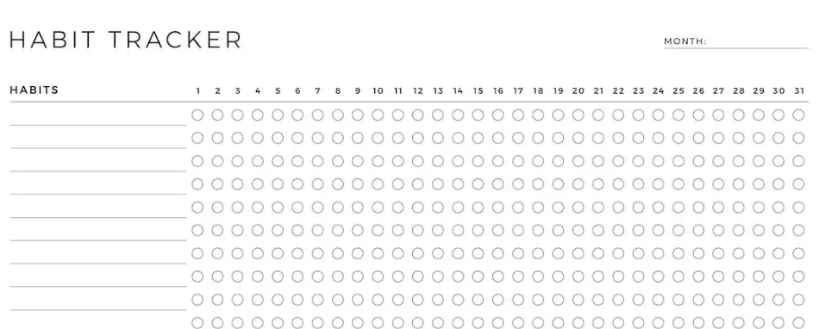
Habit trackers

Slide 23
A moment to reflect …
What is God drawing your attention to?
What are you taking away from this morning?
Has something stirred in you which needs some more time between you and God?
Which questions resonated and you need to go deeper
What support do you need?

Slide 24
A Prayer for the Ephesians (3:14-19)
¹⁴ For this reason I kneel before the Father, ¹⁵ from whom every family^{[a]} in heaven and on earth derives its name. ¹⁶ I pray that out of his glorious riches he may strengthen you with power through his Spirit in your inner being, ¹⁷ so that Christ may dwell in your hearts through faith. And I pray that you, being rooted and established in love, ¹⁸ may have power, together with all the Lord’s holy people, to grasp how wide and long and high and deep is the love of Christ, ¹⁹ and to know this love that surpasses knowledge—that you may be filled to the measure of all the fullness of God.

Slide 25
If you have any questions don't hesitate to be in touch
sharonbell@fit-fish.co.uk

