Slide 1

Your Personal Brand: Storytelling Mastery with AI
Presenter: Ong Whee-Teck
NLB My Digital Life: Productivity Booster Series

Slide 2
Today's Journey
Part 1: Personal Branding & Storytelling (25 min)
Part 2: Writing Mechanics & AI Integration (35 min)
Part 3: Examples, Pitfalls & Ethics (20 min)
Three hands-on exercises throughout

Slide 3
PART 1: PERSONAL BRANDING
(25 minutes)
"Why Your Story Matters"
The Power of Personal Brand
  Professionals with visible expertise earn up to 13x more
  55% of people engage more with brands through stories
  In 2025, your authentic story is irreplaceable by AI
  Your personal brand is your career strategy

Slide 4
Personal Branding Essentials
Authenticity: Your genuine self and values
Expertise: Your unique knowledge and skills
Visibility: How you show up and share insights
Consistency: Unified message across platforms
Storytelling is what brings these together

Slide 5
Storytelling as Your Differentiator
Example 1: https://www.linkedin.com/pulse/tipping-point-professional-relationships-why-your-network-ong-9sfwc
Example 2:
https://www.linkedin.com/posts/wheeteck_leadership-philosophy-lifelonglearning-activity-7346313693757960192-ouVa
Notice: Personal experience, not generic advice
Emotional connection, not just information
Your unique perspective shines through
Discussion: What makes these effective?

Slide 6

Hands-On Exercise #1 - "Your Turn: Quick Brand Story"
Write 100 words about a recent professional challenge
Framework: Situation + Action + Result + Lesson
Use your device - 5 minutes
Focus on authenticity, not perfection

Slide 7
PART 2: WRITING MECHANICS & AI (35 minutes)
The Creative Writing Process
"Vomit" Process: Unfiltered stream of consciousness (5-10 min)
Structure: Apply "show don't tell" + unique POV
AI Polish: Grammar, clarity, flow
Voice Check: Ensure authenticity remains

Slide 8
The "Vomit" Process - Live Demo
Tangents, incomplete thoughts, spelling errors = NORMAL
Set timer, don't stop writing, don't edit
Bypasses internal critic
Raw material for refinement
The gold is hidden in the mess

Slide 9
Show, Don't Tell
TELL: "Communication is important in leadership"
SHOW: "The room went silent when Sarah asked, 'What aren't you telling me?' That's when I learned the difference between talking and truly communicating"
Use specific scenes and moments
Include sensory details and dialogue
Let readers experience, not just understand

Slide 10
Creating Your Unique POV
What's your contrarian or distinctive take?
Connect personal experience to professional insights
Whee Teck’s Unique View…
Your unique lens is impossible to replicate

Slide 11
AI Tools Overview
ChatGPT: Conversational and creative
Claude: Thoughtful and structured
Gemini: Google-integrated
Key principle: Tools, not replacements
Human creativity first, AI refinement second

Slide 12

The Human-AI Collaboration
Step 1: YOU write authentic first draft (vomit process)
Step 2: AI refines grammar, clarity, structure
Step 3: YOU review and preserve your voice
Good prompts:
"Review for clarity, maintain my conversational tone"
"Suggest 3 opening hooks for this story"
"Tighten this without losing personal details"

Slide 13
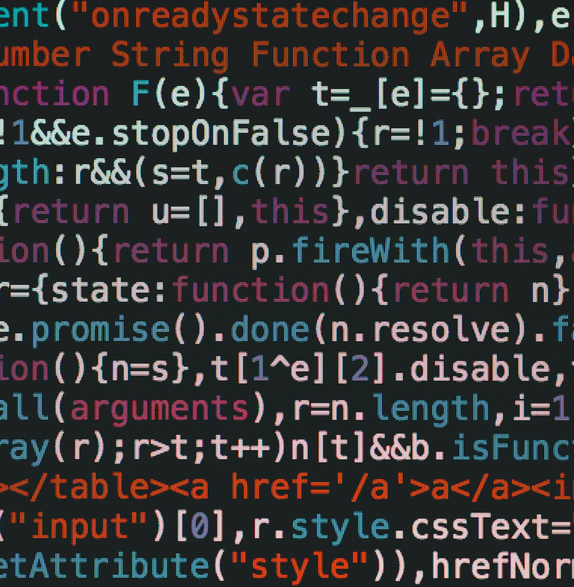
Live AI Demo
Show prompts given to AI
Display AI suggestions
Show selection/rejection process
Final version: voice intact, clarity improved
Time for this: 7-8 minutes with discussion

Slide 14

Hands-On Exercise #2
"Practice: AI-Assisted Editing"
Take your Exercise #1 story (100 words)
Use AI to:
  Generate 3 headline options
  Expand to 200 words keeping your voice
  Create 3 different opening hooks
7 minutes

Slide 15
PART 3: EXAMPLES, PITFALLS & ETHICS (20 minutes)
- The Complete Journey
Raw: Messy vomit draft
Structured: AI-assisted refinement
Final: Polished with authentic voice
Notice how voice stays consistent
AI enhances, doesn't replace

Slide 16
What Good vs. Bad Looks Like ("Effective vs. Ineffective AI Use“)
GOOD:
Human story at core
AI-enhanced clarity
Authentic voice preserved
Engaging and personal
BAD:
Generic, robotic content
Lacks personality
Over-sanitized
Sounds like everyone else

Slide 17
Demo
How NOT to use AI (ineffective dependency)
Effective AI partnership (enhancement)
Discussion

Slide 18
Quick Do's and Don'ts
DO:
✓ Use AI for grammar, structure, clarity
✓ Maintain your authentic voice
✓ Keep unique experiences central
✓ Iterate between human and AI
DON’T:
✗ Let AI write your stories
✗ Accept generic content
✗ Sacrifice authenticity
✗ Share sensitive information

Slide 19

Data Privacy - CRITICAL
❌ Personal client information
❌ Confidential company data
❌ Sensitive personal details
❌ Proprietary information
⚠️ AI terms of service = data may be used for training
Best practice: Anonymize, use fictional examples

Slide 20
Responsible AI Use - "Your Ethical Framework"
Transparency: Acknowledge AI assistance when appropriate
Honesty: Maintain intellectual integrity
Privacy: Respect others' confidentiality
Authenticity: Use AI to enhance, not deceive

Slide 21

Hands-On Exercise #3 - "Final Practice: Bring It All Together"
Take your Exercise #2 story (200 words)
Apply "show don't tell" technique
Add specific details, dialogue, sensory elements
Use AI to refine while keeping authentic voice
10 minutes

Slide 22
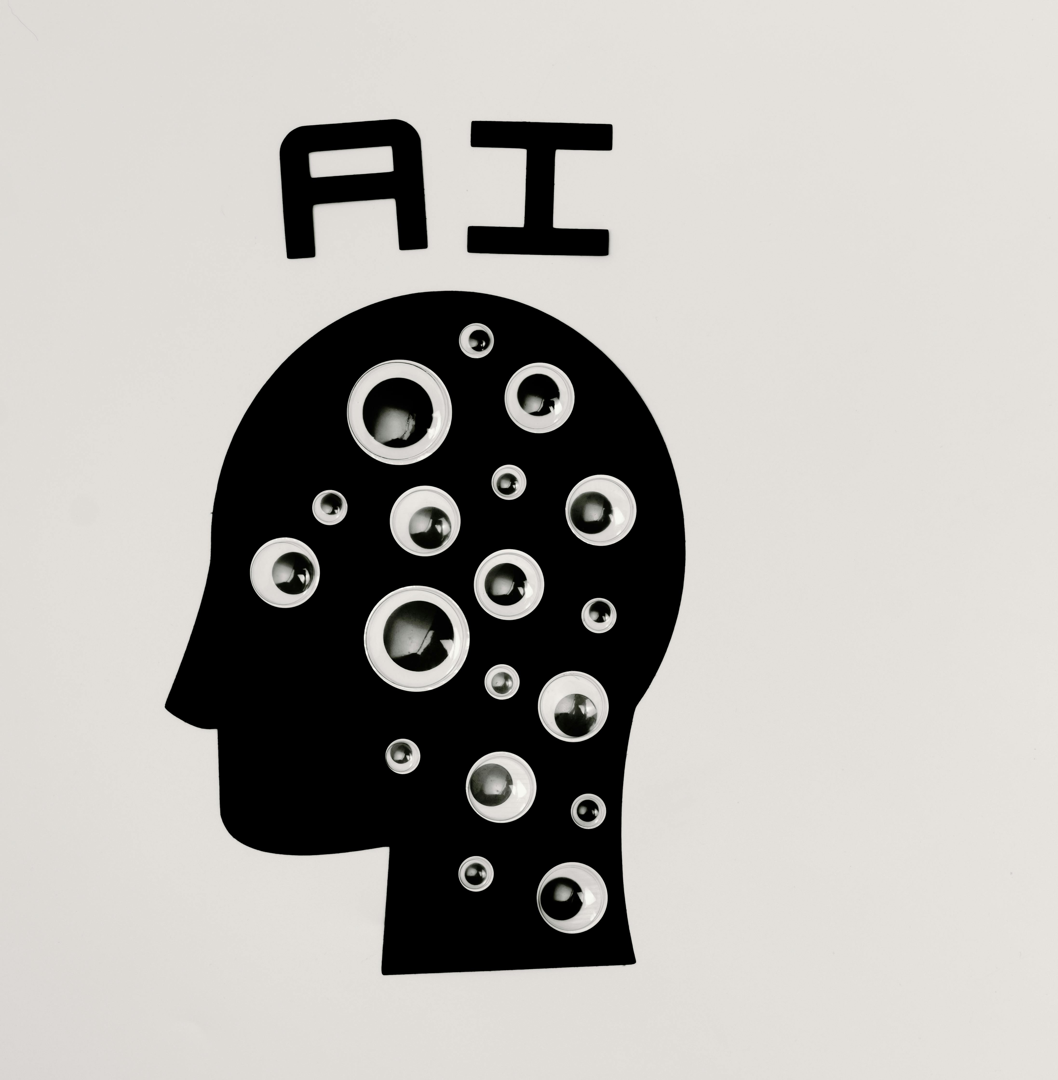
WRAP-UP (10 minutes)
Your authentic story is your competitive advantage
"Vomit" process unlocks creativity
"Show don't tell" creates emotional connection
AI is your editing partner, not your writer
Privacy and authenticity are non-negotiable

Slide 23

Your Action Plan - "This Week: Put It Into Practice"
Today: Refine one post using these techniques
This Week: Practice ethical AI usage
This Month: Write one "show don't tell" LinkedIn article
Building your brand is a marathon, not a sprint

Slide 24
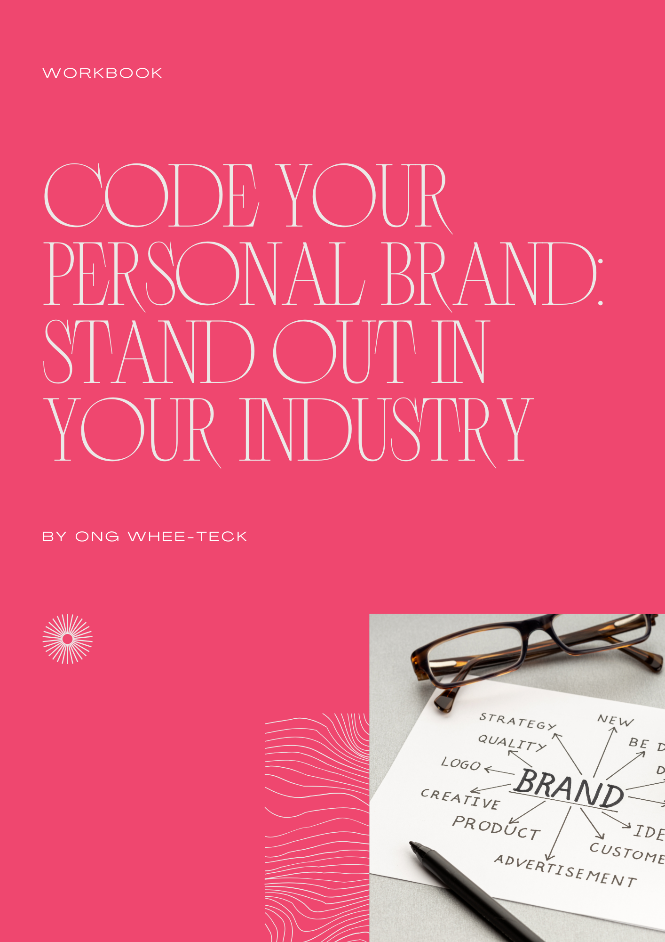
Resources & Learning
Book: "Code Your Personal Brand: Stand Out in Your Industry"
https://flipbooklets.com/pdfflipbooklets/full-code-your-personal-brand-stand-out-in-your-industry
NLB digital literacy resources
AI tool tutorials (ChatGPT, Claude, Gemini)
Practice makes progress

Slide 25
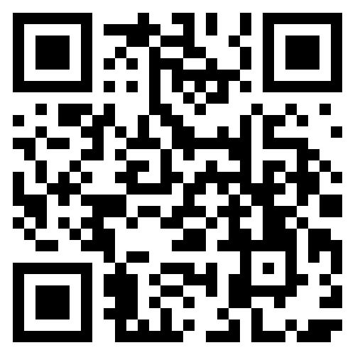
Q&A & Thank You
Open floor for questions
Keep building your authentic brand!

Slide 26
[QR code for NLB feedback form]

