Slide 1
Icelandic Prepositions and Spatial Relations
Presentation by Tbrennan

Slide 2
Notice
This slideshow is the stripped down version of a much larger and more comprehensive slideshow that I have made.
This version is focused much more on practicality than on comprehensiveness.
The full version will be made available for purchase at a later date.

Slide 3
What Are You Going To Learn?
In this presentation, my goal is to teach you how to talk about objects in relation to each other in space. To do this, we will look at various prepositions, prepositional phrases, adverbs, and adverbial phrases that concern spatial relationships.
We will NOT be looking at definitions for these words and phrases that do not have to do with spatial relationships.
We will NOT be covering the concept of motion, case, or declension in general, as it is assumed you already understand those basics.

Slide 4
What Is A Preposition
A preposition is a word that usually precedes a noun, pronoun, or noun phrase that explains the relationship between that noun and another part of the sentence, typically time and place.
English examples: On, By, At, With
Icelandic examples: Á, Í, Við, Hjá
Often, prepositions can be combined with other parts of speech to form separate or more nuanced preposition phrases.
English examples: Inside of, On top of
Icelandic examples: Fyrir ofan, Við hliðina

Slide 5
Simple Prepositions

Slide 6
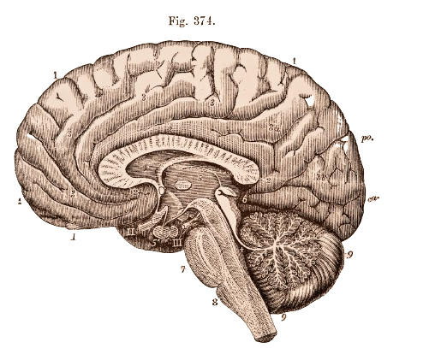
A Note About Simple Prepositions
It is very important to understand all the basic meanings of the simple prepositions that we will cover in this presentation.
The basic meanings of these words will lend themselves to more complicated phrases later.
A word’s basic meaning is not always
going to create the best translation in
English.

Slide 7
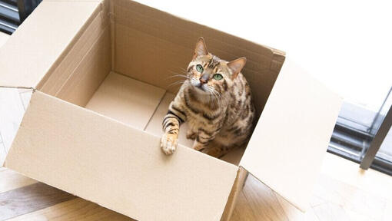
Á and Í
Á’s basic meaning is “On the top of”
Example: Kötturinn er á borðinu.
Example: Kötturinn er á hillunni.
Í’s basic idea is is “In”
Example: Kötturinn er í kassanum.

Slide 8
Á and Í
In addition to meaning “On” and “In,” Á and Í are used to express that something is located “At” or going “To” a location, independent of whether English would use “At,” “In,” or “On.”
The assignment of these prepositions is tied to the noun-location, and has to be memorized.
Some examples of words that take Á
McDonalds, Akureyri, Spánn
Some examples of words that take Í
Bíll, Skóli, Reykjavík, Sími
Notes:
There are a few rules of thumb that you can use. Á is more likely for surfaces, restaurants, and cities in northern Iceland, for example.

Slide 9
Af and Úr
Both Á and Í have natural counterparts which are used to talk about motion away from that location.
Af’s basic meaning is “Off of.” It is the opposite of Á.
Example: Hann tók matinn af borðinu.
Example: Hún datt af reiðhjólinu.
Úr’s basic meaning is “Out of.” It is the opposite of Í.
Example: Hann fór úr skólanum.
Example: Stelpurnar komu úr þessari átt.

Slide 10
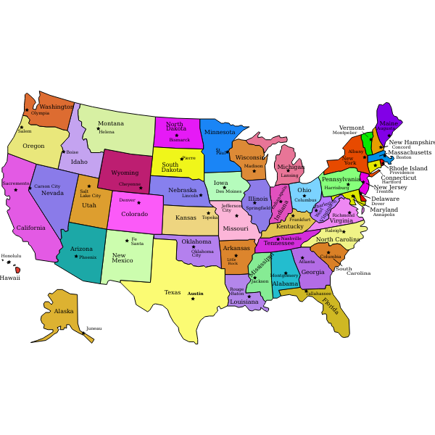
Til
Til’s basic meaning is “To.”
Til is used to express going “To” a city, state, country, or person
Example: Ég fer til Bandaríkjanna.
Example: Hann fór til Englands.
Example: Við ætlum að fara til Spánar.
Example: Kastaðu boltanum til mín.

Slide 11
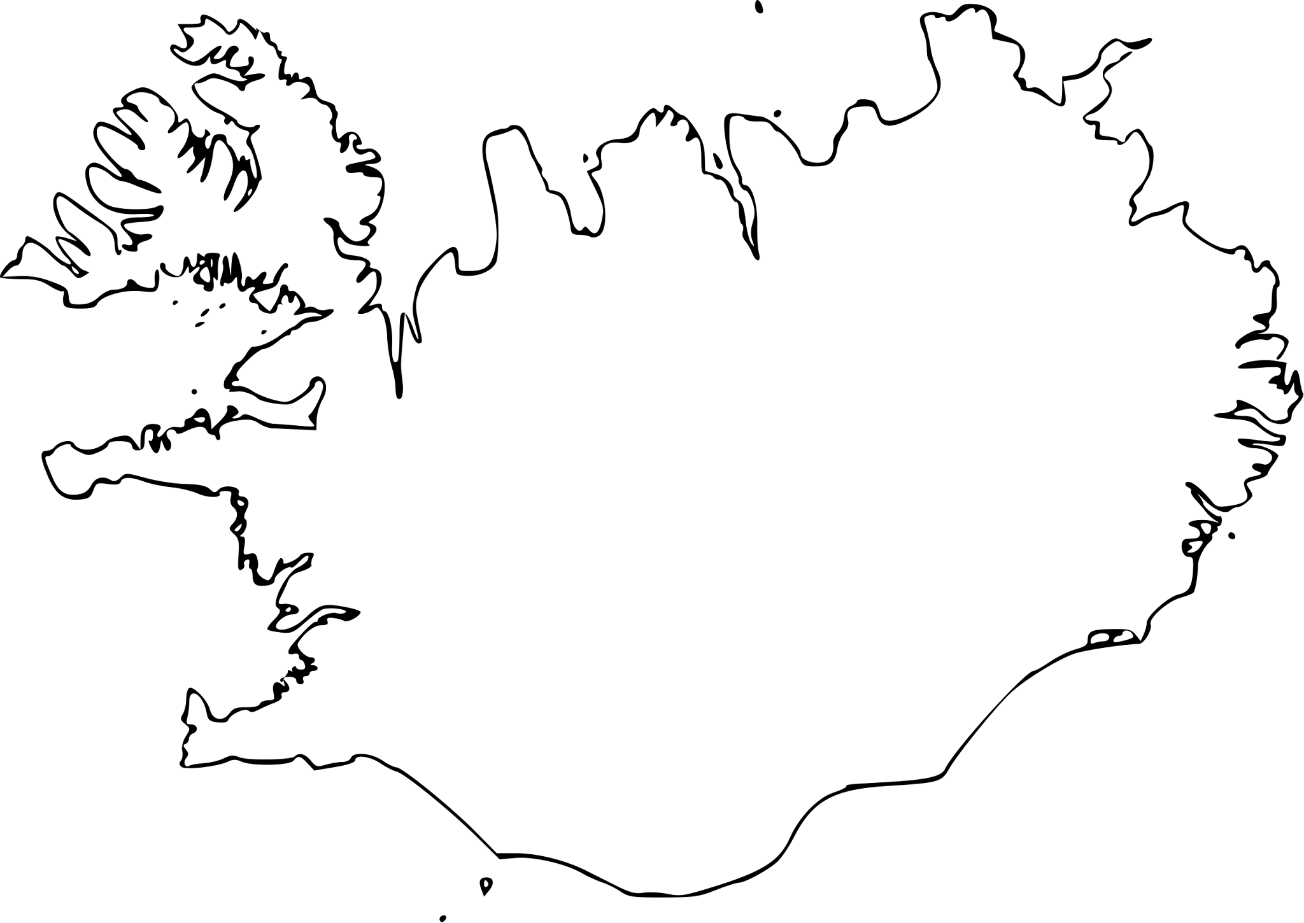
Frá
The counterpart of Til is Frá. Its basic meaning is “From”
Example: Hann fór frá Íslandi.
Example: Taktu það frá honum.

Slide 12
Að
Að’s basic meaning is “Toward.” It implies movement to but not necessarily stopping or making it to a location.
Example: Hann gekk að húsinu.
Að is also used with places that are stops along a path. For that reason, a one-way bus route to Reykjavik would use Til, but, if Reykjavík was just a single stop on a longer route, Að would be used.
Rútan fer til Reykjavíkur.
Rútan fer að Reykjavík.

Slide 13
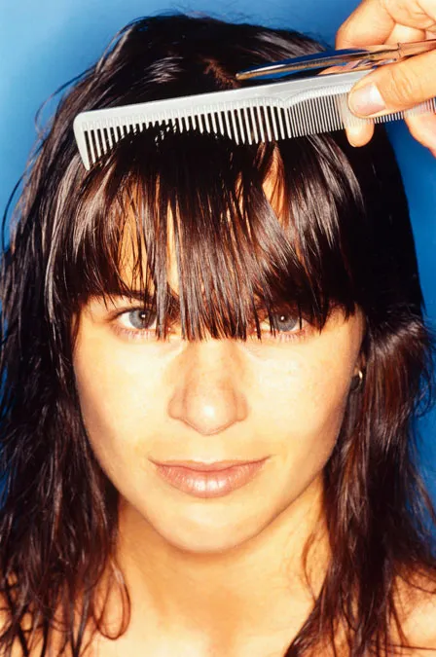
Fyrir
Fyrir ’s basic meaning is “In front of,” such as when talking about an obstruction.
Example: Hárið er fyrir augunum í henni.
Example: Maðurinn stóð fyrir dyrunum.
Example: Afsakið, þú ert fyrir mér!

Slide 14
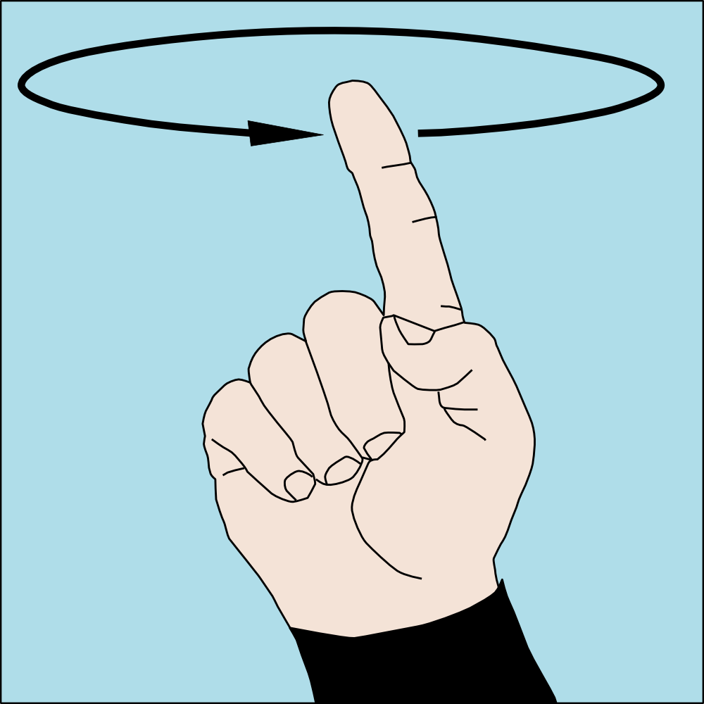
Um
Um has multiple important basic meanings!
Um can mean “Around.”
Example: Hún vafði klút um höfuðið.
Um can also mean “Throughout.”
Example: Sprengingin heyrðist um alla borgina.
Um, when talking about a path, can mean “Through.”
Example: Leiðin liggur um Þýskaland og Austurríki suður til Ítalíu.

Slide 15
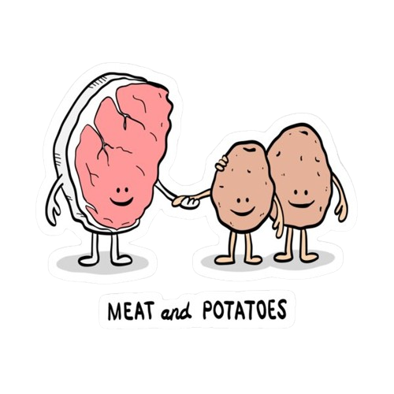
Með
Með is used to show accompaniment.
Með with dative is for something in a group.
Example: Hún er með mér.
Example: Kjöt með kartöflum.
Með with accusative is used when something is “Brought” somewhere or on someone’s person.
Ég fór með strákinn til læknis.
Ég er með penna.

Slide 16
Við and Hjá
Við and Hjá are often confused for each other as both roughly mean “At.”
Hjá’s basic meaning is in someone's place of residence, being in someone's care, or being close in the same area as something else.
Example: Ég bý hjá mömmu minni.
Example: Ég skildi þetta eftir hjá honum.
Example: Má ég setjast hjá þér.
Við’s basic meaning is beside or close to, nearly touching. It is generally closer than Hjá, and some locations, such as furniture and streets, prefer Við.
Example: Stóllinn er við borðið.
Example: Hún er ávallt við símann.

Slide 17
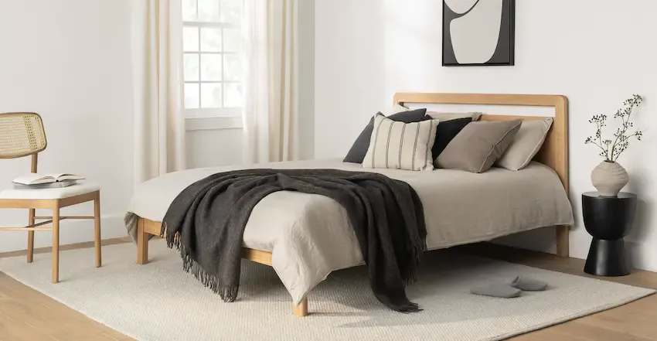
Practice Using Við and Hjá
The bed is X the wall
The table is X the bed
The table is X the slippers
Við, because they are touching, that pretty close!
Hjá and Við both work here.
Hjá, since they are both close in the same area .

Slide 18
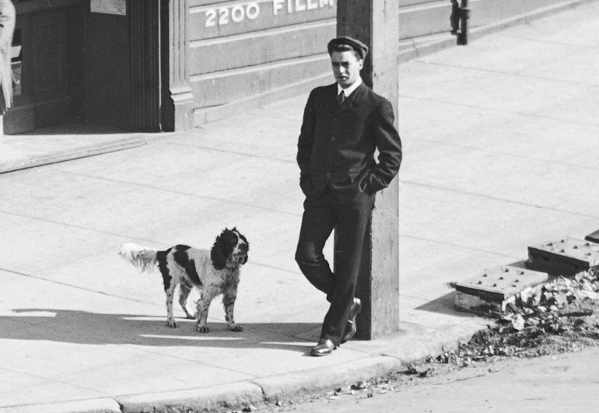
Practice Using Við and Hjá
The man is X the street
The man is X the pole
The dog is X the man
Við, streets often use við.
Við, he’s touching, very close.
Hjá, close in the same area of interest.

Slide 19
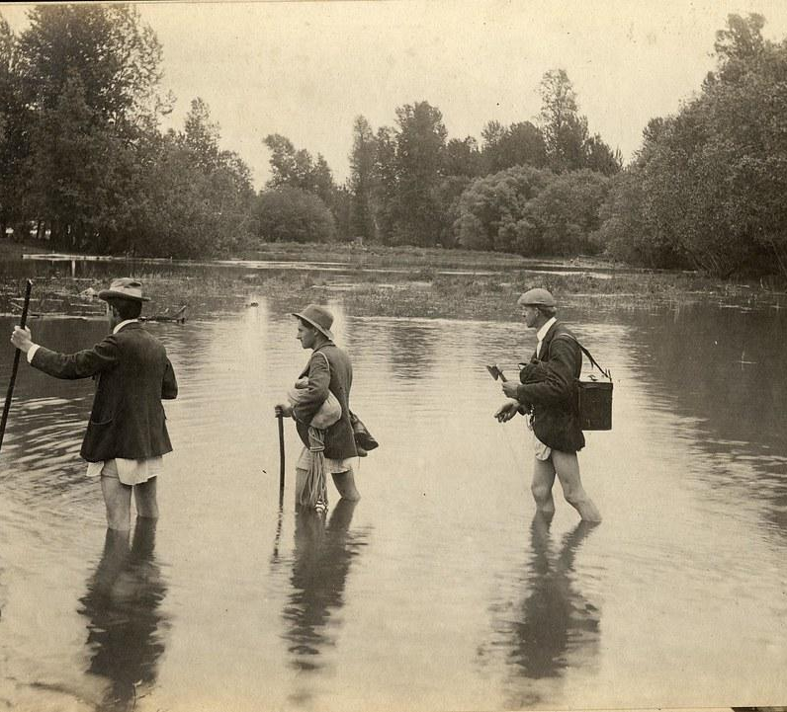
Undir, Yfir, and Eftir
Undir’s basic meaning is “Under.”
Example: Ég stend undir regnhlífinni.
Example: Hann lítur undir borðið.
Yfir’s basic meaning is “Over” or “Across.”
Example: Ljósakrónan hangir yfir borðinu.
Example: Settu sósuna yfir hrísgrjónið.
Example: Farðu yfir ána.
Eftir’s basic meaning is “Across the surface of.”
Example: Kötturinn gengur eftir þakinu.

Slide 20
Motion Adverbs

Slide 21
Adverbs and Motion
Adverbs are words that describe (for our purposes today) verbs for reasons such as motion.
Some of these adverbs have different forms depending on whether there is motion present and, if motion is present, whether that motion is to or from the specified location.
Consider how Old English had words like Whence and Whither in addition to Where. These different forms captured this motion-related meaning.
Example: Whence are you?
Example: Whither did he go?

Slide 22
Here and There
How you say “Here,” “There,” and “Where” all depend on motion.
English | Away from | Static | Towards
Here | Héðan | Hér | Hingað
There | Þaðan | Þar | Þangað
Where | Hvaðan | Hvar | Hvert

Slide 23
Practice Here, There, and Where
He’s from here
He is here
He went here
He is from there
He lives there
He goes there
Where is he from
Where is he
Where did he go
Hann er héðan
Han er hér
Hann fór hingað
Hann er þaðan
Hann býr þar
Hann fer þangað
Hvaðan er hann
Hvar er hann
Hvert fór hann

Slide 24
A Note on Here and There
As you just learned, Hér and Þar are adverbs that mean “Here” and “There” without motion.
But, they can have an -na added to the ends to add closeness, usually used if something is visible.
Example: Pabbi minn er hérna í eldhúsinu.
Example: Hann gekk út í garðinn, þar voru há tré.
Example: Hver er þarna?
Example: Býrðu hérna?
Example: Áttu heima hér?

Slide 25
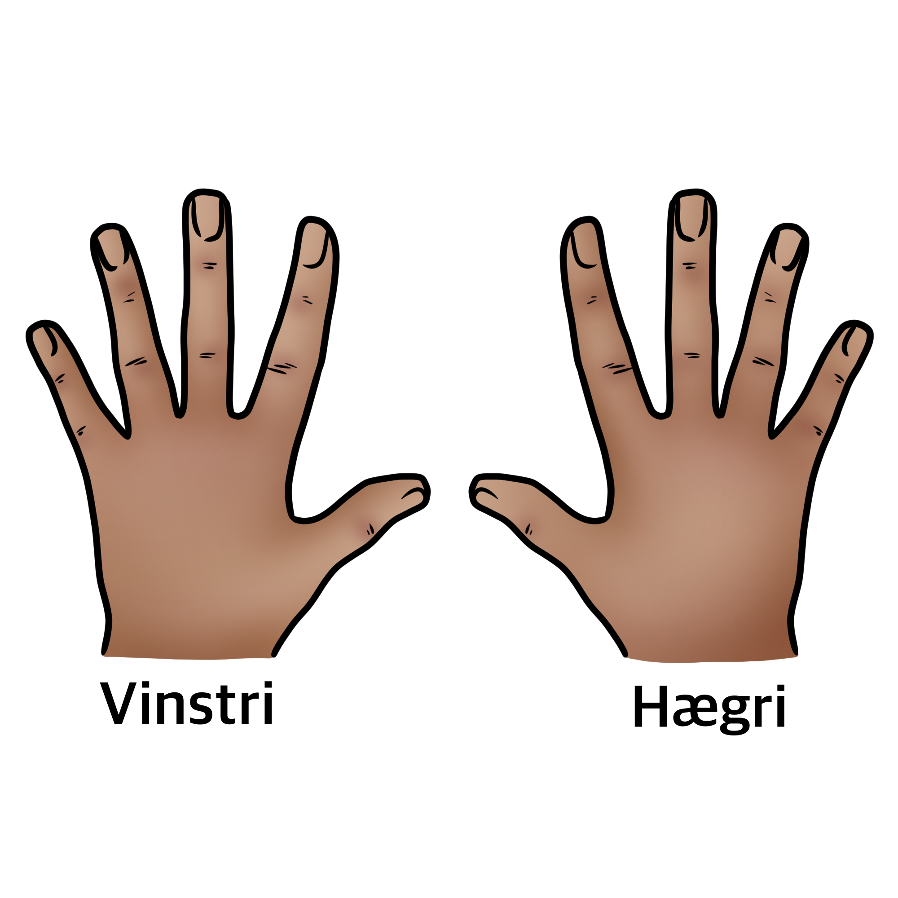
Left and Right
Vinstri and Hægri are adjectives that need to be applied to nouns even if the noun is just implied. These adjectives only exist in the comparative form, as left and right are a relative concept
Vinstri means left.
Example: Hann lyfti vinstri hendinni
Hægri means right.
Example: Hann er í hægra horninu
horn n (-s, -) means corner

Slide 26
Left and Right
Til/frá vinstri/hægri are adverbial phrases which mean “To/from the left/right.”
Example: Hún stendur þarna til vinstri.
Example: Fara til vinstri.
Example: Hún er þriðja bókin til hægri.
Example: Skotið kom frá hægri.

Slide 27
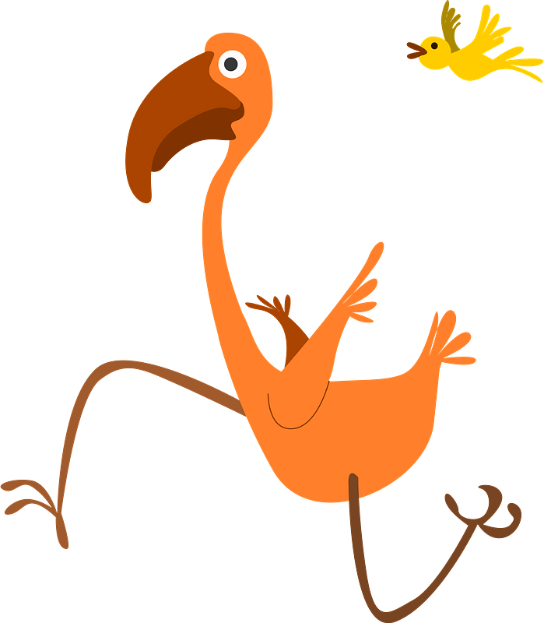
Left and right practice
Where is the light orange book?
Where is the flamingo running?
Ljósappelsínugula bókin er önnur frá vinstri á hillunni.
Flamingóinn hleypur til hægri.

Slide 28
Megin
Megin is a word that only exists in adverbial locational phrases, it forms the meaning “on the X side” after an adverb
Example: Það eru tvö herbergi vinstra megin.
Example: Hann stendur hinum megin.
Remember, the conventions you learned with the other prepositions still apply!
Example: Hann ók vinstra megin á veginum.
Example: Borð og stólar eru hægra megin í salnum.
Example: Er ekki málverkið hinum megin í stofunni? - Nei, hérna megin.
.

Slide 29
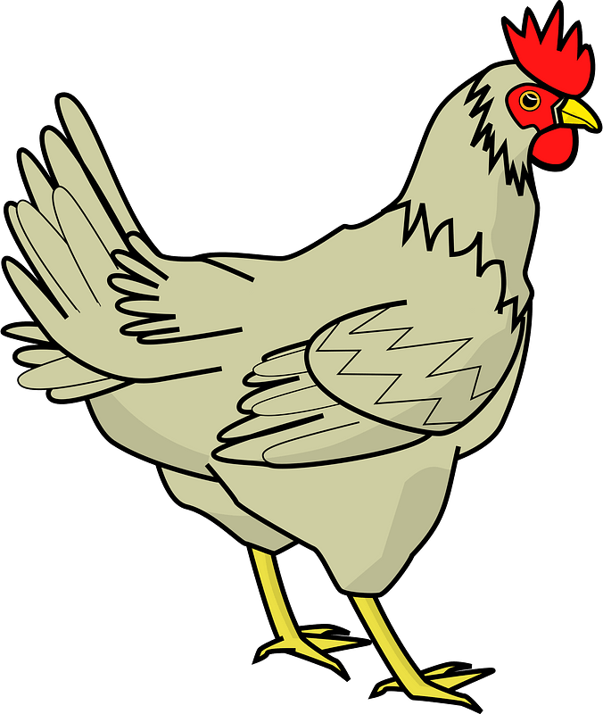
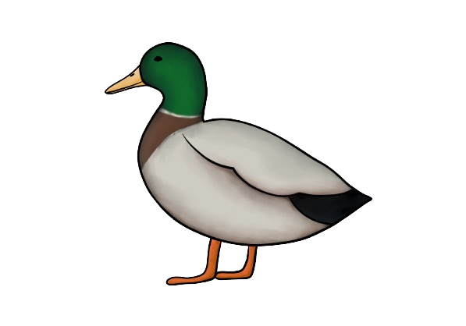
Practice: Megin practice
Where’s the hen relative to the road?
Where’s the duck relative to the chicken?
Hænan er vinstra megin við götuna.
Öndin er hinum megin við götuna.

Slide 30
Middle
There are two ways to express the concept of “The middle” in Icelandic, One is with a noun and the other with an adjective.
Using an adjective, we apply the adjective miður to the noun we wish to discuss. This adjective only exists in the strong from.
Example: Hann er á miðri myndinni.
Using a noun, we insert the word miðj/a (-u) before the noun we wish to discuss. Miðja requires the preposition í.
Example: Hann er í miðjunni á myndinni.
Example: Hann er í miðju myndarinnar.

Slide 31
Hlið
Hlið is a feminine noun that means “Side.”
Example: Það er betra að sofa á vinstri hliðinni.
You may also say that you are Við hlið einhvers, meaning “At somebody’s side.”
Example: Við hlið hans sat Júlía.
Við hliðina á is a phrase that means “Next to.”
Example: Hann settist við hliðina á mér.
Example: Ég stóð við hliðina á henni.

Slide 32
Hlið phrases
Til hliðar means “To the side,” such as when moving something.
Example: Settu tilfinningarnar til hliðar.
Example: Ég ýtti því til hliðar.
Hlið við hlið means “Side by side.”
Example: Þau börðust hlið við hlið.

Slide 33
Degree Adverbs

Slide 34
Inflecting adverbs
Some degree-inflecting adverbs (not to be confused with their adjective forms) explain relative location.
The forms of the adverb are called the positive form, the comparative form, and the superlative form.
Example: Uppi-ofar-efst
These words are often use alongside Á and Í.

Slide 35
Up-higher-highest, Down-lower-lowest
Uppi-ofar-efst represents being in a high(er) location
Example: Ég verð uppi.
Example: Nafn hennar er ofar en hans á listanum.
Example: Efst á blaðsíðu standa nokkur orð.
Niðri-neðar-neðst represent being in a low(er) location
Example: Húsið stendur niðri á sléttunni.
Example: Diskarnir eru neðar í skápnum en bollarnir.
Example: Þessar upplýsingar er að finna neðst á skjánum.

Slide 36
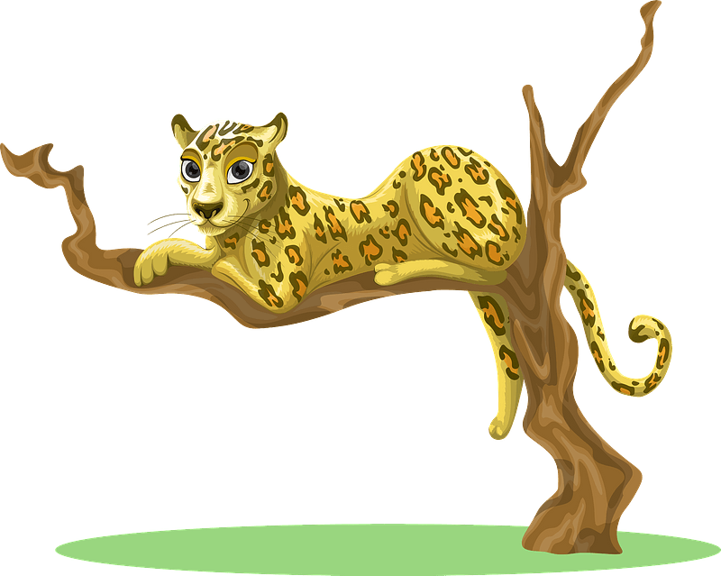
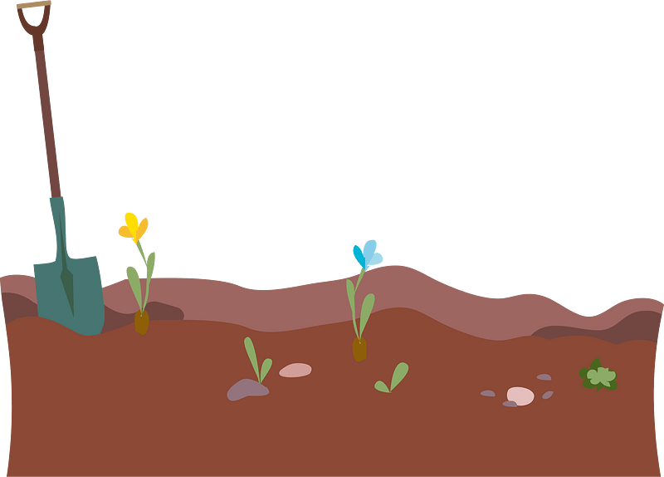
Practice: Up-higher-highest, Down-lower-lowest
Where’s the cat?
Where’s the shovel?
Kötturinn er uppi í trénu.
Skóflan er niðri í moldinni.

Slide 37
Practice: Up-higher-highest, Down-lower-lowest
Where’s the red rectangle?
Where’s the blue rectangle?
Where’s the green rectangle relative to the orange ?
Rauði rétthyrningurinn er efst.
Blái rétthyrningurinn er neðst.
Græni rétthyrningurinn er neðar en appelsínuguli rétthyrningurinn.

Slide 38
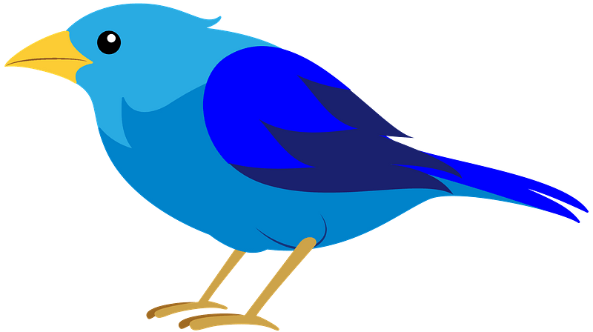
Practice: Efst, Neðst, Ofar, Neðar
Where’s the bird?
Where’s the fish?
Where’s the cat relative to the fish ?
Fuglinn er efst.
Fiskurinn er neðst.
Kötturinn er ofar en fiskurinn
Hint: Use En for comparison

Slide 39
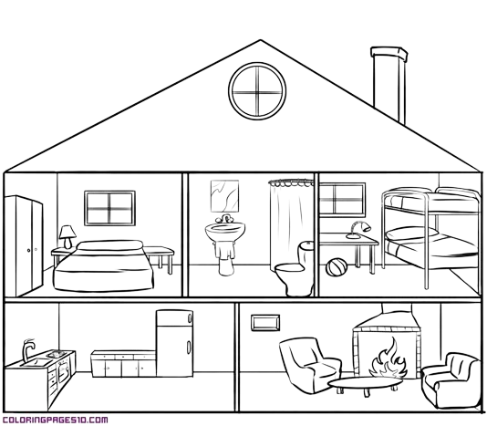
Upstairs and Downstairs
Uppi and Niðri can also be used to mean “Upstairs” and “Downstairs”
Example: Baðherbergið er uppi.
Example: Eldhúsið er niðri og vinstra megin við stofuna.
Example: Farðu upp í baðherbergi.

Slide 40
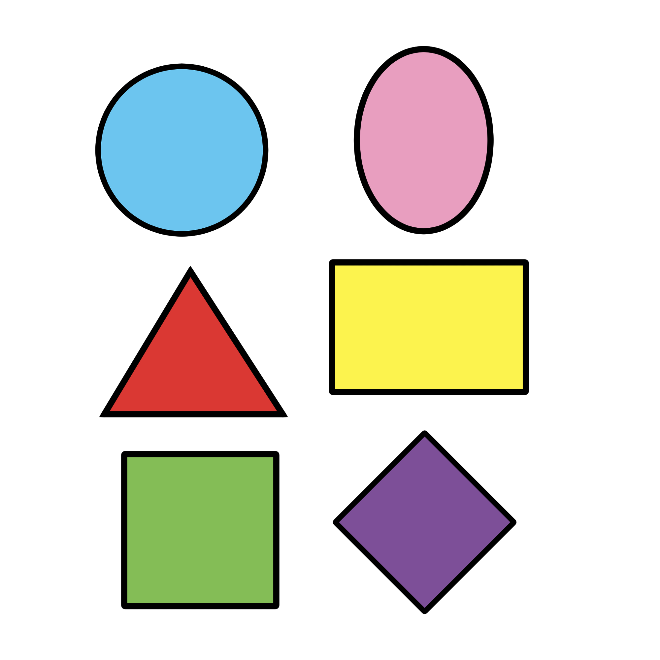
Practice: All together!
Where’s the circle?
Where’s the rectangle?
Where’s the square?
Hringurinn er uppi í vinstra horninu.
Rétthyrningurinn er í miðjunni hægra megin.
Ferningurinn er niðri í vinstra horninu.
horn n (-s, -) means corner
Notes:
Note that we are using uppi and nedri adn not efst and nest because there are only only 3 rows and the corners already imply that

Slide 41
Forward and back
*Framar-Fremst represent being in a forward(er) location.
Example: Myndin er framar í bókinni.
Example: Hún stendur fremst á myndinni.
*Aftar-Aftast represent being in a back(er) location.
Example: Þarna – aðeins aftar í borðaröðinni – sat smávaxinn drengur.
Example: Ég sat aftast í rútunni.
Framarlega and Aftarlega fill in these gaps.
Example: Hann sat framarlega í rútunni.

Slide 42
Practice: Forward and back
Where is the table of contents?
Where is the end of the book relative to the beginning ?
Efnisyfirlitið er fremst í bókinni.
Endirinn er aftar í bókinni en upphafið.

Slide 43
Far and Near
Langt-Lengra-Lengst represent being in a far(er) location.
Example: Það er langt þangað.
Example: Hann gekk lengra í skógin.
Example: Gloria er lengst í burtu.
Nærri*-Nær*-Næst represent being in a near(er) location.
Example: Farðu ekki nærri eldinum.
Example: Ég vil helst búa nær miðborginni.
Example: Hann var næst í röðinni.
Notes:
The Nær inflection is a bit strange because Nærri has the additional meaning of almost/nearly which is more common and ⅔ of the adverbs also function as their own preposition with dative
nálægt

Slide 44
Takk Fyrir Mig
This free presentation is a cut down version of a larger project which represents over 50 hours of dedicated research, writing, and effort, as well as a cumulation of years of learning.
If you learned anything, please consider leaving a donation through the QR code to the right, buying my Icelandic for Beginners Course, or asking how you can continue to support me and my efforts to teach you Icelandic.
Thank you, and have a great rest of your day.

