Slide 1


Slide 2
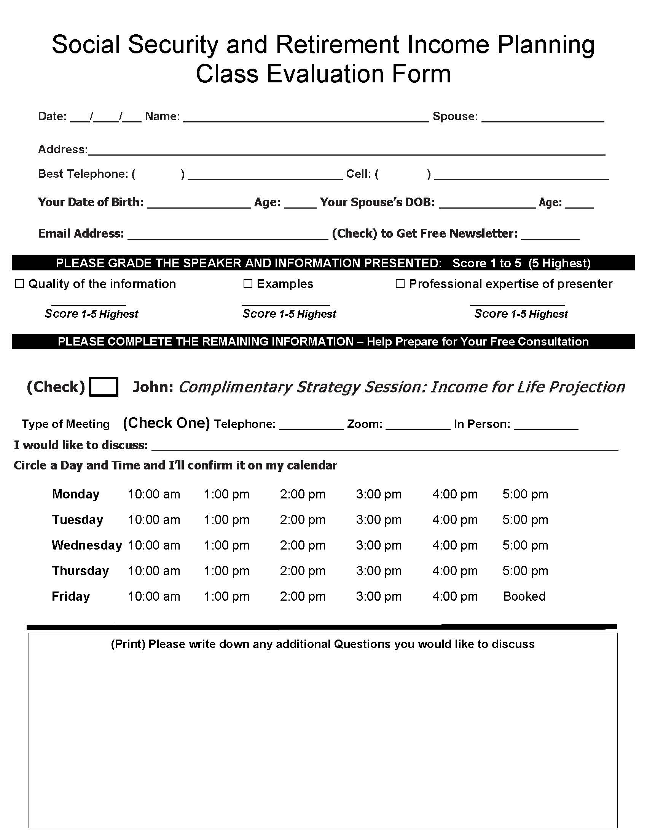
Please Fill Out
the Evaluation Form
    This helps the Church and Us
    determine whether or not you’re
    getting value from the information
    being presented.
Thank You!

Slide 3



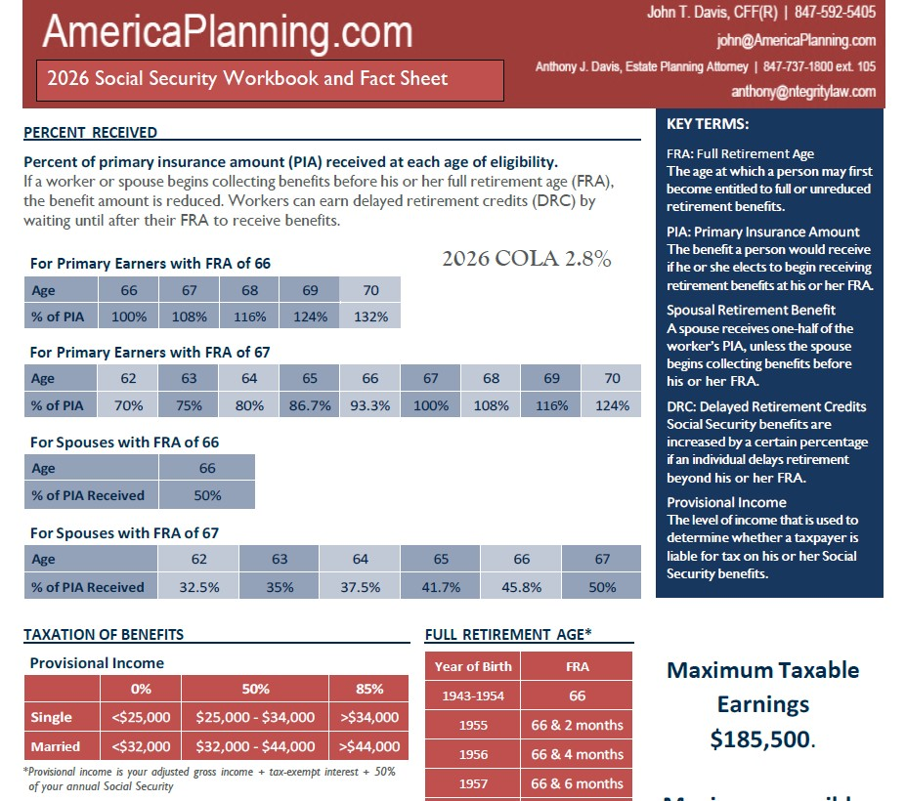
Your Presenter and before we begin
Please silence your phone.
Be sure you have a pen.
Workbook & Fact Sheet.
Presenter
John T. Davis CFF

Slide 4

America United
Wealth Planning
Phone 847.592.5405
www.AmericaPlanning.com

Slide 5

Non-Profit org
The Mission is simple
To Promote comprehensive financial literacy through free educational workshops to senior adults
My speaking today is…
My Way of Paying it Forward

Slide 6

Today is purely Educational

Slide 7
Lot of information. We move quickly – you will not be bored.
Class Today Is
90 Minutes
I Recommend that you take notes.
Questions – Write questions down as we go.
I’ll answer your questions at the end of the presentation

Slide 8
This presentation is for
Educational purposes only.
Before We Start
This information and presenting professionals are not affiliated or endorsed by the Social Security Administration or any government agency.
Presenters are licensed & certified professionals but are not providing specific legal or tax advice to you, only general information on the subjects presented.
You may also find information regarding Social Security by visiting your local Social Security Office.
Or online at www.ssa.gov.
Disclaimer
Not giving financial advice today.
Consult with your own professional.
*For information purposes only, not affiliated or endorsed by Social Security Administration or any government agency

Slide 9
Who am I?
Presenter
John T. Davis CFF
I specialize in helping pre-retirees and retirees
create predictable lifetime income strategies

Slide 10
Today I’m going to show you…
The one Social Security decision that can
increase your lifetime income by thousands
How married couples unknowingly reduce
survivor income for the spouse that lives the longest
How to turn retirement savings into
predictable income that lasts as long as you do

Slide 11
Stay With Me Until the End…
I’ll show how to secure a personalized Income-for-Life Projection. This is a Customized Plan designed just for You and Your family. The cost is covered by the AFC (Association of Financial Consultants).
You’ll have a working plan. The Income-for-Life Projection shows you how to coordinate your Social Security, investments, taxes and survivor income into a working plan.
You’ll have the Insiders Advantage. You will see what most people never see before making their most critical retirement decisions.

Slide 12

What’s the biggest mistake people make
when planning their retirement?
They Treat Social Security as just a filing decision
Instead of a coordinated income strategy.

Slide 13
Today’s Secret #1
Is to learn why …
Social Security is NOT just a Filing Decision….
How it’s a coordinated
Income Strategy Decision!

Slide 14
It’s about coordinating everything
into a plan that works for you.
Your Social Security
Your Investments
Your Taxes
Your Retirement Income
Timing

Slide 15
Does this make sense so far?

Slide 16
It’s NOT an Entitlement Program
You and Your Employer pay into the Social Security Trust (Pension) to fund it.
What is Social Security?
You’re Paying into the two Trusts. 7.65% FICA Taxes are deducted from your paycheck. (6.20% is going to Social Security and 1.45% to Medicare).
It’s a
Government Pension with Annuity
Like Features
Like a matching 401k, your employer contributes 7.65% alongside you.
When You Claim - Social Security Pays
You a lifetime Income Benefit. Just like a Private Insurance Co, Annuity Product.

Slide 17
You’ll…Need To Know these two:
Your FRA and PIA
To find out
what your Social Security Income Amount will be
FRA = Full Retirement Age. This is the age at which you get 100% of your benefit amount.

Slide 18

FRA = Full Retirement Age is determined by the year you were born.
Year of birth | Full retirement age (FRA)
1943 - 1954 | 66
1955 | 66 and 2 months
1956 | 66 and 4 months
1957 | 66 and 6 months
1958 | 66 and 8 months
1959 | 66 and 10 months
1960 or Later | 67
Social Security Administration, 2026 Social Security Changes, Fact Sheet.
Notes:
You can start benefits as early as age 62. But, depending on your full retirement age, as shown in the chart, you will receive 25-30% less in benefits.
Delaying start date after FRA results in delayed retirement credits (DRCs).
Selecting the time for you to retire should be based on your health, life expectancy, how much you have in other retirement plans, etc.

Slide 19
Social Security
PIA = Primary Insurance Amount, it’s the dollar amount you get at your Full Retirement Age. It’s 100% of your benefit Amount.
It’s Based on your own career earnings record. You must have worked for at least 10 years total and paid FICA Taxes (Federal Insurance Contributions Act) into Social Security.
To calculate Your PIA, Social Security averages your highest 35 years of earnings, then Indexes for inflation.
If that’s FRA…
what’s PIA?

Slide 20


You can Claim at any Age between
62,63,64,65,66,67,68,69,70
When is the Best Age to claim?

Slide 21
QUESTION…
Is Age 62 the best Age to Claim?
62,63,64,65,66,67,68,69,70
30% to 35% believe 62 is the best age to claim their benefits.
It’s the most popular age to apply in the U.S.

Slide 22

When to apply…
Boils down to Personal Choice.
You must take
into Consideration
When you need the money.
Your Life Expectancy.
Employment status.
All Your other income sources.

Slide 23
Ages 62-70…let's See What Happens at different Ages
Monthly Benefit Amount
Take at 62 = Lose 30%
Earn 8% Per Yr/ Gain 24% at age 70
This example assumes a benefit of $1,000 per mo.
(100% of this person's full retirement age benefit at their age 67)
Form 521 Withdraw of Application (file within 1 year of claim date)

Slide 24
You can almost double your Social Security Income based on when you elect!
Monthly Benefit Amount
67
This example assumes a benefit of $1,000 per mo.
at a full retirement age of 67
This is a family decision, because the age you apply affects your survivor's income.
This is why, many advisors recommend delaying when appropriate

Slide 25
Does this make sense so far?

Slide 26
Today’s Secret #2
The Retirement Income Cliff
Most People Don’t See This Coming…

Slide 27
You had Two Social Security checks NOW ONE…However expenses do NOT drop by 50%
The Result:
Is a potential 30%-50%
Income Drop Overnight
Passing before Your Spouse can cause an Income Cliff
This happens at the worst possible time…When the surviving spouse needs stability the most

Slide 28
“The Survivor Benefit” (This is BIG reason why NOT to apply at age 62)
What happens if EITHER one passes on before the other?
Social Security Creates an Income Cliff!
Upon the death of either one the lower $18,000 ck check is gone!
A Sudden drop in income Creating an Income Cliff
His
$36,000 Yr.
+
Her
$18,000 Yr.
=
Combined
$54,000
Her $18,000 income is lost and the Combined $54,000 Gets Reduced down to $36,000
Pay close Attention
I’m going to show you how we can fix this later on in the workshop!

Slide 29
Look at what just happened
No one wants to leave their spouse with less income at the worst possible time.
1. He or She (the Surviving Spouse)
just lost a third to half of their income…
and is left trying to afford their lifestyle.
2. They’re now in a higher Tax Bracket…
WHY? Because the Survivor can no long file a joint tax return, only as a single!

Slide 30
The Widows Tax Penalty
= Higher Tax Rates
Married Filing Jointly
Income up to $400,000
Marginal Rate: 24%
Widow Filing Single
Income up to $400,000
Their New Marginal Rate: 35%
With Proper Planning this can be either eliminated or minimalized
- When we meet, we can discuss your options -

Slide 31
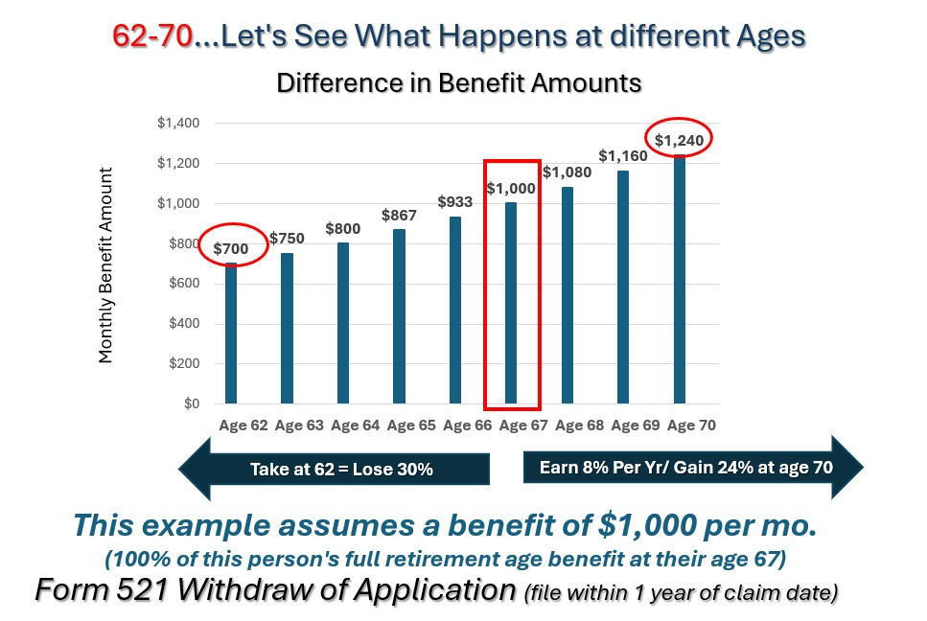
Can you see how this decision applying
at 62 affects
both spouses’ income?

Slide 32
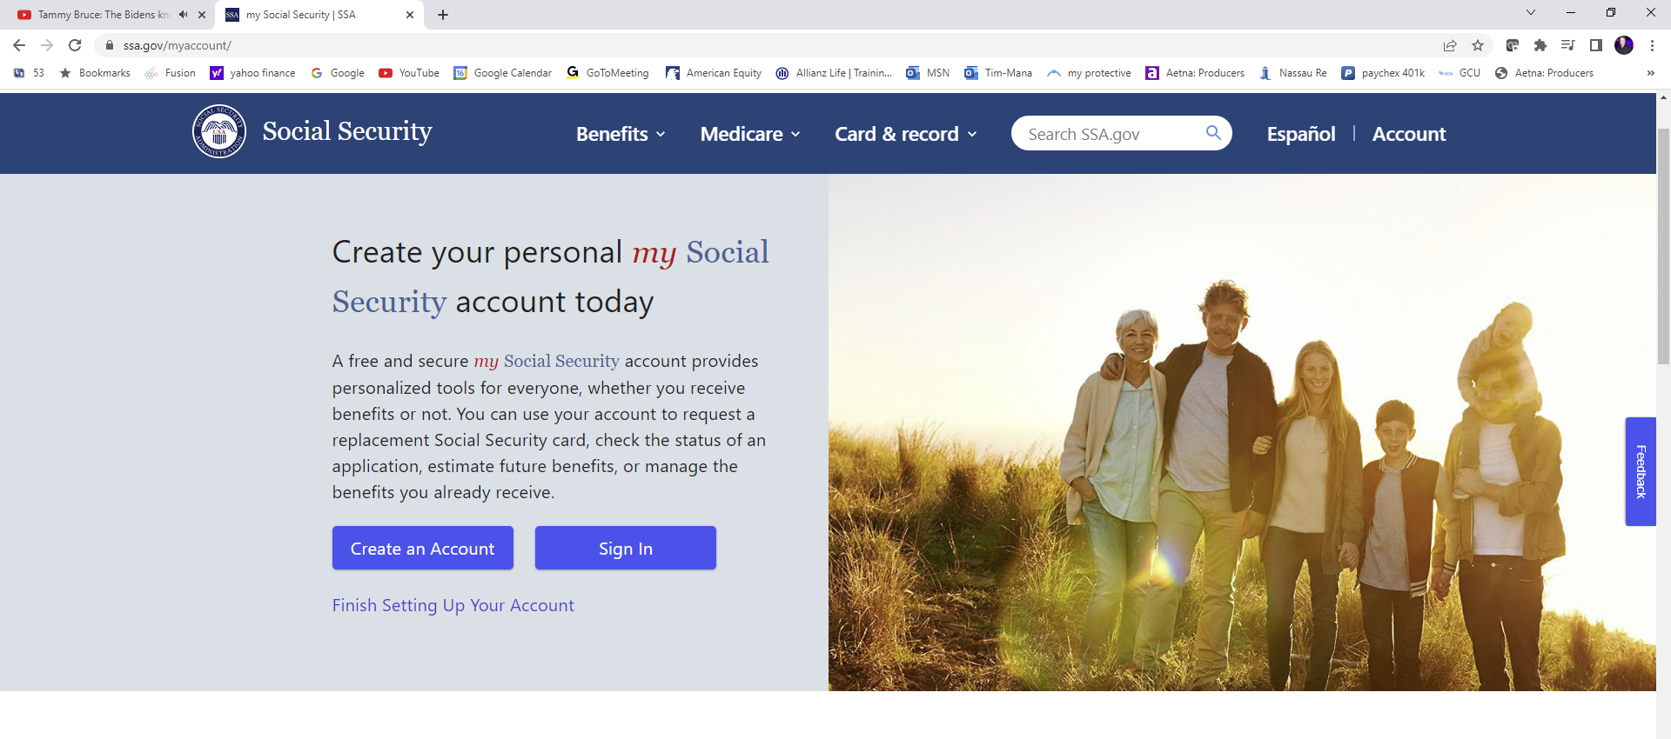
Social Security
Find your
Social Security Benefit
Visit:
ssa.gov/myaccount

Slide 33
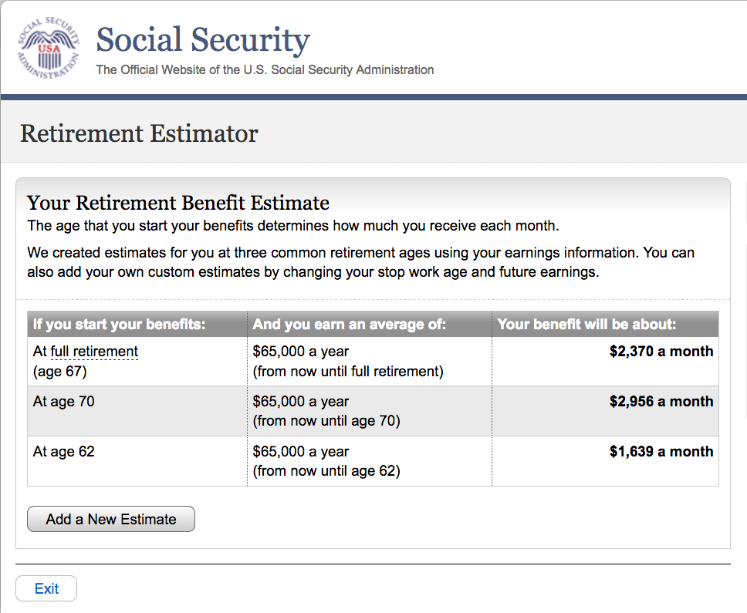
Social Security
3 Key Figures
At FRA = PIA
At age 70
At age 62

Slide 34
While Most People are asking
Social Security is just one part of your plan; the better question is….
How do I coordinate my Social Security with the rest of my retirement income sources?
When should
I claim?
And how will all my income sources (not just SSI) protect my Spouse from an Income Cliff?

Slide 35
Does this make sense?

Slide 36
Today’s
Secret #3
The Biggest Risk in Retirement
Isn't the Market
It’s
Income Inconsistency
Income Instability

Slide 37
Your employer paycheck stops.
You move from employer insurance to Medicare.
You Claim Social Security.
You stop contributing to 401k or the employer retirement plan.
You Start to draw down from investments and now Pay Taxes.
You move from ACCUMULATION Phase
to the DISTRIBUTION Phase.
Embrace this Understanding
When you retire –
things will be different.
Retirement is no longer about growing your money anymore. (Accumulation)
It’s about making your money last. (Distribution)

Slide 38
Because You are in the Distribution Phase of Life
AND you no longer have a Paycheck…

Slide 39
You need to start taking income from your market invested 401k’s, 403b’s and IRA’s….
and Your Money must last as long as you do!

Slide 40
How do you do that?

Slide 41
To achieve this Goal,
many are led to believe…a new Myth
that all they need to do is follow the
“4% Rule”
and they’ll Never Outlive Their Money!

Slide 42
This is the Advice that
Most Retirees are Given…

Slide 43
You might be asking…
What’s the 4% Rule?
This Rule tells you to sell
4% of your invested 401k’s, 403b’s and IRA’s… each year… and use the money as your retirement income.

Slide 44
The 4% Rule was designed for
Accumulation Planning
Not Retirement Income Planning

Slide 45
Do You Mind if I show you
why…this is NOT as simple
as it sounds?

Slide 46
Retirement Income Strategies
We all agree, that
You Need Income
from your investments
Yet…No one talks about the Sequence
of Market Returns
The need for a Seasoned Financial Advisor
who understands this phase of life.

Slide 47

Retirement Income Strategies
The Sequence of
Market Returns
Dictates when the 4% Rule will work for you and when it works Against you.

Slide 48
Retirement Income Strategies
The Sequence of Returns tells you what years
YOU CAN or CAN NOT
Take income out of Your 401k, 403b and IRAs invested in the Stock Market.

Slide 49
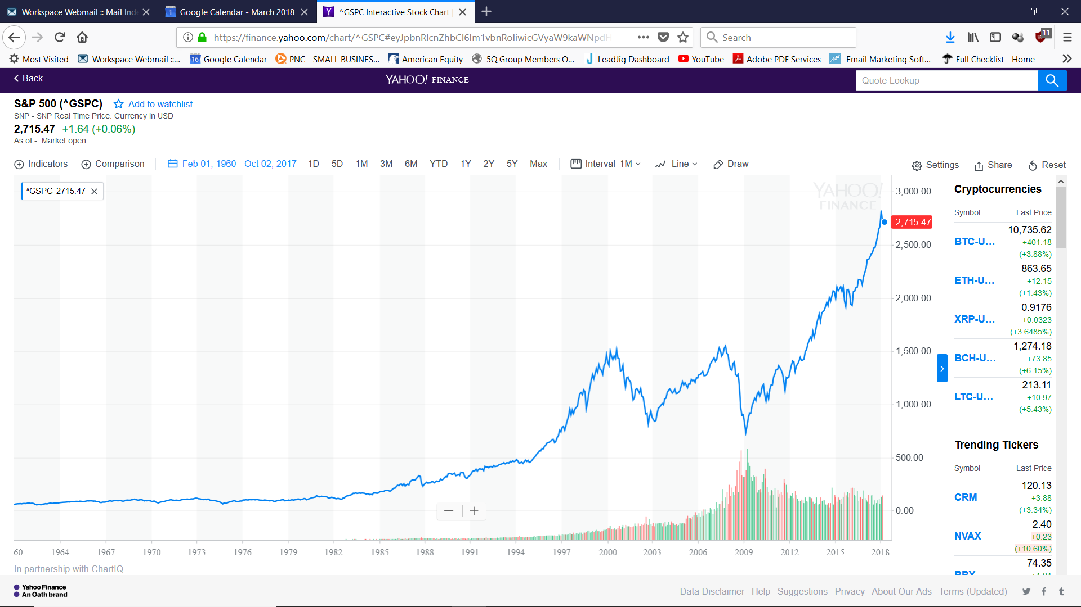
When the market is going up, the Sequence of Returns works for you.
If You sell off 4% and the market
Gains 15% - You replaced the 4%
Sold, and are ahead by 11%
Your $1,040,000 401k = $1,154,400
As long as the Market Goes Up – you’re OK
The Sequence of Returns is working in your favor.
You take Income, Replace Income and Can even Grow Your 401k, 403b and IRA’s
If You sell off 4% (4% Rule) and the market Gains 8% - The 4% you sold is replaced by the 8% market gain and you are ahead by 4%
Your $1,000,000 401k =$1,040,000.
20%+
15%+
15%+
8%+
Historical Chart of the S&P 500 reflecting it’s performance from 1960 - 2018
Notes:
2 Major Concerns….

Slide 50

Retirement Income Strategies
In Down Market Years, things are different.
Here, the Sequence of Returns is Working Against You….

Slide 51
Money is Locked Up in the Market- and taking income can permanently reduce portfolio longevity!
Take out Income and the 4% Rule will Deplete Your Wealth
It happened again in 2007 and 2008; the market fell 59% in one year!
If you sold 4%... and added in the 59% stock value drop
Between 2000 and 2002
the market fell 48%!
If you sold 4% per year and
added in the 48% stock value drop
You lost 63% of
your wealth
(And the Money is Gone!)
You lost 56% of your wealth!
(The Money is Gone!)
Historical Chart of the S&P 500 reflecting it’s performance from 1960 - 2018
Notes:
2 Major Concerns….

Slide 52
The 4% Rule…assumes
Stable markets, to protect balances
Consistent returns, to create stable income

Slide 53
Would it help to see how this
applies today and to your own situation?

Slide 54

Retirement Income Strategies
Myth…It will never happen again, not to me or not when I’m retired
NOT TRUE
Many Lost Money in 2022
2022 – Not Good

Slide 55
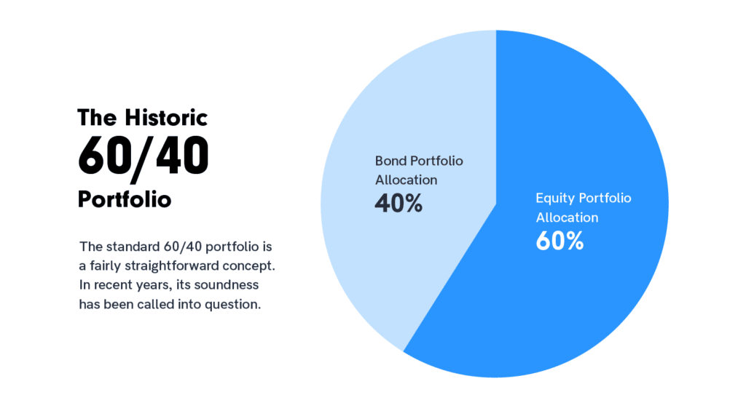
Retirement Income Strategies
Many lost 17% or more in 2022
Which is not bad if you have long time horizon before needing your money and can wait until the market comes back!

Slide 56
So…What’s the Solution…
How do you?
Avoid the income cliff?
Create predictable income?
Coordinate Social Security with your assets?

Slide 57

Retirement Income Strategies
FIRST Don’t Panic …
With Proper Planning….You Can create Stability and Prepare for BEAR markets, using the right strategy.

Slide 58


How?
Retirement Income Strategies
Don’t Put All your eggs in ONE Basket (not just the stock market)
Diversify Baskets, Not just the Assets in One Basket

Slide 59
Diversify Investment Baskets
Reallocate Assets to different Money Baskets to Create Stability
Retirement Income Strategies
Protection Basket | Growth Basket | Income Basket | TAX Advantaged Basket
CD MYGA Index Annuity Buffer ETF | Stocks Growth ETF Index Funds | Dividends / Interest Income Note Income Annuity | Life Insurance Roth IRA Trust

Slide 60


Consider a No Charge - Portfolio “MRI” / We’ll Review Your Investments

Slide 61
Social Security…is one of the strongest income sources you’ll ever have in retirement…and
for most households it replaces only about
30% to 40% of income

Slide 62
The real challenge is filling the gap so that you can afford your lifestyle and
turning the rest of your savings into income
that lasts as long as you do.

Slide 63
What if there were a way to create income
like Social Security…
from your retirement savings and
Never Outlive it?

Slide 64
Would it be helpful to see what this looks like
In a real situation?

Slide 65
Retirement Income Strategies
Case Study - Bob
Let me show you an example based on a real planning scenario
Bob Lost 17% in 2022 using the typical 401k allocation that most people have

Slide 66
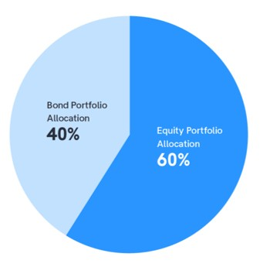
Retirement Income Strategies
Bob was Nearing Retirement
and knew that he was
Running out of time, he was Upset and talked to His Advisor
Who advised changing his allocations within his 401k.
KEY: (Not his Baskets)
The advice was to put
More in Bonds and Less in Equities

Slide 67
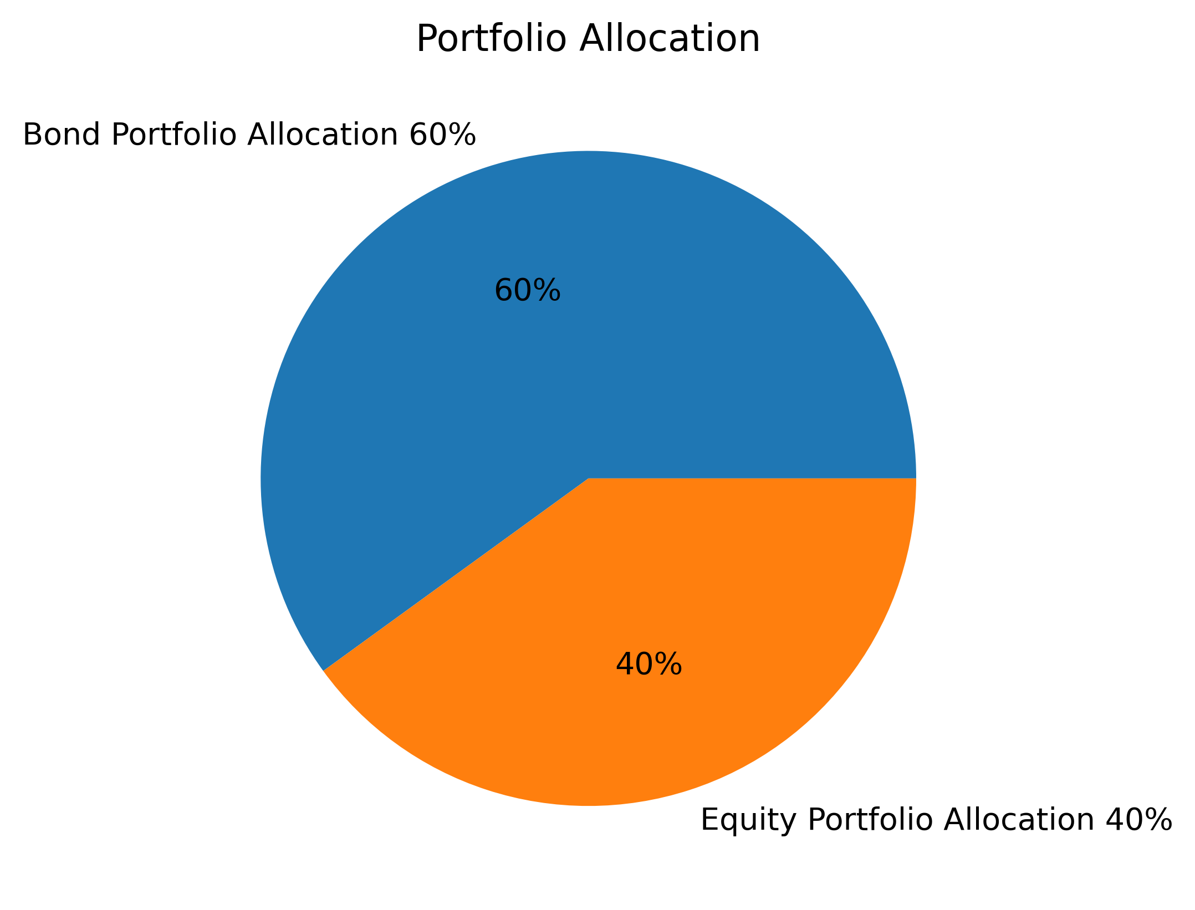
Retirement Income Strategies
to 60% Bonds
40% Equities
His Financial Advisor told him with this allocation he could count on income until age 100

Slide 68
Retirement Income Strategies
Seeing his
Advisors Numbers
I said Great!
“Let’s use his numbers and stress test
your portfolio”
“Let’s see what your income will be and how long it would last”

Slide 69
Retirement Income Strategies
40% in Equities earning 8% per year. (expected)
60% in Bonds earning 3.5% (expected)
Producing income to age 100 (maybe or maybe not)
Here is how Bob’s Advisor recommended he reallocate his $250,000 401k investment:

Slide 70
I SUGGESTED A NEW BASKET…. and that we do a side-by side comparison
I compared his brokers allocation to Rolling $250,000 into a New Basket.
New Basket…with an Insurance Co, guaranteed Income Rider, designed to mirror Social Security and create Stable income.
Retirement Income Strategies
Bob is Age 65 and wants to Retire in 5 years at age 70.
He has $250,000 in his 401k and wants to do a tax-free rollover of the funds.

Slide 71
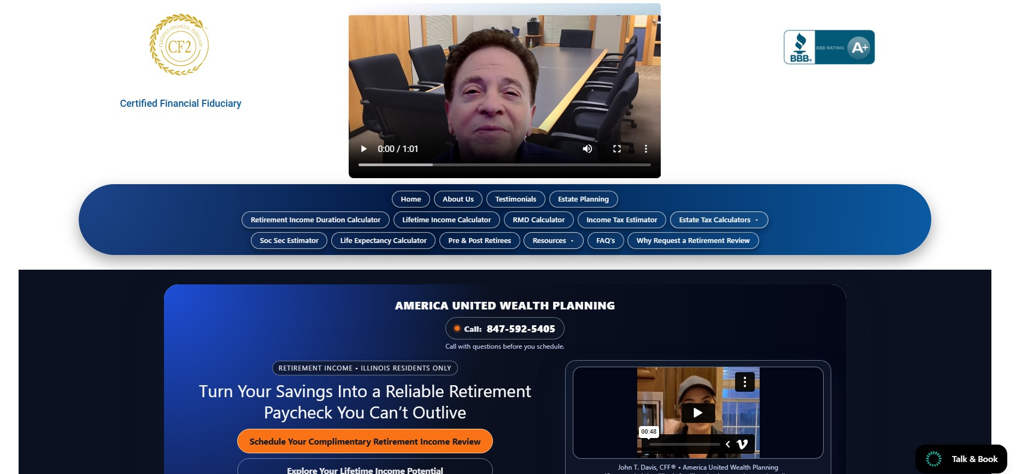
AmericaPlanning.com
Lifetime Income
Calculator

Slide 72
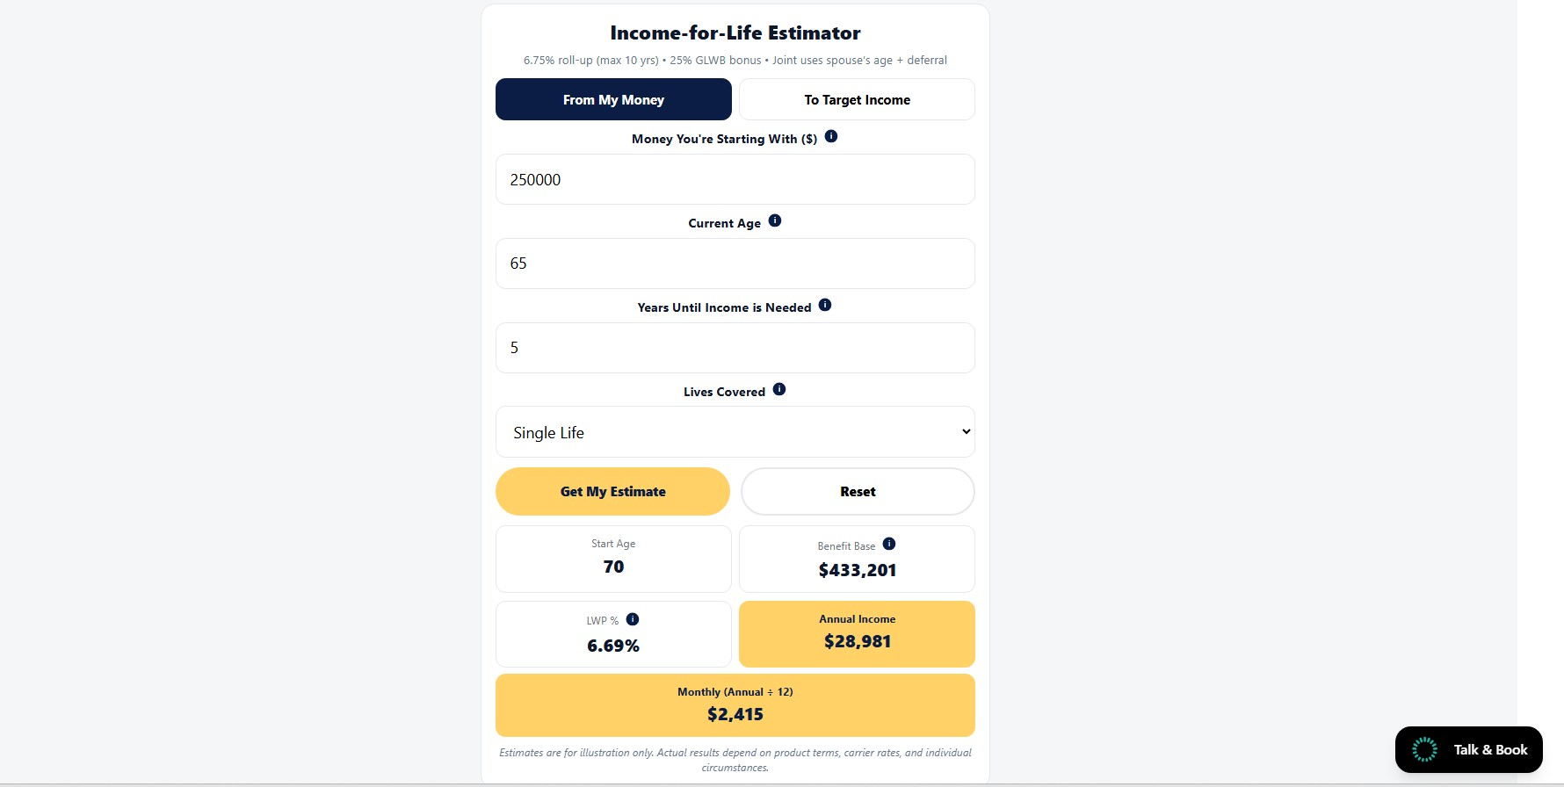
AmericaPlanning.com
Money Starting with $250,000
Put in his current age 65
Put in the years until taking income
Which will be 5 years at age 70
Click Get Estimate
Estimated Income is $28,981 per year

Slide 73
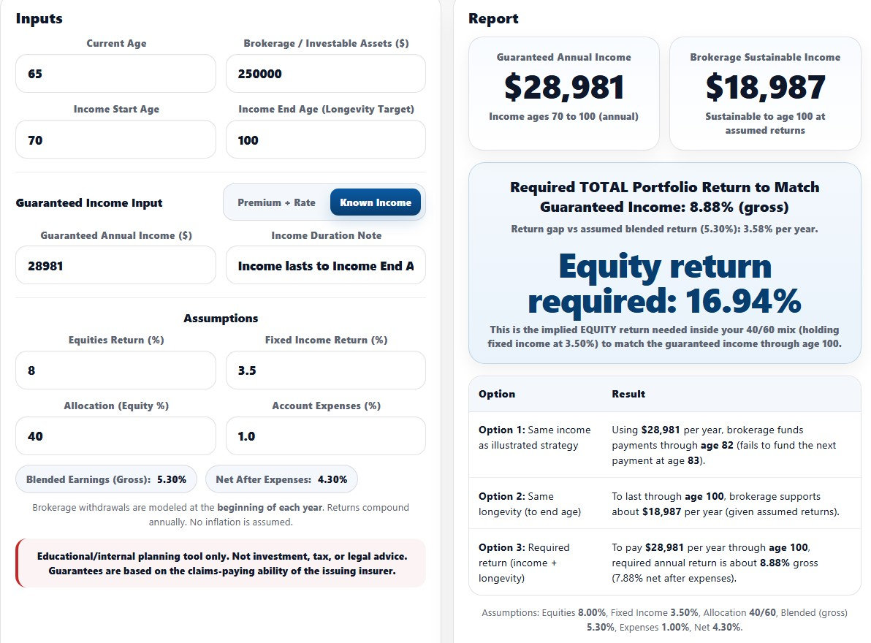
Income is $10,000
More per year
Guaranteed for Life
This is “Assumed” Income
and Returns, subject to losses, it may never happen
If he takes out $28,981 per yr. He runs out at Age 82
Take $18,987 maybe income
vs $28,981 Guaranteed
His Portfolio Needs to earn 8.88% and never go down, not one single year

Slide 74
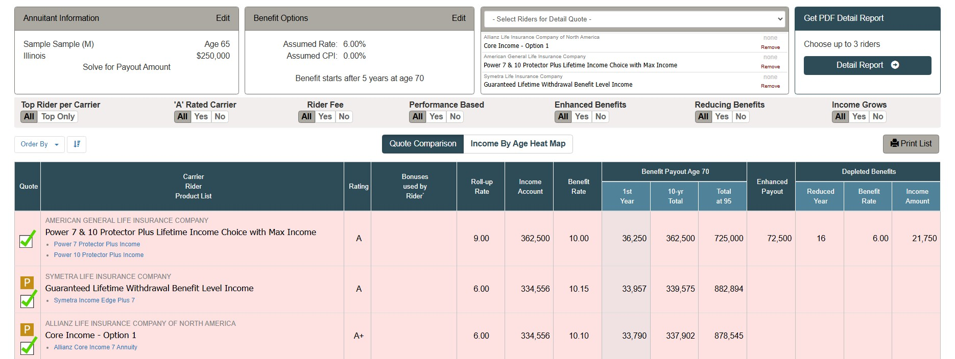
Bob’s and Mrs. Bob’s Income is NOT $28,981…it’s $36,250
This also solves the Social Security Income Cliff for Your Surviving Spouse

Slide 75
Let Me Ask You a Question...
Would it help to see how this applies
to your situation?

Slide 76
Most people leave these sessions…
With a Realization that the decisions they make regarding their Social Security, 401k’s,403b’s and IRA’s, are more complicated than they initially thought

Slide 77
Most people don’t need more products…
They need a coordinated
retirement income strategy.

Slide 78
During my Strategy Sessions with Clients
we work on building something called the
“Income-for -Life Projection”

Slide 79
The GOOD NEWS is…
The AFC, (Association of Financial Consultants) will cover the cost of
this Special Report customized just for you

Slide 80
The Income-for-Life Projection
Is the tool we use to coordinate Social Security timing, withdrawals, taxes and survivor income into one clear strategy

Slide 81
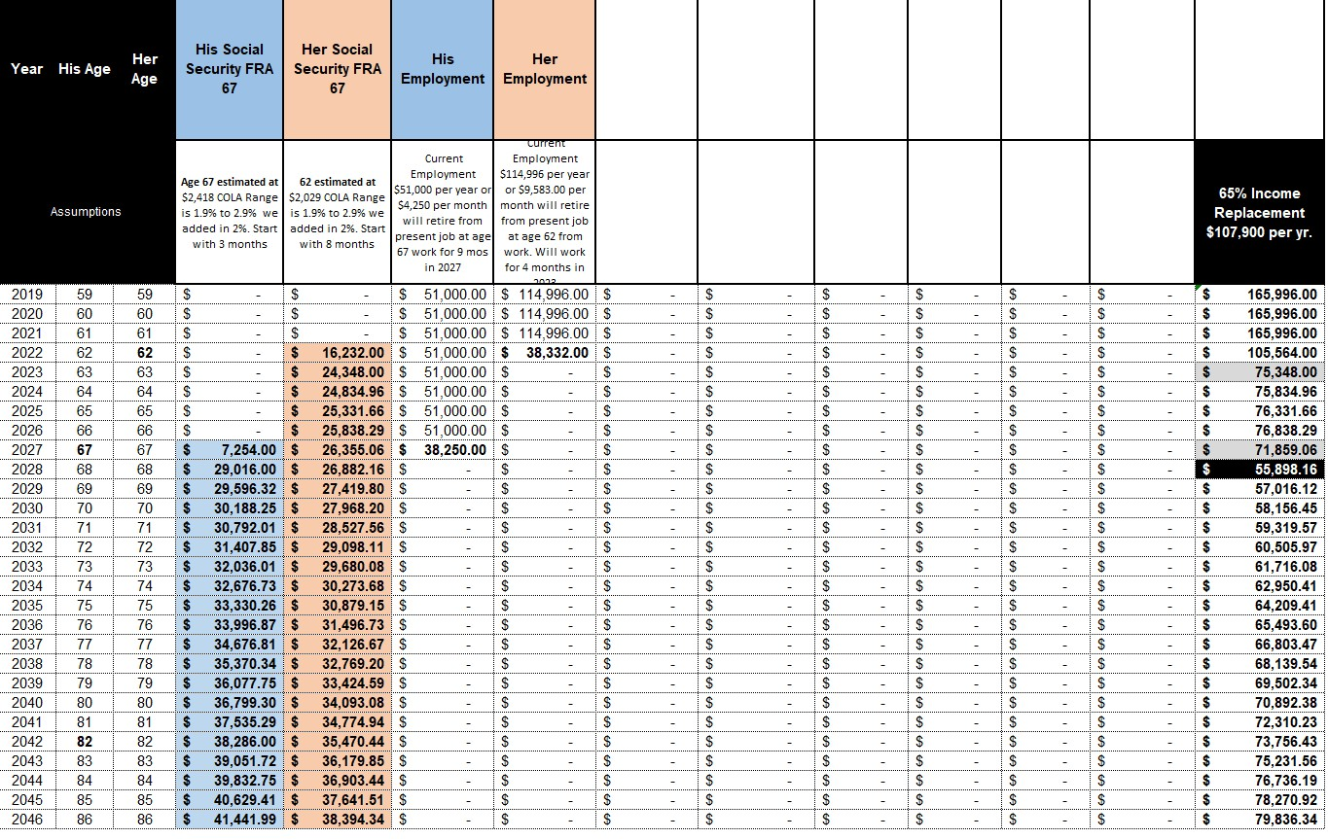
    With the Income-for-Life Projection...
    We cover…
Social Security Optimization

Slide 82
    We coordinate…
PLUS, coordinate withdrawal timing from your retirement accounts

Slide 83
    We evaluate…
$36,250
PLUS evaluate SURVIVOR income protections

Slide 84
    We Stress Test…
$36,250
PLUS, stress-test your income against market downturns

Slide 85
    We review…
PLUS, review tax exposure in retirement

Slide 86
    We build income projections…
PLUS, build a personalized lifetime income projection

Slide 87
If all a Strategy Session did was help you
Avoid claiming Social Security at the wrong time
Would it be worth it?

Slide 88
If all it did was help protect your spouse
from losing income unexpectedly…
Would it be worth it?

Slide 89
If all a Strategy Session did was show whether your savings can produce predictable lifetime income…
Would it be worth it?

Slide 90

With all the Information
Presented Today
How Many of You
are feeling
a little like this kid?

Slide 91
Strategy Sessions are Available
The Cost is covered by the AFC
No obligation
Designed for individuals within
5-10 years of retirement
Spouses encouraged (mandatory)

Slide 92
Get help building
your personalized Social Security
and Income-for-Life Projection
    You can schedule a Strategy Session
    Pick a Time and Day
    Don’t Leave Until I get You on My Calendar.
    Because each projection is personalized, I only open a limited number of Strategy Sessions each week.

Slide 93
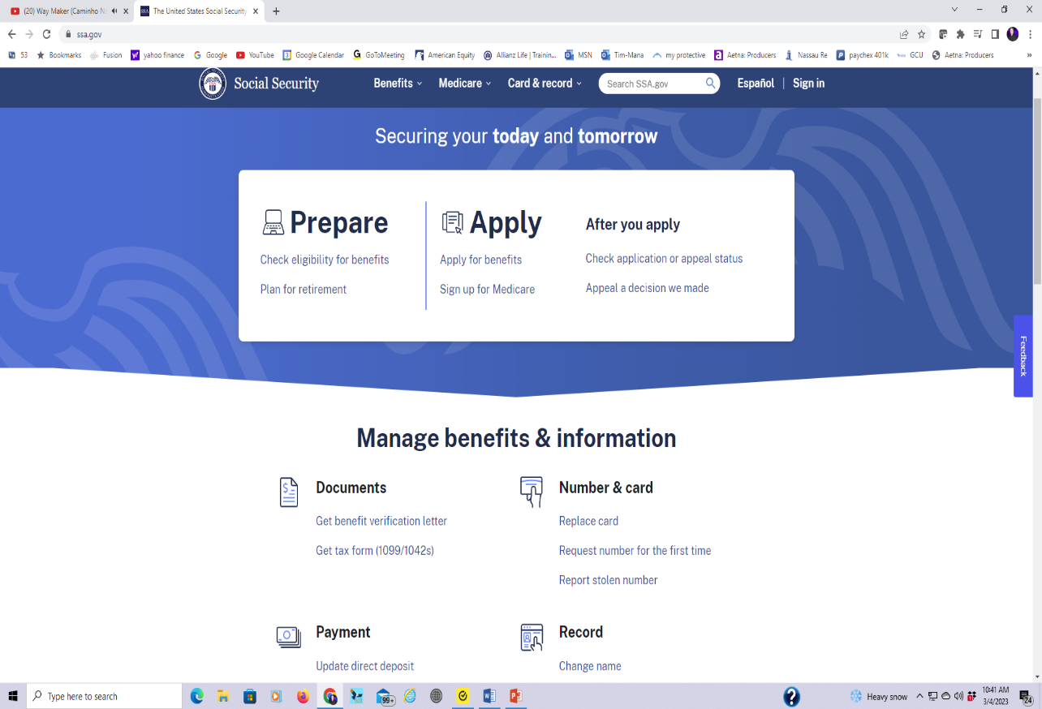
Social Security
Claim your benefit …
1. Apply online ssa.gov
2. Apply by phone 800-772-1213
3. Apply in person local SSA office - by appointment.

Slide 94
Social Security
Do Benefits
Get Taxed?

Slide 95
Social Security
Does Social Security get Taxed?
Some States, Not Illinois, will Tax Social Security Benefits.
Benefits are Subject to Federal Income Tax.
SS gets Taxed at Ordinary Income Rates.
Based on the Provisional Income formula.

Slide 96
Social Security
Married Couple SS
Bill $30,000
Susan $30,000
Total $60,000
Provisional Income:
Only counts ½ of Your Social Security check for taxing purposes
Only ½ for tax purposes
$30,000

Slide 97
Social Security
% Taxed | File - Single | File - Married
0% Subject to taxes | Less than $25,000 | Less than $32,000
50% Subject to taxes | $25,000 to $34,000 | $32,000 to $44,000
85% Subject to taxes | $34,000+ | $44,000+
Federal Tax
If it gets taxed it’s based on Provisional Income and only a portion of your benefit is subject to tax.

