Slide 1


Slide 2





Before We Begin
Please silence your phone.
Be sure you have a pen.
Presenter
John T. Davis CFF
Presenter
Anthony J. Davis
Estate Planning
Attorney
And the Workbook.

Slide 3



America United
Wealth Planning
1900 E Golf Road Suite 950 Schaumburg, Illinois 60173
3601 W. Algonquin, Ste 860
Rolling Meadows, IL 60008
Phone 847.592.5405
Phone 847. 737.1800 ext.105
www.Ntegritylaw.com
www.AmericaPlanning.com

Slide 4
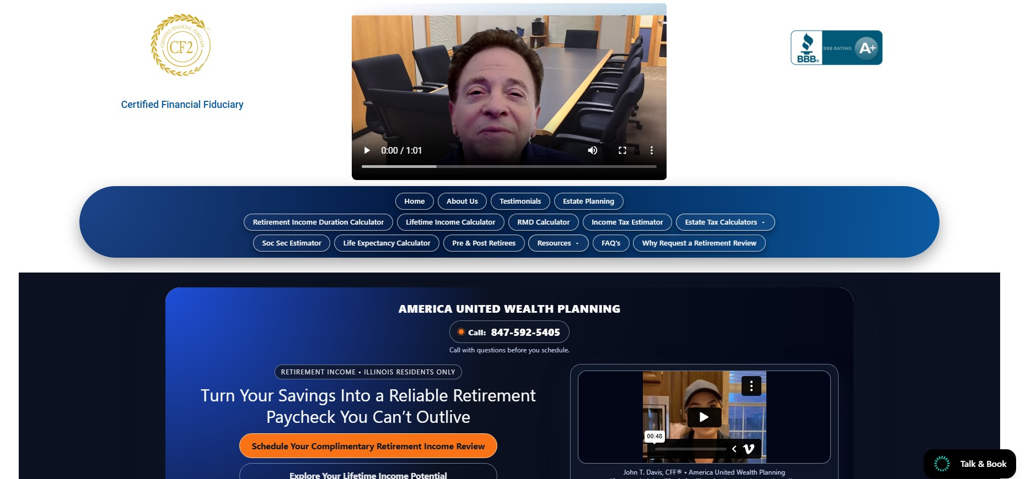
Just one address is needed: AmericaPlanning.com
Anthony’s
Contact info.
Just Click on
Estate Planning

Slide 5
By the end of…this workshop….You’ll
Learn How to Create….
Why do we call this class?
Retirement Planning “for
Peace of Mind Guaranteed”
Stability of your base Income. How to maximize your Social Security Benefits and get the most you can.
Stability of Income from Investments. How to beat the market and maximize your 401k, 403b, IRA Retirement Income and completely STOP the potential for losing money in the market! You’ll see a real Client Case Study.
Our focus is on Creating Stability in the 3 Key
Areas of Retirement
Stability of Living Documents & Legacy Docs How to protect your estate and make sure your assets get to your loved ones legally, privately and without publicly disclosing your assets.

Slide 6
Lot of information. I move quickly – you will not be bored.
Class Today Is
90 Minutes
I’ll share…Important Rule Changes and Updates you may not be aware of.
I Recommend you take notes.
Questions – Please hold until the end. Private Strategy Sessions, will be made available at no cost.

Slide 7

Today is about Education
Not here to sell anything.

Slide 8

My Pay it Forward
Non-Profit org
Free Education
to seniors in our community.

Slide 9
This presentation is for Educational purposes only.
Before We Start
Disclaimer
This information and presenting professionals are not affiliated or endorsed by the Social Security.
Administration or any government agency.
Presenters are licensed & certified professionals but are not providing specific legal or tax advice to you, only general information on the subjects presented.
You may also find information regarding Social Security from your local Social Security.
Administration Office or online at www.ssa.gov.
Not giving financial advice today.
Consult with your own professional.
*For information purposes only, not affiliated or endorsed by Social Security Administration or any government agency

Slide 10
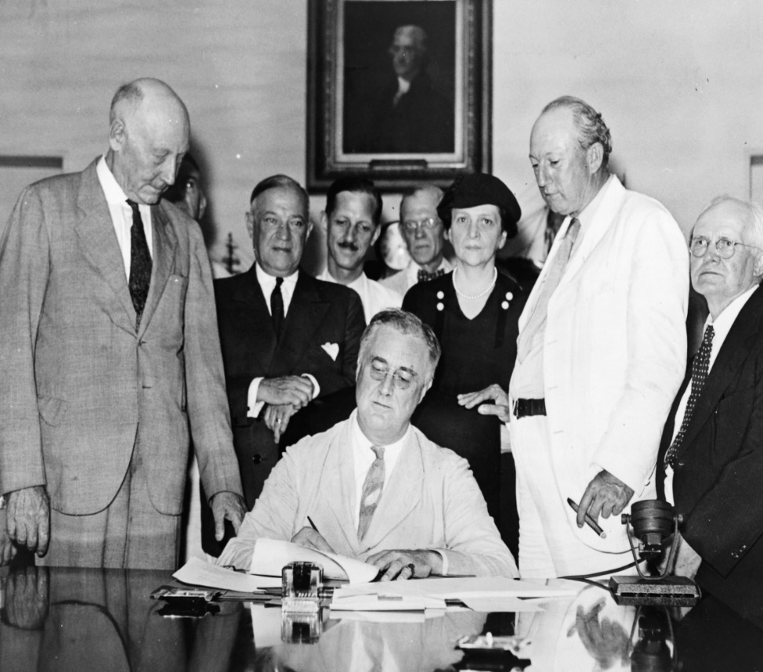
Social Security
How It Started
President Franklin D Roosevelt
Signs the social security act into law.
August 14, 1935

Slide 11
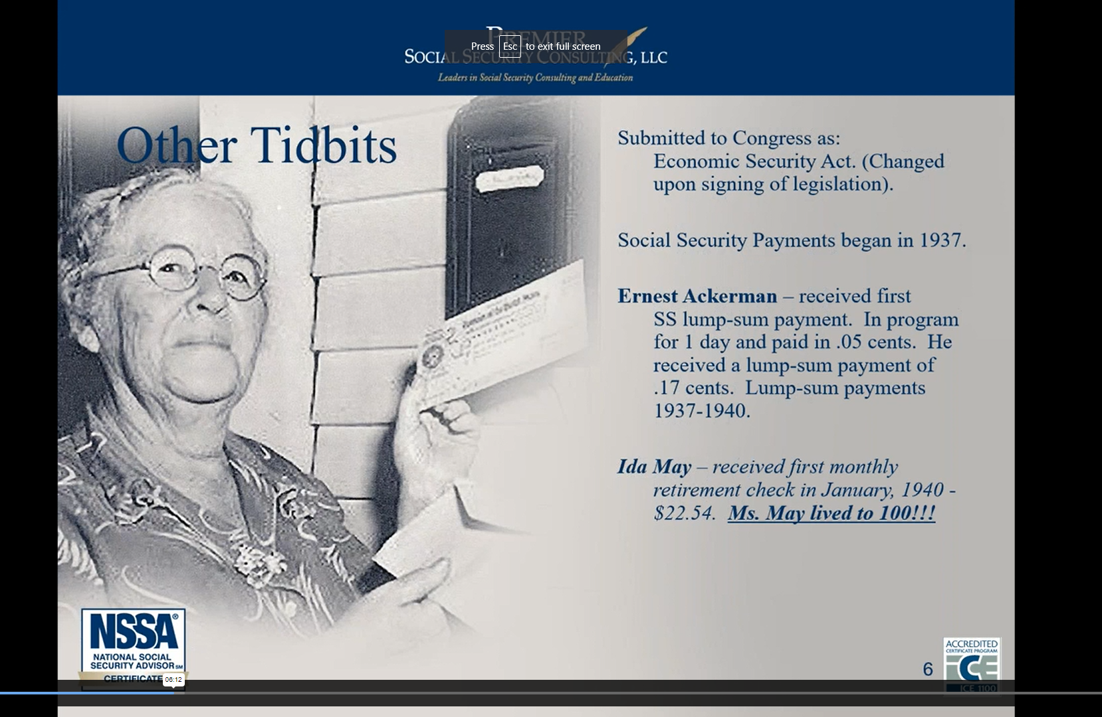
Social Security
1940
Ida May
First Monthly Social Security Check
$22.24

Slide 12
What is Social Security?
You and Your Employer pay into the Social Security Trust (annuity) to help fund it.
You’re Paying into the two Trusts through Payroll deductions. 1.Soc Sec, 2.Medicare
Social Security
Is a Government Backed Annuity
Like a matching 401k, your employer matches what you pay in. Your employer pays into the System as well.
When you claim - Social Security Pays
You a lifetime Income Benefit.
There are Private Insurance Companies
that offer annuity products that mirror your Social Security annuity. They provide lifetime
income benefits as well.

Slide 13
Social Security
Over 200 million workers will be covered.
Social Security
Over 70 million Now Collecting.
Today
Over a TRILLION in benefits paid annually.
Avg Benefit is $2,071 a month in 2026.
The Maximum FRA benefit is $4,152 a month
in 2026.

Slide 14

Social Security
Social Security –New Rules.
Be Aware of this one.
File & Suspend strategy, is GONE!
No longer any Switch Option between a married couple.

Slide 15

Social Security
The Social Security Fairness Act (Act) was signed into law on
January 5, 2025.
The Act ends the Windfall Elimination Provision (WEP) and
Government Pension Offset (GPO). This law increases Social
Security benefits for certain types of workers, including some:
teachers, firefighters, and police officers in many states;
federal employees covered by the Civil Service Retirement System; and
people whose work had been covered by a foreign social security system.
To learn more below about the steps the Social Security Administration is taking to implement the law,
visit: ssa.gov/benefits/retirement/social-security-fairness-act.html
Social Security –New Rules.
No More WEP!

Slide 16
Social Security
How is Social
Security is
Funded?
It’s Funded by those who are working…and contributing to Social Security through payroll deductions, (taxes) deducted from their paychecks.
Workers are the ones paying for Retired Worker’s who are currently collecting Social Security payments.

Slide 17
Social Security
FICA – Federal Income Contributions Act
*7.65% Employee + 7.65% Employer =15.30%
SPECIFICALLY
It’s funded by FICA taxes that are deducted from workers paychecks…
*NOTE 1.45% for Medicare Tax (6.20+1.45=7.65)
Extra .9% Get’s Paid to Medicare if Your wages are over $200,000 as a Single. AND If you’re Married Filing Jointly and have an income over $250,000 per year.

Slide 18
Social Security
These FICA taxes go into.
OASI - Old Age and Survivor Insurance
DI - Disability Insurance
Two Trusts

Slide 19

Social Security Changes
2026 Increase in benefit COLA 2.8 %
Key Updates
2026
2026 Increase in Payroll Tax Contributions
Was $168,600 Now $184,500 year
2026 Increase Medicare Part B
Was $185 a mo. Now $202.90 a mo.

Slide 20

Social Security
Is Social Security Broke?
Will my benefits be there?

Slide 21

Social Security
Social Security is solvent however,
Shortfall of about 1/3 could happen in 2034.

Slide 22
Social Security
Do You Mind if I show You
Why Social Security going broke may be a False Belief?

Slide 23
Social Security
#1 It would be….
#2 How does our Government Get Money?
Governments do not get income from selling goods and services, they tax for income.
Our Government will and MUST raise taxes to pay for these programs…OR bankrupt the economy.
Devasting for the Economy, potentially causing a Depression
Seniors spend their Social Security Money, giving jobs to workers who earn wages and those workers spend their wages to live and support their family and the economy.

Slide 24

Social Security
How to qualify for benefits
How do I Qualify for Benefits?
WORKERS need 40 PIA CREDITS or 10 YEARS of work
ONE CREDIT PIA every $1,810 earned in a year with
4 PIA CREDITS if you earn $7,240 or more.
2026
For the Social Security Geeks
You earn $1,810 which = 1 credit. Maximum of 4 PIA credits per year $7,240 earnings = 4 credits X 10 years of work= 40 credits required to qualify for retirement benefits
Social Security Administration, 2025 Social Security Changes, Fact Sheet.
Notes:
How do you qualify for benefits?
You must be fully insured, which means you earned the required number of Social Security credits.
Most workers need 40 credits. That is about 10 years of work (at four quarters each year).
Through the years the way you earn credits has changed. In 2025, one credit is recorded for every $1,810 you earn in a year, with four credits if you earn $7,240 or more.

Slide 25
Social Security
To find out your benefit Amount You…Need To Know
FRA = Full Retirement Age
PIA = Primary Insurance Amount

Slide 26
Social Security
Full Retirement Age is determined by the year you were born.
Can start benefits:
Year of birth | Full retirement age (FRA) | Age 62 benefit reduction
1943 - 1954 | 66 | 25.00%
1955 | 66 and 2 months | 25.83%
1956 | 66 and 4 months | 26.67%
1957 | 66 and 6 months | 27.50%
1958 | 66 and 8 months | 28.33%
1959 | 66 and 10 months | 29.17%
1960 or Later | 67 | 30.00%
  EARLY at age 62 = less
  FULL retirement age = 100%
  DELAY until age 70 = more
Delaying past FRA results in delayed retirement credits (DRCs).
Social Security Administration, 2026 Social Security Changes, Fact Sheet.
Notes:
You can start benefits as early as age 62. But, depending on your full retirement age, as shown in the chart, you will receive 25-30% less in benefits.
Delaying start date after FRA results in delayed retirement credits (DRCs).
Selecting the time for you to retire should be based on your health, life expectancy, how much you have in other retirement plans, etc.

Slide 27
Social Security
PIA = Primary Insurance Amount = the
Amount you
Get each month.
PIA is the dollar amount you get at your Full Retirement Age
Based on your own career earnings record.
Must have at least 10 years total, of paying FICA.
To calculate Social Security averages your highest 35 years of earnings, Then Indexes for inflation.
Remember: PIA is Your Monthly Benefit Amt.

Slide 28


Social Security How soon How Late?
You have an 8 Year window to claim SS
62,63,64,65,66,67,68,69,70
When is the Best Age to claim?

Slide 29
Social Security
About 30–35% of retirees claim Social Security at age 62, making it the single most common claiming age in the U.S.
Many believe 62 is the best age to claim

Slide 30
Social Security
Do You Mind if I show You
Why this belief, Age 62 is the best age, may be a False Belief?

Slide 31

Social Security
Our Retirement Goal should be to create STABILTY of our base income…
When to apply boils down to Personal Choice.
You must take into Consideration:
When you need the money.
Your Life Expectancy.
Employment status.
Your other income sources.

Slide 32
(TRUE or FALSE) is 62 the Best Age to claim?
Monthly Benefit Amount
Take at 62 = Lose 30%
Earn 8% Per Yr/ Gain 24% at age 70
This example assumes a benefit of $1,000 per mo.
(100% of this persons full retirement age benefit at their age 67)

Slide 33
Monthly Benefit Amount
You’ll almost double your Social Security Income!
67
This example assumes a benefit of $1,000 per mo.
at a full retirement age of 67
Form 521 Withdraw of Application (file within 1 year of claim date)

Slide 34
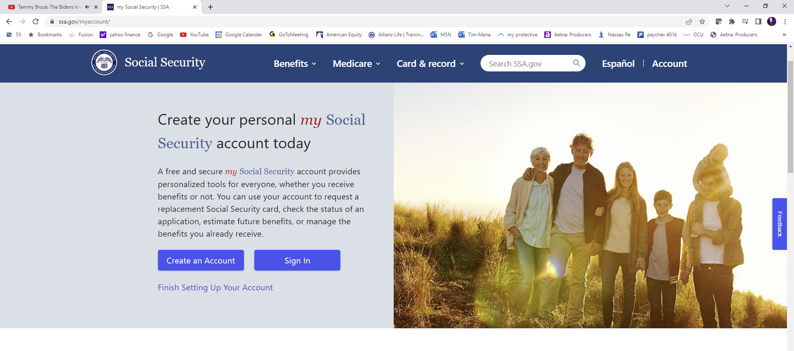
Social Security
Find your
Social
Security
Info – online
ssa.gov/myaccount

Slide 35
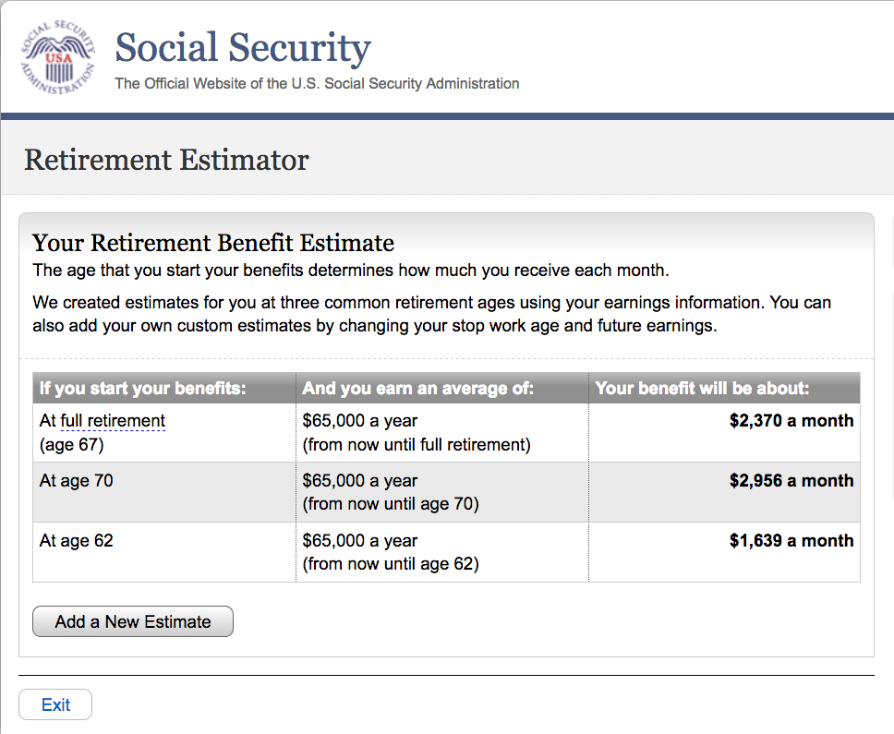
Social Security
3 Key Figures
At FRA = PIA
At age 70
At age 62

Slide 36
Form 521 Withdraw of Application (file within 1 year of claim date)
Social Security
EARLY is any year, before your FRA.
The Answer is YES…BUT know that
Your Social Security benefits are subject to the Annual Earning Test.
Which means: If you make too much money, a Penalty will apply.
The penalty reduces your monthly benefit amount, if you exceed the earnings limit.
Can you claim SS EARLY, While still working?

Slide 37
Form 521 Withdraw of Application (file within 1 year of claim date)
Social Security
2026 Annual Earnings Test (AET)
What Counts:
Earned Income. Your wages, commissions or net profits from your business. (for most it will be W-2 wages)
What’s NOT Counted?
IRA distributions
Rental Income
Lottery winnings
Stock Options
Maybe – Severance Pay
$24,480 year
$2,040 Month
$65,160 year
$5,430 Month
Form 521 Withdraw of Application (file within 1 year of claim date)

Slide 38


QUESTION…
Do Married Couples Get Additional Benefits that Singles Don’t get?
YES….
Marrieds Get Both
A “Spousal Benefit”
and
A “Survivors Benefit”

Slide 39

“The Spousal Benefit”
At FRA, You get the Option to take Your Own Benefit
or 50% of the Primary Wage Earners, Which ever is Highest!
50%
His $3,000
Her $1,000
50% of His
$3,000
= $1,500
Sadly, many wind up taking the $1,000 simply because they do not know
that they have this option and don’t take advantage of it.

Slide 40
Social Security
Divorced Ex-Spousal Benefit is …
Rules
Must have been married at least 10 years
Divorced for 2 years and at least 62.
Ex Spouse must be also be at least 62, ---
Note - Ex does not need to be collecting their social security benefit.
Haven’t remarried before 60.
Reduced amount if claimed before FRA
½ of the ex’s PIA

Slide 41
Social Security
Married Couple Survivor Benefit
Upon death, Surviving Spouse
gets the HIGHER of the two benefits
But not both
A married couple who are both collecting a social security benefit.

Slide 42
“The Survivor Benefit” (This is BIG reason why NOT to apply at age 62)
What happens if (EITHER) one passes on before the other?
Social Security Creates an Income Cliff!
Upon the death of either one the lower $18,000 ck check is gone!
A Sudden drop in income Creating an Income Cliff
His
$36,000 Yr.
+
Her
$18,000 Yr.
=
Combined
$54,000
Her $18,000 income is lost and the Combined $54,000 Gets Reduced down to $36,000
The Survivor losses 33% of their income, all while mourning
the loss of their Spouse, which could be financially devastating!

Slide 43
Social Security
Surviving spouse will Still have a switch option.
Example: Claim Deceased Spouse benefit first – then later switch and claim own later.
To claim: Must be at least 60 years old.
(50 if disabled.)
Ex-Deceased Spouse Social Security?

Slide 44
Social Security
Do Benefits Get Taxed?

Slide 45
Social Security
Does Social Security get Taxed?
Some States, Not Illinois, will Tax Social Security Benefits.
Benefits are Subject to Federal Income Tax.
SS gets Taxed at Ordinary Income Rates.
Based on the Provisional Income formula.

Slide 46
Social Security
Married Couple SS
Bill $30,000
Susan $30,000
Total $60,000
Provisional Income:
Only counts ½ of Your Social Security check for taxing purposes
Only ½ for tax purposes
$30,000

Slide 47
Social Security
% Taxed | File - Single | File - Married
0% Subject to taxes | Less than $25,000 | Less than $32,000
50% Subject to taxes | $25,000 to $34,000 | $32,000 to $44,000
85% Subject to taxes | $34,000+ | $44,000+
Federal Tax
If it gets taxed it’s based on Provisional Income and only a portion of your benefit is subject to tax.

Slide 48
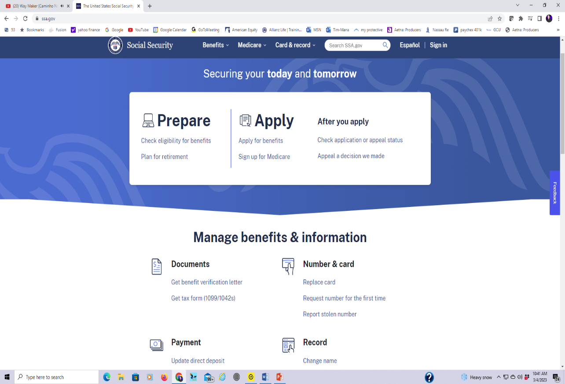
Social Security
Claim your benefit …
1. Apply online ssa.gov
2. Apply by phone 800-772-1213
3. Apply in person local SSA office - by appointment.

Slide 49

Retirement Income Strategies
Maybe all this Social Security Stuff seems more complicated than you thought ?

Slide 50
Social Security
Do You Mind if I show You
a Simpler way to find out
what Your Social Security
Income will be?

Slide 51
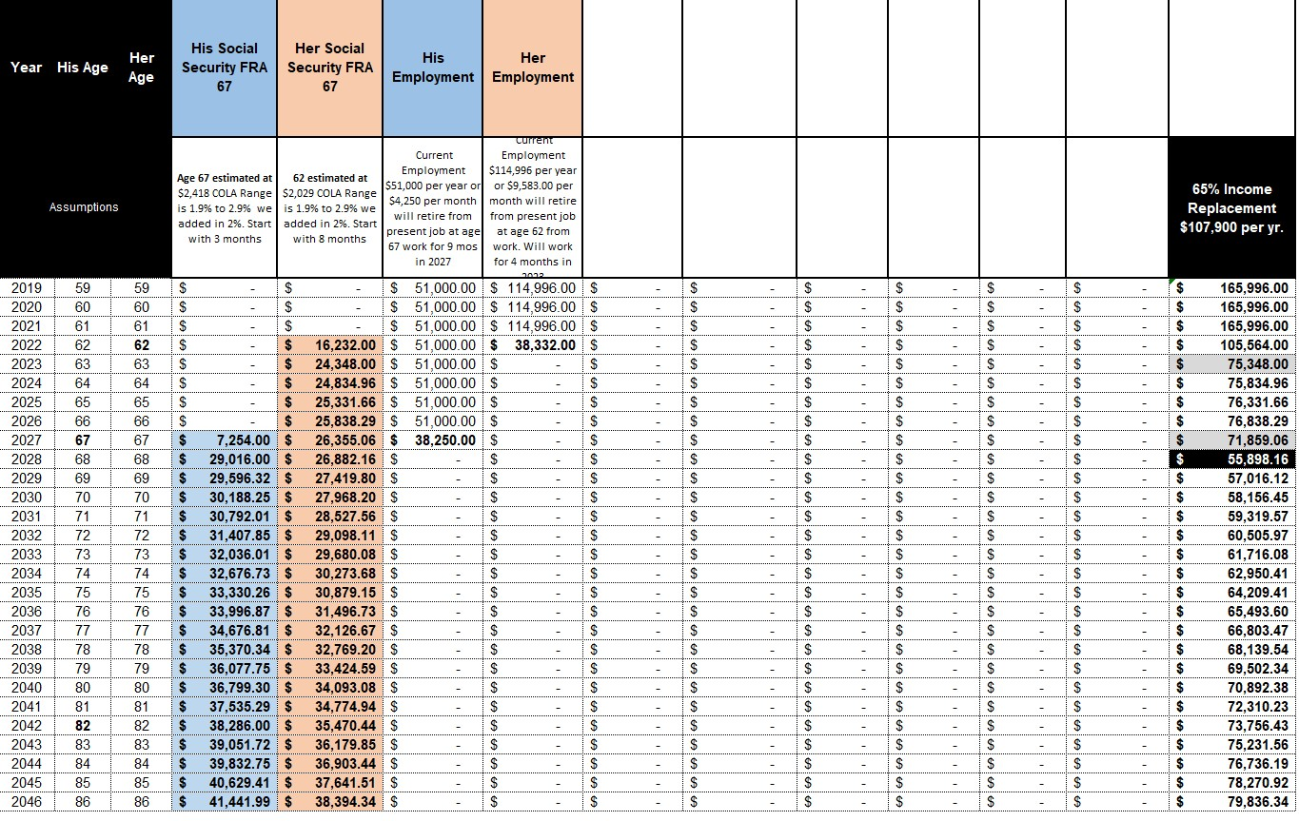
At No Cost
Customized “Income for Life” Retirement Income Projection…including projected Social Security.
    Book a Strategy Session Call or Meeting, with me Today...
    When we meet…
    I’ll Estimate Your Social Security Income and provide you with our:

Slide 52
Section 2
Retirement Income Strategies that Create Stability.
How the 4% rule recommended by your Advisor might create unstable income
How to remove the risk of outliving your income in retirement.
How my Client doubled his 401k, 403b and IRA income and how you can to.

Slide 53
Retirement Income Strategies
Your Retirement Goals
should be to:
Set up Stable Income for LIFE.
Maintain Proper Asset Allocation.
Make sure your Estate Planning and Living Legal Documents are in place

Slide 54
Social Security
Many are led to believe
“That all they need to do is follow the
4% Rule
and they’ll never outlive their money”

Slide 55
Retirement Income Strategies
You sell 4% of your invested 401k’s, 403b’s and IRA’s…
each year, and use the money as your retirement income.
What’s the
4% Rule?

Slide 56
Social Security
Do You Mind if I show you
why…
this is NOT as simple
as it sounds?

Slide 57
Retirement Income Strategies
Your employer paycheck stops.
You move from employer insurance to Medicare.
Claim Social Security.
You stop contributing to 401k or the employer retirement plan.
Start the draw down from investments and now Pay Taxes.
You move from ACCUMULATION Phase to DISTRIBUTION Phase.
When you retire –
things will be different.

Slide 58

Retirement Income Strategies
In Distribution
You’re Paycheck is gone and you’re depending on
Your Assets for Retirement income
The need for a Seasoned Financial Advisor
who understands this phase of life.

Slide 59

Retirement Income Strategies
The Sequence of
Market Returns dictates when the 4% Rule will work for you and when it won’t.

Slide 60
Retirement Income Strategies
The Sequence of Returns dictates what years YOU CAN or CAN NOT take income out of Your 401k, 403b and IRA’s invested in the Stock Market.

Slide 61
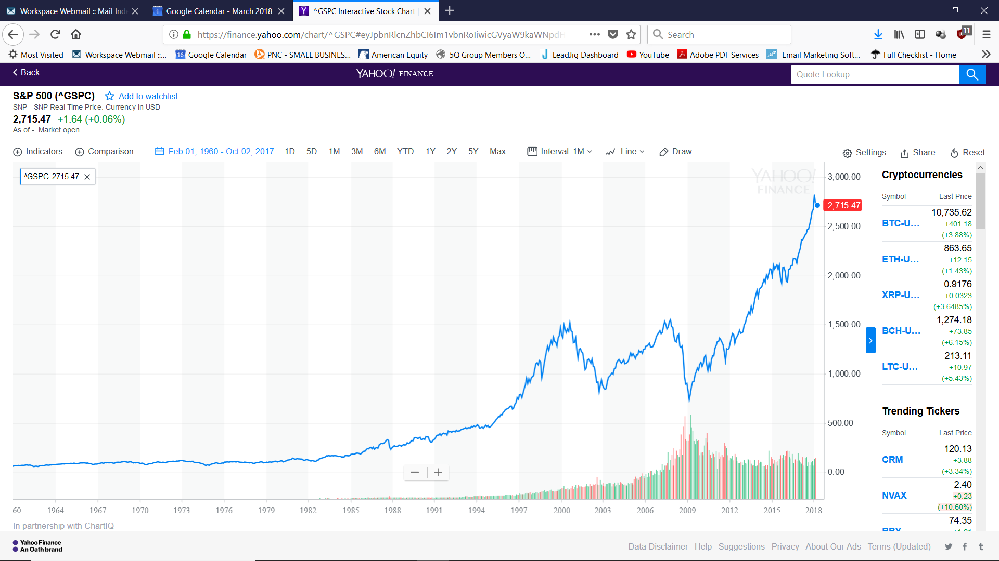
When the market is going up, the Sequence of Returns works for you.
If You sell off 4% and the market
Gains 15% - You replaced the 4%
Sold, and are ahead by 11%
Your $104,000 401k = $115,440.
As long as the Market Goes Up – you’re OK
The Sequence of Returns is working in your favor.
And…Your 401k, 403b and IRA’s Grow
If You sell off 4% and the market
Gains 8% - The 4% you sold is replaced by the 8% market gain and you are ahead by 4%
Your $100,000 401k =$104,000.
20%+
15%+
15%+
8%+
Historical Chart of the S&P 500 reflecting it’s performance from 1960 - 2018
Notes:
2 Major Concerns….

Slide 62

Retirement Income Strategies
In Down Market Years, things are different.
The Sequence of Returns is Working Against You….

Slide 63
Bear Markets = No Income!
Take out Income and the 4% Rule will Deplete Your Wealth
It happened again in 2007 and 2008; the market fell 59% in one year!
If you sold 4%... and added in the 59% stock value drop
Between 2000 and 2002
the market fell 48%!
If you sold 4% per year and
added in the 48% stock value drop
You lost 63% of
your wealth
You lost 56% of your wealth!
Historical Chart of the S&P 500 reflecting it’s performance from 1960 - 2018
Notes:
2 Major Concerns….

Slide 64

Retirement Income Strategies
Many Lost Money in 2022
2022 – Not Good

Slide 65
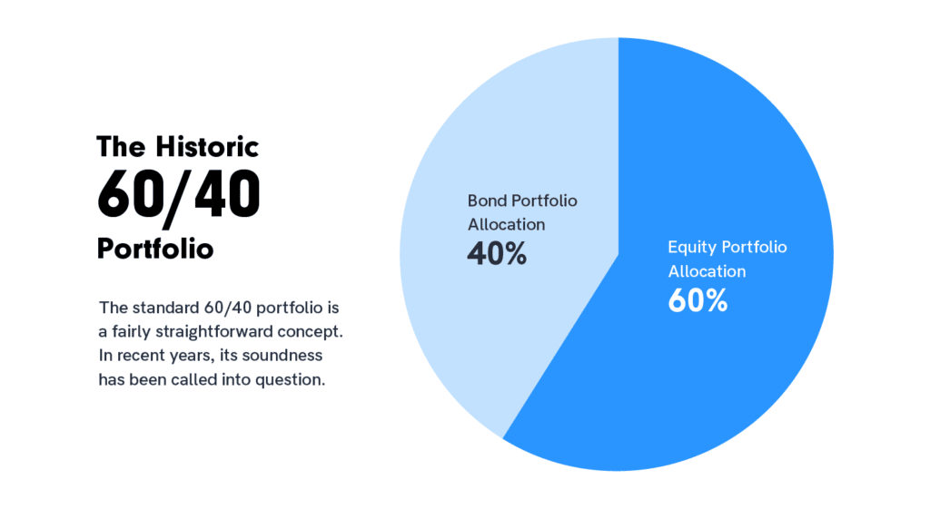
Retirement Income Strategies
Many lost 17% or more in 2022
Which is not bad if you have long time horizon before needing your money!

Slide 66

Retirement Income Strategies
Don’t Panic …with Proper Planning….You Can create Stability and Prepare for BEAR markets, with the right strategy.

Slide 67


Retirement Income Strategies
Don’t Put All your eggs in ONE Basket ----
Diversify Baskets to create stability

Slide 68


No Charge - Portfolio MRI Review of Investments

Slide 69
Diversify Investments
And Reallocate Assets to different Money Baskets and Create Stability
Retirement Income Strategies
Protection Basket | Growth Basket | Income Basket | TAX Advantaged Basket
CD MYGA Index Annuity Buffer ETF | Stocks Growth ETF Index Funds | Dividends / Interest Income Note Income Annuity | Life Insurance Roth IRA Trust

Slide 70
Social Security
Do You Mind if I show you
How I helped one of my
Clients?
1. Beat the market returns, promised by his Advisor.
2. Double his retirement income.
3. Create Stability with an income he and his wife can’t outlive.

Slide 71
Retirement Income Strategies
Case Study
Real client Age 65
$250,000 401k
Lost 17% in 2022 using the typical 401k allocation that most people have

Slide 72
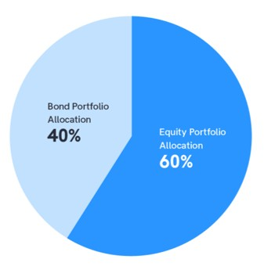
Retirement Income Strategies
Nearing Retirement
He Was Upset and talked to His Advisor
Who advised changing his allocations,
KEY: (Not his Baskets)
The advice was to put
More in Bonds and Less in Equities

Slide 73
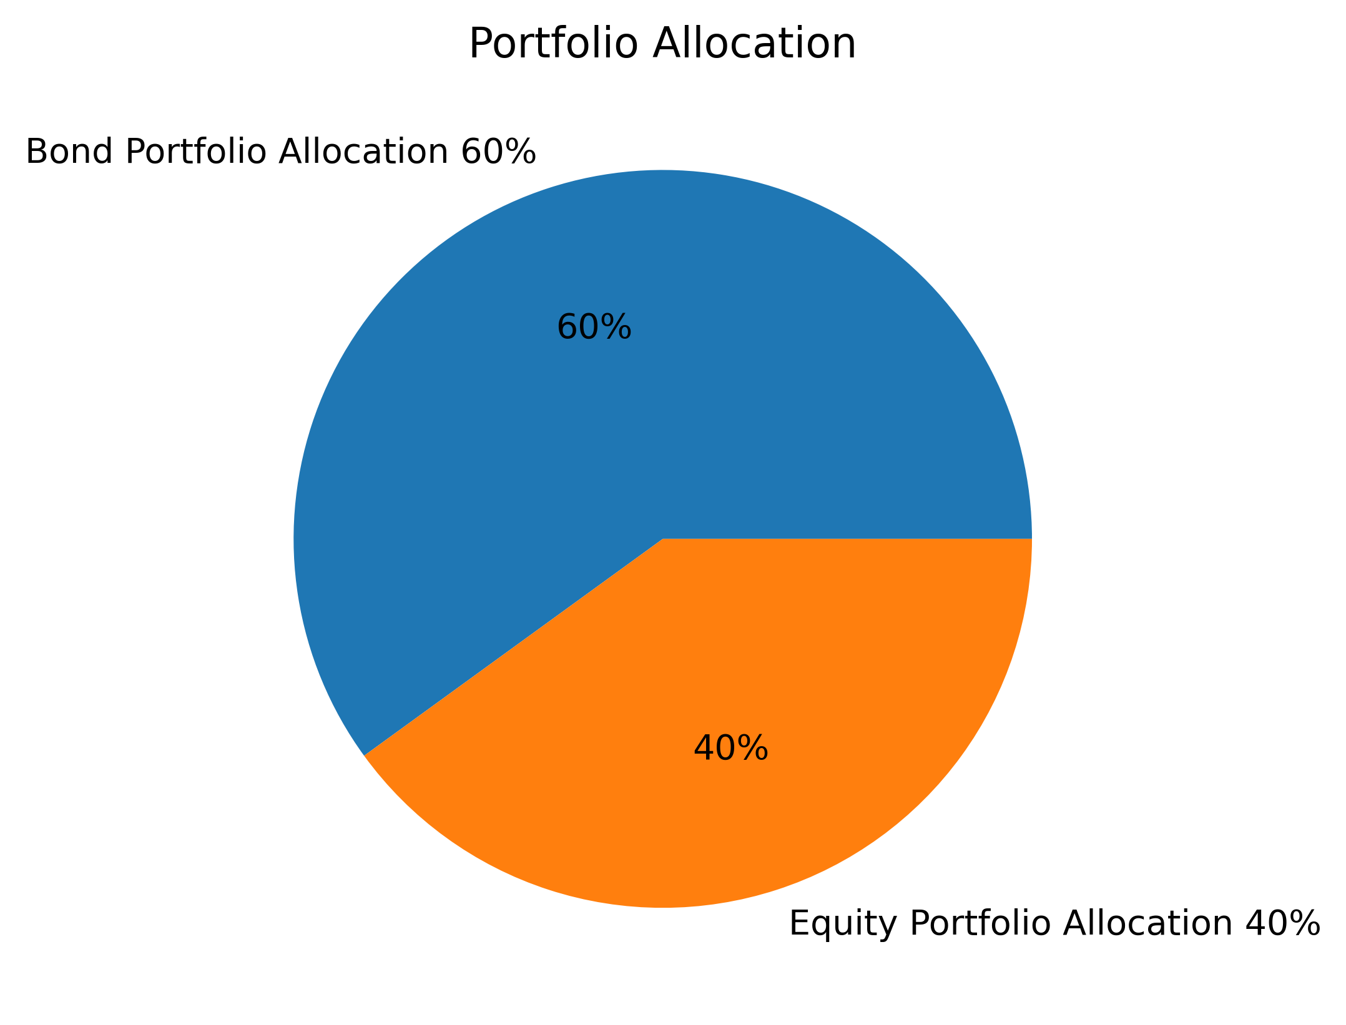
Retirement Income Strategies
to 60% Bonds
40% Equites
His Financial Advisor told him with this allocation he could count on income until age 100

Slide 74
Retirement Income Strategies
Seeing his
Advisors Numbers
I said Great!
“Let’s use his numbers and stress test
your portfolio”
“Let’s see what your income will be and how long it would last”

Slide 75
Retirement Income Strategies
His Broker’s reallocation is as follows:
40% in Equities earning 8% per year.
60% in Bonds earning 3.5%
Producing income to age 100
Client is Age 65 and wants to Retire in 5 years at age 70.
He has $250,000 in his 401k and wants to do a tax-free rollover of the funds.

Slide 76
I SUGGESTED A NEW BASKET…. and a side-by side comparison
I compared his brokers allocation to Rolling $250,000 into a New Basket. With an Insurance Co, guaranteed Income Rider, designed to mirror Social Security and create
Stable income.
Retirement Income Strategies
Client is Age 65 and wants to Retire in 5 years at age 70.
He has $250,000 in his 401k and wants to do a tax-free rollover of the funds.

Slide 77
AmericaPlanning.com
Lifetime Income
Calculator

Slide 78
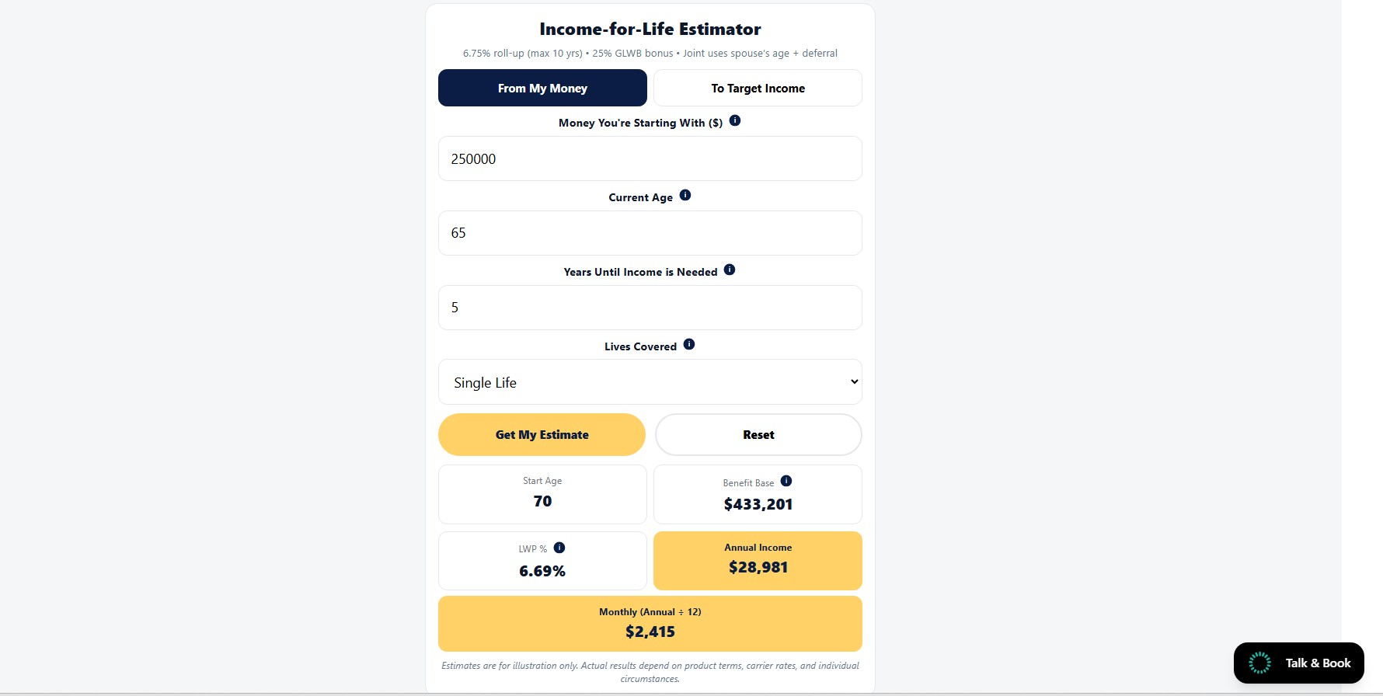
AmericaPlanning.com
Money Starting with $250,000
Put in his current age 65
Put in the years until taking income
Which will be 5 years at age 70
Click Get Estimate
Estimated Income is $28,981 per year

Slide 79
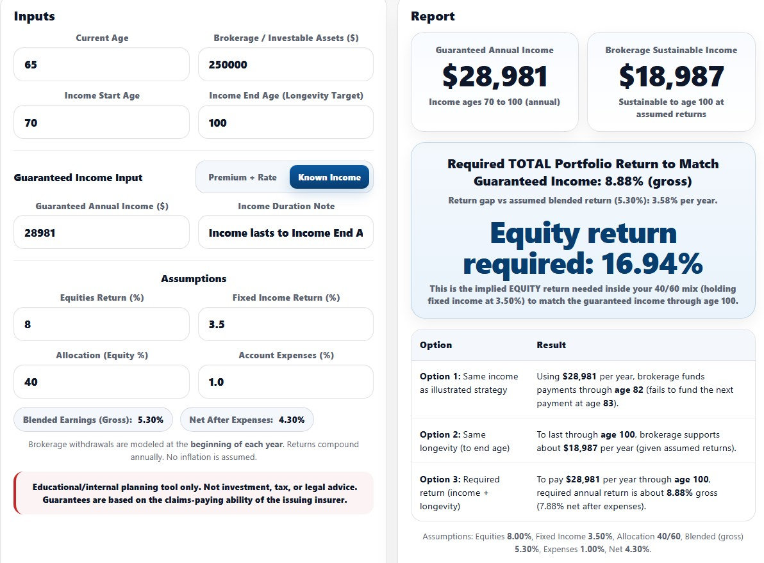
Income is $10,000
More per year
Guaranteed for Life
This is “Assumed” Income
and Returns, subject to losses, it may never happen
If he takes out $28,981 per yr. He runs out at Age 82
Take $18,987 maybe inc.
vs $28,981 Guaranteed
His Portfolio Needs to earn 8.88% and never go down, not one single year

Slide 80
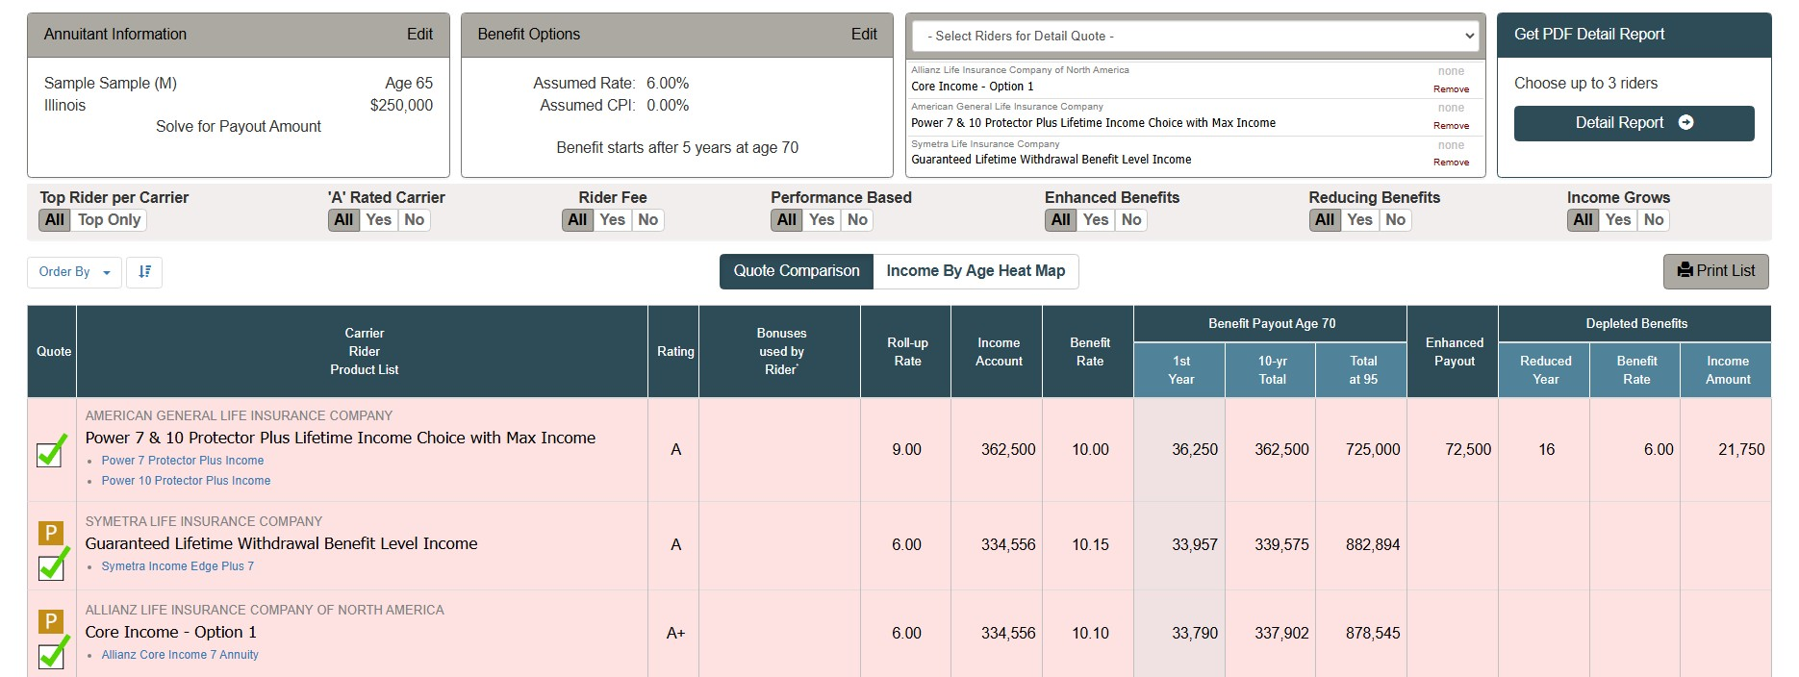
His Income is NOT $28,981…it’s $36,250
This also solves the Social Security Income Cliff for Your Surviving Spouse

Slide 81
My Client Doubled His Retirement Income because...
He…saw the importance of getting a second opinion about his retirement plan.
Social Security
Income Planning
Investments & Market Volatility
RMD’s & Taxes
Long Term Care
Estate Planning

Slide 82
    Got Questions?
    Get Answers….
    Book a Strategy Session Call or Meeting.
    We’ll answer your questions and Stress Test Your Income

Slide 83
1
2
How to protect your estate and make sure your assets get to your loved ones legally, privately and without publicly disclosing your assets.
Section 3
Estate Planning

Slide 84
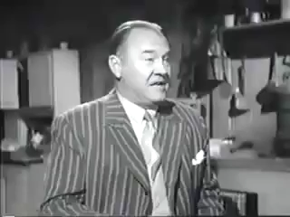
Question?
Do families always
See things…the
Same way?

Slide 85
Estate Planning - Legal Documents
Powers of Attorney
Wills/Trusts
Quality of Life Directive
Survivor’s Guide
Living Wills
Living Documents
Death Documents
Wills
Living Wills
Survivor Guides
Power of Attorney for Health
Power of Attorney for Finance
Quality of Life Directive
Trusts

Slide 86
“Does Everyone Love the Same Way?”

Slide 87
Does Everyone Love the Same Way?
You’ve done a great job preparing your Retirement Finances,
but what happens when someone is ill?

Slide 88
Does Everyone Love the Same Way?
If Dad’s in the Hospital for a bit, might someone
disagree on whom should manage mom and dad’s finances?

Slide 89
Does Everyone Love the Same Way?
Might Family members have different Opinions on
Medical Procedures or how to fund them?

Slide 90
Does Everyone Love the Same Way?
Might a child, who did most of the caregiving for a parent,
have problems with equal share distributions in a Trust or Will?

Slide 91
  This is Where Living Documents Matter
    They let someone act as an agent for you.
    The living documents are like a map for your agent.
    That Map Provides your agent with Financial and Medical Clarity for when You’re Ill.

Slide 92
  This is Where Living Documents Matter
    PRESERVE LIQUIDITY: They give your agent authorization to move money from an IRA or non-Joint bank accounts.
    ESTABLISH AUTHORITY: They establish who exactly in the family will have the authority to make decisions on your behalf when ill.

Slide 93
“How do
Powers of Attorney Work?”

Slide 94
What do Powers of Attorney do?
    They let someone act as an agent for you.
    There are Two Types
    A Power of Attorney For Finance
    A Power of Attorney For Health

Slide 95
Powers of Attorney Have to Be Durable
What does Durable Mean? If the Durable Language is Present in the POA, it means the POA keeps on working even if you’re sick. The term for this is “legal capacity.”
What Does Legal Capacity Mean? This is a fancy way of describing your ability to give verbal or written consent. Once an illness prevents someone from understanding what they are signing, the signature is no longer legally enforceable.

Slide 96
Great things start with a Simple Conversation
    In Conclusion
How can we provide our family with clarity of direction
and maintain financial Liquidity during an Illness?
Fund Access During Emergencies
  Do we have a valid Durable Power of Attorney
  for Health and Finance to access all of our accounts during emergencies?
Comfort Level of our Agents
  Let’s just talk a little bit about our family, the temperaments of our
  loved ones, and discover how to make them feel more comfortable
  with these decisions.

Slide 97
“What is a
Quality of Life Directive?”

Slide 98
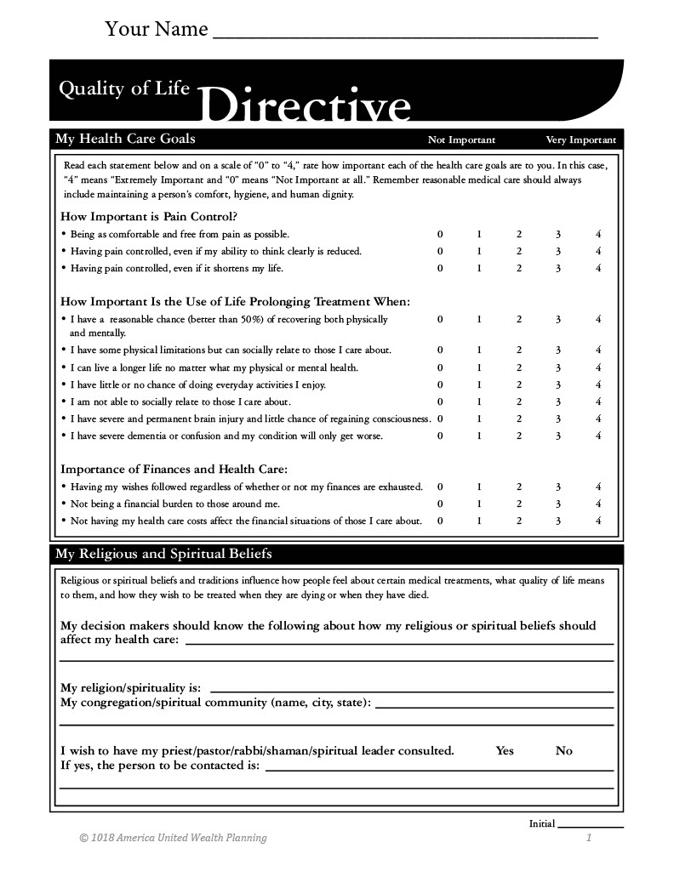

Slide 99
“What happens if You Pass
Without an Estate Plan?”

Slide 100

What Happens If You Die without an Estate Plan?
    Some property passes automatically to a joint owner or to a designated beneficiary (e.g., IRA’s, Retirement Plans, Life Insurance, Trusts.
    All other property generally passes according to state intestacy laws.

Slide 101
Death Documents
Powers of Attorney
Wills/Trusts
Quality of Life Directive
Survivor’s Guide
Living Wills
Living Documents
Death Documents
Power of Attorney for Health
Power of Attorney for Finance
Quality of Life Directive
Trusts
Wills
Living Wills
Survivor Guides

Slide 102
What is a Will and
What’s a Trust and how do they differ”

Slide 103
Both are Legal Documents designed to Distribute the Assets of a Deceased Person
A Will…
Is like a public letter to the probate court about what you want done with your legacy
A Trust…
aka (Revocable Living Trust or RLT) is like a private letter to your family, about what you want them to do with your legacy
Your instructions are in writing as to who receives your assets.
You appoint an Agent (known as an Executor)
The Executor presents your Will to a Probate Court for Distribution of Your Assets
Your instructions are in writing as to who receives your assets.
You as Owner Trustee appoint an Agent (known as an Successor Trustee)
The Successor Trustee Distributes Your Assets
Privacy is lost as Assets are advertised and made public
Privacy is maintained as Assets are not advertised. Distribution of assets is Private

Slide 104
The Advantages and Disadvantages depend on Context
A Will
An RLT or Revocable Living Trust
Overall, the Probate process in Illinois will typically take at least six months (for the running of the claims period), and can sometimes last several years (if there is estate litigation or complex asset transfers)
The revocable living trust owns the grantor's assets, and the trust doesn't die. Those assets can therefore be transferred immediately to beneficiaries, effectively settling the trust, without involving the probate court.
A Will means bureaucracy, but you have a Judge acting as a referee, for some families this is good.
A Trust is the fastest and most efficient tool, but there is no judge. This is good for stable families

Slide 105
1
2
If You have estate planning questions, Book a Strategy Session.
Great things start with a simple conversation
Let’s make sure your
Living Documents and Estate Planning Documents are set up to protect you and your loved ones.
Anthony J. Davis
Estate Planning
Attorney

Slide 106
“Why not just put my assets in my children's names?”

Slide 107
We don’t recommend it,
Here’s why

Slide 108
    #1 Title Issues with your home
Adding a child’s name to a deed gives them an ownership interest in your home.
You cannot sell Your home or refinance your mortgage without your child’s permission.
Your child could even sell their share in your property without your consent.

Slide 109
#2 Creditor Claims Against Your Assets
If Your Child is on title to your assets, they are a legal owner, and
their creditors can put claims against your assets.
This includes claims from:
Credit Card Companies,
Lending companies, or
Liability Claims stemming from an Accident.
Your assets are at risk if your son or daughter
is required to pay criminal restitution.

Slide 110
#3 Divorce Claims against your assets
    If your child goes through a divorce, the court is required to divide the parties’ property equitably.
If their name is on your assets, then your assets are technically your child’s property and
are subject to division by the court.
Your child’s former spouse may be entitled
to a share of your assets.

Slide 111
#4 Bankruptcy Claims against your assets
    If your child files bankruptcy, the bankruptcy court may be entitled to his or her share of your assets.
Placing Your Childs name on your assets is gifting them a share of your assets.
As a result, your assets may be sold to satisfy
Your Childs debts.

Slide 112
    In Conclusion
How can we provide our family with clarity of direction and
retain a voice in our affairs after we are gone?
Comfort Level of our Agents
  Let’s just talk a little bit about our family, the temperaments of our loved ones, and discover how to make them feel more comfortable with these decisions.
What Documents are most suitable for your Family
  Based on their temperaments, what documents will be most affective in preserving your vote in your legacy after you pass, and how will this affect your loved ones?

Slide 113

Retirement Income Strategies
Let Me Ask You a Question
With all the information presented today, AND in such a short period of time
How many of you are feeling a little like this kid?

Slide 114
Great things start with a Simple Conversation
What if there was
a simple way to get the Answers You Need?
There is
Simply, Book a Complimentary Strategy Session and Get Your Questions Answered and more.
John T. Davis CFF
Certified Financial
Fiduciary
Anthony J. Davis
Estate Planning
Attorney

Slide 115
As a class participant
you are entitled to a
One Hour Private Questions and Answers Strategy Session We can meet by: Telephone, Zoom or in Person
Just complete the
“Class Evaluation Form”
and Schedule a Day and Time
Anthony J. Davis Attorney at Law
Please don’t leave until
We confirm your scheduled
date and time
on our calendar
John T. Davis
CFF Certified Financial Fiduciary
www.AmericaPlanning.com

Slide 116




Please complete Your info:
Please Grade us
Check Strategy Session Anthony
Pick and Day and Time Please don’t leave until we confirm it on our calendar
Check Strategy Session John
Pick and Day and Time Please don’t leave until we confirm it on our calendar

