Slide 1
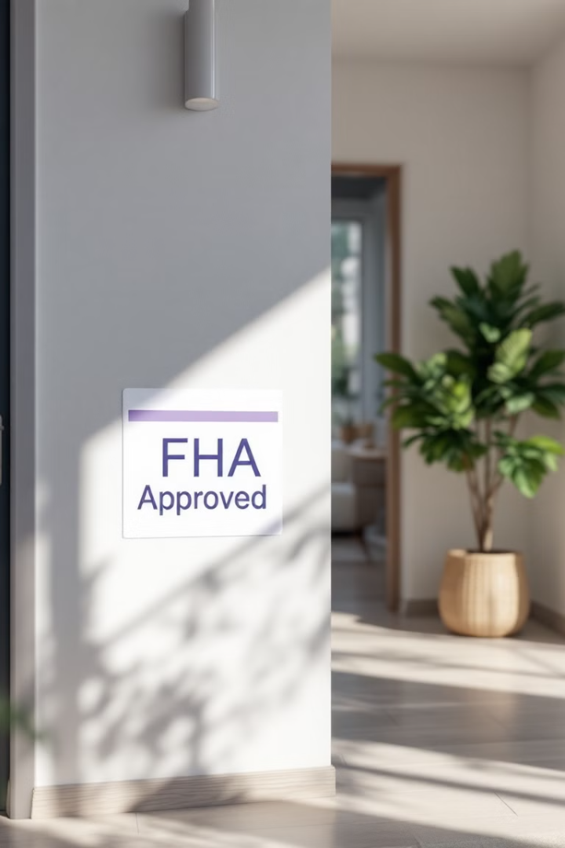

What Are FHA Minimum Property Standards—And Why You Should Care
Fix problems before they stop your loan
Unlock funding for repairs
Learn how NAFHAC consultants make it easy
By YOUR NAME
(YOUR LOGO)

Slide 2




Who Should Watch This?
Homebuyers
Homeowners
First-time buyers using FHA financing
Looking to refinance with rehab options
Real Estate Professionals
Agents, contractors, lenders serving clients

Slide 3







What Are FHA Minimum Property Standards?
Safe
Free from health hazards
Secure
Protects occupants and property
Structurally Sound
Built to last without major defects

Slide 4












Common MPS Issues That Kill Deals
No Heat
Leaking Roof
Broken furnace or heating system
Water intrusion and damage
Moisture Problems
Safety Hazards
Water damage and mold growth
Missing handrails and guardrails
Utility Issues
Lead Paint
Electrical and plumbing hazards
Chipped, peeling surfaces pre-1978

Slide 5





How MPS Affects YOU
Loan Denied
Home doesn't meet standards
Sellers Lose Buyers
Deal falls through last minute
Buyers Miss Opportunities
Dream home slips away
Professionals Waste Time
Agents and lenders start over

Slide 6

The Power of a Rehab Loan
Buy and Repair
Purchase property and fund necessary repairs
Refinance with Upgrades
Roll renovation costs into new mortgage
Simplified Payment
One monthly payment, not multiple loans
No Out-of-Pocket
Finance 100% of qualified repairs

Slide 7





Who Solves the Problem?
Finds Issues
Creates Plans
Coordinates Team
Identifies all MPS concerns
Develops comprehensive repair strategy
Works with lenders and contractors
Guides Process
Manages rehab from start to finish

Slide 8





What's an MPS Evaluation?
Property Walk-Through
Comprehensive on-site inspection
Issue Identification
Finding what would stop FHA approval
Repair Planning
Developing actionable solutions
Financing Guidance
Securing appropriate loan products

Slide 9




Why You Should Schedule One
Save Deals
Prevent last-minute loan rejections
Find Hidden Gems
Buy properties others overlook
Build Equity
Create value through strategic renovation
Client Success
Help clients achieve homeownership goals

Slide 10

Let's Get You Started
1
2
Schedule Evaluation
Direct Message
Book your MPS assessment today
Contact for help or consultant referral
3
4
Visit Website
Ask Questions
Access resources and information
We're ready to help you succeed

