Slide 1

The Pain-Pleasure Principe
[[Name Of Your Coaching Program]]
Notes:
In this lesson, you’re going to discover the pain-pleasure principle and how this drives all human behavior.

Slide 2

All Human Behavior Is Driven By Two Forces:
Pain
Pleasure
Notes:
All human behavior is driven by one of two forces: The need to escape from pain or the desire to gain pleasure (which in most cases is meeting some of the basic human needs we spoke about earlier).
Think about something as simple as eating chocolate. Why do we do it, even when we know that it’s not good for us? Because of the pleasure we gain in that moment.
What about something like getting up on a cold winter morning and going to a job that you hate?
The pain of not having a job (and thus not having money to buy food or pay for rent) is greater than the pain of going to your job each morning.
These twin forces of pain and pleasure affect every area of your life, whether you’re aware of it or not.

Slide 3
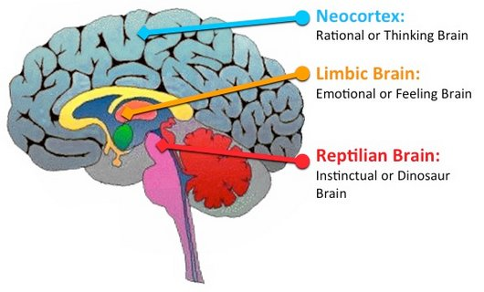
Notes:
This pain pleasure response comes from the reptilian brain – the part of our brain that is responsible for our very survival.
We are hard wired to move toward pleasure and away from pain.

Slide 4
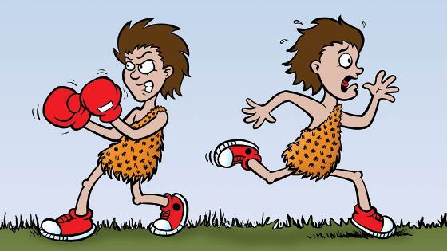
Notes:
Whenever our reptilian brain senses pain (which it equates with danger), it activates the fight or flight response in your body: either we fight the circumstances, or we run from it.
The problem is that these responses are not always appropriate for our modern times.
In prehistoric times, when the body perceived danger (which was the threat of pain) in the form of a wild animal or a hostile tribe or whatever that danger was, fight or flight was the appropriate response.
Stress at work or a traffic jam is perceived as pain and the body triggers the fight or flight response which is totally inappropriate.

Slide 5
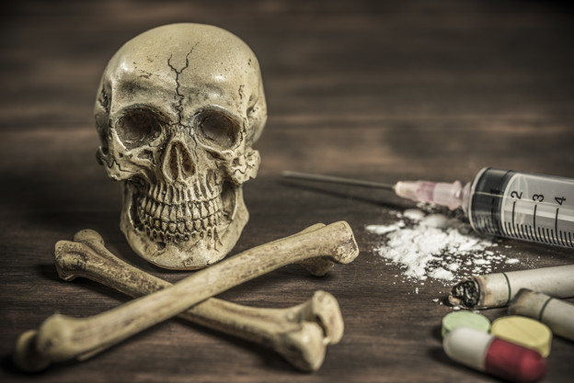
Crossing Pain & Pleasure Signals
Notes:
But the real problem comes when we link pleasure to things that are destructive and pain to things that are actually good for you.
Let’s take a look at some real life examples of pain and pleasure associations that are harming rather than helping us.
A drug addict, for example, links pleasure to taking drugs, even though this habit will, and does cause pain in every area of his life.
Let’s look at another example. Let’s say you’re overweight but you love chocolate. Chocolate gives you pleasure, and the pleasure it gives you in the moment is greater than the pain of being overweight and unhealthy.

Slide 6
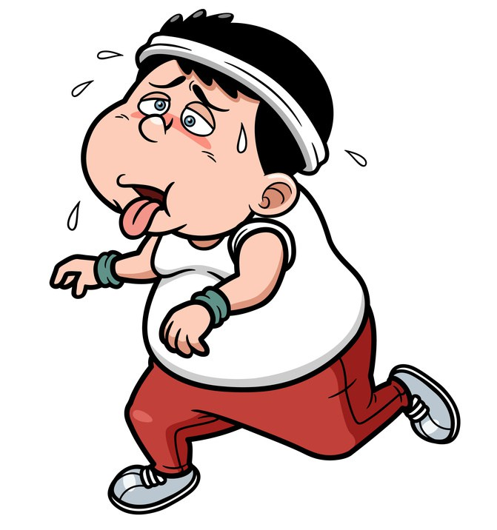
Are You Associating Pain With Something Good For You?
Notes:
Now let’s take a look at the opposite side of the coin, associating pain to something that’s actually good for you.
Let’s take the classic example of exercise. Lots of people associate massive pain to exercise and thus they never do it.
But what if they could reframe that concept and associate massive pleasure with exercise, the pleasure of having a healthy, fit body and even just the sheer joy of movement.

Slide 7
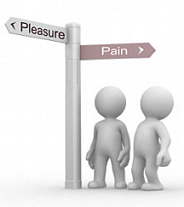
What You Link Pain or Pleasure To Will Shape Your Destiny
Notes:
Never forget, what you link pain or pleasure to will shape your destiny.
If you link pleasure to drugs, alcohol, partying and promiscuity; you will have a very different life compared to someone who links pleasure to learning, growing, improving and contributing to society.

Slide 8
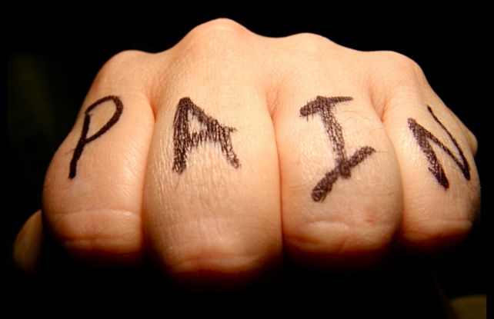
Pain Is A More Powerful Motivator Than Pleasure
Notes:
And always remember that pain is a more powerful motivator than pleasure. We will do more to avoid pain than we will to gain pleasure. Often, it’s deep pain, or hitting rock bottom that convinces people that they need to change.
For example, someone may not be motivated to lose weight by the pleasure of looking and feeling their best. But they are suddenly galvanized into action by a heart attack, where they know if they don’t change their habits, they could die.

Slide 9
So How Can You Use Pain-Pleasure In Your Coaching?
Help the client to associate pain to the actions she wants to stop doing
And pleasure to the actions she needs to take to get her closer to her goal
Notes:
So how can you use this concept of pain-pleasure in your coaching?
You can help the client to associate pain to the actions she wants to stop doing (the behaviors and actions that are stopping her from reaching her true potential) and pleasure to the actions she needs to take to get her closer to her goal.

Slide 10

Pain – Pleasure Exercise
Notes:
So right now, I want you to print out the pain/pleasure worksheet that is in the downloads section of this lesson and follow along with me.
You can use the same worksheet with your clients.
Part of becoming an awesome coach is becoming a better person and living at your highest potential and that’s what we’re going to be doing throughout this entire program.
[[[SO PLEASE TURN TO PAGE ….IN YOUR MANUALS AND I’M GOING TO WALK YOU THROUGH THE PAIN-PLEASURE EXERCISE. YOU’RE GOING TO BE DOING THIS EXERCISE FOR YOURSELF, FOR SOMETHING PERSONAL TO YOU.]]]

Slide 11
Pain Pleasure Exercise
1. Write down one action you need to take that you’ve been putting off.
2. Why you haven’t taken action. What pain have you linked to taking this action?
3. Write down all the pleasure you got from indulging in this negative behavior?
4. Write down what it will cost you if you don’t change now.
5. Write down the pleasure you will get if you take action now.
6. Read the list every morning & evening for the next 30 days.
Notes:
Write down one action you need to take that you’ve been putting off.
So maybe you need to lose some weight or to stop smoking. Maybe you need to complete your degree or quit a job you hate in order to start your own business…..something you’ve always wanted to do.
Whatever that action for you is, I want you to write that down. Pause the video if you need extra time.
Once you’re done, move on to question two. Write down why you haven’t taken action. What pain have you linked to taking this action?
These questions will help you to uncover the pain that you’ve linked to this action. And it doesn’t always have to be something profound. Maybe it’s simply the pain of taking time out of your busy day.
So I want you to think of what pain you’ve linked to this action and write it down.
IF YOU DON’T HAVE ENOUGH SPACE, THEN USE THE BLANK SIDE OF THE PAGE TO CONTINUE]
Step 3 is to write down all the pleasure you’ve had in the past indulging in this negative behavior. So let’s say you want to quit smoking. What pleasure did you get each time you lit up your cigarette? Was it instant stress relief? Maybe it’s a sense of belonging?
Or perhaps your goal is to lose weight. Then why do you continue to overeat and eat all the wrong foods?
You’re probably doing that to avoid the pain of depriving yourself of your favorite foods and at the same time getting the pleasure that comes from eating these foods.
Write these reasons down. Pause the recording if you have to.
Now I want you to write down what it will cost you if you don’t change now.
What’s it going to cost you physically if you keep gaining weight or keep smoking?
What’s it going to cost you emotionally?
What’s it going to cost you in terms of the relationships with the people you love?
What’s it going to cost you financially?
What’s it going to cost you in terms of self-respect?
I want you to imagine what it’s going to cost you 5 years down the line, 10 years down the line, if you keep doing what you’ve been doing. When you’re writing down the answers I want you to tap into how this is going to make you feel. Don’t just say “I’ll get fat.” – that’s not enough. How is being overweight going to make you feel?
How is disappointing your loved ones or being a poor role model to your children going to make you feel. Really tap into those feelings.
You’ve got to remember that we are creatures of emotion, not logic, so use that to your benefit.
And the final step is to write down all the pleasure you’re going to get if you take action right now.
How is this going to impact your life now, 2 years into the future, 5 years into the future, a decade into the future. How will this impact the relationships you have with your loved ones? How will this impact your self-esteem and your sense of what’s possible for your life? How will it impact you financially? How will it affect you physically? Again, really dig deep into your emotions and write down how these changes will make you feel.
Now that you have your list with you. I want you to read this list out loud every morning and evening for the next 30 days. When you’re doing this with a client you will ask them to do the same.
Reading this out loud every day for the next 30 days will help to cement in your mind the changes you’ve made with regard to what you link pain-pleasure to and you will find yourself changing automatically and effortlessly.
In the next video, we’re going to go through the different modalities and how you can use that to build rapport and communicate better with your clients and in your everyday life. See you then.

