Slide 1

Responsibility: THE CORNERSTONE OF LASTING CHANGE
[[Name of Your School]]
Notes:
Getting the client to assume total responsibility for their lives is the cornerstone of successful coaching. In this lesson, we will discuss the concept of personal responsibility and how you can use it to transform your own life and the lives of your coaching clients as well. This is also a concept that is important to ingrain into children from a young age, so they grow up automatically assuming ownership and responsibility for their lives.

Slide 2
In Order To Be Coachable, The Client Needs To Assume Responsibility For Their Lives
If the client does not assume personal responsibility for their behavior (and the results that accompany that behavior), they will never be able to make positive changes in their lives.
The client needs to understand and accept that everything in their life is the result of the actions they either have taken or they haven’t taken. Only then will they be coachable.
People skirt responsibility for their actions by blaming other people or circumstances for the results they are experiencing in their lives.
Notes:
If the client does not assume personal responsibility for their behavior (and the results that accompany that behavior), they will never be able to make positive changes in their lives.
The client needs to understand and accept that everything in their life is the result of the actions they either have taken or they haven’t taken. Only then will they be coachable.
People skirt responsibility for their actions by blaming other people or circumstances for the results they are experiencing in their lives.
Have you ever heard people make statements like “My husband always puts me down. That’s why I have no confidence.” or “The teacher doesn’t like me. That’s why I got a poor grade on the exam.” How many times have you heard people make similar statements. Perhaps you make these excuses yourself.

Slide 3
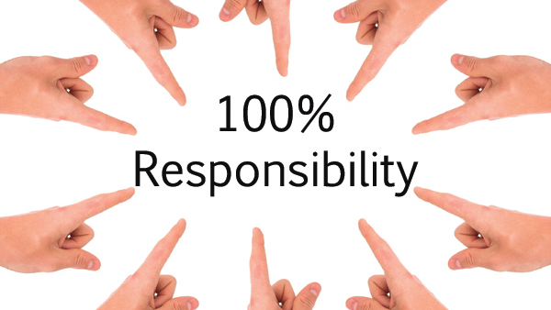
Notes:
In his wonderful book. The Success Principles Jack Canfield says and I quote “One of the most pervasive myths in the American culture today is that we are entitled to a great life – that somehow, somewhere, someone (certainly not us) is responsible for filling our lives with continual happiness, exciting career options, nurturing family time and blissful personal relationships simply because we exist. But the real truth is that there is only one person responsible for the quality of the life you live.
That person is you.
If you want to be successful, you have to take 100% responsibility for everything you experience in your life. This includes the level of your achievements, the results you produce, the quality of your relationships, the state of health and physical fitness, your income, your debts, your feelings – everything!

Slide 4
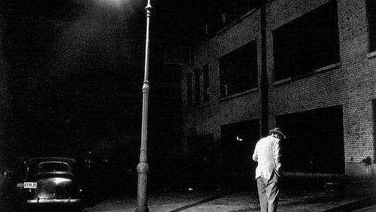
Notes:
He goes on to tell a story that illustrates the futility of searching outside of yourself for the answers of why your life is the way it is and I’d like to share that with you here.
There’s a man who goes out for a stroll one evening and he comes upon another man down on his knees, looking for something under a streetlamp. The passerby stops and asks the man what he’s looking for. The man answers that he’s looking for his keys and the passerby offers to help him.
After an hour of futile searching, the passerby asks the man We’ve looked everywhere for your keys. Are you sure you lost them here? To which the man replies No, I lost is over there and points to a place further down the road in the shadows and then says But I’m looking for it here under the streetlamp because there’s more light here.
We may chuckle at how silly the man is, to look for keys where they are so obviously not, but we do the exact same thing in our lives by looking outside ourselves for the reason that our lives are not the way we want them to be.

Slide 5
The Life You Are Currently Living Is The Result Of Your Past Choices
You also have to accept that the life you are currently living is the result of the choices you have made in the past.
That can be painful, but it’s also tremendously liberating because it means that from this point forward, you can make new and better choices, which will lead to new and better results.
Notes:
You also have to accept that the life you are currently living is the result of the choices you have made in the past. That can be painful, but it’s also tremendously liberating because it means that from this point forward, you can make new and better choices, which will lead to new and better results.
Let’s say before, when you got a bonus, you blew it on having a night on the town.
Now you decide to spend that same bonus on taking a continuing education class. This leads to a promotion, which allows you to move to a better house in a better school district which means that your kids can now get a better education, which leads to a better college and better job.
Do you see the ripple effect of one seemingly small decision?

Slide 6

Limiting Factors Don’t Keep You Stuck, You Do
Notes:
Too many of us blame limiting factors outside of our control for not reaching our goals.
We can’t do something because our spouse won’t let us.
We can’t start a business because we don’t have the money.
But can’t you think of dozens of people who found a way to raise the capital necessary in order to start a business? They may have sold some of the possessions, borrowed money from family and friends, found backers for their ide, took second jobs….the point is they did what it took to get the money they needed.
For every reason why it’s not possible, there are hundreds of people who have overcome those very circumstances and succeeded.
So it’s not these limiting factors that hold us back, it’s ourselves.

Slide 7

You Create Or Allow Everything That Happens To You
Notes:
Practically everything that happens in your life, you have either created (through your actions or inactions) or you allowed it to happen to you by your inaction or your unwillingness to do what’s necessary to change it.
Let’s look at an example of creating what happens to you.
If you treat your spouse badly by yelling and verbally abusing them and they walk out on you, then you created that.
On the other hand, if you were never abusive, but you failed to take the time to meet your spouse’s needs and nurture your marriage and they walk out on you, then you created that as well.
Now let’s look at how you allow situations or events to happen to you by your failure to take action to change it.
Let’s say a woman is being abused by her husband. While she may not be responsible for the abuse, she is responsible for staying and allowing him to treat her poorly.
Which brings us to another point, which is ignoring the signs along the way that something is wrong.

Slide 8
STOP Ignoring Warning Signals
Examples of External Signals:
Examples of Internal Signals:
Your husband comes home late every evening & you find lipstick on the collar of his shirt
Your friends warned you that the guy you want to marry is trouble
Your car starts rattling and you ignore it and keep driving
You notice a small lump in your breast and you ignore it
Your gut instinct that something is wrong
That fleeting thought that just maybe your friends were right
The vivid dream that woke you up in the middle of the night
Notes:
You see, very few things in life “just happen” to you. More than likely, you got several signals along the way that something wasn’t right and you ignored them. You may have gotten external signals or internal ones, often both.
Some examples of external signals are:
Your husband comes home later and later each evening with excuses that he’s working and one day you find lipstick on the collar of his shirt
Your friends warned you that the guy you want to marry is trouble
Your car starts rattling and you ignore it and keep driving
You notice a small lump in your breast and you ignore it
These are all examples of external signs
Then there are internal warning signals:
Your gut instinct that something is wrong
That fleeting thought that just maybe, just maybe, your friends were right
The vivid dream that woke you up in the middle of the night
But so many of us ignore these signals because it’s scary and uncomfortable to face the truth and do something about it.
But avoidance is not the answer. You will pay the piper, one way or another.
And often, it’s much better to heed the warning signs and nip the problem in the bud than to ignore it and have to face the truth much later down the road when the problem is much bigger.
Is there some warning signal that you need to pay attention to?

Slide 9

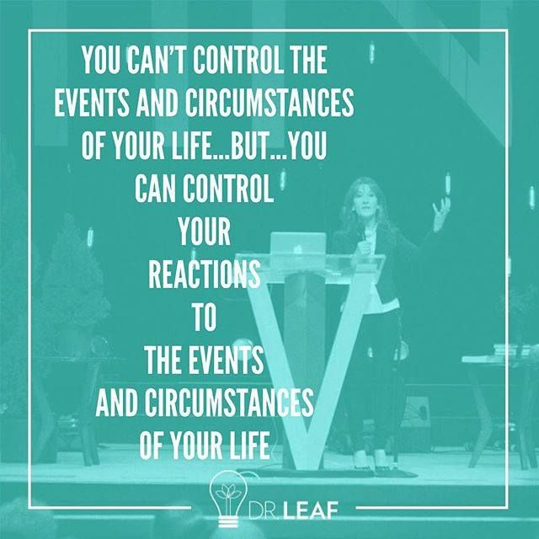
But What About Events Outside Of Your Control?
Notes:
But what about events outside of your control?
Things like accidents, natural disasters, the illness or death of a loved one?
While you can’t always control external events, you can always control your reaction to them. And your reaction is governed by the meaning you attach to those events.
Let’s take a look at some examples:
Two mothers lose their children in accidents involving drunk drivers. One can’t handle the pain and ironically, becomes an alcoholic. The other one raises up and founds MADD (Mother’s Against Drunk Drivers), a non-profit organization dedicated to curbing the problem of drunk driving in the US.
Let’s look at another example that illustrates this point.
In 1994, an earthquake devastated Los Angeles. The earthquake damaged one of the main freeways leading to the city. Traffic was at a virtual standstill and what used to be a one hour drive has now become a 2-3 hour commute.
Two days later, a CNN reporter was interviewing people as they were commuting to work. The reporter knocked on the window of one of the cars stuck in traffic and asked the man how he was doing.
The man angrily responded that he hated California and complained about recent floods, fires and earthquakes. He also complained that no matter what time he left for work he was always late.
Then the reporter spoke to the car behind him and asked the second driver the exact same question.
This driver had a completely different reaction. He was happy and had brought along things to keep him occupied when he was stuck in traffic. In fact, he was busy learning Spanish while he was stuck in traffic. How’s that for a productive use of your time?
So you see, it’s not so much what happens to us, but how we react to it that matters.

Slide 10
The 3 Things You DO Have Control Over:
The thoughts you think
The images you visualize and
The actions you take ( in other words, your behavior)
Notes:
You have control over 3 things in your life:
The thoughts you think
The images you visualize and
The actions you take ( in other words, your behavior)
So if you don’t like what you’re producing in your life, then you have to change one of these 3 things; your thoughts, the images running through your mind or your actions…..often all three.
Change what you focus on and start focusing on what you do want, rather than what you don’t want.
Change what you daydream about.
Instead of creating mental movies about what you don’t want, start creating mental movies about your ideal outcome and what you do want.
Change the books you read and the people you surround yourself with.
Live on the cause side of life and the effects will take care of themselves.

Slide 11
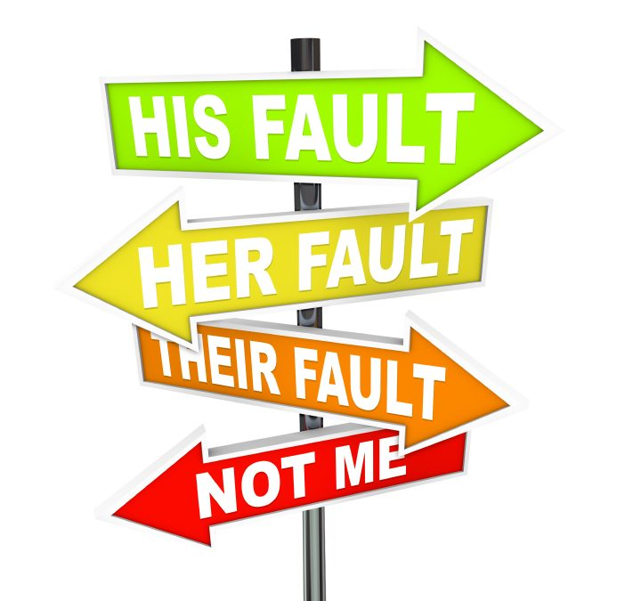
Playing The Blame Game Keeps You Trapped
Notes:
We’ve been conditioned to play the blame game, not only by our parents and the people around us, but by the media as well.
We blame our parents, spouses, the economy, the government, our boss, kids or anyone else for why we don’t have the life we want.
But if you choose to play the blame game, then you need to understand that you will never be able to change your life.
The same is true for your coaching clients.
Assuming 100% responsibility for your life means giving up all your excuses, all the reasons why you can’t do something or why you haven’t up till now, letting go of all your victim stories and all blaming of other people and circumstances….forever.

Slide 12
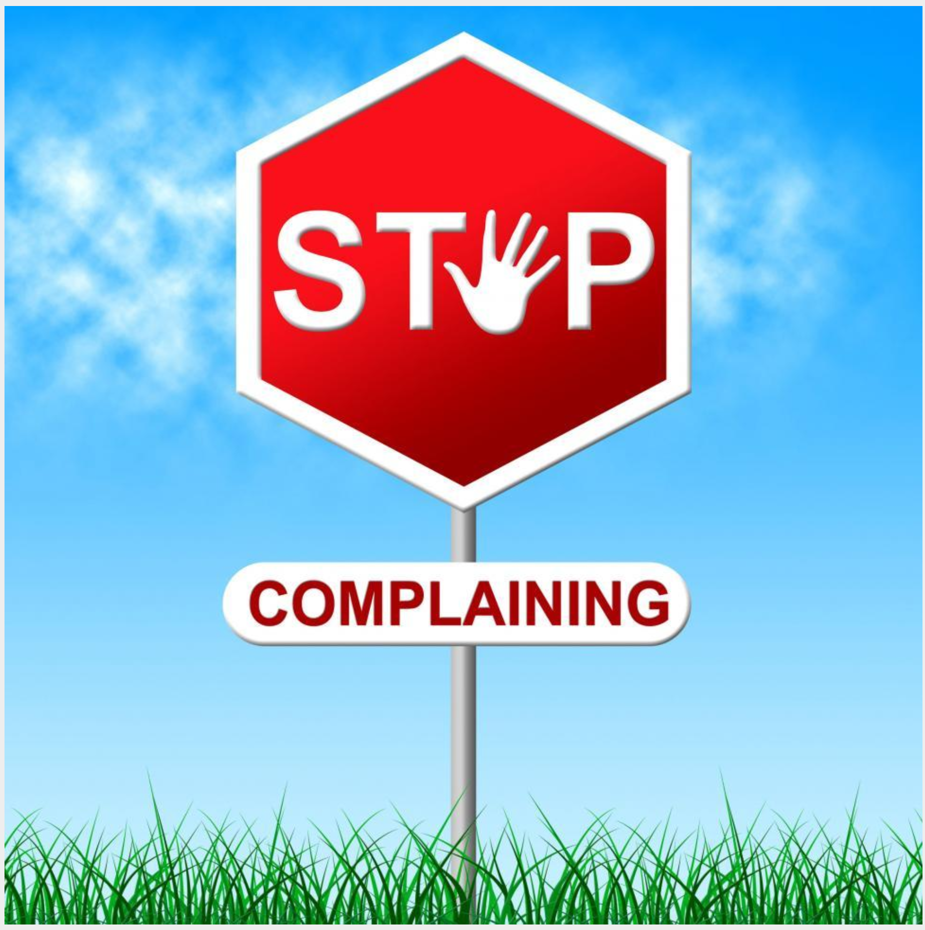
Notes:
In addition to letting go of blame, you also need to stop complaining.
In order to complain about something or someone, you have to believe that something better is possible.
So instead of complaining, make requests instead. Tell the person concerned how you would like things to be, rather than complain about how things are right now.
And if someone can’t do anything about the situation, then why complain about it in the first place?
Stop complaining for one week and watch how your life changes.

Slide 13
Accepting Personal Responsibility Will Change Your Life!
Accepting responsibility means enduring the discomfort of knowing that you have created your current reality.
But if you’re the one who created this mess, it also means that you’re the one who can not only clean up this mess, but create a whole new reality for yourself.
If you don’t accept personal responsibility, you give away your power to other people and things
Notes:
The concept of personal responsibility is one of the most difficult things to accept. It’s far easier and more natural to blame other people for your own shortcomings and lack of results.
Accepting responsibility for your own life is very difficult because it requires us to endure the discomfort of knowing that we have created our current reality.
But the flipside of the coin is that with acceptance comes a tremendous amount of power and freedom.
If you’re the one who created this mess, you are also the only one capable of clearing it you and then creating a new reality for yourself. This is tremendously liberating.
If you don’t accept personal responsibility for your life, you give your power away to other people and other things.

Slide 14

Notes:
A great phrase you can teach clients that illustrates this sense of responsibility is “If it’s to be, it’s up to me.”

Slide 15
3 Steps To Assuming Responsibility For Your Life
Step 1: Start acting “as if” you take 100% responsibility for your life.
1
Step 2: Start paying attention of any warning signals and take appropriate action
2
Step 3: Pay attention to the feedback you’re getting
3
Notes:
So how can you change and start taking responsibility for your life today?
1. The first step is to start acting “as if” you are 100% responsible for your life.
So if something doesn’t go as planned, you’re going to ask yourself some tough questions.
These questions are on the Taking Responsibility Worksheet, which will you find in the resources section, on your resources disc or below this video.
Here are some of the questions you’re going to ask yourself:
What part did I play in creating these circumstances?
How am I creating or allowing this to happen?
What were my belief and thought patterns that created this reality?
What can I do differently next time?
What am I doing that’s working that I need to do more of?
What am I doing that I need to do less of?
What am I not doing that I need to try (to see if it works)?
When you start asking yourself these questions, you will be amazed at how your life starts to shift and how you will embrace your God-Given power and step into your role as the co-creator of your life.
2. The second step is to start paying attention to any warning signals and take appropriate action.
3. And finally, pay attention to the feedback you’re getting in your life. If things are working, great. If not, take some time to reflect and see where you are going wrong and take steps to correct that.
In the next video, we will be discussing the concepts of pain and pleasure and how they influence our choices as well as how to use this powerful force to stop doing the things you don’t want to do and start doing the things you do want to do.
So now, I want you to take out the taking responsibility worksheet and work through some area of your life where you are not happy with the results. You’ll find this worksheet in the resources section or on your resource disc or at bottom of this video in the downloads section.
Although the process is very simple, there are also two completed examples that you can go through to see how it’s done.
So work on that now and I’ll see you in the next lesson.

