Slide 1


COHORT 3
March 12, 2024

Slide 2
OUR 5th SESSION!
How Things Went in the Last Week?
  Last minute business-y questions?

Slide 3
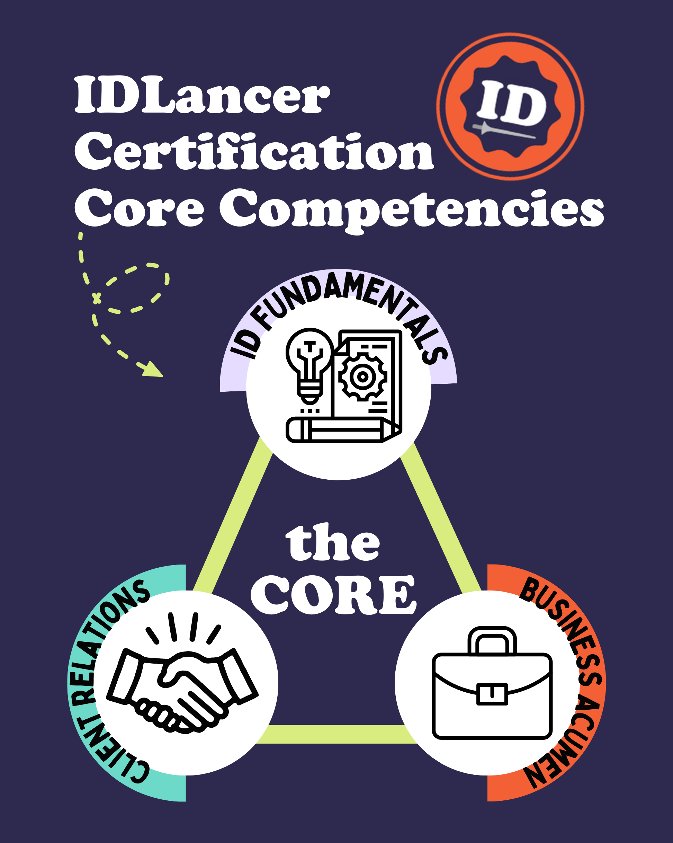
Business Acumen
Goals
Brand
Legal
Marketing
Proposals/Contracts
Finance
Taxes
Client Relations
Finding clients
Nurturing clients
Keeping in touch with clients
Project communications
ID Fundamentals
Art and science of adult learning
Learning design principles
Visual design principles
Notes:
This month, we’re going to cover how to court, close, and continue with clients.

Slide 4
WHAT COMES TO MIND?
When you think of the topic of “client relations” what words/phrases/concepts does it bring to your mind?
(Use the Zoom annotate tool to write a word or doodle in the white space!)

Slide 5

FINDING CLIENTS
Enthusiastic, warm messages on LinkedIn, email, etc.
Be a human not a business machine
Ooze flexibility (especially with agencies!)
Friendly, open, positive vibes
Don’t be afraid of the exclamation point
Find common ground (and remember that common ground for later!)
Make all the connections you can
Go back to employers and former colleagues to “say hi” (and spread the word)

Slide 6
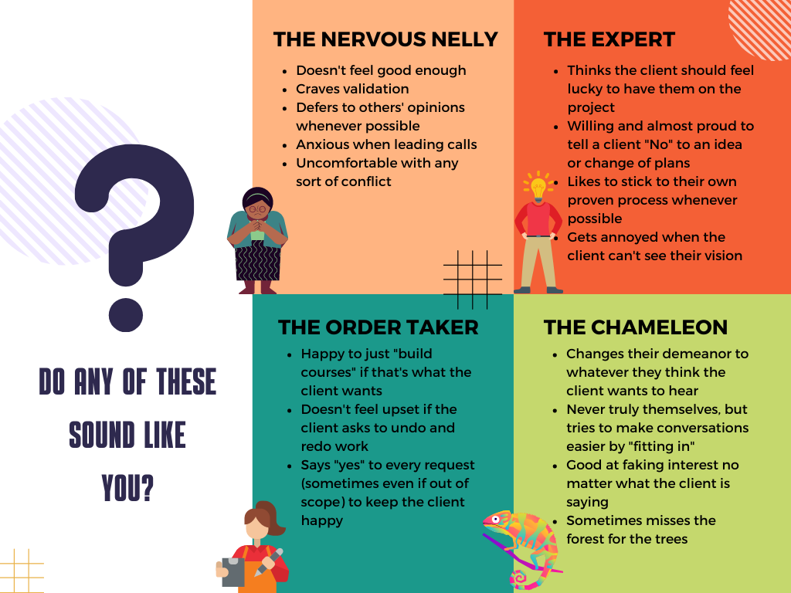
Hint: We are all ALL of these sometimes. There’s no “right” answer.
Notes:
Self awareness is a good starting point to improving your client relations skills.

Slide 7




“YES FIRST” MINDSET
Start with a “yes” and work your way back to no when…
  discussing your skills/abilities
  considering/applying for potential gigs
  collaborating with clients

Slide 8
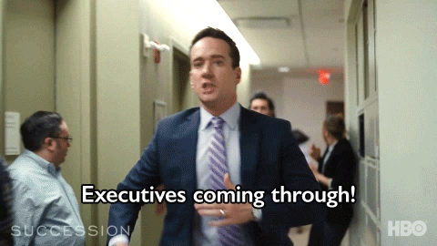
THE FIRST DATE
Find a partner and record your conversation!
Pretend your partner works at a company that could be your next potential client. You’ve been invited to share a sample of your eLearning work and explain it to them. The client is looking for someone to take existing slide presentations and instructor-led content and turn them into more interactive eLearning. Your partner will ask you questions as if they are your potential client.

Slide 9
WHAT DO YOU WANT TO KNOW?
Use this space to add some topics or questions you want us to cover this month.

Slide 10
Business Acumen
Goals
Brand
Legal
Marketing
Proposals/Contracts
Finance
Taxes
Client Relations
Finding clients
Nurturing clients
Keeping in touch with clients
Project communications
ID Fundamentals
Art and science of adult learning
Learning design principles
Visual design principles

