Slide 1
Ion Mobility-Mass Spectrometry Separation of Steroid Structural Isomers and Epimers
Alana Rister

Slide 2
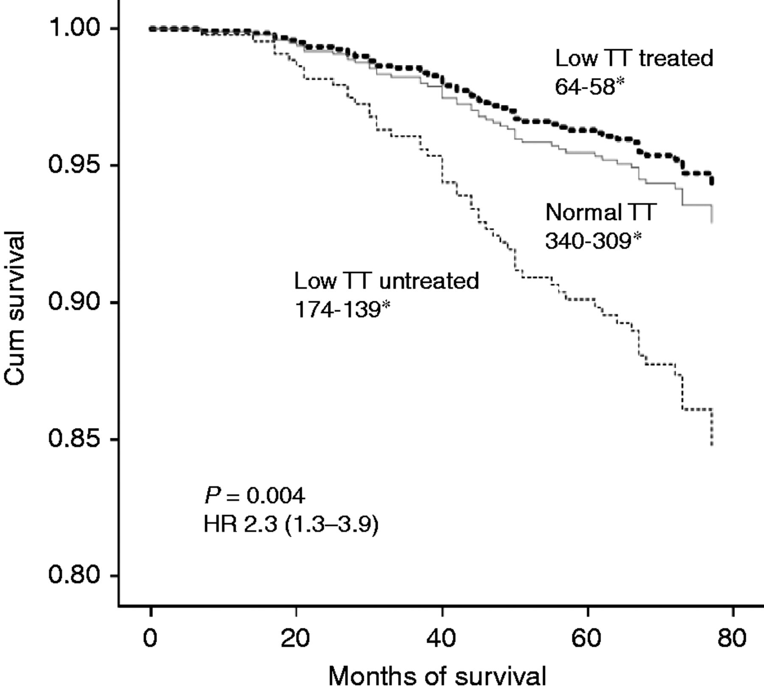
Importance of Steroid Analysis
Steroid analysis is used:
Medical diagnosis
Environment testing
Sports performance testing
Challenges in steroid analysis:
Low concentration
High potency
Isomers
Testosterone
Vakkat Muraleedharan et al. Eur J Endocrinol 2013;169:725-733

Slide 3
Steroids
Involved in cellular signaling
Derivatives of cholesterol
Involved in:
Glucose regulation
Stress response
Sex characteristics
Mineral balances
Male Sex Hormone
Female Sex Hormone
Adrenal Response
Regulates Glucose Metabolism

Slide 4
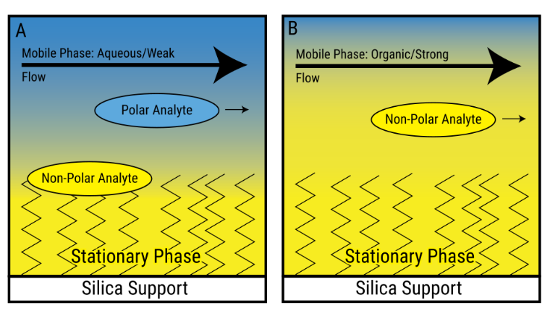
Previous Analysis Methods
Attribute | Liquid Chromatography | Ion Mobility Spectrometry | Mass Spectrometry
Phase | Liquid Phase | Gas Phase | Gas Phase
Separation | Polarity | Size, Shape, and Charge | Mass and Charge
Time Scale | Minutes-Hours | Milliseconds-Seconds | Microseconds-Seconds
Type of Instrument Used in this Research | Reversed Phase Liquid Chromatography | Traveling Wave Ion Mobility Spectrometry | Time-of-Flight (µs) Ion Cyclotron Resonance (s)

Slide 5
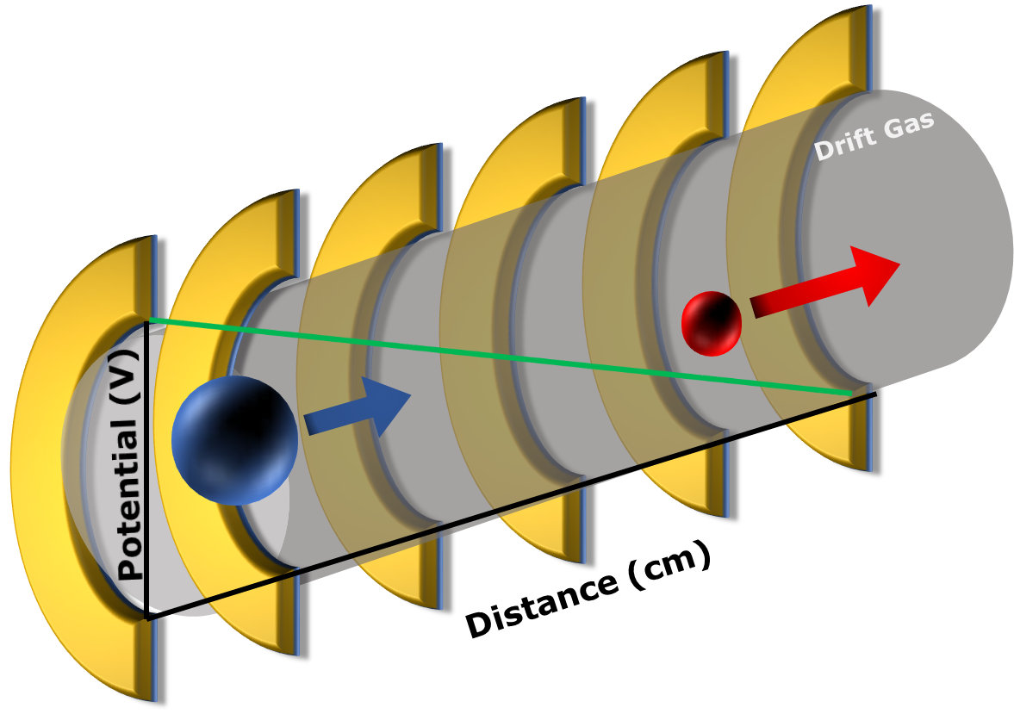
Ion Mobility Spectrometry
Gas Phase Separator
Separates based on size, shape, and charge
Types of ion mobility:
Drift tube ion mobility
Traveling wave ion mobility

Slide 6
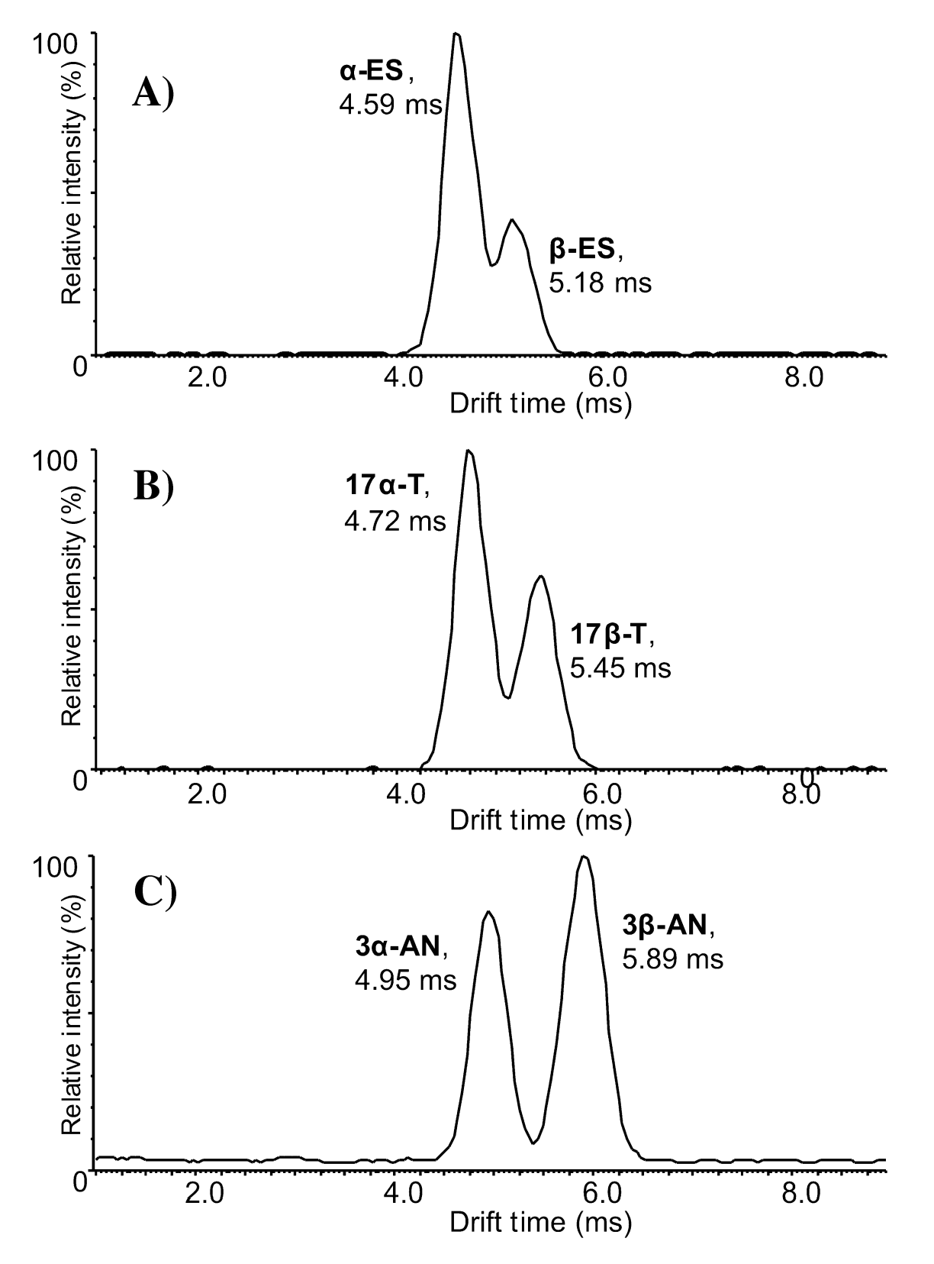
Previous Methods for Steroid Separation in IMS
Derivatization
Changing of drift gas
Using metal adducts to generate multimeric species
Ahonen, L.; Fasciotti, M.; af Gennäs, G. B.; Kotiaho, T.; Daroda, R. J.; Eberlin, M.; Kostiainen, R. J. of Chromat. A 2013, 1310, 133.

Slide 7
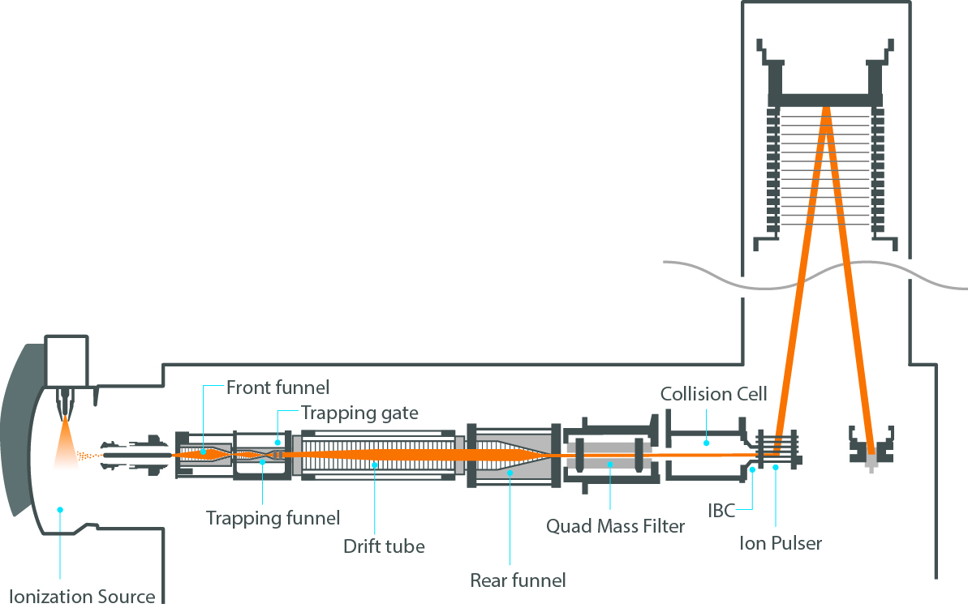
IMS Experiments
Native Steroid Solutions
Ion Mobility-Mass Spectrometry
(DTIMS)
Extract Arrival Time Distributions
Collision Cross Section Measurements
Agilent 6560
Chouinard, C.D., Cruzeiro, V.W.D., Roitberg, A.E. et al. J. Am. Soc. Mass Spectrom. (2017) 28: 323.

Slide 8
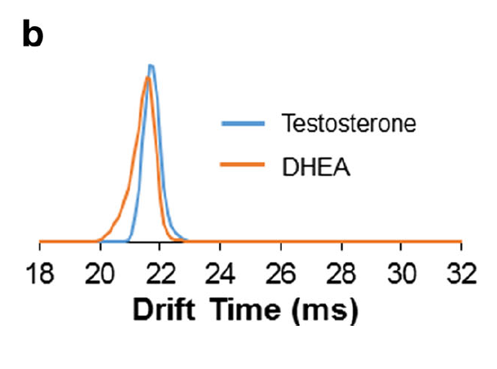
Results
Separation of protonated species
Separation of sodiated species
Changing drift gas
Alternative cations
Chouinard, C.D., Cruzeiro, V.W.D., Roitberg, A.E. et al. J. Am. Soc. Mass Spectrom. (2017) 28: 323.

Slide 9
IMS Analysis of Protonated Steroids
Chouinard, C.D., Cruzeiro, V.W.D., Roitberg, A.E. et al. J. Am. Soc. Mass Spectrom. (2017) 28: 323.

Slide 10
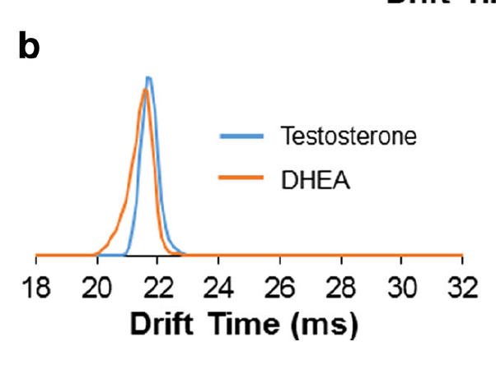
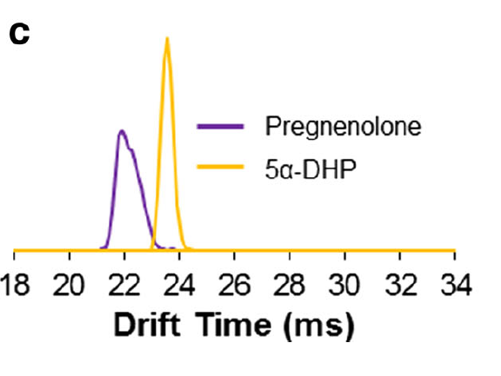
Protonation Separation of Steroids Isomers
Chouinard, C.D., Cruzeiro, V.W.D., Roitberg, A.E. et al. J. Am. Soc. Mass Spectrom. (2017) 28: 323.

Slide 11
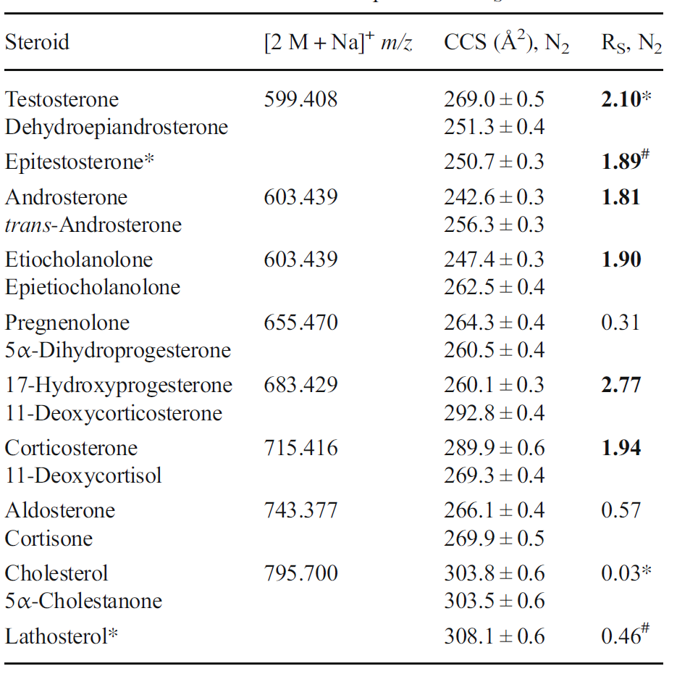
Results
Separation of protonated species
Separation of sodiated species
Changing drift gas
Alternative cations
Chouinard, C.D., Cruzeiro, V.W.D., Roitberg, A.E. et al. J. Am. Soc. Mass Spectrom. (2017) 28: 323.

Slide 12
Sodiated Monomer Separation
Chouinard, C.D., Cruzeiro, V.W.D., Roitberg, A.E. et al. J. Am. Soc. Mass Spectrom. (2017) 28: 323.

Slide 13
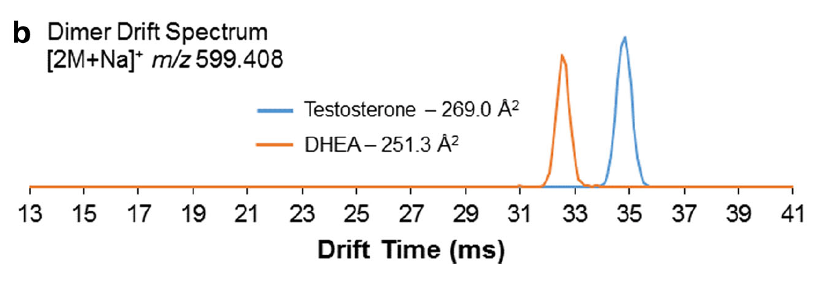
Sodiated Dimer Separation
Chouinard, C.D., Cruzeiro, V.W.D., Roitberg, A.E. et al. J. Am. Soc. Mass Spectrom. (2017) 28: 323.

Slide 14
Sodiated Isomer Resolution
Chouinard, C.D., Cruzeiro, V.W.D., Roitberg, A.E. et al. J. Am. Soc. Mass Spectrom. (2017) 28: 323.

Slide 15
Results
Separation of protonated species
Separation of sodiated species
Changing drift gas
Alternative cations
15
20
25
30
35
40
45
15
20
25
30
35
40
45
Chouinard, C.D., Cruzeiro, V.W.D., Roitberg, A.E. et al. J. Am. Soc. Mass Spectrom. (2017) 28: 323.

Slide 16
Drift Gas Affects on Separation
15
20
25
30
35
40
45
15
20
25
30
35
40
45
15
20
25
30
35
40
45
Drift Time (ms)
Drift Time (ms)
Drift Time (ms)
Chouinard, C.D., Cruzeiro, V.W.D., Roitberg, A.E. et al. J. Am. Soc. Mass Spectrom. (2017) 28: 323.

Slide 17
Drift Gas Affects on Separation
Chouinard, C.D., Cruzeiro, V.W.D., Roitberg, A.E. et al. J. Am. Soc. Mass Spectrom. (2017) 28: 323.

Slide 18
Drift Gas Affects on Collision Cross Sections
Drift Gas | Helium | Argon | Nitrogen | Carbon Dioxide
Polarizability | 0.205 | 1.6 | 1.7 | 2.9
Molecular Weight | 4.00 Da | 39.95 Da | 28.01 Da | 43.99 Da
Chouinard, C.D., Cruzeiro, V.W.D., Roitberg, A.E. et al. J. Am. Soc. Mass Spectrom. (2017) 28: 323.

Slide 19
Results
Separation of protonated species
Separation of sodiated species
Changing drift gas
Alternative cations
Chouinard, C.D., Cruzeiro, V.W.D., Roitberg, A.E. et al. J. Am. Soc. Mass Spectrom. (2017) 28: 323.

Slide 20
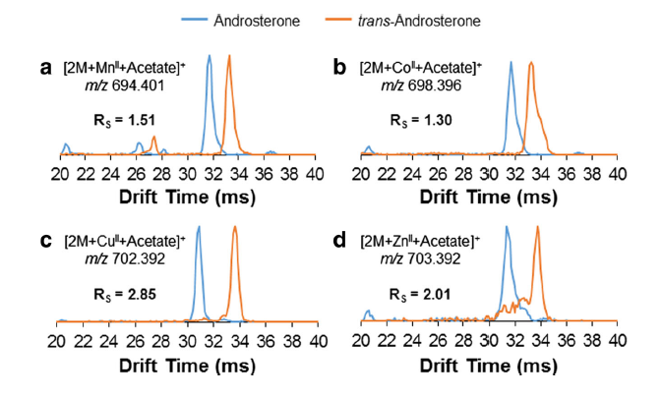
Transition Metal Cations
Chouinard, C.D., Cruzeiro, V.W.D., Roitberg, A.E. et al. J. Am. Soc. Mass Spectrom. (2017) 28: 323.

Slide 21
Optimal Separation Conditions
Chouinard, C.D., Cruzeiro, V.W.D., Roitberg, A.E. et al. J. Am. Soc. Mass Spectrom. (2017) 28: 323.

Slide 22
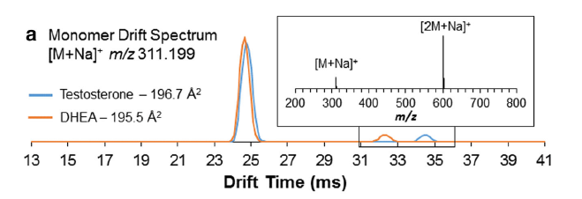
Conclusions
Baseline resolution was achieved for most steroid isomer pairs as sodiated dimers
Carbon dioxide achieved better resolution as a drift gas than nitrogen or helium
Transition metal adducts could provide additional separation as tested on one pair of isomers
Chouinard, C.D., Cruzeiro, V.W.D., Roitberg, A.E. et al. J. Am. Soc. Mass Spectrom. (2017) 28: 323.

Slide 23
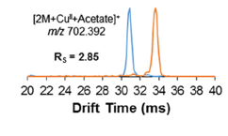
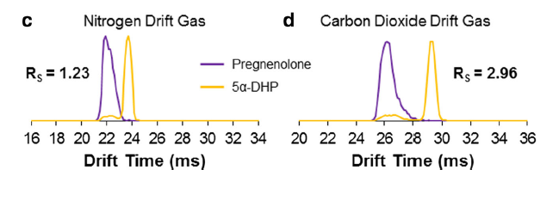
Future Directions
Analysis of additional cation species
Orthogonal separation with liquid chromatography
Analysis of biological samples
Chouinard, C.D., Cruzeiro, V.W.D., Roitberg, A.E. et al. J. Am. Soc. Mass Spectrom. (2017) 28: 323.

