Slide 1

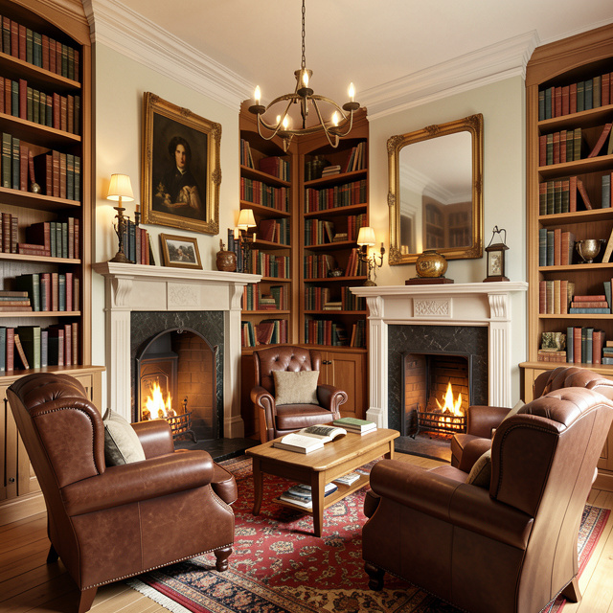
Worlds of Imagination and Feedback
How the Inklings Created Middle-earth and Narnia

Slide 2

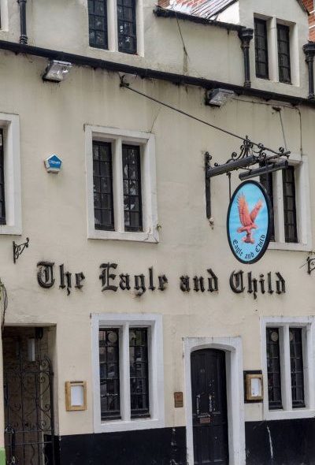
Welcome Back, Fellow Inklings!
A Quick Recap
Last time, we met at the Eagle and Child pub in Oxford. We learned that the Inklings weren't just a club; they were best friends who shared a love for big ideas!
The Dreamers
J.R.R. Tolkien and C.S. Lewis were the stars of the group. They believed that by sharing their unfinished stories, they could help each other make those stories even better. Today, we're going to dive deeper into their magical worlds!

Slide 3

Inkling Trivia Challenge
Question 1:
Which ‘Inkling’ author wrote 'The Chronicles of Narnia'?
Question 2:
Which author spent years creating the world of Middle-earth?
Question 3:
In what city did the Inklings meet to discuss their books?
Answers on the next slide...

Slide 4
Inkling Trivia Challenge
✅​
Answer 1:
C.S. Lewis
Answer 2:
J.R.R. Tolkien
Answer 3:
Oxford, England

Slide 5
Inklings Match-Up
1.
The Hobbit
a)
Written by J.R.R. Tolkien
2.
Prince Caspian
b)
Written by J.R.R. Tolkien
3.
The Lion, the Witch and the Wardrobe
c)
Written by C.S. Lewis
4.
The Lord of the Rings
d)
Written by C.S. Lewis

Slide 6
Inklings Match-Up
✅​
1.
The Hobbit
a)
Written by J.R.R. Tolkien
2.
Prince Caspian
c)
Written by C.S. Lewis
3.
The Lion, the Witch and the Wardrobe
d)
Written by C.S. Lewis
4.
The Lord of the Rings
b)
Written by J.R.R. Tolkien

Slide 7
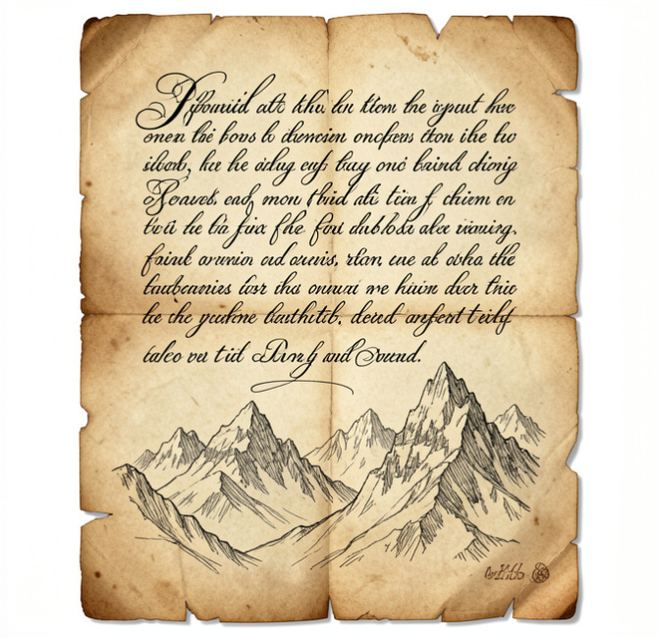
The Magic of Language
Tolkien's Secret
Did you know Tolkien didn't just write stories? He invented entire languages first! He believed a world felt more real if its people had their own way of speaking.
Mythology Matters
Both authors loved ancient myths about dragons, heroes, and magic. They took these old ideas and mixed them with their own imaginations to create something completely new. Narnia and Middle-earth are built on thousands of years of human storytelling!

Slide 8

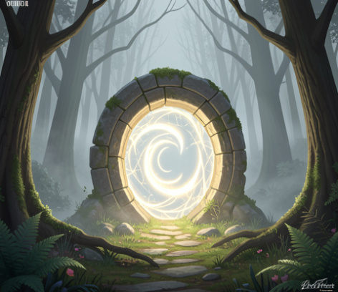
The Critic’s Chair: Writing
Now it's your turn! Write a short paragraph (3-4 sentences) starting a fantasy story. Introduce a mysterious place or a magical character. Don't worry about being perfect—just be imaginative!

Slide 9

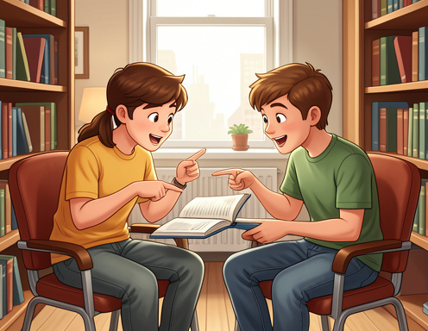
The Critic’s Chair: Feedback
The Inklings were famous for giving 'tough but kind' feedback. Read your partner’s paragraph. How can you give them Inkling-style encouragement?

Slide 10
The Critic’s Chair: Feedback
✅​
You might have said...
Focus on a specific detail you loved.
Suggest a new word to make a description stronger.
Ask a curious question about the character's secret.
Remind them that every great book starts with a messy first draft!

Slide 11
The Creative Process
Answers on the next slide...
How did the Inklings move from an idea to a finished book?
The author uses the feedback to improve the story.
The author gets an idea from mythology or language.
The author writes a first draft of a chapter.
The chapter is read aloud at the pub for friends to hear.

Slide 12
The Creative Process
✅​
How did the Inklings move from an idea to a finished book?
The author gets an idea from mythology or language.
1.
The author writes a first draft of a chapter.
2.
The chapter is read aloud at the pub for friends to hear.
3.
The author uses the feedback to improve the story.
4.

Slide 13

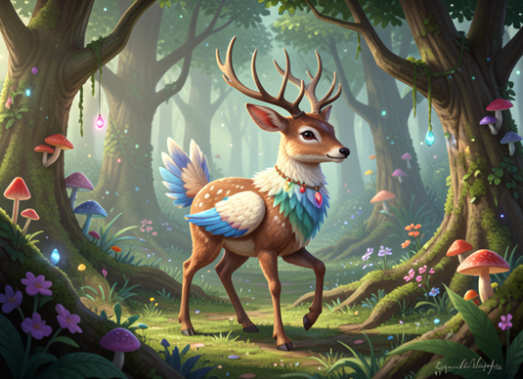
Create a New Myth
Tolkien and Lewis loved unique creatures like Ents and Fauns. Draw a brand new mythological creature that could live in Narnia or Middle-earth. Give it a name and one special power!
What you'll need: 🎨​ 🖌️​
Drawing paper, Colored pencils or markers, Your imagination

Slide 14

The Inklings' Legacy
Beyond the Books
We've explored how Lewis and Tolkien changed fantasy forever. Because they were willing to share their 'worlds of imagination' with friends, millions of readers around the world can visit them too.
Your Journey
Remember, your stories are better when you share them! Keep writing, keep drawing, and always find friends who encourage your biggest dreams.

