Slide 1

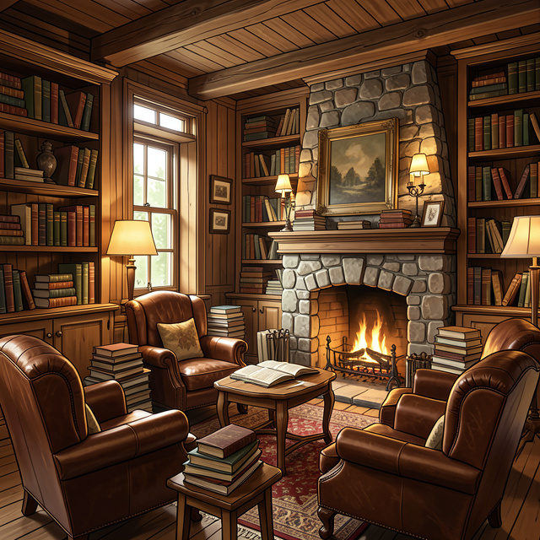
Who Were the Inklings?
The Secret Group Behind Your Favorite Fantasy Worlds

Slide 2


A Very Special Club
Friends and Writers
Imagine a group of friends who loved stories as much as you do! The Inklings were a group of writers and teachers at Oxford University in England about 100 years ago.
What's in a Name?
They called themselves 'Inklings' because it was a play on words. An 'inkling' is a tiny idea, but it also reflects the ink they used to write their famous books!

Slide 3
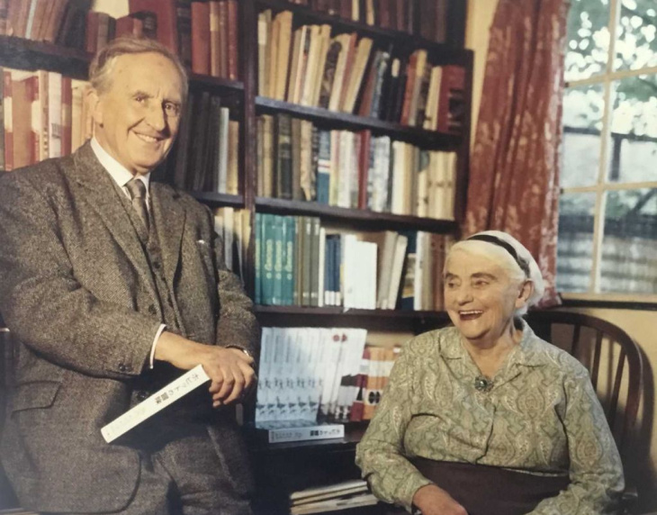
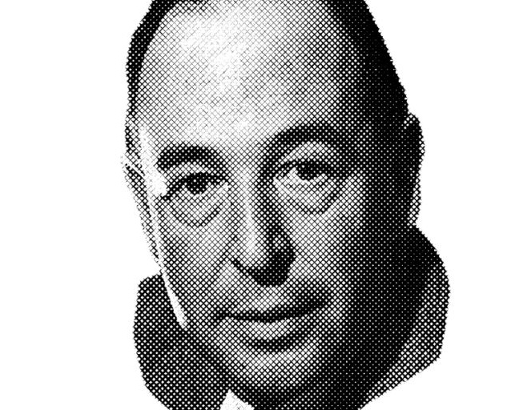
The Famous Duo
J.R.R. Tolkien (left) wrote 'The Hobbit'; C.S. Lewis (right) wrote 'Narnia'.

Slide 4
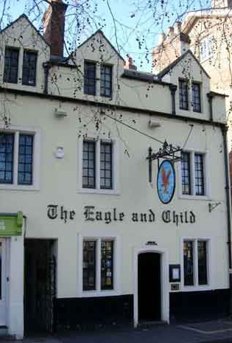
Meeting at the 'Eagle and Child'
The Favorite Hangout
The Inklings didn't meet in a boring classroom. They usually met at a local pub called the Eagle and Child, which they nicknamed 'The Bird and Baby.'
Reading Aloud
They would gather in a small, private room. One person would pull out a messy, handwritten chapter of a new story and read it out loud to the group while the others listened closely.

Slide 5
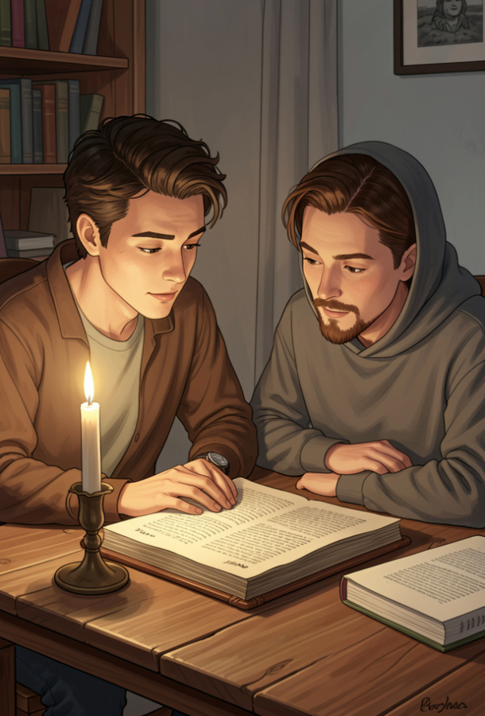
The Inklings' Core Values
1
Honest Feedback
They gave helpful advice to improve stories, even when it was tough to hear.
2
True Friendship
They supported one another through long years of writing and difficult times.
3
Big Imagination
They believed myths were important ways to tell the truth about the world.

Slide 6
Check Your Knowledge!
Answers on the next slide...
What did the Inklings do when they met at the 'Eagle and Child'?
1.
They watched movies based on their books.
2.
They read their unfinished stories to each other.
3.
They practiced for a basketball tournament.
4.
They graded their students' homework together.

Slide 7
Check Your Knowledge!
✅​
What did the Inklings do when they met at the 'Eagle and Child'?
1.
They watched movies based on their books.
2.
They read their unfinished stories to each other.
👍​
3.
They practiced for a basketball tournament.
4.
They graded their students' homework together.

Slide 8
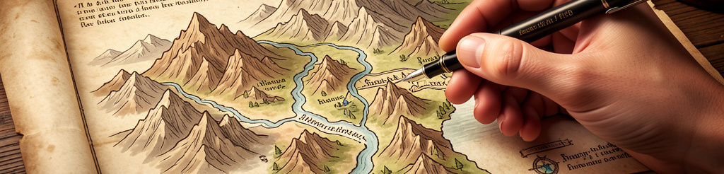
How Middle-earth was Born
Without the Inklings, 'The Lord of the Rings' might never have been finished!
C.S. Lewis encouraged Tolkien every week, telling him his story about Hobbits was wonderful and that he must keep writing.

Slide 9

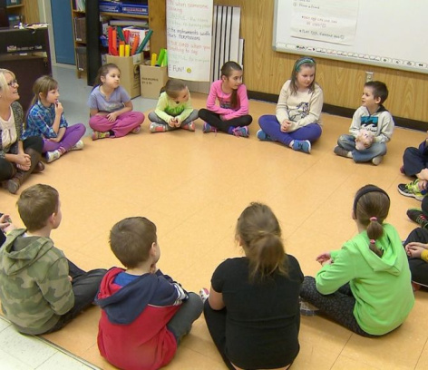
Activity: The Eagle and Child Circle
Step into Character: Form a circle to become 'Young Inklings' at the pub. Share an imaginary story prompt (e.g., 'A dragon afraid of heights'). Listen to friends and offer one 'Encouraging Inkling' comment per idea.

Slide 10
Inkling Vocabulary
1.
Inkling
a)
Helpful advice given to improve work.
2.
Feedback
b)
The original handwritten version of a story.
3.
Oxford
c)
The university and city where the group lived.
4.
Manuscript
d)
A small idea or a person who writes with ink.

Slide 11
Inkling Vocabulary
✅​
1.
Inkling
d)
A small idea or a person who writes with ink.
2.
Feedback
a)
Helpful advice given to improve work.
3.
Oxford
c)
The university and city where the group lived.
4.
Manuscript
b)
The original handwritten version of a story.

Slide 12
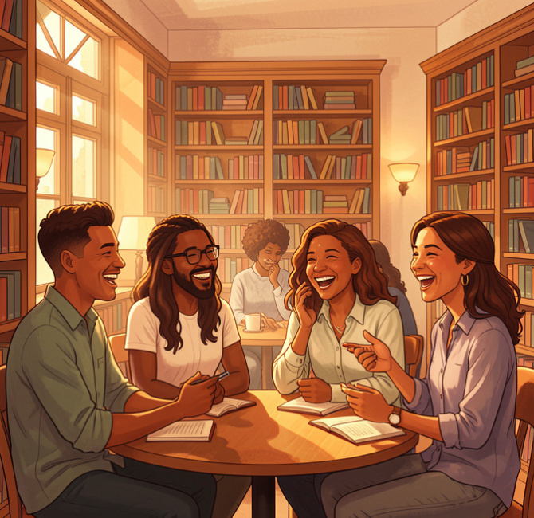
The Power of a Group
What We Learned
Writing can be lonely, but the Inklings showed us that having a community makes us better creators. By sharing their work and helping their friends, they created worlds like Narnia and Middle-earth that we still love today.
Your Turn
Next time you write, remember that sharing your 'inklings' with a friend might just be the start of a great adventure!

