Slide 1
Tollgates - DMAIC

Slide 2





Lean Six Sigma DMAIC Improvement Process Road Map
Define
Measure
Analyze
Improve
Control
Activities
Identify Problem
Validate Problem Statement
Gather Voice of the Customer & Business
Develop CCR’s & CBR’s
Validate Goal Statement
Validate Business Case
Validate Project Scope
Select and Launch Team
Develop Project Schedule
Complete Define Tollgate
Appropriately Map Process
Identify Key Input, Process and Output Metrics
Develop Operational Definitions
Develop Data Collection Plan
Validate Measurement System
Collect Baseline Data
Develop Working Cost Estimate
Determine Process Performance/Capability
Complete Measure Tollgate
Identify Potential Root Causes
Reduce List of Potential Root Causes
Confirm Root Cause to Output Relationship
Estimate Impact of Root Causes on Key Outputs
Prioritize Root Causes
Complete Analyze Tollgate
Develop Potential Solutions
Develop Evaluation Criteria
Select Best Solutions
Develop ‘To-Be’ Process Map(s)
Develop Pilot Plan
Pilot Solution
Develop Full Scale Implementation Plan
Complete Improve Tollgate
Implement Mistake Proofing
Develop SOPs, Training Plan and Process Controls
Implement Solution and Ongoing Process Measurements
Identify Project Replication Opportunities
Develop Final Cost Estimate
Complete Control Tollgate
Transition Project to Process Owner
Tools
Project Charter
Project Selection Tools
Value Stream Map
Various Financial Analysis
Effective Meeting Skills
Stakeholder Analysis
Communication Plan
SIPOC Map
High-Level Process Map
Project Management Tools
VOC and Kano Analysis
RACI and Quad Charts
Process Mapping
Process Cycle Efficiency
Little’s Law
Operational Definitions
Data Collection Plan
Statistical Sampling
Measurement System Analysis
TPM
Generic Pull
Setup Reduction
Control Charts
Histograms
Constraint Identification
Process Capability
Value Analysis
Process Constraint ID
Takt Time Analysis
Cause and Effect Analysis
FMEA
Hypothesis Tests
Correlation Analysis
Simple and Multiple Regression
ANOVA
Components of Variation
Conquering Product and Process Complexity
Queuing Theory
Brainstorming
Replenishment Pull/Kanban
Stocking Strategy
Process Flow Improvement
Process Balancing
Analytical Batch Sizing
Total Productive Maintenance
Design of Experiments (DOE)
Solution Selection Matrix
‘To-Be’ Process Mapping
Poka-Yoke
Control Charts & SPC
Standard Operating Procedures (SOPs)
Training Plan
Communication Plan
Implementation Plan
Process Control Plans
Visual Process Control Tools
Project Replication
Project Commissioning
Team Feedback Session

Slide 3
Learning Objectives
Understand the change equation
Know the objective of each phase of DMAIC
Apply the proper Tollgate to each phase of a DMAIC project

Slide 4
The Change Equation
C = Change
SD = Shared Dissatisfaction with the “as-is” state
V = Vision for a “to-be” state that is exciting
FS = First Steps, at least, of a path to get from SD to V
C = f(SD, V, FS)
Note: Equation is notional/conceptual, not mathematical

Slide 5
Primary Expectation For Define
A well characterized project
Characterizing C

Slide 6
Define Potential Additional Deliverables
Process Map (various levels of detail)
SIPOC
Formal, Detailed Communication Plan
Formal Risk Analysis
RIE Planning
Characterizing C

Slide 7
Expectations For Measure
Valid Data Characterizing the “As-is” State
Process Data
Detailed Process Map
Data characterizing key Input & Process Measures
Data characterizing the key Output Measures
C_{p}, C_{pk}, and/or Sigma Quality Level
Gap Identification
Data Validation
Gage R&R
Kappa Study
Kendal’s Coefficient
Data Audit
Developing SD

Slide 8
Expectations For Analyze
Primary Root Causes Are Verified
Fishbone Diagram
Cause and Effect Matrix
t-Tests, *p-Tests
ANOVA
Linear Regression
*Logistic Regression
*Advanced topics requiring MBB support
*Chi Squared Tests
Design of Experiments Results
Value Analysis
Time-Value Analysis
Takt Rate Analysis
Flow Analysis
Developing SD

Slide 9
Expectations For Improve
Potential Solution & Pilot Plan
Some Potential Tools/Activities
DOE Results
Variation Analysis
Brainstormed Solutions
Criteria Matrix
Formal Risk Analysis
FMEA
Implementation/Pilot Plan
Developing V & FS

Slide 10
Expectations For Control
Solution In Place & Proven
Standard Operating Procedures in use
Control Plan in place
Measurement system validated
Statistical Evidence of improvement
Final cost estimate
Proving C

Slide 11
What Is a Tollgate Review?
A recognizable event that the project must pass through at each phase of the project (D-M-A-I-C)
Presentation followed by questions and discussion
Suggest 15-20 min max without questions
15-45 minutes allotted afterwards for questions and discussion
The Tollgate review ends with a Go/No-Go decision by the Sponsor
“Given what we know now, should we continue to invest effort in this project?”

Slide 12






Tollgate Reviews
Define
Measure
Analyze
Improve
Control
Validate
Define
Measure
Analyze
Improve
Control
Tollgate Reviews
Key topics of Tollgate Review include:
Project Deliverables, Status and Risks
Project Schedule/timeline
Changes in project characteristics
Whether to continue the project or not
Expected Benefits – Financial and Non-Financial

Slide 13
When to Do a Tollgate Review
Define – After validation of the project charter by the project team
Measure – After the measurement system is validated and current state data is collected
Analyze – After the root causes (critical X’s) have been validated and prioritized
Improve – After a pilot has been completed
Control – After all the changes have been implemented and the desired process performance has been achieved
Subsequent additional reviews conducted as part of the Control Phase and Project Closeout include:
Validation of benefits
Project Commissioning (Transition to Process Owner)
Sustainment of gains

Slide 14
Who Should Attend?
Facilitator (BB or GB)
Black Belt or Green Belt mentor
Project Sponsor
Process Manager
Project Team (Measure and later)
Deployment Director (Early in deployment)
Senior Staff
Master Black Belt (optional)
Resource Manager
Other Stakeholders (optional)

Slide 15
How to Structure a Tollgate Review
Tell the story!!
One slide executive overview of the current state of the project
Title, Phase (DMAI or C), Goal(s), Estimated completion date, how it’s going (Red, Yellow or Green Light)
Review the goal of the specific Tollgate

Slide 16
How to Structure a Tollgate Review
15-20 minutes (max) presentation
No questions
Define – Project Leader (GB/BB)
MAI – Process Owner and/or Team
Control – Process Owner & Team
Your project presentation
Charter, team, highlight any changes
Follow the DMAIC roadmap
Tell the story
Name of tool – what team learned
Project plan
Project barriers and issues
Tollgate review questions and discussion
Tollgate decision
Document Tollgate results in tracking tool(s)

Slide 17
Key Characteristics of a Good Tollgate Review
Improvement team presenters leave feeling encouraged and respected
Reviewers leave feeling effective
Reviewers and presenters learned something new about the improvement project
Presenters and reviewers felt they could be open and candid
Reviewers refined their listening, reinforcing, questioning, and suggestion skills
Reviewers and presenters leave with a clear unified view of the path forward and benefits
Reviewers and presenters leave feeling this was a good use of their time

Slide 18
The Attendee Contribution
Reinforce use of logic and data which you want the team to continue
Ask questions of clarification about logic and data. Identify places where conclusions have no visible logic and data behind them – assume logic or data might be there and ask questions to invite it to come out.
Ask questions to encourage self-discovery of problems. If there are many instances of missing logic or data:
Focus on the place where consequences will be most serious if not discovered
Focus on the first or earliest omission
Offer one or two specific suggestions for improving logic and data

Slide 19
Define Tollgate Tollgate Questions Checklist (Provided to Project Sponsor)
Note: Not all questions will need a specific document in every project. Use those tools that are applicable.
Has the project been chosen because it is in alignment with Army goals and the strategic direction of the ‘business’? Have other similar projects been completed in Power Steering? Are we duplicating projects that have already been completed?
What is the problem statement – detailing (what) is the problem, (when) was the problem first seen, (where) was is it seen, and what is the (magnitude or extent) of the problem. Is the problem measured in terms of Quality, Cycle Time or Cost Efficiency? Ensure there is no mention or assumptions about causes and solutions – if you already know the solution (e.g. development of a database, it’s not a candidate for a LSS project/certification).
Does a goal statement exist that defines the results expected to be achieved by the process, with reasonable and measurable targets? Is the goal developed around each problem in the problem statement? Does it address: Quality, Cycle Time or Cost Efficiency?
Does a financial business case exist, explaining the potential impact (i.e. measured in dollars) of the project on the Army, Major Commands, Subordinate Commands, Budgets, Net Operating Results, etc.?
Is the project scope reasonable? Have constraints and key assumptions been identified? Have IT implications been addressed and coordinated with IT managers?
Who is on the team? Are they the right resources and has their required time commitment to the project been confirmed by your local Command and Team?
What is the high level work plan? What are the key milestones (i.e. dates of tollgate reviews for DMAIC projects)?
Who are the customers for this process? What are their requirements? Are they measurable? How were the requirements determined?
Who are the key stakeholders? How will they be involved in the project? How will progress be communicated to them? Do they agree to the project?
What kinds of barriers/obstacles will need assistance to be removed? Has the development of a risk mitigation plan to deal with the identified risks been developed?

Slide 20
Measure Tollgate Tollgate Questions Checklist (Provided to Project Sponsor)
Note: Not all questions will need a specific document in every project. Use those tools that are applicable.
Has an overarching Value Stream Map been completed with data to better understand the process and problem, and show where in the process the root causes might reside?
Has the team conducted a value-added (NVA, CVA, BVA) and cycle time analysis, identifying areas where time and resources are devoted to tasks not critical to the customer?
Has the team identified the specific input (x), process (x), and output (y) measures needing to be collected for both effectiveness and efficiency categories (I.e. Quality, Speed, and Cost Efficiency measures)?
Has the team developed clear, unambiguous operational definitions for each measurement and tested them with others to ensure clarity and consistent interpretation?
Has a clear, reasonable choice been made between gathering new data or taking advantage of existing data already collected by the organization?
Has an appropriate sample size and sampling frequency been established to ensure valid representation of the process we are measuring?
Has the measurement system been checked for repeatability and reproducibility, potentially including training of data collectors?
Has the team developed and tested data collection forms or check sheets which are easy to use and provide consistent, complete data?
Have all baseline measurements relative to the problem statement and goal been identified and measured/collected? To include from the perspective of the VOC (e.g. questionnaires) and VOB?
Has the team developed a Working Cost Estimate?
Has baseline performance and process capability been established? How large is the gap between current performance and the customer (or project) requirements?
Has the team been able to identify and complete any ‘Quick Wins’?

Slide 21
Analyze Tollgate Tollgate Questions Checklist (Provided to Project Sponsor)
Note: Not all questions will need a specific document in every project. Use those tools that are applicable.
Has the team examined the process and identified potential time traps/ bottlenecks, disconnects, and redundancies that could contribute to the problem statement?
Has the team analyzed data about the process and its performance to help stratify the problem, understand reasons for variation in the process, and generate hypothesis as to the root causes of the current process performance?
Have the root causes been identified and validated?
Does the team understand why the problem (the Quality, Cycle Time, or Cost Efficiency issue identified in the Problem Statement) is being seen?
Has the team been able to identify and complete any additional ‘Quick Wins’?
Have findings to-date required modification of the Project Charter? If so, have these changes been approved by the Project Sponsor and the Key Stakeholders?
Have any new risks to project success been identified, added to the Risk Mitigation Plan, and a mitigation strategy put in place?

Slide 22
Improve Tollgate Tollgate Questions Checklist (Provided to Project Sponsor)
Note: Not all questions will need a specific document in every project. Use those tools that are applicable.
What techniques were used to generate ideas for potential solutions?
What narrowing and screening techniques were used to further develop and qualify potential solutions?
What evaluation criteria were used to select a recommended solution?
Do the proposed solutions address all of the identified root causes, or at least the most critical?
Were the solutions verified with the Project Sponsor and Stakeholders? Has an approval been received to implement?
Was a pilot run to test the solution? What was learned? What modifications were made?
Has the team seen evidence that the root causes of the initial problems have been addressed during the pilot? What are the expected benefits?
Has the team considered potential problems and unintended consequences (FMEA) of the solution and developed preventive and contingency actions to address them?
Has the proposed solution been documented, including process participants, job descriptions, and if applicable, their estimated time commitment to support the process?
Has the team developed an implementation plan? What is the status?
Have changes been communicated to all the appropriate people?
Has the team been able to identify any additional ‘Quick Wins’?
Have findings to-date required modification of the Project Charter? If so, have these changes been approved by the Project Sponsor and the Key Stakeholders?
Have any new risks to project success been identified and added to the Risk Mitigation Plan?

Slide 23
Control Tollgate Tollgate Questions Checklist (Provided to Project Sponsor)
Note: Not all questions will need a specific document in every project. Use those tools that are applicable.
Has the team prepared all the essential documentation for the improved process, including revised/new Standard Operating Procedures (SOPs), a new/updated training plan, and a process control system/report?
Has the necessary training for process owners/operators been performed?
Have the right metrics (Xs/Ys) been selected and documented as part of the Process Control System to monitor performance of the process and the continued effectiveness of the solution? Has the metrics briefing plan/schedule been documented? Who owns the measures? Has the Process Owner’s job description been updated to reflect the new responsibilities? What happens if minimum performance is not achieved?
Has the solution been effectively implemented? Has the team compiled results data confirming that the solution has achieved the goals defined in the Project Charter?
Has the Financial Benefit Summary been completed? Has the Resource Manager reviewed/validated it IAW LSS Guidebook?
Has the process been transitioned to the Process Owner, to take over responsibility for managing continuing operations? Do they concur with the control plan?
Has a final Storyboard documenting the project work been developed?
Has the team forwarded other issues/opportunities, which were not able to be addressed, to senior management?
Have “lessons learned” been captured?
Have replication opportunities been identified and communicated to similar agencies (internal and external)?
Has the hard work and successful efforts of our team been celebrated?

Slide 24

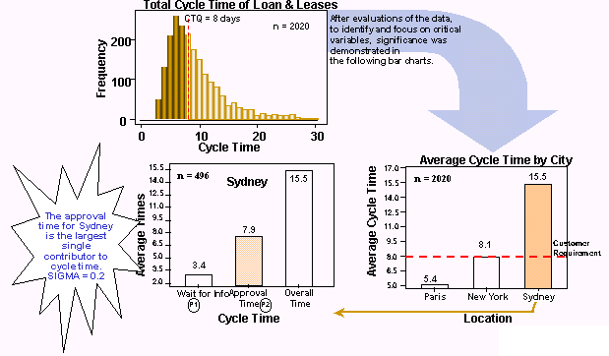
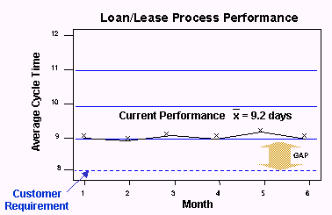
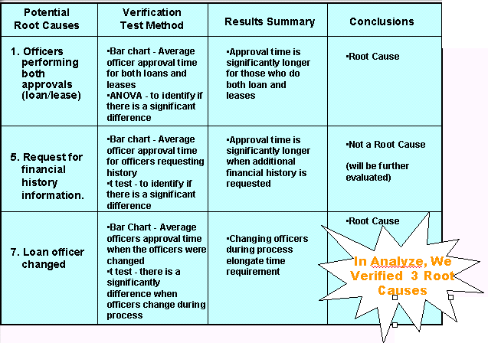
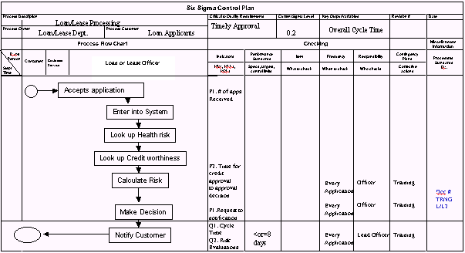
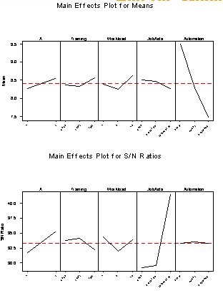
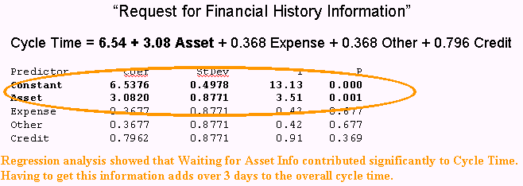
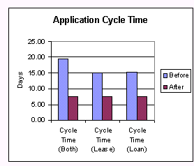
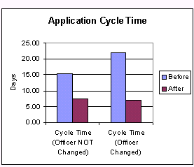
Project “Storyboard” – Example
Define
1.2 Day
CCR Gap
Sigma Performance Level of 1.3
Project Charter
BUS CASE: Be #2 Fin Service Provider
GOAL: Reduce Loan/Lease CT from
9.2 to 8.0 days by July 1
Measure
FIN IMPACT: $2.7M per year
Analyze
Potential Root Causes
Control
Improve
Loan or Lease
Pilot Plan
Screen Entry
“Officer performs both” & “Officers changed”, eliminated as contributors to high cycle time.
Color Printouts
Officer Work & Turnover, Waiting, & Automation
Affect CT; Job Aids affect Variation in CT
Rewards & Recog
Flex Time

Slide 25
Takeaways
Now you should be able to:
Explain the change equation elements
Describe the primary objective for each phase of a DMAIC project
Identify the “as-needed” objectives for each phase of a DMAIC project
Describe who should attend a tollgate and why
Describe the content and flow of each tollgate in the DMAIC project

