Slide 1
Project Charters

Slide 2





Lean Six Sigma
DMAIC Improvement Process Road Map
Define
Define
Measure
Measure
Analyze
Analyze
Improve
Improve
Control
Control
Activities
Tools
Identify Problem
Validate Problem Statement
Gather Voice of the Customer & Business
Develop CCRs & CBRs
Validate Goal Statement
Validate Business Case
Validate Project Scope
Select and Launch Team
Develop Project Schedule
Complete Define Tollgate
Project Charter
Project Selection Tools
PIP Management Process
Value Stream Map
Various Financial Analysis
Effective Meeting Skills
Stakeholder Analysis
Communication Plan
SIPOC Map
High-Level Process Map
Project Management Tools
VOC and Kano Analysis
RACI and Quad Charts

Slide 3
Learning Objectives
Apply the elements of project chartering to a Lean Six Sigma project
Understand the roles and responsibilities associated with chartering a Lean Six Sigma project

Slide 4
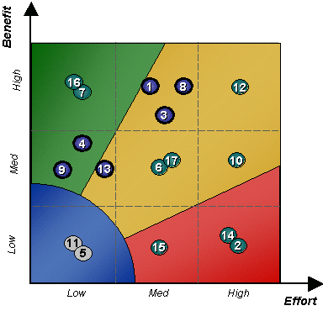
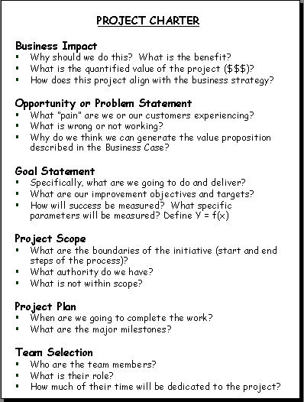
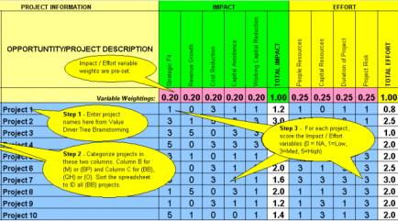
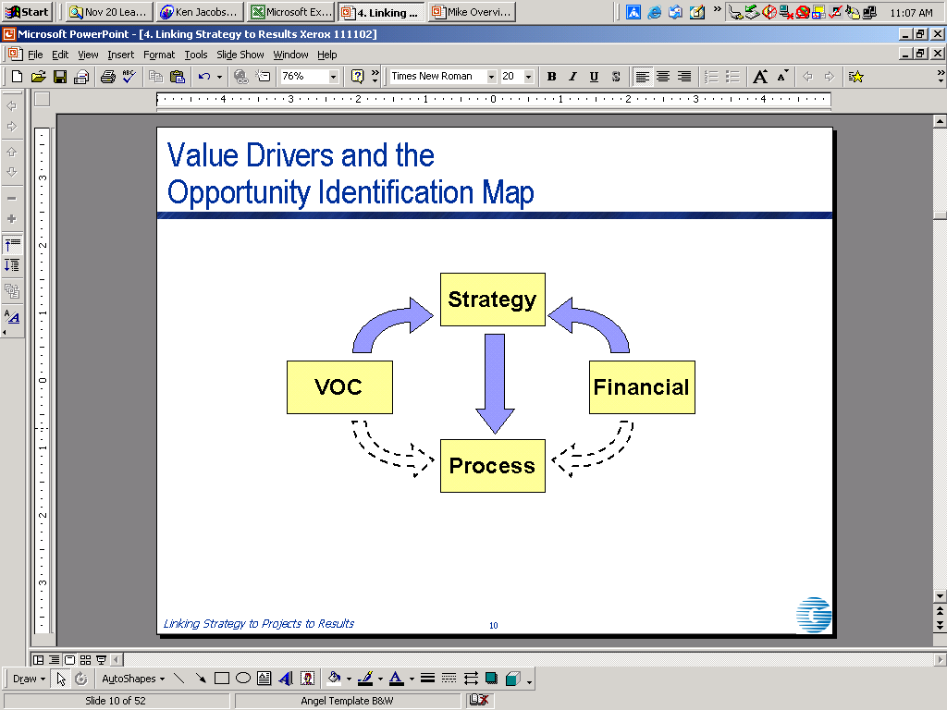
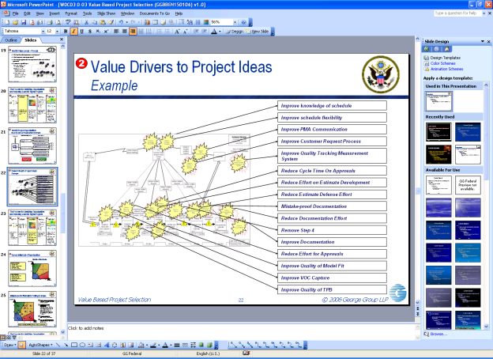
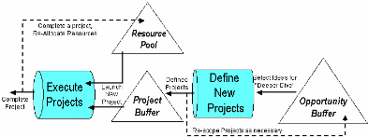
The Process for Identifying Opportunities and Selecting Lean Six Sigma Projects
1
2
3
4
5
Identify Value Levers
Identify Project Opportunities
Screen Initial List of Opportunities
Scope and Define Projects
Prioritize List of Defined Projects
Identify value levers in the organization
  Strategic
  Financial
  Customer
  Operational (Process)
Prioritize value levers
Translate Value Levers into Opportunity Areas
Translate Opportunity Areas into Project Ideas
Score each project as High / Med / Low for Benefit and Effort
Fill in Benefit / Effort Matrix
Review plotted results
Select highest priority opportunities for further analysis
Assign opportunities to project sponsors for project definition
Complete Draft Project Charters
Evaluate projects using Evaluation Criteria
Update Benefit / Effort Matrix
Review plotted results
Prioritize projects
Schedule project launches based on resource availability
  Reduce Projects-in-Process

Slide 5
RACI for Project Charter Development
R
Responsible
A
Accountable
Identify / Screen Project
Opportunities
Select Projects for
Execution
C
Consulted
Develop Draft Project
Charters
Assign Project Sponsors
I
Informed
In hierarchy order of responsibility.
Leadership | R | R | C | R
Deployment Director | A | A | C | A
Project Sponsor | A | A | R/A | A
Belt | I |  | C | C
Responsible - The person liable if this part of the project fails. "The buck stops here“ There is only one!
Accountable - The person or unit that does the work. "The doer”
Consulted - Provides opinion and information. "In the loop"
Informed - Communication to people who will be affected. "Kept in the picture"
Notes:
5

Slide 6
Project Chartering
The charter defines the team’s mission.
It includes the following elements:
  Business Case
  Opportunity or Problem Statement
  Goal Statement
  Project Scope
  Project Plan (Tollgate Timeline)
  Team Selection
The Project Charter does NOT solve the problem
It is a living document, that will change over time...

Slide 7
Who Develops the Project Charter
The Project Sponsor is responsible AND accountable for developing a draft Project Charter, with assistance from:
  Deployment Director, who might start the process of filling out the Project Charter
  Resource Manager
    Take the lead in developing cost data
    Buy-in
  Executive Staff
  Facilitator (GB/BB), potential team members (if possible)
Notes:
7

Slide 8
Project Charter Elements
Business Impact
Why should we do this? What is the benefit?
How does this project align with the business strategy?
What is the quantified value of the project ($$$)?
Opportunity or Problem Statement
What “pain” are we or our clients experiencing?
What is wrong or not working?
Why do we think we can generate the value proposition described in the Business Impact?
Goal Statement
What are our improvement objectives and targets?
Specifically, what is going to be better?
How will success be measured? What specific parameters will be measured?
Project Scope
What are the boundaries of the initiative (start and end points of the process or parts of a system)?
What authority do we have?
What is not within scope?
Project Plan
How are we going to get this done?
When are we going to complete the work?
What are the major milestones (tollgates)?
Team Selection
Who are the team members?
What is their role?
How much of their time will be dedicated to the project?

Slide 9
Project Charter Development
Is an Iterative Process
Scope must address the bulk of the problem identified
Scoping can change what measurements needed to be tracked
Benefits are proportional to scope
Opportunity or Problem Statement
Goal Statement
Business
Impact
Project Scope
What is the ‘Current State’?
What “pain” are we or our clients experiencing?
What is wrong or not working?
What is the desired ‘Future State’?
What are our improvement objectives and targets?
Specifically, what is going to be better?
How will success be measured? What specific parameters will be measured?
What is the value (strategic and/or financial) of closing the gap between ‘Current’ and ‘Future’ states?
What is the financial benefit – the quantified value of the project ($$$)?
What are the boundaries of the initiative (start and end points of the process or parts of a system)?
Is the scope reasonable?
What is not within scope?

Slide 10
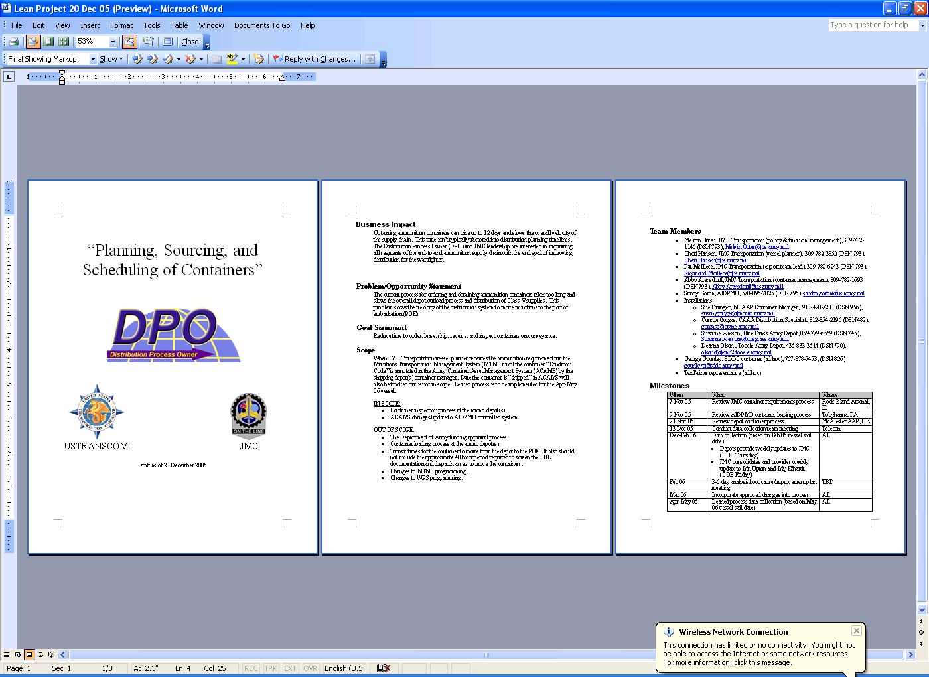
Project Charter
Example
Team Selection
Business Impact
Problem Statement
Goal statement
Scope
In Scope
Out of Scope
Project Plan
or Milestones
Who / What / Where

Slide 11
Opportunity or Problem Statement
Business Impact
Why should we do this? What is the benefit?
How does this project align with the business strategy?
What is the quantified value of the project ($$$)?
Opportunity or Problem Statement
What “pain” are we or our clients experiencing?
What is wrong or not working?
Why do we think we can generate the value proposition described in the Business Impact?
Goal Statement
What are our improvement objectives and targets?
Specifically, what is going to be better?
How will success be measured? What specific parameters will be measured?
Project Scope
What are the boundaries of the initiative (start and end points of the process or parts of a system)?
What authority do we have?
What is not within scope?
Project Plan
How are we going to get this done?
When are we going to complete the work?
What are the major milestones (tollgates)?
Team Selection
Who are the team members?
What is their role?
How much of their time will be dedicated to the project?
Note: Even though the Business Case is listed first in the Project Charter, it is helpful to develop the Opportunity or Problem Statement and Goal Statement before the Business Case.
The Business Case is listed first in the Project Charter because the value creation potential is generally of primary interest for people reading the charter.

Slide 12
Building an Opportunity or
Problem Statement
An Opportunity or Problem Statement:
Contains information that gives specificity to the issue
Quantifies the “pain” caused by the current problem
  What is occurring/happening? (Example: Increase in cycle time)
  When did the problem start? (Example: starting in FY03)
  Where is the occurrence? (Example: at all locations)
  Magnitude of the problem (Example: average of 21 days and to process an Interim Flight Clearance)
Problem Statement Template:
The [customer] expects [metric (central tendency/spread)] and the current process is operating at [metric (central tendency/spread)]. This (What) began (When) at (Where).

Slide 13
Exercise:
Creating an Opportunity/Problem Statement
Objective
Create a Problem Statement for GGA's Budget Department
Instructions (Led by the Budget Director, with assistance from Instructors)
Identify the key process metrics to be improved, the Y’s
  These come from the Customers (Regional Program Managers) and the Process Owner (Assistant Undersecretary for Programs)
Develop an Opportunity or Problem Statement for each metric chosen
Record your Opportunity or Problem Statement on a flip chart or template and be prepared to present to the group.
Time = 10 Minutes

Slide 14
Goal Statement
Business Impact
Why should we do this? What is the benefit?
How does this project align with the business strategy?
What is the quantified value of the project ($$$)?
Opportunity or Problem Statement
What “pain” are we or our clients experiencing?
What is wrong or not working?
Why do we think we can generate the value proposition described in the Business Impact?
Goal Statement
What are our improvement objectives and targets?
Specifically, what is going to be better?
How will success be measured? What specific parameters will be measured?
Project Scope
What are the boundaries of the initiative (start and end points of the process or parts of a system)?
What authority do we have?
What is not within scope?
Project Plan
How are we going to get this done?
When are we going to complete the work?
What are the major milestones (tollgates)?
Team Selection
Who are the team members?
What is their role?
How much of their time will be dedicated to the project?

Slide 15
How to Establish the Project Goal
Several Possible Options
Meeting or exceeding customer requirements, established through the VOC process
Meeting or exceeding business requirements, established through the VOB process (i.e. requirements of the Process Owner)
Benchmarking the performance of direct competitors
Benchmarking ‘best practice’ performance from companies in non-competitive industries (e.g., web-based product customization/sales at Dell and order fulfillment at Amazon)
A portion of the process ‘entitlement’, typically 70%
  Entitlement is the historical best performance of the process

Slide 16
Examples of Bad Goal Statements
Improve cost of the process
Establish a good CAC Issuing process
Develop an automated CAC Issuing system
Implement Kiosk to create CACs.

Slide 17
Exercise:
Creating a Goal Statement
Objective
Create a Goal Statement for GGA's Budget Department
Instructions (Led by the Budget Director)
For each Problem Statement, create at least one Goal Statement for the project
Time = 10 Minutes

Slide 18
Business Impact
Business Impact
Why should we do this? What is the benefit?
How does this project align with the business strategy?
What is the quantified value of the project ($$$)?
Opportunity or Problem Statement
What “pain” are we or our clients experiencing?
What is wrong or not working?
Why do we think we can generate the value proposition described in the Business Impact?
Goal Statement
What are our improvement objectives and targets?
Specifically, what is going to be better?
How will success be measured? What specific parameters will be measured?
Project Scope
What are the boundaries of the initiative (start and end points of the process or parts of a system)?
What authority do we have?
What is not within scope?
Project Plan
How are we going to get this done?
When are we going to complete the work?
What are the major milestones (tollgates)?
Team Selection
Who are the team members?
What is their role?
How much of their time will be dedicated to the project?

Slide 19
Business Impact Objectives
Define:
A clear and common understanding of “why we should do the project”
What is the benefit (savings, cost avoidance, revenue generation, non-financial)?
What is the quantified, estimated value of the project in monetary terms?

Slide 20
Financial Guidelines Clearly Define How Benefits Are Estimated and Measured
Financial benefits for a project are classified as:
  Cost reduction
    Savings
    Cost avoidance
  Revenue generation
Frequently a project’s non-financial benefits will generate financial benefits. E.g., a project that reduces cycle time will almost certainly generate a cost avoidance.
In developing the project charter, a precise financial estimate is not required. The projected financial benefit can be developed based on the professional judgment of the supporting resource manager, functional experts, and MBB/BB/GB.
General Guidance

Slide 21
Lean Six Sigma Financial Principles
Every step is taken to ensure the integrity and accuracy of the data
Impacts on internal controls are proactively identified and communicated
Financial benefits are measured by comparing baseline process costs with revised process costs. Cost data are developed in one of three ways: from official accounting systems, from non-financial systems, and from independent estimates.
Processes developed to calculate and assess benefits must be simple and not overly complex
The primary reporting metrics for Lean Six Sigma projects is the impact on Budget and strategic goals
Lean Six Sigma metrics complement, but do not replace, other critical measures and analyses
All organizations consistently define, quantify, measure, and report Lean Six Sigma projects in a tracking system
General Guidance

Slide 22
Types of Financial Benefits
Cost reduction – A reduction in the number of dollars needed to meet a customer-established requirement by executing a certain process or function. All cost reductions are either savings or cost avoidance.
  Savings – Cost reductions that enable a manager to remove programmed or budgeted funds and apply them to other uses. Savings are viewed from an Army perspective: An initiative that reduces costs in one appropriation or organization but increases costs elsewhere represents savings only to the extent that there is a net cost reduction that can be applied to other uses.
  Cost avoidances – All cost reductions that are not savings
Revenue generation – An increase in the dollars that flow into the Army, over and above appropriated funds and customer funding received through a revolving fund
Financial benefits are determined by comparing the cost (or revenue generation) of the baseline, “as-is” process with the cost (or revenue generation) of the revised, “to-be” process.
The LSS Deployment Guidebook provides examples that explain the definitions.
General Guidance

Slide 23
Estimating Financial Benefits
The Deployment Director and Project Sponsor may make a preliminary estimate of financial benefits prior to project selection, as a means of helping to prioritize projects
During charter development, a complete cost estimate is not required. The projected financial benefit can be developed based on the professional judgment of the resource manager, functional experts, and MBB/BB/GB.
Later in the DMAIC process, cost estimates are required twice:
  At the Measure tollgate, the team will develop its Working Cost Estimate and post it to PowerSteering.
  At the Control tollgate, the team will develop the Final Cost Estimate and post it to PowerSteering.
  This will be discussed in greater detail in a subsequent class.
General Guidance

Slide 24
Approaches for Developing Cost Data
Develop independent estimate
  Independent means an estimate developed by someone who is not part of the organization responsible for the process being transformed
  Techniques include
    Bottom up
      Identify all individual elements that generate cost
      Identify the cost of each element
      Sum the elements
    Top down
      Start with the whole pie
      Exclude items out of scope or not likely to happen
      Estimate how much can be impacted by the project

Slide 25
Bottom-Up Estimates
Create a statement that summarizes the change and where/how the financial impact will occur
  Must correspond to the baseline situation
  Can be a “hypothesis statement”
Lay out a “Chain of Causality” that describes how the benefits will be realized
  IF <this action> THEN <this result>
    There may be several steps in a given chain
  Explicitly list any assumptions
Estimate the impact on process cost of each “Chain of Causality”
Capture your rationale and your calculations in supporting documents (formulas, calculations, assumptions)

Slide 26
Top-Down Estimates
Establish the total size of the opportunity / problem within the scope of the project
Estimate how much of that can be “solved” by a successful Lean Six Sigma project
Estimate the impact of the solution on the cost of the process
Capture your rationale and your calculations in supporting documents (formulas, calculations, assumptions)
Example
  Wasted effort for process XYZ averages $450,000 per month
  40% of this is “engineered” into the process
    $450,000 x 60% addressable x 50% reduction = $135,000 / month

Slide 27
Confidence in Our Estimates
Confidence
  What are the assumptions behind the estimates ?
  How comfortable are we with the assumed values ? How does this impact the result ?
  How good is the “hard data” we based our calculations on ?
  Is the “Chain of Causality” believable ?

Slide 28
Exercise:
Developing the Business Impact
Objective
Develop a Business Impact for GGA's Budget Department
Instructions (Led by the Budget Director)
Establish the potential financial benefits for GGA's Budget Department
Classify the Business Impact(s) as Cost Reduction (Savings or Cost Avoidance) or Revenue Generation
Time = 15 Minutes

Slide 29
Project Scope
Business Impact
Why should we do this? What is the benefit?
How does this project align with the business strategy?
What is the quantified value of the project ($$$)?
Opportunity or Problem Statement
What “pain” are we or our clients experiencing?
What is wrong or not working?
Why do we think we can generate the value proposition described in the Business Impact?
Goal Statement
What are our improvement objectives and targets?
Specifically, what is going to be better?
How will success be measured? What specific parameters will be measured?
Project Scope
What are the boundaries of the initiative (start and end points of the process or parts of a system)?
What authority do we have?
What is not within scope?
Project Plan
How are we going to get this done?
When are we going to complete the work?
What are the major milestones (tollgates)?
Team Selection
Who are the team members?
What is their role?
How much of their time will be dedicated to the project?

Slide 30
Project Scope Objectives
Define:
What are the boundaries of the initiative (start and end steps of the process)?
What authority do we have?
What is not within scope?
Commandments?
  “Thou shalt” or “Thou shalt nots” of the project
Monuments?
  Things that can’t be moved/changed (i.e. IT system)

Slide 31
Elements of a Scope Statement
A Scope Statement defines the boundaries of the project.
Scope-In
  Areas that will be addressed
  Consider applying the 80/20 rule to narrow the scope addressed
  Example: The project will address all standard Interim Flight Clearances at all sites.
Scope-Out
  Specific areas that will not be addressed
    Aspects of the problem
    Areas of the business / physical locations
    Related issues that can be addressed later
  Example: The project will not address Special Flight Clearances or Permanent Flight Clearances.

Slide 32
Relationships to Other Project Charter Elements
Business Impact
  Benefits are proportional to scope
Opportunity or Problem Statement
  Scope must address the bulk of the problem identified
  Consider using Pareto analysis to narrow the scope
Goal Statement
  Scoping can change what measurements you want to use / track
Project Plan
  Consider splitting projects into pieces when effort is too high

Slide 33
Project Plan and Team Selection
Business Impact
Why should we do this? What is the benefit?
How does this project align with the business strategy?
What is the quantified value of the project ($$$)?
Opportunity or Problem Statement
What “pain” are we or our clients experiencing?
What is wrong or not working?
Why do we think we can generate the value proposition described in the Business Impact?
Goal Statement
What are our improvement objectives and targets?
Specifically, what is going to be better?
How will success be measured? What specific parameters will be measured?
Project Scope
What are the boundaries of the initiative (start and end points of the process or parts of a system)?
What authority do we have?
What is not within scope?
Project Plan
How are we going to get this done?
When are we going to complete the work?
What are the major milestones (tollgates)?
Team Selection
Who are the team members?
What is their role?
How much of their time will be dedicated to the project?

Slide 34
Key Elements of Team Selection
How many team members?
Which functions or skills are required (identify specific individuals, if necessary or possible)?
What percentage of their time is required?
Note: Too many team members is
difficult to manage and could also be early indicator of scope issue
Note: Too few team members will reduce the breadth of support for the change
Note: Each team must have a resource manager, although not necessarily on a full-time basis
Extended Team
Supporting skills
“Pull-in” as needed
Core Team
Critical skills
3-5 team members
Full-time leader

Slide 35
Project Plan Guidelines
RIE Style
  Define – 1 week
  Measure – usually 1-3 weeks, could be longer depending on process
  Analyze – during RIE
  Improve – might be during RIE, pilot might follow RIE
  Control – 1 week-1 month depending on process
Other Projects
  Define – 1 week
  Measure – usually 1-4 weeks, could be longer depending on process
  Analyze – 1-4 weeks, usually on the shorter side
  Improve – 2-6 weeks
  Control – 1 week-1 month depending on process

Slide 36
Project Charter Summary

Slide 37
Project Charter Elements
Business Impact
Why should we do this? What is the benefit?
How does this project align with the business strategy?
What is the quantified value of the project ($$$)?
Opportunity or Problem Statement
What “pain” are we or our clients experiencing?
What is wrong or not working?
Why do we think we can generate the value proposition described in the Business Impact?
Goal Statement
What are our improvement objectives and targets?
Specifically, what is going to be better?
How will success be measured? What specific parameters will be measured?
Project Scope
What are the boundaries of the initiative (start and end points of the process or parts of a system)?
What authority do we have?
What is not within scope?
Project Plan
How are we going to get this done?
When are we going to complete the work?
What are the major milestones (tollgates)?
Team Selection
Who are the team members?
What is their role?
How much of their time will be dedicated to the project?

Slide 38
How to Tell If a Good Project Charter
Has Been Developed?
Have all of the questions been answered for each element of the Project Charter?
Will the Facilitator (BB/GB) clearly understand:
  What is to be improved?
  By when?
  With what resources?
  Measured by what results?
Does the Sponsor clearly understand:
  Whether the project is “do-able”?
  Worth doing?
  A high enough priority to dedicate resources?
  How to measure progress and the conclusion?

Slide 39
Project Charter Evaluation
S.M.A.R.T.
Another way to evaluate a Charter's completeness is though an evaluation methodology called “SMART”
This acronym is a checklist to ensure that the charter is effective and thorough
Specific
    Does it address a real problem?
Measurable
    Are we able to measure the problem, establish a baseline, and set targets for improvement?
Attainable
    Is the goal achievable? Is the project completion date realistic?
Relevant
    Does it relate to a strategic objective?
Time Bound
    Have we set a date for completion?

Slide 40
Exercise:
Validate your Project Charters (Optional)
Instructions
Using your own project, validate your Project Charters, including:
  Business Impact
  Opportunity or Problem Statement
  Goal Statement
  Project Scope
  Project Plan
  Team Selection
For any sections that have issues, formulate specific questions to ask to clarify that section
Time = 30 Minutes

Slide 41
Takeaways
Now you should be able to:
Given a process, develop a problem/opportunity statement and the other elements of a good charter
Given an element of a charter, assess the quality of that element
Describe the roles and responsibilities associated with Lean Six Sigma project chartering

