Slide 1
Process Mapping

Slide 2









Lean Six Sigma DMAIC Improvement Process Road Map
Define
Define
Measure
Measure
Analyze
Analyze
Improve
Improve
Control
Control
Activities
Tools
Identify Problem
Validate Problem Statement
Gather Voice of the Customer & Business
Develop CCRs & CBRs
Validate Goal Statement
Validate Business Case
Validate Project Scope
Select and Launch Team
Develop Project Schedule
Complete Define Tollgate
Project Charter
Project Selection Tools
Value Stream Map
Various Financial Analysis
Effective Meeting Skills
Stakeholder Analysis
Communication Plan
SIPOC Map
High-Level Process Map
Project Management Tools
VOC and Kano Analysis
RACI and Quad Charts

Slide 3
Learning Objectives
Develop skill with process maps to analyze the process in detail from the process participants’ and the customers’ viewpoints
Learn Process Mapping as a critical skill to eliminating waste in the existing process
Learn the features of different approaches to process mapping to enhance team learning
Learn how to develop a detailed, data rich Value-Stream Map from a Process Map

Slide 4
Why Map The Process?
Visualize the Process
Identify what to measure
Identify where to measure
Identify gaps between strategic focus and actual process
Charter development
Identify projects – strategically assign BB/MBB
Identify project/process focus areas
Identify Suppliers/Inputs
Identify Customers/Outputs
Identify process handoffs
Identify decision points & branches
VA/NVA analysis
Identify where/when defects occur
Identify where lead time problems lie
Identify where WIP is
Process
Mapping
Process
Mapping
Process mapping tools may be the most widely effective set of improvement tools in our Lean Six Sigma toolbox!

Slide 5
Process Mapping
SIPOC
Sets the scope of the Value-Steam map
Process Map
Top-down
Swim-lane
Detailed
Outline
Value Stream Map
Specialized Maps
Input/Output Analysis
Time/Value Analysis
Defect Fall-Out
Spaghetti Diagram
Not all tools are needed for every project!

Slide 6
SIPOC
Supplier-Input-Process-Output-Customer

Slide 7
High-Level SIPOC Chart
Supplier-Input-Process-Output-Customer (SIPOC) Chart
Suppliers – Significant internal/external suppliers to the process
Inputs – Significant inputs to the process i.e. material, forms, information, etc.
Process – One block representing the entire process
Outputs – Significant outputs to internal/external customers
Customers – Significant internal/external customers to the process
The best place to start mapping/analyzing the process
A high-level SIPOC chart helps to identify the process output(s) and the customers of that output so that the Voice of the Customer can be captured.

Slide 8
How To Do A SIPOC
Label Process
May place first and last step in process
May summarize (3-6 steps)
Brainstorm and Prioritize Customers
For critical few Customer Groups (1-3) – Brainstorm and Prioritize Significant Outputs
Later verify by VOC tools
May designate as CTQ, CTS, CTC (Critical to Quality, Speed, Cost)
Brainstorm and Prioritize Significant Inputs
For critical few – Identify Supplier

Slide 9
Label Process
S
I
P
O
C
Suppliers
Inputs
Process
Outputs
Customer
Hiring Process

Slide 10
Brainstorm and Prioritize Customers
S
I
P
O
C
Suppliers
Inputs
Process
Outputs
Customer
Hiring Process
Manager

Slide 11
Brainstorm and Prioritize Outputs
S
I
P
O
C
Suppliers
Inputs
Process
Outputs
Customer
Hiring Process
New person in place and productive
Manager

Slide 12
Identify Inputs
S
I
P
O
C
Suppliers
Inputs
Process
Outputs
Customer
Hiring Request
Candidate Pool
Hiring Process
New person in place and productive
Manager

Slide 13
Identify Suppliers
S
I
P
O
C
Suppliers
Inputs
Process
Outputs
Customer
Manager
Society
Hiring Request
Candidate Pool
Hiring Process
New person in place and productive
Manager

Slide 14
SIPOC Uses
SIPOC
Process Mapping
For broader understanding
Value Stream Mapping
For deeper analysis
To identify Key Output (Y’s), Process & Input (X’s) Variables/Metrics, i.e. Y = f(X)
To develop C&E Matrix (focus project scope)

Slide 15
Leading and Lagging Measures
Leading Measures tell the need to adjust process before the fact
Evaluate inputs and adjust downstream process to reflect results of evaluation
The Input and Process Metrics from SIPOC map (the X’s) are Leading Measures for process performance
Lagging Measures inform about process performance and the need for adjustment after the fact
Some close lagging measures are able to give immediate feedback to the process – small likelihood of providing inconsistent service
Evaluate results of process step and feed information upstream
Some long lagging measures take so long to give feedback that decision-making is not timely and not well defined – great likelihood of providing inconsistent service
Evaluate results of process’ output and feed information upstream
The Output Metrics from the SIPOC map (the Y’s) are Lagging Measures for process performance

Slide 16
SIPOC and Requirements Exercise
Break into 3-4 person teams
Use the Budget Simulation, or choose one person’s project, and create a SIPOC by doing the following:
Define the start and finish points for the chosen process
List several Customer Groups
For 1 or 2 Customer Groups, list the top customer requirements and their associated output(s)
Cite 1 or 2 suppliers and their associated input(s)
Prepare to present to the class
Time: 20 minutes

Slide 17
Process Mapping

Slide 18
Process Mapping Hints
Do not try to map EVERY service/process – select a typical service to follow
Map with the team – Real place, real people, real work
Identify CVA, NVA-R, NVA Activities (more on this later!)
Add project critical metrics as applicable
One person should ‘coordinate’ the mapping of the total flow
Do not ask individual area managers to map “their” process and paste these together
Do not map your organization, but rather the flow of products through the organization (“be” the paper, product, etc.)

Slide 19
Problem Definition and Process Mapping
The first step in creating a process map is to have a well-defined problem statement (see the Project Charter module)
Process mapping will illustrate a process or business function with respect to the problem statement
You can help refine the problem statement by asking What? When? Where? Magnitude? and maybe Who? (without laying blame), but management must ultimately define the issue.
Notes:
19

Slide 20
What Is a Process Map?
A graphical representation of a process flow identifying the steps of the process, displaying the X’s (inputs) and Y’s (outputs) of the process and of each individual step
Process maps need to be modified to fit the particular needs of any specific process
Operations

Slide 21
Process Map Goals
What does your process look like?
Where do the key inputs occur that affect the outputs?
How do you categorize the variables?
Are there any hidden rework loops?

Slide 22
High-Level Process View
High-Level View
Depicts the major elements and their interactions
Should show the role of feedback and information flow

Slide 23
Low-Level Process View
Low-Level View
Each process has sub-processes which have micro-processes (see the Top-Down model)
Go to the level necessary to address the root cause of the problem and to assure ownership is clear
Do not describe or review the entire process (or system) at this level!

Slide 24
Current State Hints
Clarify process mapping scope with the sponsor
Start with the SIPOC
Use broad Value Stream Map or Process Outline if available
Team should walk the process, gather data
Staple yourself to a request/order
Use paper to draw first drafts, not computer

Slide 25
Example: Time Study Form For Deeper Understanding of Lead Time of Each Step
Notes:
25

Slide 26
Example: Process Flow Data Gathering Template
Templates (like at left), or just Paper & Pencil, can be used to get started
From: 100 Management Charts,
by Soichiro Nagashima,
www.apo-tokyo.org

Slide 27
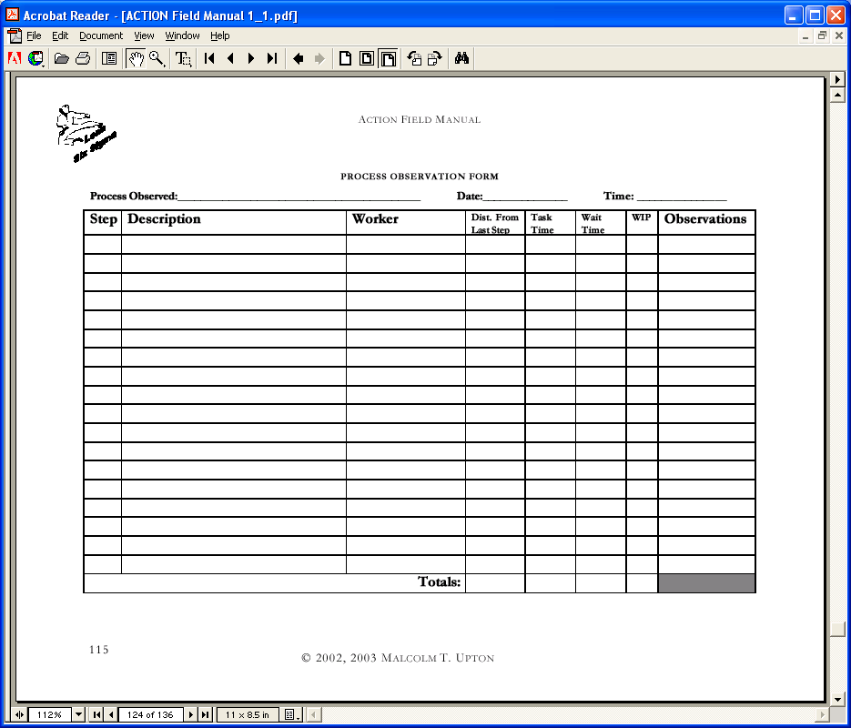
Example: Process Observation Form
From: ACTION Field Manual, © 2003 Malcolm T. Upton, University of Phoenix Doctor of Management Candidate

Slide 28
Top-Down Chart
A High-Level Chart which is selectively expanded from the highest level down to the level where the root cause is located
Determine the Start and Finish Points of the broad Process
Define 5 to 9 high level activities between Start and Finish
Expand the high level activity(ies) most likely to contain the root cause into 5 to 9 medium level activities
Choose the medium level activity(ies) most likely to contain the root cause into 5 to 9 lower level activities
Expand again (and again!) until the level at which the cause(s) of the problem is reached
At this level complete detailed process map(s)
A tool to aid in focusing flow-charting effort
Do not flow chart a large process to a significant detail, FOCUS!

Slide 29
Process Map Option: “Swim Lane” Map
Use for large, complex processes when:
Multiple departments/functions are involved, including outside the firm
Sequence and time of processes is important (as in lead time reduction)
Can show information and service flows if needed
Top lane is typically process customer

Slide 30
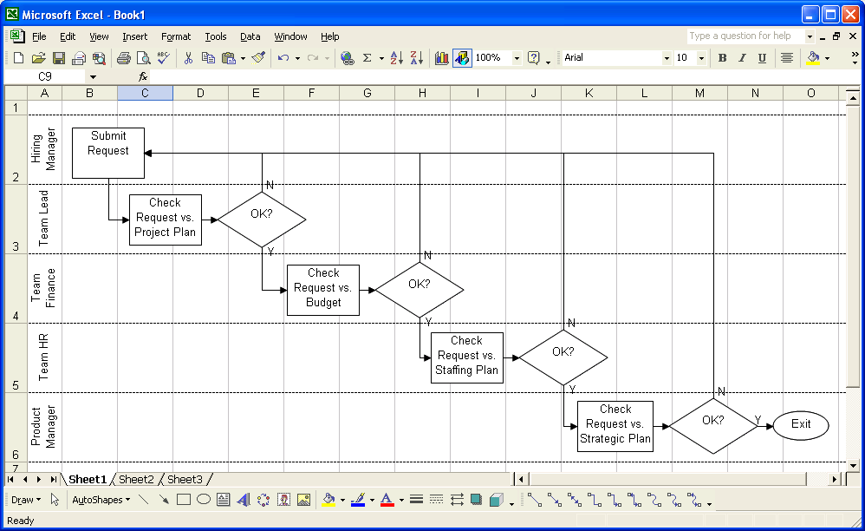
Swim Lane Example

Slide 31
Mapping Helpful Hints
Always create Process Maps and Value Stream Maps with a team. Rarely does one person have all process knowledge.
Interrogate the process by watching in many different conditions. You must watch the process as it happens to see the detail you need.
Do not let space be an issue. Consider using sticky notes as the process steps and post on a wall to get your initial ideas across.
If your map does not have enough space to list all the information, use numbered reference sheets as attachments.
Maintain your Process and Value-Stream Maps with dates and update them as necessary. Use them as a reference. Always maintain a baseline and version control.

Slide 32
The Process Map Should Contain Enough Detail to Enable Effective Analysis
It should illustrate both the work flow and the organizational interaction
It should use a common language (symbology) which is understood by everyone
It should capture all multiple paths, decisions, and rework loops
It should contain adequate detail
Too much detail is incomprehensible
Too little detail has no analytical value
Start, Stop
Process Step or Operation
Decision
Transport of movement
Storage, waiting time
Delay

Slide 33
The Process Map Should Address All Types of Tasks
Operation
E.g., Prep patient for surgery, type letter, prepare bill
Transportation
E.g., Move material by messenger, move material by cart, mail
Storage
E.g., Raw material in bulk storage, filing of documents
Delay
E.g., Wait in line to be serviced, wait for elevator, material waiting to be processed, papers waiting to be filed, papers waiting to be picked up
Inspection
E.g., examine service for quality, read gauge, examine forms, proofread

