Slide 1
Project Management Tools

Slide 2
Project Management Tools
The following are some tools that are useful in organizing,
reporting and tracking all of a project’s necessary
components and deadlines:
Project Charter
Communications Plan
Stakeholder Analysis
MGPP
Risk Assessment Matrix
Issue Log

Slide 3
Project Charter - Reminder
Charter elements:
Organization Impact
Problem or Opportunity Statement
Goal Statement
Project Scope
Project Plan
Team Selection
To be started at Team Launch and maintained and edited as scope is clarified
Organization Impact should not change significantly after Measure phase

Slide 4
Pert Chart Overview
Description
Graphical representation of all significant deliverables to be completed in the course of the project/workstream. Focuses on discrete outputs such as present-state barriers, conceptual designs, detailed designs, completed modules of coding, test plans, etc.
Initial draft of tool is completed at beginning of project. Process owners and experts should be consulted in identification of deliverables. Separate Maps may be built for different phases of the project. As workstream progresses, more detailed deliverables may be added.
Pert Chart should remain stable for each major phase of a project. Although additions and slight revisions may occur, any major changes should signify a need to “re-baseline” the project.
Graphical chart showing deliverables with dependencies and integration points noted. May be split into hierarchical levels for complex workstreams.
PERT stands for Program Evaluation Review Technigue, a methodology developed by the U.S. Navy in the 1950s to manage the Polaris submarine missile program. A similar methodology, the Critical Path Method (CPM), was developed for project management in the private sector about the same time.
Creation
Maintenance
Format
Origin

Slide 5
Pert Chart
Defines a clear, quantifiable output of work completed during the course of a workstream
Graphical tool used to communicate the output and approach of the workstream
Could include Milestones, Key Decisions/Events, Reporting of Findings, Present State Definition, Conceptual Designs, etc.
Helps paint a picture of what the workstream will deliver
Clarifies quantified work complete vs. work planned
Hand-off tool defining work envisioned by Assessment Team
Basis that the project timeline should be built around
Used to gauge % complete vs. planned complete around discrete work definition
Instrumental in provoking thought around integration points with stream leads

Slide 6
Pert Chart Lessons Learned
Not easy to find a balance between good project planning and excessive detail which locks you into very specific deliverables
Avoid slipping into micro-management around deliverables
Maintain flexibility around deliverables especially when the needs of the organization change
Maps work much better than lists when painting a picture of workstream
Lists are easier to maintain if you want to show dates (and for roll-up)

Slide 7
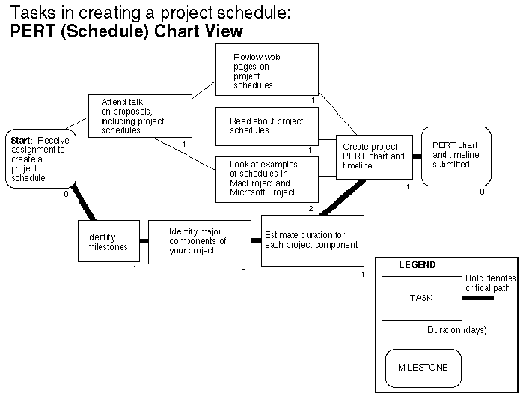
Pert (CPM) Example

Slide 8
Multi-Generation Project Plan - Reminder
Vision
The overall goal or problem statement for that generation. What is to be accomplished? Why? Can also be metrics with targets!!
Process Generations
Series of releases; each release characterized by distinct combinations of features or level of performance. The goal of that generation.
Multi-Generation Project Plan (MGPP)
Ability to execute the MGPP with current technology or the identification of needed technological developments for each generation. What is required from a technology standpoint to execute the vision? This could also include special personnel requirements to support the vision!!
Platforms and Technology
Notes:
The vision is the goal of each generation of the product/service. The vision is often at the level of a business strategy.
The generations describe how you will achieve the goal in each generation and what features will you provide to implement the vision.
Platforms and technologies describe what the generations look like. In this section you should note whether you already have the capability, whether you need to adapt your current technology in order to provide the capability, or whether the technology needs to be developed.
Multi-Generation Plan (MGPP)
Key Points
Understand the scope of the overall problem. Break the problem into manageable “chunks” based on Pareto analysis of defects and prioritized customer requirements. Consider the state of current technology and it’s ability to execute on potential solutions.

Slide 9
Risk Assessment Matrix
A simple tool to help communicate project risk factors
Types of Risk
Schedule – Project will achieve goal, but later than expected
Performance – Project will not achieve goal, or achievement will be less than it could have been
Assessment dimensions
Likelihood – How likely is it that the risk factor will impact the project?
Consequence – How much impact will the risk factor have on the project schedule or performance?
Assessed on scales of 1 (least) to 5 (most)

Slide 10
Likelihood Assessment
5 – 80%+ chance of impacting project
4 – 60%-80% chance of impacting project
3 – 40%-60% chance of impacting project
2 – 20%-40% chance of impacting project
1 – Less than 20% chance of impacting project

Slide 11
Consequence Assessment
Schedule
5 – 3+ month extension
4 – 2 to 3 month extension
3 – 1 to 2 month extension
2 – 2 to 4 week extension
1 – 1 to 10 day extension
Performance
5 – No significant improvement in goal metric(s)
4 – Slight improvement in goal metric(s), < 30% of goal achieved
3 – Minor improvement in goal metric(s), 30 to 60% of goal achieved
2 – Improvement in goal metric(s), 60 to 90% of goal achieved, but not as much improvement as could have been realized
1 – 90 to 100% of goal achieved

Slide 12
Color Coding Risk
Find the grid square that corresponds to the Likelihood and Consequence assessment numbers
This codes the risk as Red (high risk), Yellow (medium risk), or Green (low risk)
Each risk should be explained along with the consequence and mitigation plan
5
4
3
Likelihood
2
1
1
2
3
4
5
Consequence

Slide 13
Risk Analysis Matrix Example
Data Availability (Schedule)
Risk: Process tracking system, which shows enough critical process time information in some stages of the process, might not be available.
Mitigation: TBD
Consequence: Might have to spend 1to 2 weeks to collect enough data to be statistically significant.
Project Scope (Performance)
Risk: Current scope of process is very large with multiple sub-processes. Team unlikely to be able to complete DMAIC process on currently defined scope.
Mitigation Plan: Team will need to re-scope this project according to the following plan:
Complete process mapping
Reduce scope to Critical Path
Based on data, reduce scope to parts of process that most affect PLT within control of the Project Team.
Consequence: If mitigation plan is unacceptable, team unlikely to be successful.
5
4
GGA steps of Process Map (Performance)
Risk: Team has no control over getting information from GGA and might not be able to get verifiable information in the time available.
Mitigation Plan: Team had to scope this out of the process.
Consequence: 1 week lost time
3
Likelihood
2
1
1
2
3
4
5
Consequence
Personnel Availability (Schedule)
Risk: Team Members have multiple schedule conflicts during Month of March. Lack of team member availability and participation on team could slow data collection during MEASURE phase.
Mitigation: TBD
Consequence: Might have to delay MEASURE Tollgate
Process Mapping (Schedule)
Risk: Very large process to map. Team might not have time to define sufficient level in the time available.
Mitigation Plan: Scope to the “critical few” process paths
Consequence: 1 to 2 week slide in schedule
Notes:
Risk assessment of Project success

Slide 14
Issue Log
Team log used to track and address issues and also barriers, actions, concerns, and risks
Can be an output from Team Launch
Can result from Team Meetings and Tollgate Reviews
Repository for all the miscellaneous “parking lot” issues that crop up during a project
Ensures teams are proactively managing open issues and risk with weekly reviews and updates
An Issue Log is also known as a Project Action Log

Slide 15
Issue Log Template
Lean Six Sigma Project Action Log
 |  |  |  | Last Revised: | 6/14/2007
No | Description/ Recommendation | Status Open/Closed/Hold | Due Date | Revised Due Date | Resp. | Comments / Resolution
1
2
3
4
5

Slide 16
Takeaways
Successful project management requires an understanding of:
Overall Project Management process
Individual Team Roles
Basic Project Management Skills
Communication Planning
Responsibilities and challenges facing project managers
Forming and Leading High Performing Teams
Running Effective Team Meetings
Project management tools that will optimize project performance

