Slide 1
LSS Practitioners Toolkit

Slide 2
<Project Title> DMAIC Project Storyboard

Slide 3
<Project Title> Define Phase

Slide 4
Project Status – Define Phase
Achievements to Date:
XXX
XXX
Risks/Issues
XXX
XXX

Slide 5
Define Deliverables
Deliverables | Helpful Tools Aligned with Deliverables | Slides
1. Project Charter | Charter Template | 6-9
2. High Level Process Documentation | Detailed Process Map | 10
 | SIPOC/High Level Process Map | 11-12
 | Value Stream Map | 13
3. List of Customer(s) and Project CTQs (Critical to Quality) | CTQ Tree | 14-15
 | VOC Ranking Matrix | 16
4. Capture VOC | VOC Ranking Matrix | 16
 | VOC Data Collection Plan | 17-18
 | Affinity Diagram | 19
 | Cause and Effect Diagram | 20
 | Cause and Effect Matrix | 21
5. Draft Communication Plan (Internal) | Guidelines on Group Decision Making | 22-24
 | Stakeholder Analysis | 25
 | Stakeholder Communication Plan | 26
6. Estimated Project Benefits | Project Benefit Estimate Worksheet | 27
7. Project Plan/Timeline | Microsoft Project® or other Project Planning Tool | N/A

Slide 6
Project Charter - Instructions
Business Impact and Business Case
Why should we do this? What is the benefit?
How does this project align with the business strategy?
What is the quantified value of the project in improved quality, speed, or cost ($ savings)
Opportunity or Problem Statement
What “pain” are we or our clients experiencing?
What is wrong or not working?
Why do we think we can generate the value proposition described in the Business Impact?
Goal Statement
What are our improvement objectives and targets?
Specifically, what is going to be better?
How will success be measured? What specific parameters will be measured?
Project Scope
What are the boundaries of the initiative (start and end points of the process or parts of a system)?
What authority do we have?
What is not within scope?
Project Plan
How are we going to get this done?
When are we going to complete the work?
What are the major milestones (tollgates)?
Team Selection
Who are the team members?
What is their role?
How much of their time will be dedicated to the project?

Slide 7
Project Charter (1 of 3)
Project Name: | Date:
 | Process Owner:
Project Sponsor: | Black/Green Belt:
Business Impact
<What is the value and benefit of doing the project?>
Business Case
<Quantify and categorize the cost savings, avoidance, revenue generation expected>

Slide 8
Project Charter (2 of 3)
Opportunity/Problem Statement
<What issue are we addressing?>
Goal Statement
<What is the improvement objective and target?>
Project Scope
In: Out:

Slide 9
Project Charter (3 of 3)
Project Plan
Define Gate Review: Measure Gate Review: Analyze Gate Review: Improve Gate Review: Control Gate Review:
Team Selection
<List Team members including role and % commitment to the project>

Slide 10

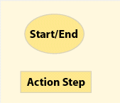
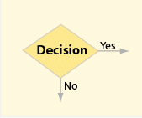
Detailed Process Map – Instructions
Detailed Process Map
Symbols
Example Detailed Process Map
Several software applications can be used for Detailed Process Maps (MS Visio, MS PowerPoint, iGrafx)
The maps provide a visual depiction of rework loops, and identifies “critical x’s”
Detailed process maps not only identify the steps, but also inputs and outputs for each step
The detailed process map is a living document that is updated throughout the project

Slide 11
SIPOC - Instructions
Instructions
SIPOC Template
SIPOC stands for Suppliers, Inputs, Process, Outputs, and Customers
The SIPOC provides a high-level view of the process and key linkages
Steps for constructing a SIPOC:
What steps are included in the process today? Keep this at a high level, 5-7 steps maximum
Who are the primary customers, internal and external, for this process?
What do the customers receive? This should related to their Critical to Quality requirements
Identify the significant suppliers of the process – who provides the inputs to your process?
Once the SIPOC is complete, determine potential metrics for the Customers, Inputs, Process Steps, and Outputs – these will be used in the Measure phase
Metrics should be aligned by Quality, Speed, and Cost
5
4
1
3
2

Slide 12
SIPOC
Suppliers
Inputs
Process
Outputs
Customer
Supplier 1
Supplier 2
Input 1
Input 2
Step 1 – XXX
Step 2 – XXX
Output 1
Output 2
Customer 1
Customer 2
Customer
Input Metrics
Process Metrics
Output Metrics
<List Customer Metrics> |  |  |  | Quality
 |  |  |  | Speed
 |  |  |  | Cost

Slide 13
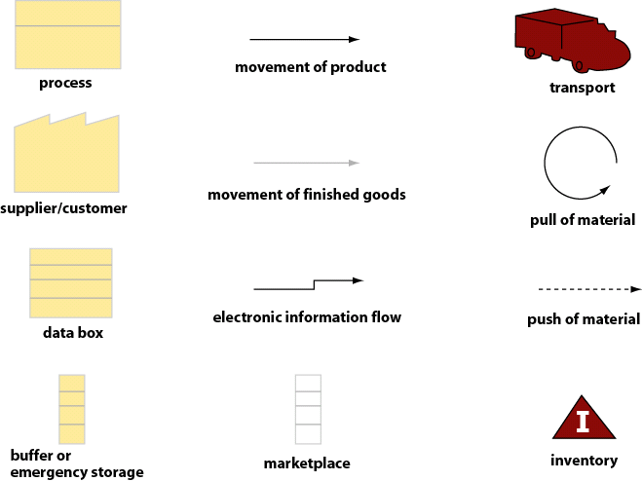
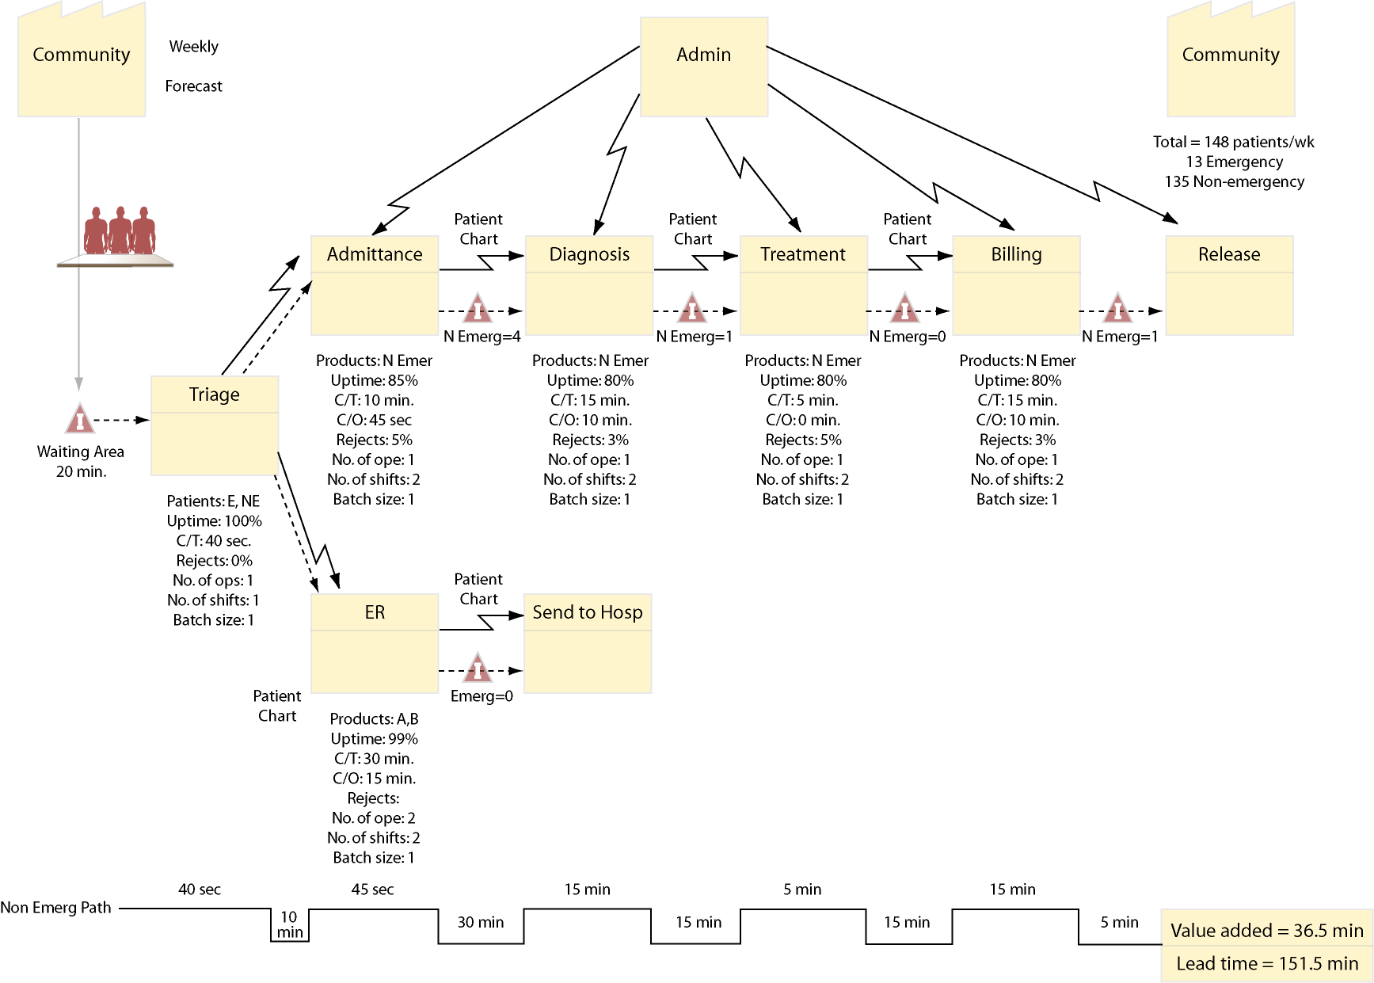
Value Stream Map – Instructions
Value Stream Map Symbols
Example Value Stream Map
Several software applications can be used for Value Stream Maps (MS Visio, MS PowerPoint, iGrafx)
Value Stream Maps are best applied in situations where you wish to better understand the flow of the product/service, and wish to associate data with the process steps
Examples of Value Stream Map data to capture in the process “data box” include Cycle Time, Touch Time, # Shifts, # Resources, Down Time, DPMO, Yield, and Rework
Value-added and non-value added (VA/NVA) time is summarized on the bottom of the Value Stream Map (VA times are on the top “steps,” NVA times are on the bottom “steps.”)

Slide 14
CTQ Tree – Instructions
CTQ Tree Template
2
3
4
1
Instructions
The CTQ tree is used to translate customer needs into measurable Critical to Quality (CTQ) requirements – VOC data collection is used to validate this tree
Choose need/process/product to be detailed, and enter it into the “Needs” section of the tree diagram
Add detail and organize components – build branches related to the base needs, characterized as “Drivers.” While there the template has only one set of drivers per need, there could be secondary or tertiary drivers that branch out from the main drivers. To populate Ask:
“What are the components or sub-sets represented by this need?”
“Is this part of a larger category of need/requirement?”
For the drivers, state the CTQ requirements in measurable terms
If known at this point, you can also populate customer specifications for each of the CTQs

Slide 15
CTQ Tree
Needs
Drivers
CTQs
Specifications
Enter driver here
Measurable CTQ here
Specification here
Measurable CTQ here
Specification here
Enter need here
Enter driver here
Measurable CTQ here
Specification here
Measurable CTQ here
Specification here
Enter driver here
Measurable CTQ here
Specification here
Measurable CTQ here
Specification here
Enter need here
Enter driver here
Measurable CTQ here
Specification here
Measurable CTQ here
Specification here
General
Hard to measure
Specific
Easy to measure

Slide 16
VOC Ranking Matrix – Instructions
VOC Ranking Matrix Template
1
2
3
4
Instructions
Excel template: VOC Ranking Matrix.xls
Use this matrix when you have multiple customers and requirements with potentially conflicting priorities. The tool will rank requirements based on relative customer importance and each customer’s ranking of the various requirements
The tool uses a ranking system of 1,4,7, and 10, with 10 being the highest ranking
Requirements with the highest % ranking in the % Rank column are the most important customer requirements
Steps:
List all customers related to the in-scope process
Rank each customer in relative importance to the process (multiple customers can have the same ranking)
List all customer requirements as determined from VOC data collection
For each individual customer, rank each of the requirements in relative importance to that customer (multiple requirements can have the same ranking)

Slide 17
VOC Data Collection Plan – Instructions
VOC Data Collection Plan Template
1
3
4
2
5
Instructions
The VOC Data Collection Plan is a means to organize the approach for gathering customer needs data
The customers from the SIPOC should be an input to this tool
Steps:
List all customers related to the in-scope process
Identify the various segments of customers affected by this process – e.g. Transactional (frequency, size of customer), Descriptive (location, demographic), or Attitudinal (driven by cost, service, or value)
For all of the customers listed, determine what you want to know about them to derive your Critical to Quality characteristics
List the potential sources of the data – sources can be proactive (e.g. surveys) or reactive (e.g. web hits)
Summarize the goals of the VOC data collection plan

Slide 18
VOC Data Collection Plan
Who | What & Why | Sources
Customers & Segments Customers List all customers identified in the SIPOC Market Segments Identify the relevant market segments applicable to the customers | List what you want to know through the data collection plan | Reactive Sources Proactive Sources Check all that apply
 |  |  | Complaints |  | Interviews
 |  |  | Problem or service hotlines |  | Focus groups
 |  |  | Tech support calls |  | Surveys
 |  |  | Customer service calls |  | Comment cards
 |  |  | Claims, credits |  | Sales visits/calls
 |  |  | Sales reporting |  | Direct observation
 |  |  | Product return info. |  | Market research/ monitoring
 |  |  | Warranty claims |  | Benchmarking
 |  |  | Web page activity |  | Quality scorecards
 |  |  | Other: |  | Other:
 |  | Summary
 |  | Summarize VOC data collection plan efforts here.

Slide 19
Affinity Diagram – Instructions
Affinity Diagram Example
<Theme #1>
<Theme #2>
<VOC Need A>
<VOC Need D>
<VOC Need E>
<VOC Need A>
<VOC Need D>
<VOC Need A>
<VOC Need B>
<VOC Need I>
<VOC Need F>
<VOC Need G>
<VOC Need G>
<VOC Need G>
<VOC Need G>
<VOC Need C>
<VOC Need C>
<VOC Need H>
Instructions
<Theme #3>
The affinity diagram is a simple way to aggregate customer comments into common themes for VOC
The example above shows what an affinity diagram might look like with three major themes – all final affinity diagrams will look different, depending on the number of comments and potential key themes
The exercise is best done placing individual customer comments on Post-it® notes, where like comments are physically grouped into like themes based on team input
Some comments might stand alone and not be part of a larger theme (such as VOC Need “I” in the above example)
<VOC Need J>
<VOC Need K>
<VOC Need L>
<VOC Need L>
<VOC Need L>
<VOC Need L>
<VOC Need M>
<VOC Need M>
<VOC Need M>

Slide 20
Cause and Effect Diagram - Instructions
Instructions
Cause and Effect Diagram Example
Excel template: Fishbone Diagram Tool.xls – you can also manually create a diagram directly in Power Point
The purpose of the Cause and Effect Diagram is to assist teams in identifying and categorizing potential root causes in an organized fashion.
Steps:
List the problem/issue to be studied in the "head of the fish".
Label each major "bone" of the "fish“ with one of the categories to the right (e.g. 6 M’s, 4 P’s, 4 S’s). Note: You may use one of the four categories suggested, combine them in any fashion or make up your own. The categories are to help you organize your ideas.
Use an idea-generating technique (e.g., brainstorming) to identify the factors within each category that may be affecting the problem/issue and/or effect being studied. The team should ask... "What are the machine issues affecting/causing..."
Repeat this procedure with each factor under the category to produce sub-factors. Continue asking, "Why is this happening?" and put additional segments each factor and subsequently under each sub-factor.
Continue until you no longer get useful information as you ask, "Why is that happening?"
Analyze the results of the fishbone after team members agree that an adequate amount of detail has been provided under each major category. Do this by looking for those items that appear in more than one category. These become the 'most likely causes".
For those items identified as the "most likely causes", the team should reach consensus on listing those items in priority order with the first item being the most probable" cause
2
3
4
1
Common Diagram Categories:
People, Process, Technology, and Physical Infrastructure
The 6 M’s Methods, Machines, Materials, Manpower (People), Measurements, Mother Nature
The 4 P’s: Place, Procedure, People, Policies
The 4 S’s: Surroundings, Suppliers, Systems, Skills

Slide 21
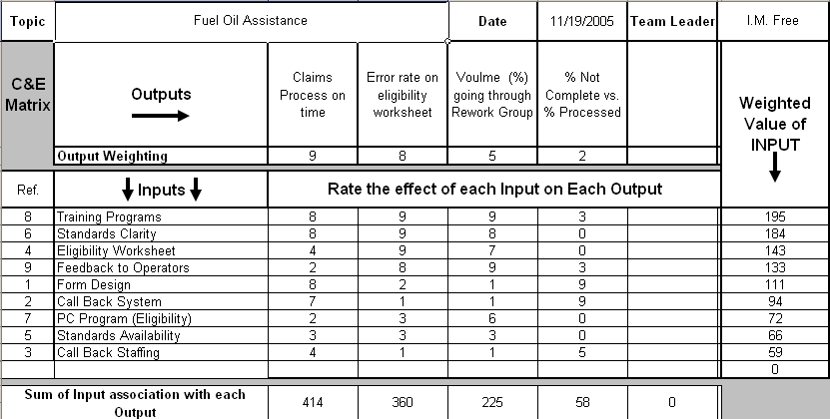
Cause and Effect Matrix – Instructions
Cause and Effect Matrix Example
1
2
3
5
4
Instructions
Excel Template: C&E Matrix.xls
The Cause and Effect Matrix can be used for understanding which inputs are likely to move our process outputs, which can drive the voice of the customer we need to collect in support of the project
Steps:
Identify outputs or dependent variables that describe your area of investigation / improvement
Rank the importance of these outputs relative to each other (Weighting)
Identify the inputs (independent variables) that may have an effect on the identified outputs (note: not all Xs affect all Ys)
Rank (team approach is best) how each X impacts each Y
Multiply these impact ratings times the weighting and sum to obtain a value of the overall importance of each input (the Excel tool does this automatically)

Slide 22
Guidelines on Group Decision Making (1 of 3)
Why is it important?
Organization members and leaders make decisions in the group all the time. The decision-making process can be stressful because some members see it as a form of power struggle; some people cannot bear the idea of losing an argument, and some people simply do not like to make decisions
Decisions are an important part of group life, and you may wonder how your group could improve in this area. All groups, clubs, executive boards, and committees go through a development process. Understanding the process will help you as a leader.
There are four stages of development. If you understand these stages you can combine your energies and reach a group decision.
FORMING: finding and establishing a place in a new organization, determine goals and purpose, get to know each other
STORMING: communication problems occur, members compete with each other, splinter groups form, hidden agendas surface, team begins to set boundaries
NORMING: members identify and agree on roles for solving problems, feedback is high and well received, team confidence is high, appreciation, trust and respect build
PERFORMING: team is collaborative and interdependent, high confidence and task accomplishment, high motivation and morale members find solutions to problems, support levels are high, members care about each other
The goal: to get your organization to the level of performing. Once your organization is at that level, group decision making is an easy process.

Slide 23
Guidelines on Group Decision Making (2 of 3)
Since members possess the essential ingredients for the solution of all disagreements, group decisions should be based on all the members' input
Certainly, if there are decisions that only take a few people to make, it may not be necessary to involve the entire group.
Group Consensus Guidelines
Effectiveness in communication is of paramount importance in the consensus decision making process. You can enhance your group communication by paying attention to the following "Do’s” and “Don'ts"
DO:
Listen, not only to the words, but to the rationale being offered.
Pursue your point and be persistent if you have good information
Manage your time effectively, relative to the number of decisions that are being made.
Involve all team members to ensure use of their knowledge and experience
Strive for the best answer. Thinking in cause-and-effect terms avoids dealing only with symptoms
DON'T:
Argue for the sake of winning your point. You may learn something by being open – minded
Give up on your conclusion simply to avoid conflict. Let objective reasons or sound information prevail
Allow the group to get hung up on a specific item -- move on and come back later
Compete by assuming that someone must win and someone must lose. Look for the best alternative
Resort to voting. This tends to split the group into winners and losers

Slide 24
Guidelines on Group Decision Making (3 of 3)
The Leader’s Role
This approach to group decision making places the leader in a particular role in which he/she must cease to contribute, avoid evaluation, and refrain from thinking about solution or group products; instead he/she must concentrate on the group process by assuming responsibility for accurate communication between members.
The way decisions are made testify to the degree of effectiveness of a group. Here is a list of facts about effective and ineffective groups:
Effective Groups
Generate more ideas than individuals
Have a high level of participation
Develop a climate where members can be relaxed, open and direct
Are task-oriented
Ineffective Groups
Pool ignorance and misinformation
Eject non-conforming members
Force members to comply or compromise
Engage in "groupthink“
Take action because they cannot think of any reason not to
Effective Group Members
Defer to members who they are certain have the facts
Form loyalties to their own group
Encourage and support other group members
Mediate differences in the group
Ineffective Group Members
Give in on items they are sure of
Oppose or block decisions without cause
Dominate discussions

Slide 25
Stakeholder Analysis – Instructions
Stakeholder Assessment Example
1
2
3
4
5
Instructions
Excel Template: Stakeholder Analysis.xls
It is advantageous to know who is in favor of the project and who the team must convince to support or, at a minimum, accept the project
It is also of value to know who can remove or insert roadblocks (high influence)
A Stakeholder Analysis provides numeric ratings on the stance (support / non-support), influence (high / low), and the activity level (active / passive) of stakeholders
If there appears to be excessive resistance to a proposed project, it is best to defer that project until management resolves the discord
Steps:
List all stakeholders and their positions, by name where possible
For each stakeholder, rate the level of support (or non-support) related to the project (+10 for strongly for, -10 for strongly against)
For each stakeholder, rate the level of influence related to the process (+10 for high influence, -10 for low influence)
For each stakeholder, rate the level of engagement related to the team (+10 for actively involved, -10 for passive)
The color codes highlight areas of importance that must be addressed (if negative) or leveraged (if positive)

Slide 26
Stakeholder Communication Plan – Instructions
Stakeholder Communications Plan Example
1
4
2
3
Instructions
Excel Template: Stakeholder Communications.xls
The Stakeholder Communications Plan helps a team assess the stakeholders that require specific actions and communications to move them to the desired level of support for a project
Not all stakeholders need to be advocates of the project; just being neutral is enough in some cases
Steps:
List all stakeholders, by name and position where possible
For each stakeholder, estimate the current level of support for the project, rating them from “undermining” to “advocate”
For each stakeholder, identify the optimum level of support to help the project’s success
Identify the communications and actions required to achieve the optimum level of support, assigning specific responsibilities for execution to team members

Slide 27
Project Benefit Estimate Worksheet - Instructions
Instructions
Project Benefit Estimate Example
Excel Template: Project Benefit Estimate.xls
The Project Benefit Estimate is a means to summarize potential project benefits, mainly related to cost, but also related to speed and quality
Only populate the fields related to your project benefit; most likely, you will populate only a small portion of the total fields
Add or change the fields based on the needs of the project
Steps:
Identify the project title, and period of time for project benefits (typically a 12-month window starting at a specific date after the project Control phase)
Check if this is an initial estimate or the final values (most likely initial estimate in the Define and Measure phases, and final value in Improve and Control phases)
Cost of Services – any reduction in variable costs associated with providing the service or making the product
Fixed Overhead – any reduction in fixed costs that do not vary based on the number of services rendered or items produced
Cost of Poor Quality – any reduction in the costs associated with errors in the process; also includes cost avoidance
Benefits – any new revenue as a result of the project
Project Costs – costs incurred as a result of the solution implementation; this also includes the labor cost for team members
Soft Savings – relates to any non-financial benefits (e.g. improved customer service or cycle times)
One-Time Savings – any savings realized that will not be repeated on a monthly basis
1
x
2
3
7
4
8
5
9
6

Slide 28
<Project Title> Measure Phase

Slide 29
Project Status – Measure Phase
Achievements to Date:
XXX
XXX
Risks/Issues
XXX
XXX

Slide 30
Measure Deliverables
Deliverables | Helpful Tools Aligned with Deliverables | Slides
1. Detail the Process | Flow Chart | 32
 | Value Stream Map | 33
 | Detailed Process Map | 34
2. Define Project Output (Y) and Potential Drivers (x’s) | Cause and Effect Diagram | 35
 | X/Y Matrix | 36
3. Define Defect(s) and Set Specification Limit(s) | Defect Definition Table | 37-38
4. Data Collection Plan | Data Collection Plan Table | 39-40
 | Sample Calculator (Continuous & Discrete Data) | 41-42
5. Validate the Measurement System | Measurement System Evaluation (MSE) Control Charts | 43
 | Attribute R&R (Repeatability & Reliability) | 44
6. As-Is Process Capability | Control Charts (I-mR, X-Bar R, P Chart, C Chart) | 45-46
 | Process Capability Baseline | 47-48
7. Validate COPQ and Benefit Estimate | Project Benefit Estimate Worksheet | 49

Slide 31

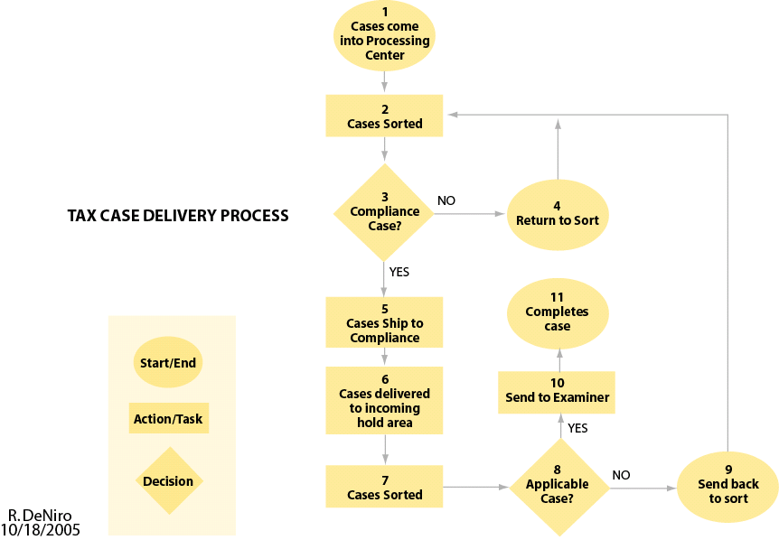
Flow Chart – Instructions
Flow Chart Symbols
Example Flow Chart Map
In the Measure phase, flow charts are a good way to understand the task-level detail within the in-scope process
Flow Charts are best applied in situations where the team needs to understand the process steps in detail in order to determine re-work loops, hand-offs, or individual worker actions
Numbering the steps is a best practice for ease of reference
For each decision step, there should be multiple branches based on multiple types of decisions (i.e. “yes/no” decision branches)

Slide 32
Value Stream Map – Instructions
Value Stream Map Symbols
Example Value Stream Map
Value Stream Maps (VSMs) are best applied in situations where you wish to better understand the flow of the product/service, and wish to associate data with the process steps
VSMs do not get into the task-level detail of each individual step as in a flow chart – the focus is on the higher level activities
Identify customer value first (what is this process producing for the customer?), and then the required pace of delivery to meet customer demand
Examples of Value Stream Map data to capture in the process “data box” include Cycle Time, Touch Time, # Shifts, # Resources, Down Time, DPMO, Yield, and Rework
Value-added and non-value added (VA/NVA) time is summarized on the bottom of the Value Stream Map (VA times are on the top “steps,” NVA times are on the bottom “steps.”)

Slide 33
Detailed Process Map – Instructions
Detailed Process Map
Symbols
Example Detailed Process Map
In the Measure phase, detailed process maps are a good way to understand the task-level detail within the in-scope process
Detailed process maps are best applied in situations where the team needs to understand not only the process steps in detail, but also the inputs and outputs of each step
Inputs are characterized as either: controllable (the team can affect, SOP (part of existing policy), and noise (inputs that are too expensive/difficult to control, or you chose not to control)

Slide 34
Cause and Effect Diagram - Instructions
Instructions
Cause and Effect Diagram Example
Excel template: Fishbone Diagram Tool.xls – you can also manually create a diagram directly in Power Point
The purpose of the Cause and Effect Diagram is to assist teams in identifying and categorizing potential root causes in an organized fashion
In Measure, the Cause & Effect Diagram is a good way to organize potential project X’s that affects the critical Y’s
Steps:
List the problem/issue to be studied in the "head of the fish".
Label each major "bone" of the "fish“ with one of the categories to the right (e.g. 6 M’s, 4 P’s, 4 S’s). Note: You may use one of the four categories suggested, combine them in any fashion or make up your own. The categories are to help you organize your ideas.
Use an idea-generating technique (e.g., brainstorming) to identify the factors within each category that may be affecting the problem/issue and/or effect being studied. The team should ask... "What are the machine issues affecting/causing..."
Repeat this procedure with each factor under the category to produce sub-factors. Continue asking, "Why is this happening?" and put additional segments each factor and subsequently under each sub-factor.
Continue until you no longer get useful information as you ask, "Why is that happening?"
Analyze the results of the fishbone after team members agree that an adequate amount of detail has been provided under each major category. Do this by looking for those items that appear in more than one category. These become the 'most likely causes".
For those items identified as the "most likely causes", the team should reach consensus on listing those items in priority order with the first item being the most probable" cause
2
3
4
1
Common Diagram Categories:
People, Process, Technology, and Physical Infrastructure
The 6 M’s Methods, Machines, Materials, Manpower (People), Measurements, Mother Nature
The 4 P’s: Place, Procedure, People, Policies
The 4 S’s: Surroundings, Suppliers, Systems, Skills

Slide 35
X/Y Matrix – Instructions
X/Y Matrix Example
1
2
3
4
Instructions
Excel template: Blank XY Matrix.xls
The XY matrix can be used to help identify an area of focus for the FMEA, or it can be used by a project team to identify the initial factors for a designed experiment
When the output variables (Y's) are not to specification, the situation represents potential "EFFECTS“
When each input variable (X) is not to specification, "CAUSES" are present.
Steps:
Enter, into the Output Variables (Y's) row, those characteristics that the team and /or customer deem important (use the outputs identified on the process map)
Then numerically rate each Y from 1 to 10, the most important receiving the highest number and so on. Place these numbers in the Output Rating row.
Identify all of the potential causes (X's) that can impact the various outputs and list these in the Input Variables (X's) column (use the X's identified on the process map).
Next determine the impact of each X on each Y. In the Association Table numerically rate (using a scale from 1-10, the most important receiving the highest number) the effect each X has on each Y.

Slide 36
Defect Definition Table – Instructions
Defect Definition Table Example
Little x Performance Standards
Measurement Unit | Unit Description | Defect Definition/ Specification Limits | Defect Opportunity
Door gap | Units are measured in thousandths of an inch | Any gap < .125” obr > .187” | Each door attached in the Tuscaloosa factory
Telephone wait time | Units are measured in seconds of customer wait time per call | Any customer wait time > 90 seconds from pick-up | Each unique customer call
1
2
3
4
Instructions
The purpose of the Defect Definition Table is to clearly identify and describe (in a measurable manner) the critical defects associated with the in-scope process; reducing the defect(s) described should have a direct linkage to the Steps:
Measurement Unit – Identify what measure is being tested (i.e. where in the process is the potential defect?)
Unit Description – Define the unit of measure, or how you will specifically measure if a defect exists
Defect Definition/Specification Limits – what is the defect? In many cases, this will be defined by customer specification limits derived from VOC/VOB
Defect Opportunity – what units are being measured to determine the defect?

Slide 37
Defect Definition Table
Little x Performance Standards
Measurement Unit | Unit Description | Defect Definition/ Specification Limits | Defect Opportunity

Slide 38
Data Collection Plan Table – Instructions
Data Collection Plan Example
Measure | Data Type | Operational Definition | Segmentation Factors | Who | When | Quantity | How Taken
Incorrectly processed work orders | Discrete | The number of work orders not processed according to DOD regulations (5 defect opportunities each) | By installation, day of week, and work order type | All team members | One month starting 12/1/06 | 30 samples for each installation | Work order quality check sheet created by team
Work order timeliness | Continuous | Total time, in hours, to completely process a work order from time/date stamp of initial call to resolution noted in the work order system | By work order type, installation, and unit calling in work order | All team members | One month starting 12/1/06 | All work orders (entire population) | Work order database information
1
2
3
4
5
6
7
8
Instructions
The purpose of the Data Collection Plan is to clearly identify the methods for gathering data in the Measure phase; it improves consistency between multiple team members if larger data collection efforts, and also allows the Green Belt/Black Belt an opportunity to identify the logic behind data collection
Steps:
Measure – Identify the measures required to find out more about the process (usually derived from process maps of the in-scope process)
Data Type – Is measure Discrete or Continuous?
Operational Definition – Provide a detailed definition of the measurement criteria
Segmentation Factors – Segmentation is a process used to divide a large group into smaller, logical categories for analysis; these factors can help you stratify the data to find special causes
Who – Identify who will collect the data
When – Define the specific time period where the data will be collected
Quantity – Determine the number of units that need to be evaluated (Based on a sample plan)
How Taken – Will the data be collected Manually or Automatically? What is the data collection method? If multiple individuals are collecting data, this needs to be standardized

Slide 39
Data Collection Plan Table
Measure | Data Type | Operational Definition | Segmentation Factors | Who | When | Quantity | How Taken

Slide 40
Sample & Error Calculators – Instructions (Continuous Data)
Sample Calculator Example
1
3
4
3
4
2
Instructions
Excel template: Continuous Sampling.xls
The purpose of the calculating sample sizes is to make valid inferences about a population without having to measure all data points in the population
Continuous data has a unique means for calculating sample size based on the existing variation in the data
Steps:
Collect an initial sample size (approximately 30 data points) to calculate a sample standard deviation
Calculate confidence interval based on the desired level of confidence: 99%, 95%, 90%, or 80% (the tool calculates this automatically)
Determine your desired error (e.g. +/- 2 minutes) or enter in the number of samples you plan on taking
The tool will calculate your required sample size based on confidence and error, or it will calculate your error based on confidence and your planned sample size

Slide 41
Sample & Error Calculators – Instructions (Attribute Data)
Instructions
Sample Calculator Example
Excel template: Attribute Sampling.xls
The purpose of the calculating sample sizes is to make valid inferences about a population without having to measure all data points in the population
Attribute data has a unique means for calculating sample size based on the expected proportion of an occurrence (e.g. a defect) in a population
Steps:
Identify the total size of the entire population (estimate if not known)
Collect an initial sample size (approximately 30 data points) to calculate a sample proportion of occurrence
Determine your desired sampling error (%)
Determine your desired confidence level (%) – this is usually 100% minus the sampling error
The tool will calculate your required sample size based on the proportion of occurrence and desired sampling error
Note: If the required sample size divided by the total population size (n/N) is > .05, adjust the sample size by using the “Small Population” sample size output
1
2
3
4
5

Slide 42
MSE Control Charts – Instructions (X-bar and R-bar)
Instructions
X-Bar and R-Bar Example
Excel Template: MSE.xls
X Bar- Individual measure of a part by a person
X Bar Bar- Mean of all part measures
X UCL- Upper Control Limit;
X LCL- Lower Control Limit;
----------------------------------------------------------------------
Range- Difference between highest and lowest measure of a part for each person
R Bar- Mean of ranges across all measures
R UCL- Upper Control Limit for ranges
R LCL- Lower Contral Limit for ranges
Look For:
Stability (by having all data points in control on the R-bar chart)
Discrimination (Measurement system has the ability to detect small changes)
Repeatability (The ability for a single operator to return the same measured value of the same unit)
Reproducibility (Each operator sees each item the same)
Bias (No one operator sees each item either smaller or larger than any other operator)
Capability (The measurement variation is small enough that one can tell the differences between items)

Slide 43
Attribute R&R – Instructions
Attribute R&R Example
Instructions
Excel Template: Attribute R&R.xls Purpose: The Attribute Repeatability and Reliability test looks at a measurement system where human appraisers are the gauge, measuring a particular characteristic (e.g. quality) of a process; the test evaluates how consistent the appraisers are with each other, and in some cases, a known standard The 95% UCL and 95% LCL represent the 95% upper and lower confidence limits on the binomial distribution. The Calculated Score is the basic computation reported on the report page for % Appraiser and % Score vs Attribute. The 95% confidence interval represents the range within which the true Calculated Score lies given the uncertainty associated with limited sample sizes. As sample size increases (in this case, Total Inspected) the confidence interval will get smaller and smaller which indicates more reliable estimates of the true percentages. The Attribute R&R template contains detailed instructions on executing the test and interpreting the results
Notes:
Continuous Data
To do a gage R&R study for continuous data…
Choose Stat > Quality Tools > Gage Study > Gage R&R Study (Crossed or Nested).
Use Gage R&R Study (Crossed) when each part is measured multiple times by each operator.
Use Gage R&R Study (Nested) when each part is measured by only one operator, such as in destructive testing. In destructive testing, the measured characteristic is different after the measurement process than it was at the beginning. Crash testing is an example of destructive testing.
Minitab provides two methods for assessing repeatability and reproducibility: X and R, and ANOVA. The X and R method breaks down the overall variation into three categories: part-to-part, repeatability, and reproducibility. The ANOVA method goes one step further and breaks down reproducibility into its operator, and operator-by-part, components.
The ANOVA method is more accurate than the X and R method, in part, because it considers the operator by part interaction. Use the X and R method for your project.
-----------------------------------------------------------------------
Discrete Data
To do an attribute gage study (Analytic method)…
Choose Stat > Quality Tools > Gage Study > Attribute Gage Study (Analytic Method).
Alternatively, utilize the embedded Excel object to enter your project MSA data to determine data acceptability.
-----------------------------------------------------------------------
MSA “Rules of Thumb” – Interpreting the results (continuous data):
GR&R% of Tolerance
R&R less than 10%: Measurement system acceptable
R&R 10% to 30%: May be acceptable; make decision based on classification of characteristic, hardware application, customer input, etc.
R&R over 30%: Measurement system not acceptable; have to identify and fix problem before continuing
Number of Distinct Categories  “Signal-to-noise” ratio = (StdDevParts/StdDevGR&R) X 1.41 and rounded. Guidelines:
< 2—no value for process control, parts all “look” the same.
= 2—can see two groups—high/low, good/bad.
= 3—can see three groups—high/mid/low.
≥ 5—acceptable measurement system (higher is better).

Slide 44
Control Charts – Roadmap
Select Measurement
Attribute or Variable Measurement
?
Variable
Attribute
Subgroup size =1
?
Yes
No
Defectives or Defects ?
Defectives
Defects
Constant sample size?
Constant sample size?
Subgroup size <10?
Yes
Yes
Yes
No
No
No
I-mR Chart
-R Chart
-s Chart
np Chart
p Chart
c Chart
u Chart

Slide 45
Control Charts – Instructions
Control Chart Examples
Instructions
Excel Template: Control Chart Generator.xls Purpose: Control Charts focus attention on process variation over time; this variation can apply to the project Y (major output) or X’s (process steps or inputs that affect the output) Control charts are a key tool to differentiate between special cause and common cause variation within a process Types of Control Charts in the Control Chart Generator: Individuals and Moving Range (I-MR): Used for data sets with a sample size of one per measurement (individuals); the moving range chart shows the variation from one point to the next Average and Range (X Bar and R): Used for data sets with relatively small sample sizes in the subgroups (usually 3-5), where the average of each subgroup is plotted Proportions Chart (P Chart): for attribute data with variable sample sizes, where you are plotting the proportion defective (entire units defective, regardless of the number of defects) Count Chart (C Chart): for attribute data of constant sample size where you are plotting the number of defects (one unit may have multiple defects)

Slide 46
Process Capability Baseline – Instructions
Capability Baseline Examples
2
1
3
Instructions
Excel Templates: Sigma Calculator.xls, Cp Calculator.xls, Cpk Calculator.xls Purpose: The process baseline calculators is a means to identify the baseline performance of a process through determining the overall defect rate and the existing variation of the process compared to process specifications Tools: Process Sigma – identify the number of units sampled from the process, the total number of defects, and the total number of defect opportunities per unit. The calculation output, Process Sigma, is a measure of the short term ability of the process to meet customer requirements (6 Sigma = 99.9997% defect-free) Cp – specify the upper and lower customer specification limit (in some cases the lower specification limit may be 0), and identify the standard deviation (sigma) of the sample data (note: this is not the same as process sigma above, this is strictly the statistical standard deviation calculated from the sample). The calculation output, Cp, is a measure of the capability of the process to meet customer specifications, regardless of how the process is performing today (Cp of 1 is ideal) Cpk - specify the upper and lower customer specification limit (in some cases the lower specification limit may be 0), and identify the standard deviation (sigma) and mean (average) of the sample data (note: as in Cp, sigma is strictly the statistical standard deviation calculated from the sample). The calculation output, Cpk, is a measure of the capability of the process to meet customer specifications, taking into account the current average process performance (Cpk of 1 is ideal)

Slide 47
Process Capability Baseline - Summary
 | Sample Mean | Sample Std Dev | # Opportunities | # Defects | DPMO | Process Sigma | Cp | Cpk
Performance Baseline
Performance Target

Slide 48
Project Benefit Estimate Worksheet - Instructions
Instructions
Project Benefit Estimate Example
Excel Template: Project Benefit Estimate.xls
The Project Benefit Estimate from the Define phase is revisited in the Measure phase as you now have more information on the process
Only populate the fields related to your project benefit; most likely, you will populate only a small portion of the total fields
Add or change the fields based on the needs of the project
Steps:
Identify the project title, and period of time for project benefits (typically a 12-month window starting at a specific date after the project Control phase)
Check if this is an initial estimate or the final values (most likely initial estimate in the Define and Measure phases, and final value in Improve and Control phases)
Cost of Services – any reduction in variable costs associated with providing the service or making the product
Fixed Overhead – any reduction in fixed costs that do not vary based on the number of services rendered or items produced
Cost of Poor Quality – any reduction in the costs associated with errors in the process; also includes cost avoidance
Benefits – any new revenue as a result of the project
Project Costs – costs incurred as a result of the solution implementation; this also includes the labor cost for team members
Soft Savings – relates to any non-financial benefits (e.g. improved customer service or cycle times)
One-Time Savings – any savings realized that will not be repeated on a monthly basis
1
x
2
3
7
4
8
5
9
6

Slide 49
<Project Title> Analyze Phase

Slide 50
Project Status – Analyze Phase
Achievements to Date:
XXX
XXX
Risks/Issues
XXX
XXX

Slide 51
Analyze Deliverables
Deliverables | Helpful Tools Aligned with Deliverables | Slides
1. List of Verified Root Causes (Critical x’s) | Brainstorming | 53
 | 5 Why’s | 54
2. Cause and Effect Relationship Between Critical Inputs (x’s) and Critical Output Variables (Y’s) are Verified | Cause and Effect Diagram | 55
 | Graphical Analysis Box Plots Histograms Pareto Charts Scatter Plots | 56-59
 | Cause & Effect Matrix | 60
 | Statistical Tools Hypothesis Testing Roadmap | 61-62
 | ANOVA | 63
 | List of Significant x’s | 64
 | FMEA (old process) | 65

Slide 52
Brainstorming Technique
Step | Action
1 | Identify a clear objective and provide a quantitative target.
2 | Ask team to write one idea per Post-It™ note.
3 | Run the activity for the time defined in the quantitative target.
4 | Ask team members to place their ideas onto the main bones of a cause-and-effect diagram.
5 | Use an affinity diagram to group potential causes within each branch into logical groupings for potential action.

Slide 53
5 Why’s – Instructions
5 Why’s Example
Q1. Why did Problem E happen? Because of S.
Q2. Why did S happen? Because of T.
Q3. Why did T happen? Because of U.
Q4. Why did U happen? Because of V.
Q5. Why did V happen? Because of X.
Local focus
on causes.
Wider focus
on causes.
Wider focus
on causes.
Wider focus
on causes.
Actionable cause
(or start new path).
Instructions
Purpose: 5 Why’s is a conversational tool designed to quickly drill down to an actionable cause for a specific problem
Start with a problem and ask why it happened. Ask why that happened. Keep going until you reach a cause your team can take action to fix
If you have to ask why 5 times and have not reached a cause your team can take action on, start a new chain of questions
If you reach a cause that is beyond your team’s ability to address, stop and pass that information along to your project champion for action

Slide 54
Cause and Effect Diagram - Instructions
Instructions
Cause and Effect Diagram Example
Excel template: Fishbone Diagram Tool.xls – you can also manually create a diagram directly in Power Point
The purpose of the Cause and Effect Diagram is to assist teams in identifying and categorizing potential root causes in an organized fashion
In Analyze, the team should refer to the Cause & Effect Diagram to further refine your critical X’s (initially identified in the Define and Measure phases)
Steps:
List the problem/issue to be studied in the "head of the fish".
Label each major "bone" of the "fish“ with one of the categories to the right (e.g. 6 M’s, 4 P’s, 4 S’s). Note: You may use one of the four categories suggested, combine them in any fashion or make up your own. The categories are to help you organize your ideas.
Use an idea-generating technique (e.g., brainstorming) to identify the factors within each category that may be affecting the problem/issue and/or effect being studied. The team should ask... "What are the machine issues affecting/causing..."
Repeat this procedure with each factor under the category to produce sub-factors. Continue asking, "Why is this happening?" and put additional segments each factor and subsequently under each sub-factor.
Continue until you no longer get useful information as you ask, "Why is that happening?"
Analyze the results of the fishbone after team members agree that an adequate amount of detail has been provided under each major category. Do this by looking for those items that appear in more than one category. These become the 'most likely causes".
For those items identified as the "most likely causes", the team should reach consensus on listing those items in priority order with the first item being the most probable" cause
2
3
4
1
Common Diagram Categories:
People, Process, Technology, and Physical Infrastructure
The 6 M’s Methods, Machines, Materials, Manpower (People), Measurements, Mother Nature
The 4 P’s: Place, Procedure, People, Policies
The 4 S’s: Surroundings, Suppliers, Systems, Skills

Slide 55
Graphical Analysis – Instructions (Box Plots)
Instructions
Box Plot Example
Excel template: DMAIC_Analysis_Excel_Toolkit_IMA.xls
The purpose of the Box Plot is to display variation by category for easy, direct comparisons. It is effective for illustrating similarities or differences in a process output between regions, garrisons, process stages, or any other stratification categories.
In Analyze, the team should consider Box Plots to quickly see process variation by categories.
Interpretation:
Process output values on the Y-axis, categories for comparison on the X-axis.
The box represents the middle 50% of the data points for a given category. The median value is represented by a triangle inside the box. If the median is in the center of the box, then median = mean for that category.
The lengths of the whiskers represent the lower and upper 25% of the data for a category, except the statistical outliers (special cause variation).
Unexpected (special cause) variation is represented by red asterisks. These data points should be investigated because the may due to unwanted causes affecting the process.
4
1
2
3
1
Notes:
Select “Enable Macros” to run the Excel tool.

Slide 56
Graphical Analysis – Instructions (Pareto Charts)
Instructions
Pareto Chart Example
Excel template: DMAIC_Analysis_Excel_Toolkit_IMA.xls
The purpose of the Pareto chart is to display frequency of occurrences by category for easy, direct comparisons. Data is lined up with most-frequent category on the far left, and a cumulative percent curve is often drawn above the boxes.
In Analyze, the team should consider Box Plots to quickly see if any particular category occurs more frequently (e.g., has more defects) than others.
Interpretation:
Count of occurrence values on the Y-axis, categories for comparison on the X-axis.
Bars are scaled to show relative frequency of occurrence by category, sorted in descending order with largest count on the left.
The cumulative percent of total occurrences for the ordered categories is plotted above the category bar, and the percent scale is on the right axis.
Typically the Pareto Principle holds if about 80% of the total count is represented by about 20% of the categories. The idea is that working on the few categories creating most of the occurrences will yield most of the benefit.
3
1
3
2
1
Notes:
Select “Enable Macros” to run the Excel tool.

Slide 57
Graphical Analysis – Instructions (Histograms)
Instructions
Histogram Example
Excel template: DMAIC_Analysis_Excel_Toolkit_IMA.xls
The purpose of the histogram is to display the spread of process data, showing the size of the process variation and the shape of the distribution (e.g., normal, skewed, etc.).
In Analyze, the team should consider Histograms to visualize process variation for any part of the process of interest.
Interpretation:
The output values are typically graphed in “buckets” or ranges on the X-axis. For example, values between 5-10 may be grouped into one bar. This depends on the range of values being plotted and the number of data points in the graph.
The frequency of occurrence of a given value (or bucket of values) is plotted on the Y-axis.
The width of the graph reveals the range of variation in the process. The shape of the curve tells whether the data is normally distributed, or possibly whether most output values occur at the low- or high- end of the range (skewed).
2
3
1
Notes:
Select “Enable Macros” to run the Excel tool.

Slide 58
Graphical Analysis – Instructions (Scatter Plots)
Instructions
Scatter Plot Example
Excel template: DMAIC_Analysis_Excel_Toolkit_IMA.xls
The purpose of the scatter plot is to show relationships between two variables, e.g., relationships between input and output variables.
In Analyze, the team should consider Scatter Plots to look for relationships between process inputs and outputs that may have true cause-effect relationships and lead to root causes.
Interpretation:
Process output data is typically plotted on the Y-axis.
Process input data for one input is typically plotted on the X-axis.
The X-Y data is plotted on a graph. The presence of a pattern (e.g., the data in the example appears to follow a line as # opportunities increase with # reviews) may indicate a true cause-effect relationship between input and output. The nature of this relationship must still be verified by process experts, for there may be another (unidentified) cause that just happens to make both of the plotted values increase as it changes. For example, ice cream sales may increase with an increase in shark attacks, but it could be that the increase in summer heat is causing both ice cream sales and shark attacks to increase.
If a straight-line pattern exists, it can be fit mathematically to the general form Y = M*X + B. In the example to the right, for every additional review, there are 12.554 more opportunities created on average. The R² value indicates how well the math fits the observed data; the closer R² is to 1.0, the better the math explains the observations.
1
3
2
Notes:
Select “Enable Macros” to run the Excel tool.

Slide 59
Cause and Effect Matrix – Instructions
Cause and Effect Matrix Example
1
2
3
5
4
Instructions
Excel Template: C&E Matrix.xls
The Cause and Effect Matrix can be used for understanding which inputs are likely to move our process outputs, which can drive the voice of the customer we need to collect in support of the project
Steps:
Identify outputs or dependent variables that describe your area of investigation / improvement
Rank the importance of these outputs relative to each other (Weighting)
Identify the inputs (independent variables) that may have an effect on the identified outputs (note: not all Xs affect all Ys)
Rank (team approach is best) how each X impacts each Y
Multiply these impact ratings times the weighting and sum to obtain a value of the overall importance of each input (the Excel tool does this automatically)

Slide 60
Hypothesis Testing Roadmaps
Notes:
Decide what basic comparison you need (comparing means, variances, proportions or non-normal center-of-mass). From that starting point on the chart above, follow the decision tree to the appropriate hypothesis test depending on the data you are analyzing.

Slide 61
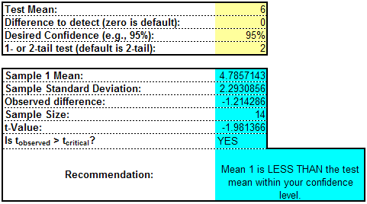
Statistical Tools – Hypothesis Tests
General Instructions
Hypothesis Test Example
Step | Action
1 | Make a claim about two or more things differing. Determine the alternate hypothesis (H_{A}, the things are different) and the null hypothesis (H₀, the things are the same).
2 | How much risk are you willing to accept? Determine your confidence level (typically 95%, or alpha risk of 5%).
3 | Assume the null is true. Let the statistics tell you if your assumption is likely to be correct.
4 | Choose and run the appropriate test. You can compare: 1) one or two discrete samples with a Proportions Test, 2) one or two continuous samples with a t-Test, 3) more than two continuous samples with an ANOVA, or 4) more than two discrete samples with a Chi Square.
5 | Make a decision. If the P-value is high (greater than your chosen risk level), then conclude that your null hypothesis is correct. If the P-value is low (less than your chosen risk level), conclude that your alternative hypothesis is correct.
6 | Apply business context. Determine your next steps for your project based on whether the things you compared are different or not. For example, if they are different statistically, does that mean they are different in practical terms? Two cars may differ in price by one cent, but does the real price difference have any practical impact on your decision to buy?
Excel File for Hypothesis Testing: Hypothesis Tests.xls

Slide 62
ANOVA – Instructions
ANOVA Uses
Example ANOVA
Excel Template: Hypothesis Tests.xls
Use this test when you need to perform hypothesis testing on more than two population means. This is a more convenient method than running multiple T-tests.
This tool helps you understand the relationship between variables or the effects that those variables have on a response (cause and effect).
You can use an ANOVA in gage R&R, hypothesis testing, and for existing processes to measure performance based on a number of variables.

Slide 63
List of Significant X’s (Causes) – Instructions
Significant X’s Example
3
1
2
4
5
6
Instructions
Excel Template: Significant X’s.xls
The List of Significant X’s summarizes the work in the Analyze phase to determine the critical inputs that impact the process output that you are trying to improve; these significant X’s are carried forward to the Improve phase to determine solutions
Steps:
Identify if the potential X was validated using some form of hypothesis testing
List the actual X, in specific, measurable terms
Identify if the significant X is measurable – if not, we will probably discard it
List the source of data to measure the significant X
List the type of data (continuous or attribute)

Slide 64
Failure Mode Effects Analysis (FMEA) – Instructions
FMEA Example
9
1
2
3
4
5
6
7
8
10
11
Instructions
Excel Template: FMEA.xls
The FMEA is a risk assessment matrix that prioritizes causes by severity of impact, frequency of occurrence, and ability to prevent/ detect
The exercise requires process experts, and it greatly enhanced with a detailed process map; use expert judgment or data to select most troublesome process step and complete the matrix for that step before moving to another process step
Steps:
Process Step: Choose the process step from the detailed process map most likely to result in a defect.
Failure Modes: Identify failure modes for the chosen process step. List each expected output for the step; a failure mode is the opposite of an expected output.
Failure Effects: For each failure mode, list the effects (negative consequences) on the process if that failure occurs.
Severity (SEV): Rate each failure effect on a scale (1-10 is common, 1 is little effect an 10 is major negative consequences if the failure occurs.) For simplicity, take the highest effect rating for a given failure mode and assign that value to all of the failure effects for that failure mode.)
Causes: For each failure mode, identify the likely causes. Consider first any inputs required to execute the process step; these are potential causes. Also consider process expert knowledge.
Occurrence (OCC): For each cause, rate its occurrence frequency on a scale (1-10 is common, 1 is infrequent, 10 is very often. Use data if available.)
Controls: For each cause, list actions currently in place designed to prevent the cause or detect it when it occurs.
Detection (DET): Rate the controls for each cause (1-10 is common, 1 is exceptional preventions in place, 10 is no controls to prevent or event detect that cause.)
Risk Priority Number (RPN): Multiply SEV * OCC* DET. The higher the RPN, the more priority should be given to correcting a particualr cause.
Action: The project team should assign corrective actions for the highest RPN causes.
Responsible/ Timing: Each action should have a team member assigned as responsible for completion and a suspense date.

Slide 65
<Project Title> Improve Phase

Slide 66
Project Status – Improve Phase
Achievements to Date:
XXX
XXX
Risks/Issues
XXX
XXX

Slide 67
Improve Deliverables
Deliverables | Helpful Tools Aligned with Deliverables | Slides
1. List of Improvements | Pugh Matrix | 70
 | Solution Selection Matrix | 71
 | Project Benefit Worksheet | 72
2. Identify Quick Hits | Quick Wins | 73
 | Rapid Improvement Events/Kaizen | 74
3. Validated Improvements | Pilot Improved Process | NA
4. Improved Process | Future State Process Map | 75
 | Future State Value Stream Map | 76

Slide 68
Pugh Matrix – Instructions
Pugh Matrix Example
Excel Template: Pugh Matrix.xls
The Pugh Matrix is a criteria-based selection matrix which may be used select a best design concept from among alternatives.
Steps:
Develop evaluation criteria from Voice of the Business, Voice of the Customer, and process experts.
Pick a concept as a baseline, typically the current process design.
Score each concept as better than (+), same as (S), or worse than (-) the baseline for each criteria.
Analyze results, selecting the design with the highest score. Use the best individual features of the other designs to remove negatives, and enhance positives of chosen concept until the “best” solution emerges.
2
1
Instructions
3
4

Slide 69
Solution Selection Matrix – Instructions
Solution Selection Matrix Example
1
2
3
4
Instructions
Excel Template: Solutions Matrix.xls
The Solutions Matrix compares each potential improvement to each of the verified root causes, and ranks the potential improvements in order of positive impact on the process.
Steps:
Determine defect root causes and enter them into the appropriate place in the spreadsheet.
Rate the impact of the root cause on the process (higher number = higher impact). You may use RPNs from an FMEA for this, or a scale of 1-10 (10 is biggest impact).
List the potential improvements.
Using a defined 1-10 scale in the spreadsheet, rate each potential improvement to each root cause. Next, rate each potential improvement for business or other risk and for implementation cost. The spreadsheet will make all calculations and rank each potential improvement, with the best choice having a rank of 1.

Slide 70
Project Benefit Worksheet - Instructions
Instructions
Project Benefit Example
Excel Template: Project Benefit.xls
The Project Benefit Estimate from the Measure phase is revisited in the Improve phase to finalize project benefits
Only populate the fields related to your project benefit; most likely, you will populate only a small portion of the total fields
Add or change the fields based on the needs of the project
Steps:
Identify the project title, and period of time for project benefits (typically a 12-month window starting at a specific date after the project Control phase)
Check final values (the Improve phase should provide you with the final values for project benefit based on the quantified improvements)
Cost of Services – any reduction in variable costs associated with providing the service or making the product
Fixed Overhead – any reduction in fixed costs that do not vary based on the number of services rendered or items produced
Cost of Poor Quality – any reduction in the costs associated with errors in the process; also includes cost avoidance
Benefits – any new revenue as a result of the project
Project Costs – costs incurred as a result of the solution implementation; this also includes the labor cost for team members
Soft Savings – relates to any non-financial benefits (e.g. improved customer service or cycle times)
One-Time Savings – any savings realized that will not be repeated on a monthly basis
1
x
2
3
7
4
8
5
9
6

Slide 71
Quick Wins
‘Quick Wins’ are suggestions that can be accomplished in a relatively short time, without great expense and with a positive outcome for all stakeholders
‘Quick Wins’ typically surface during project selection discussions, during team meetings, employee suggestion programs, or through informal discussions
Examples of When to Use | Benefits | Common Pitfalls | Potential Tools*
Process Step Elimination Procedure Change Communication Improvement Supplier Price Reduction Part Substitution Training on Best Practices Error Proof a Process Step Process Balancing / Layout Safety Stock Elimination (Just in Case Inventory) | Requires minimal or no capital expenditures Demonstration of results provides momentum for project Drives desired results sooner rather than later | Team members may consider everything is a ‘Quick Win’ Care must be taken to ensure proposed solution does not negatively impact upstream and downstream processes and customer service Lack of stakeholder involvement and buy-in will lead to failure | High-level process map/SIPOC Stakeholder Analysis SOPs Control Plans

Slide 72
Kaizen Event
Kaizen assembles cross-functional teams composed of key stakeholders and subject matter experts aimed at improving a process or problem identified within a specific area in a focused and compressed time period (typically 4-5 days)
Typically employed when obvious waste sources have been identified and/or when results are needed immediately
Examples of When to Use | Benefits | Common Pitfalls | Potential Tools*
Additional capacity needed Cycletime reduction Cost reduction Quality problems Safety/ergonomic issues Compliance issues Stakeholders and subject matter experts are located across multiple geographies Any other urgent business problems | Drives desired results sooner rather than later Focused effort that engages stakeholders and subject matter experts in common forum Avoids “start-and-stop” cycles of longer-term efforts | Effort will fail without institution of control plan Ability to disengage participants from “regular job” Managerial commitment Participant focus on Kaizen event rather than daily tasks (e.g., e-mail, meetings, etc.) Lack stakeholder involvement and buy-in will lead to failure Inadequate preparation and post-event follow-up | Pareto Cause & Effect Diag. Spaghetti Diagram NVA Analysis Value Stream Maps Standard Work Sheet Time Observation Form Standardization/SOPs Percent Loading Chart 5S Pull/Kanban Defect Prevention Set Up Reduction
* For additional information reference Green Belt LSS training materials and websites noted within this toolkit

Slide 73
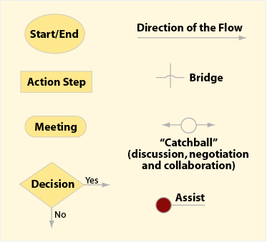
Future State Process Map
Example Detailed Process Map
Detailed Process Map Symbols
Several software applications can be used for Detailed Process Maps (MS Visio, MS PowerPoint, iGrafx)
At this point in the project, the detailed process map identifies the “Should Be” process that reflects the changes the improved the quality, timeliness, or cost associated with the process

Slide 74
Future State Value Stream Map
Value Stream Map Symbols
Example Value Stream Map
Several software applications can be used for Value Stream Maps (MS Visio, MS PowerPoint, iGrafx)
At this point in the project, the Value Stream Map identifies the “Future State” process that reflects the changes the improved the quality, timeliness, or cost associated with the process

Slide 75
<Project Title> Control Phase

Slide 76
Project Status – Control Phase
Achievements to Date:
XXX
XXX
Risks/Issues
XXX
XXX

Slide 77
Control Deliverables
Deliverables | Helpful Tools Aligned with Deliverables | Slides
1. Process Control Plan | Control Charts / SPC | 81-82
 | Control Plan | 83
 | Address SOPs | NA
2 Communication Roadmap | Communications Plan Template | 84
3. Implementation Roadmap | Implementation Plan Template | 85
4. Visual Process Control Tools | Primary Metric Chart | 86
5. Change Management Roadmap | TBD
6. Project Documentation Benefits | Executive Summary Document | 87-88

Slide 78
Control Charts – Roadmap
Select Measurement
Attribute or Variable Measurement
?
Variable
Attribute
Subgroup size =1
?
Yes
No
Defectives or Defects ?
Defectives
Defects
Constant sample size?
Constant sample size?
Subgroup size <10?
Yes
Yes
Yes
No
No
No
I-mR Chart
-R Chart
-s Chart
np Chart
p Chart
c Chart
u Chart

Slide 79
Control Charts – Instructions
Control Chart Examples
Instructions
Excel Template: Control Chart Generator.xls Purpose: Control Charts focus attention on process variation over time; this variation can apply to the project Y (major output) or X’s (process steps or inputs that affect the output) In the Control phase, Control Charts are a means to track process variation over time, and allows the Process Owner to react to out of control processes Types of Control Charts in the Control Chart Generator: Individuals and Moving Range (I-MR): Used for data sets with a sample size of one per measurement (individuals); the moving range chart shows the variation from one point to the next Average and Range (X Bar and R): Used for data sets with relatively small sample sizes in the subgroups (usually 3-5), where the average of each subgroup is plotted Proportions Chart (P Chart): for attribute data with variable sample sizes, where you are plotting the proportion defective (entire units defective, regardless of the number of defects) Count Chart (C Chart): for attribute data of constant sample size where you are plotting the number of defects (one unit may have multiple defects)

Slide 80
Control Plan – Instructions
Control Plan Example
9
1
3
4
5
6
7
8
2
Instructions
Excel file is: Control Plan.xls
This plan catalogues all activities that must be performed to ensure that the recommended Process Improvements are continued and that the process remains in control
The items are considered to be on-going events over the life of the process. Note: In some cases, it may be beneficial to provide a separate 1 or 2 page instruction sheet for the major control mechanisms
This summary can include potential failure mechanisms and corrective actions if they have been identified. If a summary sheet is used, reference the document here and attached the document to the plan.
Steps:
Control Action #: Provide a unique tracking number for each Item
Control Action: This should describe the activity that is being conducted. For metrics and control chart activities, this should include a description of the X's and Y's that are being measured. For coaching and reviews, it should include a description of who is being coached and what technical competency is being re-enforced.
Responsible Individual: This is the individual that will be held accountable for ensuring the action item is complete.
Frequency: How often will the action be executed (daily, weekly, monthly, etc.)
Process Step: What process step is the action associated with or where in the process is the action executed.
Target Value: List the target value for the X or Y being measured.
Upper Control Limit: List the Upper Control Limit for the X or Y being measured.
Lower Control Limit: List the Lower Control Limit for the X or Y being measured.
Reaction Plan: List the actions that should be taken when the measure is outside the Control Limits.

Slide 81
Communication Plan – Instructions
Instructions
Communications Plan Example
There are several key points that should be incorporated into any communication plan:
Identify your target audience, including all project stakeholders and team members.
Establish the logistics for your communication (when, where, how long)
Determine your media (email, handouts, LCD projector, any specific format/ template, etc).
Determine specifically what the message needs to be (project closure, improvement results, issues requiring support, etc).
All of this should be documented on a single sheet of paper so that progress can be tracked and no aspects of the communication plan become forgotten.

Slide 82
Implementation Plan – Instructions
Implementation Plan Example
3
5
6
7
8
1
2
4
Instructions
This plan catalogues all activities that must be performed to ensure that the recommended Process Improvements are implemented. The items are considered to be single event items (completed one time and not ongoing over the life of the process).
Steps:
Solution: List the solution (from the Improvement Selection Matrix.
Improvement Action: This is a specific action that must be accomplished in order to implement the recommend improvement. Cross reference action to FMEA if appropriate. This entry can also be used to reference the action back to a specific input or output variable (X or Y). This should include one time actions such as specific training. However, coaching and other on going actions should be listed in control plan.
Control Action #: List the appropriate control action number if a control has been put in place to ensure the change/action is continued after the implementation.
Responsible Individual / Solution Owner: This is the individual that will be held accountable for completing the action item. The person responsible for ensuring the action is completed (if different than the Responsible Individual) should also be listed.
Issues/Barriers: This list the potential issues and barriers that may be incurred while completing the specific action. If additional support will be needed to remove the issue or barrier, the individual responsible for providing the added support should be listed.
Risk Mitigation: For the High risk actions, what are the additional actions that will be taken to ensure the successful completion of the action item.
Target Completion Date: When does the action need to be completed to support the overall implementation of the PIP recommendations.
Current Status or Completion Date: Document the current status of the action item during routine meetings and document the final completion date when the action item is completed.

Slide 83
Primary Metric Chart – Instructions
Instructions
Primary Metric Chart Example
A primary metric chart graphically displays the key process output (typically a business metric) over time.
The purpose of this chart is to provide the process owner with a means of quickly identifying when the process output is not performing as desired, so actions can be taken to correct any problems.
Control charts are an excellent means of charting primary metrics, allowing the process owner to use the voice of the process (control limits, patterns in the data) to determine if anything has gone wrong of if the process is stable. The primary metric can be tracked over time using the basic Individual & Moving Range chart in the Excel file: Control Chart Generator.xls (details for this tool are found in the Measure Phase of this document).

Slide 84
Project Executive Overview
Project description
Add text here
(i.e.: The processing of orders)
Major changes the project team implemented
Add text here
(i.e.: Changed from a batch and queue to a single piece flow)
(i.e.: Broke work into common “buckets” that leveled work among resources)
Key output measures of the old process
Add text here
(i.e.: Time to respond to the customer was 4 weeks)
(i.e.: cost was $400 per transaction)
(i.e.: 25% of the transactions had quality defects)

Slide 85
Project Executive Overview (continued)
Key output measures of the new process
Add text here
(i.e.: Time to respond to the customer is 18 hours)
(i.e.: Cost is $200 per transaction)
(i.e.: 3% of the transactions have quality defects)
Description of the critical controlled inputs that brought about the improvement
Add text here
(By standardizing work and setting a takt time based on demand the team was able to flow the work)
Key learning of the project
Add text here
(i.e.: By flowing the work the team was able to reduce inventory levels while increasing quality with less manpower)
(i.e.: Of the 25% of the defects, 90% were reworks 2 or more times)
What impact does this improvement have
Add text here
(i.e.: Dollars saved, Quality increase, Time to respond reduced)

Slide 86
Lean Six Sigma Internet Resources
www.isixsigma.com
Wide range of articles, tools, conferences and practitioner forums (free)
Lexicon Terms - Lean Enterprise Institute
Lean enterprise “toolkit”, library containing background articles about lean enterprises, definitions of key terms, examples of value-stream maps, conferences and practitioner forums (free)

