Slide 1



Smarter NEC contract management for projects in South Africa
Tuesday 20th October

Slide 2


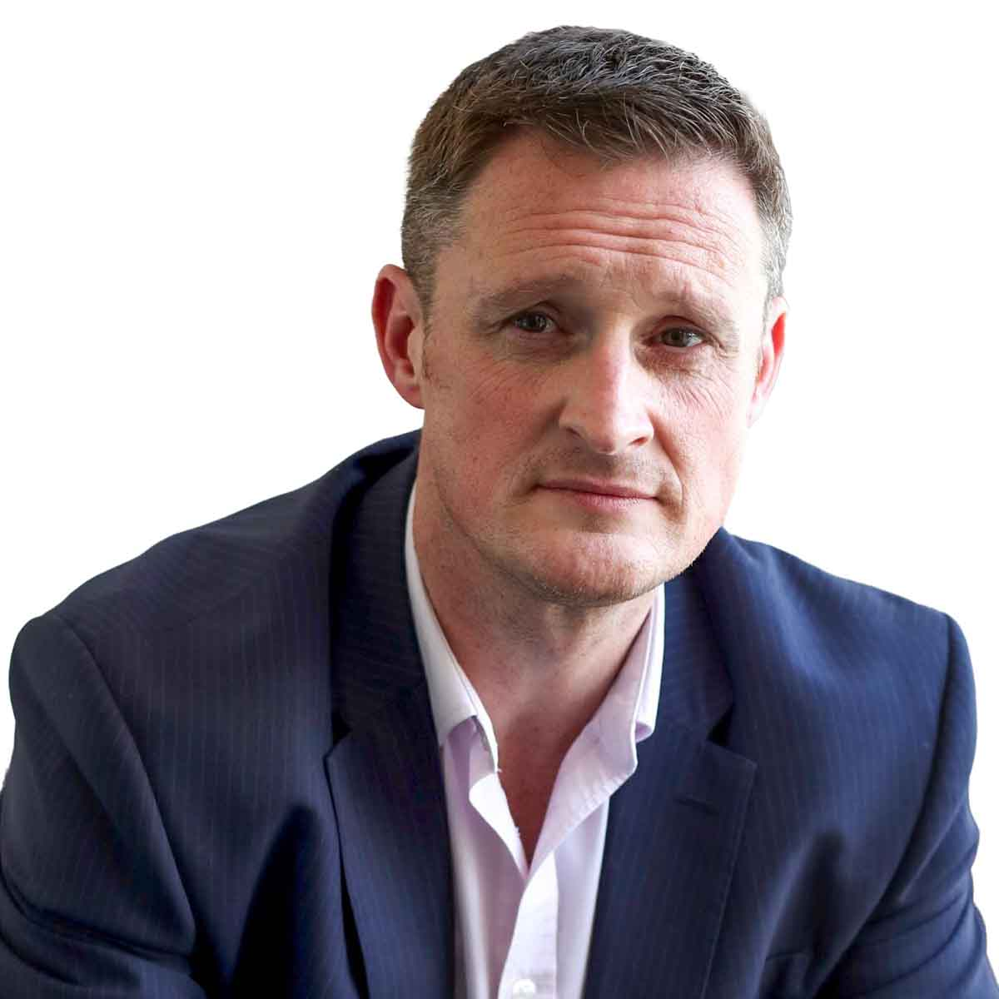
Our Panelists
Dr Stuart Kings
Charley Wainwright
Justin Harris
NEC4 Drafter & Co-author, Sypro
Business Development Director, Sypro
Associate Director, AtkinsRéalis

Slide 3

Managing your NEC contracts
Sypro is a digital contract management platform that helps you manage contracts, control risk, and improve project outcomes.
Why Sypro?
One platform for NEC, FIDIC and custom contracts
Created by an original drafter of NEC4
17+ years supporting project delivery
Structured management of key contract processes
Portfolio-wide visibility and reporting
Better governance, reduced risk and fewer disputes

Slide 4





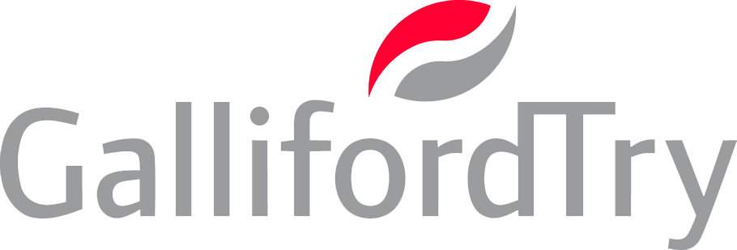


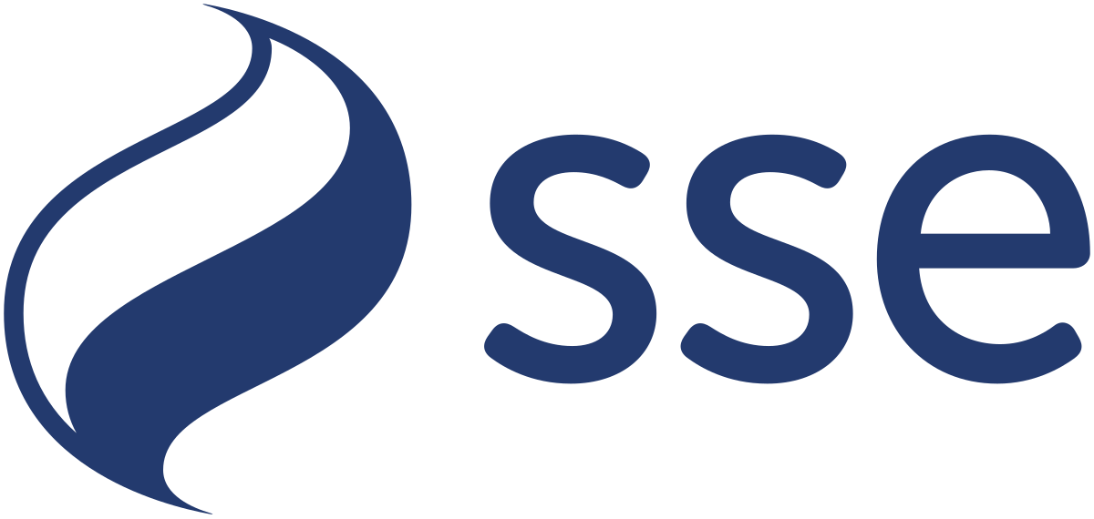
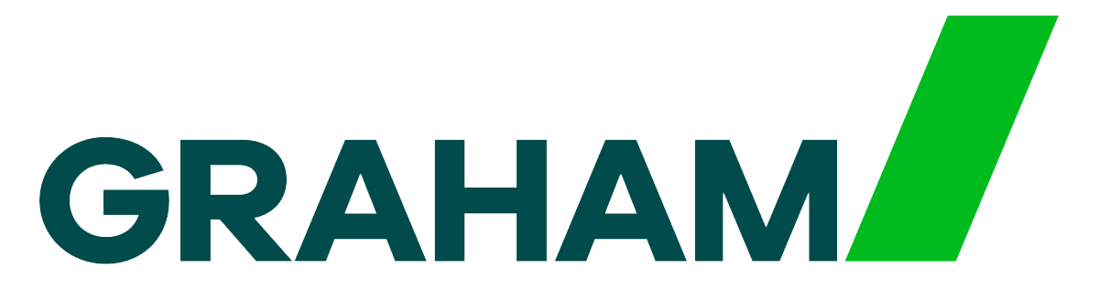



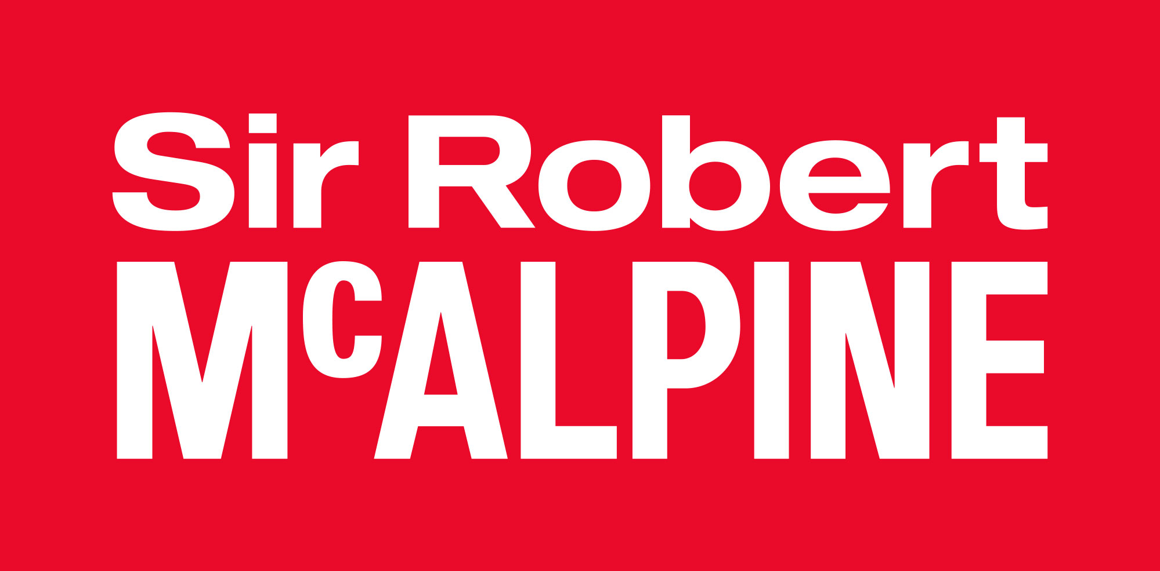


Trusted globally
Notes:
Please can the white background be removed from some of these logos?

Slide 5

How do you currently manage your NEC contracts?
Poll 1

Slide 6
How Suffolk Highways manages NEC compliance

Slide 7
Suffolk County Council
Growth, Highways and Infrastructure
Support with:
  Term Services Contract procurement
    Highways: c£40m p.a. to c£50m p.a. NEC4-hybrid
    Streetlighting: c£4m p.a. NEC4-hybrid
    Intelligent Traffic Signals: c£1m p.a. NEC4
  Contract mobilisation
  Service Management
    Streetlighting, ITS plus Gull Wing Bridge c£1.5m p.a. operations & maintenance contract
  Commercialism with Quantity Surveyor

Slide 8

Good governance is the cornerstone of how we operate
As a local authority we’re operating on behalf of the Suffolk tax-payers, residents and travelling public
We needed to strengthen our contract management governance; using the contract is a good thing
The new contracts introduced 2 Service Manager functions across 4 contracts, 4 new contractors and variable knowledge, skill and experience of NEC4 at both client and contractor

Slide 9
Support people on their change management journey
People moved from one organisation to another
A change in contract terms
Some people are trained in NEC, some are experienced in NEC and some are new to NEC
Sypro is an excellent, intuitive and user-friendly system but it’s still a change
People adopt change at different speeds and with different comfort levels
PEOPLE
PROCESS
TECHNOLOGY

Slide 10

Sypro and Power BI are driving our contract management efficiencies
Fundamentally we have a much better handle on contract communications
Our governance drives ownership of the actions needed to collaboratively progress contract communications
The Sypro Power BI solution has enabled us to move away from time-heavy manual assessment and reporting
Improved contract governance enables us to focus discussions where it matters most
Some people have benefited from a ‘PMO light touch’ as they go through their own contract maturity

Slide 11

Software demonstration

Slide 12
Would you like to learn more about how Sypro can support your organisation?
Poll 2

Slide 13




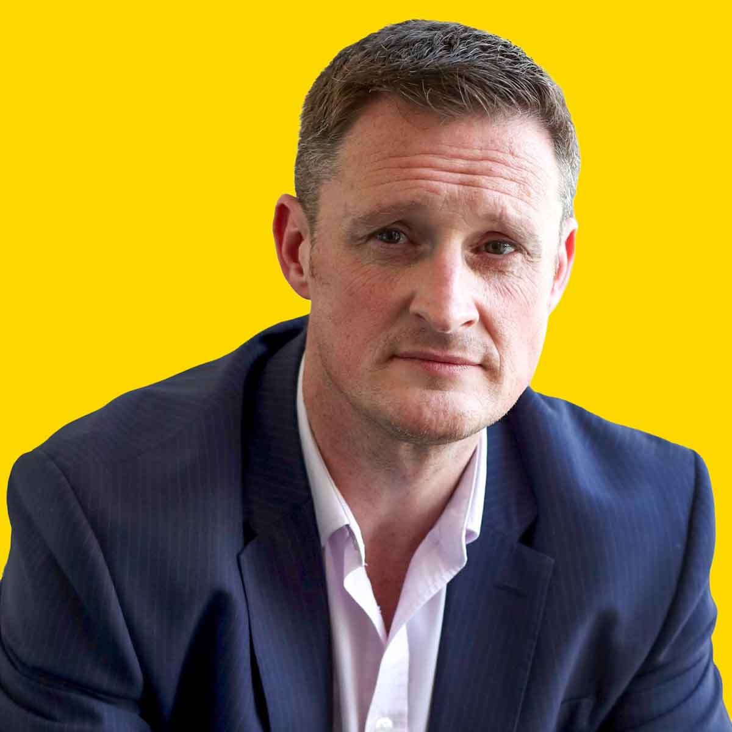
Q&A
Dr Stuart Kings
Charley Wainwright
Justin Harris
NEC4 Drafter & Co-author, Sypro
Business Development Director, Sypro
Associate Director, AtkinsRéalis
Notes:
Add Stuart to this layout.
Add Charley’s new headshot.
Replace Knowledge Hub logo with Sypro x ICE-SA lock up.

Slide 14

Thank you
01482 765601 | sypro.co.uk

