Slide 1
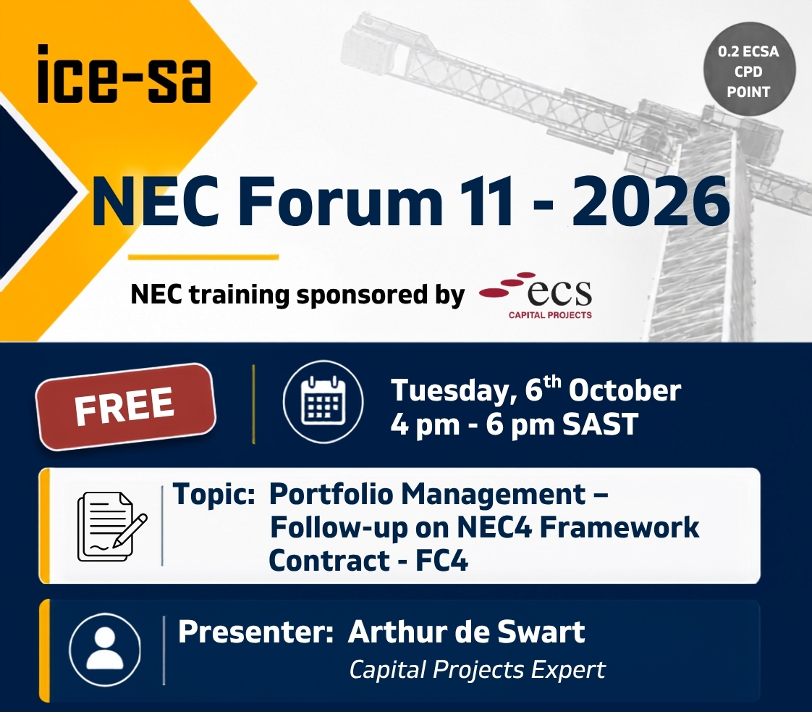

Slide 2

Do the right things,
not only doing things right.
Portfolio Management and the Framework Contract (FC4)
Utilising the FC4, in conjunction with the rest of the NEC4 suit, to accelerate delivery of Portfolios.
ICE-SA Jam Session
Prepared by ECS Associates | 5 October 2026
Arthur De Swardt

Slide 3


BASIS OF THIS JAM SESSION
Purpose of today’s session
How can we maximise the NEC4 suite of contracts, especially the Framework Contract (FC4), to optimise the delivery of a portfolio of capital projects
1
What is Portfolio Management and what are its contracts challenges
2
How the NEC4 suite supports portfolio delivery
Section title
3
Real world example
MINING & METALS | INFRASTRUCTURE | ENERGY | POWER | WATER | GAS | RENEWABLE ENERGY
ECS Associates

Slide 4

Section 1
1
What is Portfolio Management and what are its contracts challenges
MINING & METALS | INFRASTRUCTURE | ENERGY | POWER | WATER | GAS | RENEWABLE ENERGY
ECS Associates

Slide 5

1
What is Portfolio Management
Are we doing the right things,
as well as doing things right ?
A Portfolio is a collection of Projects, Programmes, Portfolios and other Enterprise activities that are managed together to deliver strategic Enterprise Benefits
A Portfolio defines:
The capital project activities that, combined, will deliver the organizational goals
Early scope and benefits of all projects
Which projects should go ahead, when and where,
How much budget should be allocated to each project
A Portfolio of Infrastructure capital projects is normally managed in a Portfolio Management Office (PfMO).
The PfMO normally reports to the Executive Level
The right project at the right time with the right contract
MINING & METALS | INFRASTRUCTURE | ENERGY | POWER | WATER | GAS | RENEWABLE ENERGY
ECS Associates

Slide 6

1
What is Portfolio Management
What do Portfolio Managers worry about?
Are our projects continually aligned with the company strategy
If not, what are we going to do about it
Long term planning (5, 10, 15 years MTEFx3)
Is the pipeline of projects maximised
Do our service providers (Contractors, PSP’s) have enough capacity for our pipeline
Can the market service our pipeline
Project BENEFITS, not necessarily only deliverables
Project MILESTONES, not necessarily activities
MINING & METALS | INFRASTRUCTURE | ENERGY | POWER | WATER | GAS | RENEWABLE ENERGY
ECS Associates

Slide 7
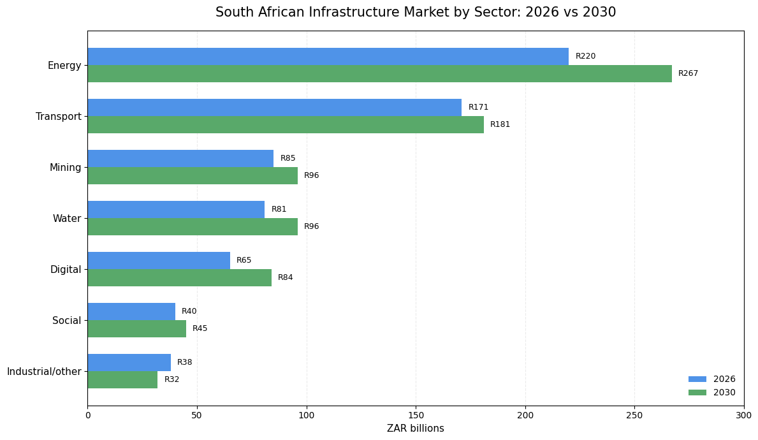

Portfolios are large: SA Infrastructure Budget 2026 to 2030
21%
Key:
Public vs Private
29%
Total Infra Budget
2026 | R 700 bn
2030 | R 801bn
Accum. | R3,745 bn
MINING & METALS | INFRASTRUCTURE | ENERGY | POWER | WATER | GAS | RENEWABLE ENERGY
ECS Associates
Source: SA Government News Agency (deputy Minister of Finance)
Notes:
Source: SA Government News Agency (deputy Minister of Finance), 13 May 2026

Slide 8
1
What is Portfolio Management
How Portfolios, Programmes and Projects fit together
Portfolio
Projects
Programs
Sub Portfolio
Other Enterprise activities
Budgeting, planning, prioritizing, stakeholder engagement
Sub -Projects
Sub- Programs
Projects
Programs
Projects
Projects
Projects
MINING & METALS | INFRASTRUCTURE | ENERGY | POWER | WATER | GAS | RENEWABLE ENERGY
ECS Associates

Slide 9
1
What is Portfolio Management
Project
The Building Block
Temporary endeavor undertaken to create a unique product, service, or result. In infrastructure, it has a defined start and end date, a specific budget, and focuses on output delivery.
Programme
The Connected Benefits
A group of related projects managed in a coordinated way to obtain benefits and control that wouldn't be possible from managing them individually. It focuses on outcomes and business benefits rather than just physical outputs.
Objective: To manage interdependencies between projects and ensure the overall capability is realized.
Portfolio
The Strategic Alignment
A collection of projects, programmes, and operations grouped together to achieve strategic business or government objectives. The components of a portfolio may not be directly interdependent, but they compete for the same funding, resources, and executive attention.
Objective: To maximize the return on investment by choosing the right mix of programmes and projects aligned with high-level strategy.
Objective: To deliver a specific asset on time, within budget, and to technical specifications.
Example: Constructing a single bridge or upgrading a specific water treatment plant.
Example: A school classroom building programme.
Example: A Municipal portfolio of water, energy, roads
MINING & METALS | INFRASTRUCTURE | ENERGY | POWER | WATER | GAS | RENEWABLE ENERGY
ECS Associates

Slide 10
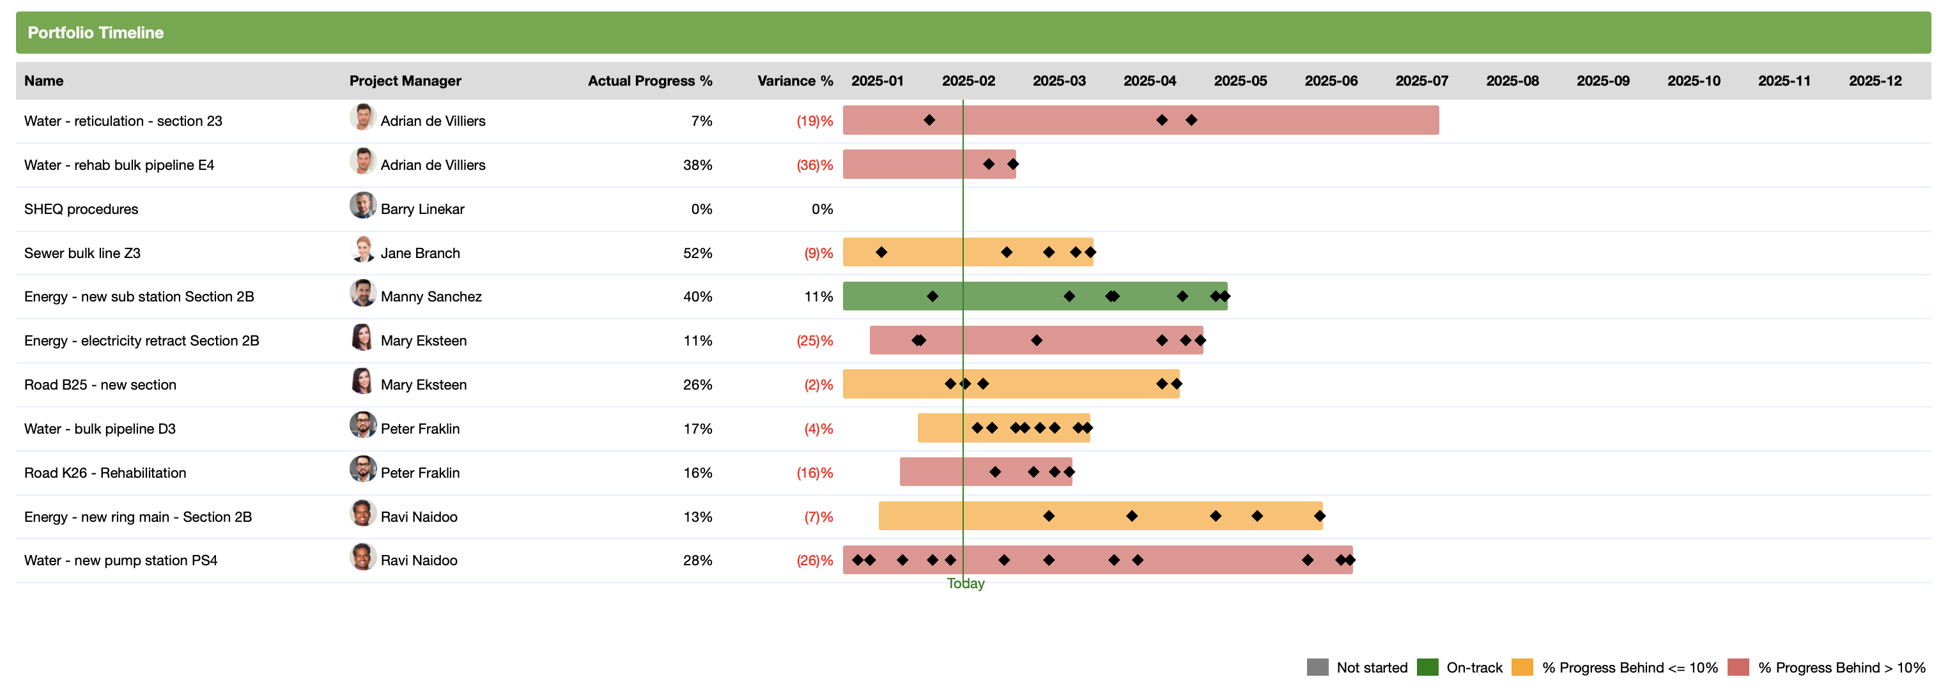
Portfolio schedule – concerned about MILESTONES and BENEFITS

Slide 11
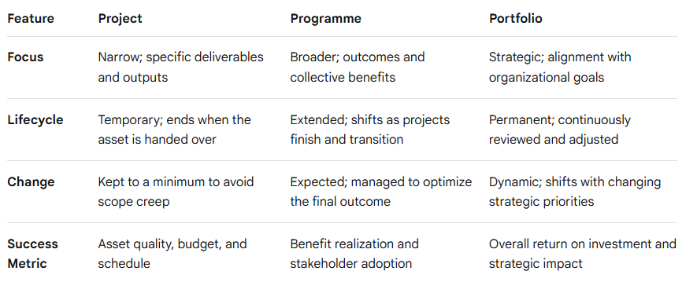
1
What is Portfolio Management
MINING & METALS | INFRASTRUCTURE | ENERGY | POWER | WATER | GAS | RENEWABLE ENERGY
ECS Associates

Slide 12
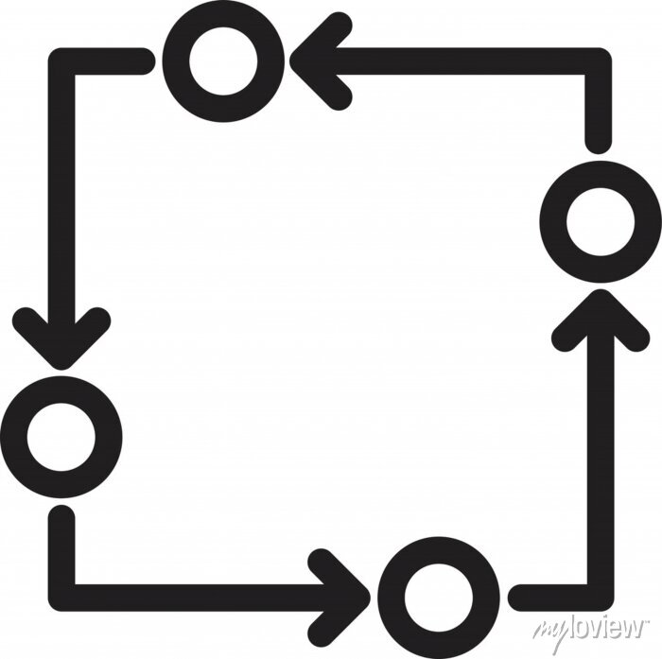
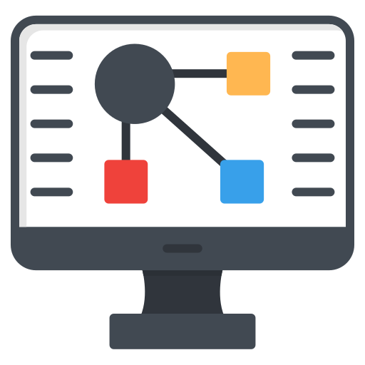






1
What is Portfolio Management
Portfolio Management Activities
Strategy & Investment Alignment
Portfolio
Optimisation & Balancing
Governance
Risk
Assurance
Monitoring, Controlling & Reporting
Portfolio aligned to your Enterprise Strategy
Portfolio aligned to your Investment plan
Portfolio adjusted annually to align to new demands
Portfolio optimised to maximise Benefits within the available Budget
Portfolio balanced to balance the demands between Departments and Programmes and Enterprise priorities
Portfolio managed according to an Enterprise-wide methodology that creates consistency and repeatability of Benefit outcomes
Clear Stage Gates to govern approvals
Checks at each Stage Gate to continually review Benefits against KPI’s
Develop Enterprise-wide Portfolio Risk Management Framework
Identify Risks
Analyse Risks
Develop Risk responses
Monitor and Control Risks
Ensure risk mitigation measures are built into project schedules and budgets
Develop Enterprise-wide Assurance Management Framework
Create 4-lines of defence
Create early warning triggers proactively deal with risks
Conduct regular reviews and audits
Agree the metrics to be monitored with Executive and Project teams
Develop Reporting KPI’s
Monitor KPI’s
Develop Reports and Dashboards
Communicate Reports and Dashboards according to an agreed cadence
Reports and Dashboards to Monitor and Control the Portfolio
Portfolio Management Deliverables
Tools to align, optimise, & balance your portfolio
Portfolio Management Methodology
Cloud-based workflow system to institutionalise the methodology
Handbook as a reference guide to the
Methodology
Management Information System across horizontal and vertical silo’s
Risk management Framework, tool and reporting
Assurance framework, project reviews, health checks, audit
Geographic Information System to plot your projects and create a Master Plan
Dashboards to provide the right intelligence reporting to each level in the Organisation
MINING & METALS | INFRASTRUCTURE | ENERGY | POWER | WATER | GAS | RENEWABLE ENERGY
ECS Associates

Slide 13
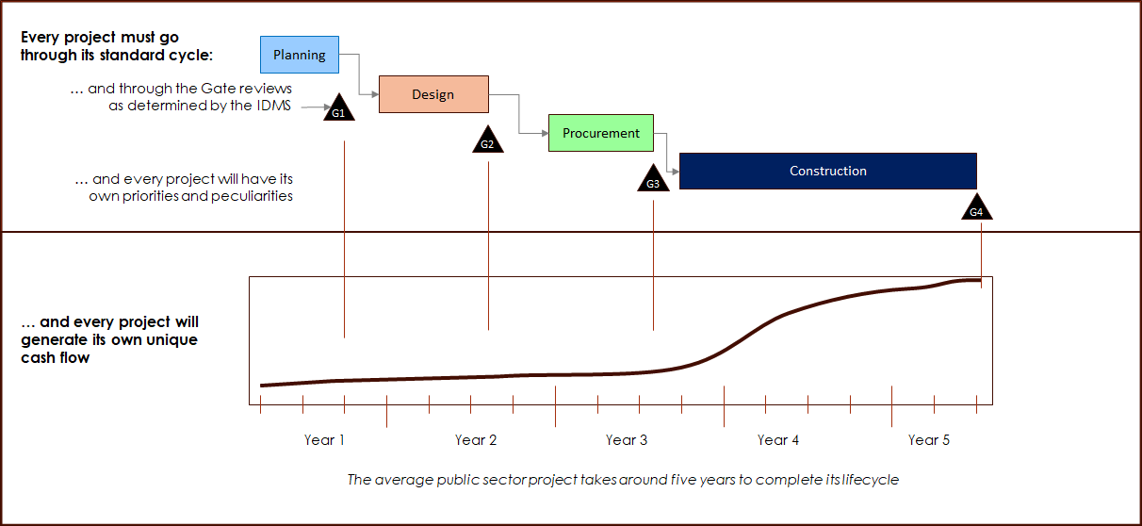
1
What is Portfolio Management and what are its contracts challenges
Contracts challenge # 1
Rigid project lifecycle
With such a long and rigid lifecycle, what are the chances that it remains as the right project at the place at the right time with the right budget
MINING & METALS | INFRASTRUCTURE | ENERGY | POWER | WATER | GAS | RENEWABLE ENERGY
ECS Associates

Slide 14
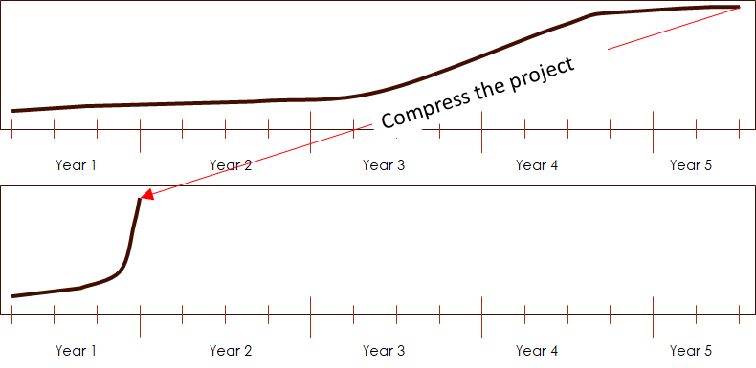
1
What is Portfolio Management and what are its contracts challenges
Contracts challenge # 2
Unrealistic budget windows
Government projects are often driven by service delivery crises and the annual budgeting cycle.
Projects are often:
Prioritized by urgent service delivery crises, and not within the broader context of infrastructure planning
The Project life cycle gets squeezed into a financial year
This generates the standard “hockey stick” effect, resulting in:
A Portfolio that is not meaningfully Prioritised
A Portfolio that is not planned for long term efficiencies
Planning and design shortcuts
Pressure to deliver construction within unrealistic timeframes (often between January to June of the financial year)
Construction short cuts
Crisis management
MINING & METALS | INFRASTRUCTURE | ENERGY | POWER | WATER | GAS | RENEWABLE ENERGY
ECS Associates

Slide 15
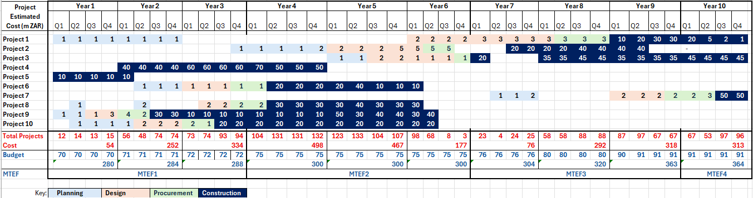
1
What is Portfolio Management and what are its contracts challenges
Prioritising and sequencing of the projects in the portfolio to match available budget as well as project demands
Contracts challenge # 3
Sequencing
MINING & METALS | INFRASTRUCTURE | ENERGY | POWER | WATER | GAS | RENEWABLE ENERGY
ECS Associates

Slide 16
1
What is Portfolio Management and what are its contracts challenges
Contracts challenge # 3
Sequencing (contd.)
MINING & METALS | INFRASTRUCTURE | ENERGY | POWER | WATER | GAS | RENEWABLE ENERGY
ECS Associates

Slide 17
Section 2
2
How the NEC4 suite supports Portfolio delivery, especially the Framework Contract (FC4)
Acknowledgement: Richard Patterson NEC4 Framework Contract webinar
MINING & METALS | INFRASTRUCTURE | ENERGY | POWER | WATER | GAS | RENEWABLE ENERGY
ECS Associates

Slide 18
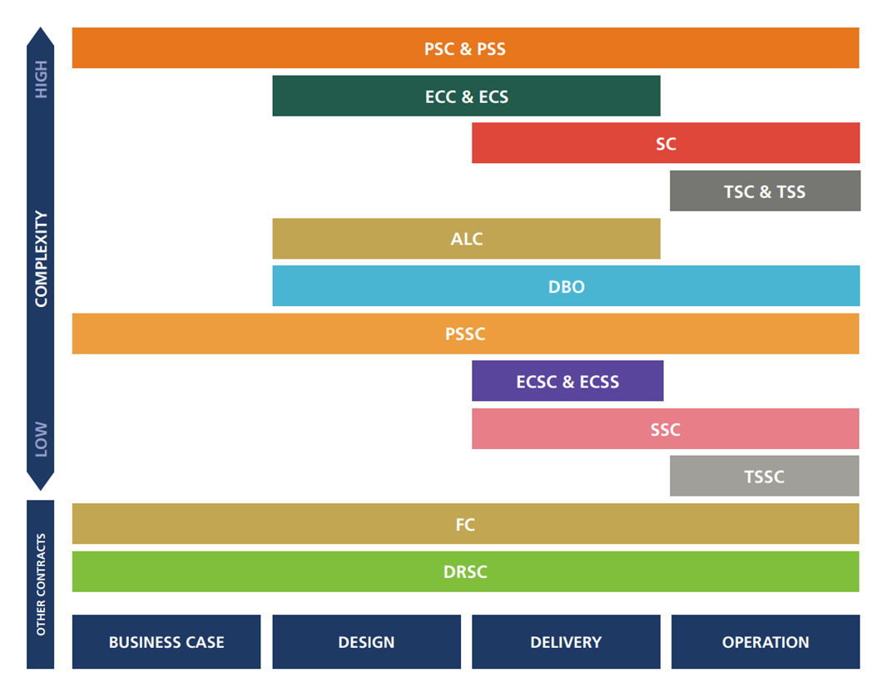
2
How the NEC4 suite supports Portfolio delivery, especially the Framework Contract (FC4)
The NEC4 family of contracts
Procurement strategy: who does what, when (vertical, horizontal split)
Contracting strategy: how to allocate the risk
Acronym | Definition
PSC | Professional Service Contract
PSS | Professional Service Subcontract
ECC | Engineering and Construction Contract
ECS | Engineering and Construction Subcontract
SC | Supply Contract
TSC | Term Service Contract
TSS | Term Service Subcontract
ALC | Alliance Contract
DBO | Design, Build and Operate Contract
PSSC | Professional Service Short Contract
ECSC | Engineering and Construction Short Contract
ECSS | Engineering and Construction Short Subcontract
SSC | Supply Short Contract
TSSC | Term Service Short Contract
FC | Framework Contract
DRSC | Dispute Resolution Service Contract
MINING & METALS | INFRASTRUCTURE | ENERGY | POWER | WATER | GAS | RENEWABLE ENERGY
ECS Associates

Slide 19
2
How the NEC4 suite supports Portfolio delivery, especially the Framework Contract (FC4)
The landscape of procurement vehicles
Relational/Strategic
Framework
Contract (FC)
Agreement to execute
FUTURE works on
instruction.
Flexible scope.
Panel / Roster
List of pre-qualified
suppliers. Often
rotational.
No guarantee of work.
Operationally rigid.
Transactional
Term Service
Contract (TSC)
Continuous service
for a duration.
E.g., Cleaning,
Vegetation
Management.
One-off Contract
Unique, high-value
projects.
Defined start/end.
Specific Scope.
(ECC, ECS, DBO)
Frameworks are most useful where future needs are likely, but their timing, quantity or precise location is uncertain.
MINING & METALS | INFRASTRUCTURE | ENERGY | POWER | WATER | GAS | RENEWABLE ENERGY
ECS Associates

Slide 20
2
How the NEC4 suite supports Portfolio delivery, especially the Framework Contract (FC4)
When the procurement cycle is longer than the work itself, the system is too slow for responsive infrastructure delivery.
The goal: framework contracts that are faster without becoming uncontrolled.
The Scope does not have to be detailed at Framework Stage
MINING & METALS | INFRASTRUCTURE | ENERGY | POWER | WATER | GAS | RENEWABLE ENERGY
ECS Associates

Slide 21


2
How the NEC4 suite supports Portfolio delivery, especially the Framework Contract (FC4)
Framework contracting = capacity first, orders later.
The FRAMEWORK (Level 1):
Framework Contract: an agreement between a Client and one or more Contractors, the purpose of which is to establish the terms governing orders to be awarded during a given period, in particular with regard to price and, where appropriate, the quantity envisaged (ISO 10845:2020)
The ORDERS (Level 2):
A Time Charge Order: is an instruction to provide advice on a proposed Work Order on a time charge basis.
Work Order: is a contract to carry out work within the framework scope.
It is
• A long-term arrangement
• A way to pre-establish key terms
• A mechanism for repeat work
• A programme-level supplier strategy
It is not
• A guarantee of work
• A blank cheque
• An open-ended appointment
• A substitute for proper scope definition
Allows repeat work
Allows for Early Supplier Involvement (ESI)
Value is created through issuing of orders which are read together with the framework contract
Zero value contract
MINING & METALS | INFRASTRUCTURE | ENERGY | POWER | WATER | GAS | RENEWABLE ENERGY
ECS Associates

Slide 22
THE FRAMEWORK IS THE PLATFORM; EACH ORDER IS A SEPARATE CONTRACT
How NEC4 FC works: two levels
Level 1: NEC4 Framework Contract
NEC Framework Contract (FC)
Sets the ‘Rules of the Game’ (Contract Data Part 1 & 2)
Client + Suppliers | Client’s Representative | Framework scope | Selection procedure | Quotation procedure | Framework Information
Level 2
Time Charge Order
Advice, investigations, scoping, early input before a later Work Order. Usually time-based.
Work Order
Separate contract to carry out work. Must be within framework scope and use order-specific documents.
NEC PSC
(Professional Services Contract)
NEC PSSC
(Professional Services Short Contract)
NEC ECC
(Engineering &
Construction)
NEC ECSC
(Engineering &
Construction Short Contract)
The FC is the coat hanger; the orders are the contracts hanging from it.
Time Charge Orders help define the problem.
Work Orders deliver the solution.
MINING & METALS | INFRASTRUCTURE | ENERGY | POWER | WATER | GAS | RENEWABLE ENERGY
ECS Associates

Slide 23
CONTRACT STRUCTURE
The NEC4 core clauses: FC compared to ECC (Eng & Construction Contr) and PSC (Prof Serv Contr)
Aspects
NEC4 ECC
NEC4 PSC
NEC4 FC
Parties
Client / Contractor
Client / Consultant
Client / Supplier(s)
Agent / administrator
Project Manager and Supervisor
Service Manager
Client’s Representative
1. General
Actions, communications, roles, early warning, etc.
Actions, communications, roles, early warning, etc.
Actions, communications, Client’s Representative, corrupt acts
2. Main responsibilities
Contractor’s main responsibilities
Consultant’s main responsibilities
Parties’ obligations; Supplier selection; Time Charge Order; Work Order quotation
3. Time / completion
Starting, programme, completion
Starting, programme, completion
Completion of the framework obligations
4-8
Quality, payment, compensation events, title, liabilities and insurance
Quality, payment, compensation events, rights to material, liabilities and insurance
Not used in the FC - dealt with in the individual order contract where applicable
9. Termination
Termination under the ECC
Termination under the PSC
Termination of the Framework Contract
Secondary options
Used where selected in Contract Data
Used where selected in Contract Data
Generally not used in FC; relevant options are selected in the order contract
The FC sets the framework machinery. ECC and PSC contain the detailed project/service administration machinery.
MINING & METALS | INFRASTRUCTURE | ENERGY | POWER | WATER | GAS | RENEWABLE ENERGY
ECS Associates

Slide 24
WHEN ORDERS MAY BE PLACED AND COMPLETED
Framework timing: End Date, Time Charge Orders and Work Orders
Framework start
End Date
Time Charge Order
advice / scoping
Work Order A
delivery before End Date
Work Order B
may complete after End Date if awarded before it
Work Order X
Not permitted
new order after End Date
Rule of thumb: do not award a new order after the framework End Date. An order properly placed before the End Date may have its own later Completion Date if the framework and governance documents allow it.
MINING & METALS | INFRASTRUCTURE | ENERGY | POWER | WATER | GAS | RENEWABLE ENERGY
ECS Associates

Slide 25
EARLIER SUPPLIER INPUT AND FASTER ORDER PLACEMENT
Project lifecycle: framework contracts
Time Charge Order
Selection and Quotation
Work Order
Advice, options and value engineering
Defined in the FC
Carry out the work
1
Strategy
2
Concept
3
Design
4
Procurement
5
Works
6
Handover
7
Close Out
8
Post implementation review
Fast track
Frameworks support Early Contractor Involvement and value engineering without waiting for a full project-by-project procurement process.
MINING & METALS | INFRASTRUCTURE | ENERGY | POWER | WATER | GAS | RENEWABLE ENERGY
ECS Associates

Slide 26
THE FRAMEWORK OPTION FITS REPEATABILITY, UNCERTAINTY AND NEED FOR RAPID MOBILISATION
When a framework is suitable
Suitable
Recurring category of work
Uncertain quantities, timing or locations
Need for rapid mobilisation
Programme or portfolio delivery
Scope can be defined by category
Supplier capacity must be secured
Less suitable
Unique mega-project with complete scope
Requirement outside advertised framework scope
No clear selection procedure
No delegated authority or budget
Supplier capability uncertain
Used merely to avoid competition
Decision test: can the Client describe the category, selection rules and commercial basis now, even if the exact order is unknown?
MINING & METALS | INFRASTRUCTURE | ENERGY | POWER | WATER | GAS | RENEWABLE ENERGY
ECS Associates

Slide 27
WHY ORGANISATIONS CHOOSE THIS ROUTE
Advantages of using framework contracts
1
Speed
Faster mobilisation once need is identified.
2
Consistency
Standard commercial and contractual rules.
3
Flexibility
Different order forms and pricing options.
4
Competition
Mini-competition or objective allocation can retain value pressure.
5
Relationships
Longer-term learning, collaboration and innovation.
6
Portfolio control
Track spend, workload, performance and capacity.
7
Reduced admin
Less repeated tendering and negotiation.
8
Risk management
Pre-vetted capacity and repeatable documentation.
Frameworks create value by standardising what should be standard and preserving choice where the specific order needs it.
MINING & METALS | INFRASTRUCTURE | ENERGY | POWER | WATER | GAS | RENEWABLE ENERGY
ECS Associates

Slide 28
FRAMEWORKS ARE USEFUL WHEREVER THE CATEGORY REPEATS BUT THE EXACT ORDER IS NOT YET KNOWN
Potential South African applications
Public infrastructure
Schools, clinics and public buildings
Roads, stormwater and municipal works
Water and sanitation repairs
Electricity distribution infrastructure
Professional services and investigations
Disaster recovery and emergency works
Private infrastructure and industry
Mining sustaining capital
Plant shutdowns and maintenance
Commercial property portfolios
Renewable energy programmes
Telecommunications rollout
Data centres and logistics facilities
Common factor: repeated category + uncertain timing, quantity or location.
MINING & METALS | INFRASTRUCTURE | ENERGY | POWER | WATER | GAS | RENEWABLE ENERGY
ECS Associates

Slide 29
Section 3
3
Real world example
MINING & METALS | INFRASTRUCTURE | ENERGY | POWER | WATER | GAS | RENEWABLE ENERGY
ECS Associates

Slide 30
Section 3
3
Real world portfolio delivery pressure
Daily Maverick reports:
The Mayor of a major Metro in SA plans to spend … money on highly visible projects that can be completed before voters head to the polls.
The mayor has also proposed that members of the mayoral committee (MMCs) meet without top City bosses to decide which unfinished projects should be prioritised.
He proposed identifying projects needing immediate completion, securing their funding, and delaying newer initiatives. “We are 50 days away to an election”.
Statement: 1 Oct 2026
Completion: 4 November 2026
MINING & METALS | INFRASTRUCTURE | ENERGY | POWER | WATER | GAS | RENEWABLE ENERGY
ECS Associates

Slide 31
Key takeaways
Portfolio Management: Do the – RIGHT THINGS, not only doing things right
Portfolios are at the ENTERPRISE level
Key contracts challenges in Portfolios are:
  Rigid project lifecycles
  Unrealistic budget windows
  Project sequencing
The FC4 provides some flexibility of contracting in Portfolios
The NEC4 suite supports Portfolio delivery
A good framework is faster because the rules are already designed.
Further reading:
Constructing the Gold Standard
An Independent Review of Public Sector Construction Frameworks
By Professor David Mosey
Centre of Construction Law, King's College London

Slide 32
ECS Professional Services
Focus on Claims and Dispute Avoidance
NEC
$10Bn
Accredited
Projects managed
Capital Project Services
1000+
Project Management
Claims & Dispute Management
Specialists Network
800+
Technical Advisory
Business/Project Analysis
Cumulative Years Experience
Contract (NEC, FIDIC, JBCC, GCC)
Training and Development
Scope Management
400+
16
Project Management Consulting
Training sessions
Professional Affiliations
SMART Construction
Independent Assurance
Construction Law and Contracts
Collaboration Culture
Internet and Internet Services
Online Advertising
Project Management Office
Expert Resources
Social Media Advisory Services
Data Visualisation and PowerBi
Procurement and Contract Strategies
Project Services
Planning and Delay Analysis
Commercial Management
Optimisation & balancing
Dispute Avoidance and Resolution
Contract Management Advisory
Strategy Alignment
Monitoring
Claims Management
Portfolio Management
Risk Management
Governance
Controlling
Dispute Avoidance Board Services
Expert Witness
Risk
Reporting
WWW.ECS.CO.ZA
MINING & METALS | INFRASTRUCTURE | ENERGY | POWER | WATER | GAS | RENEWABLE ENERGY
Assurance

