Slide 1



NEC4: Incentivising
Suppliers
Not just X Clauses
By Joseph Keogh
Notes:
Position the presentation as a practical commercial toolkit. The emphasis is not to create windfall bonuses, but to move contractor focus toward outcomes that matter to the Employer: timely handover, fewer defects, faster close-out, better planning, and reliable reporting.

Slide 2

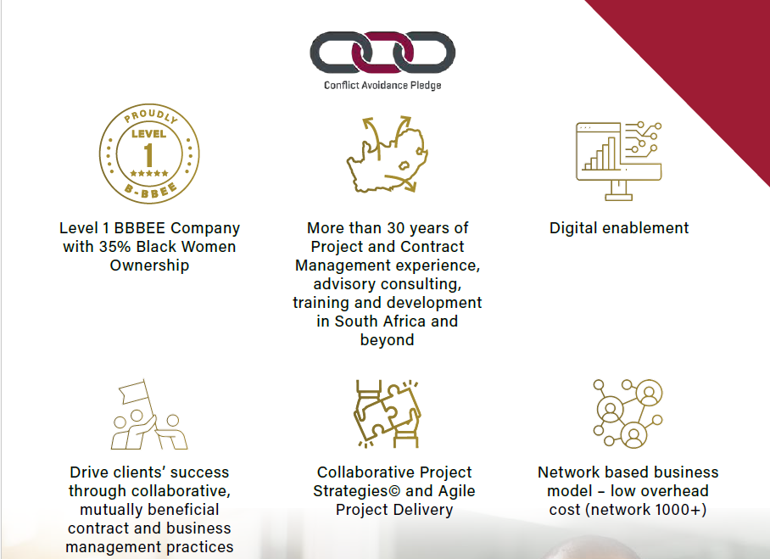

Slide 3

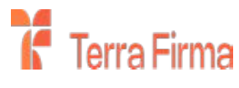






















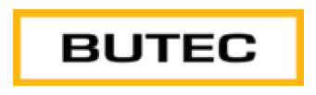




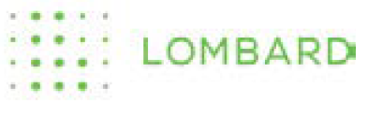
























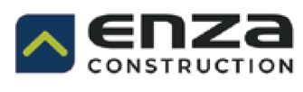
Delivering Impact with Our Clients and Partners

Slide 4
The core principle: incentives must change behaviour
“Show me the incentive and I will show you the outcome.”
Charlie Munger
Targeted outcomes
“What gets measured gets managed.”
Peter Drucker
• first-time-right
• defect-free
handover
Quality incentives
"If you punish people too much for failure, then they will respond accordingly, and the innovation you will get will be very incrementalist. Nobody’s will try anything bold for fear of getting fired... so risk-reward must be balanced and favour taking bold moves."
Elon Musk
• early completion
• milestones
• reliability
Delivery incentives
• delay damages
• defects
• retention
• claims discipline
Baseline contract controls

Slide 5
CONTRACT LANDSCAPE
South African standard forms: examples of where incentives fit
NEC
FIDIC
JBCC
GCC
Particular Conditions
Special conditions
Incentive architecture
Contract additions
X6 early Completion
X20 KPI payments
Pain/gain incentive
Value Engineering
X21 Life Cycle Cost
X29 climate performance
Bonus for early completion
Milestone payments
Performance bonus
Cost-engineering mechanisms
Practical completion bonuses
Defects close-out incentives
Quality-related retention
Payment milestones
Milestone payments
Late performance consequences
Bonus provisions where stated
Project-specific KPIs
Practical conclusion
NEC provides the clearest incentive toolkit. FIDIC, JBCC and GCC can offer incentives, but usually need carefully drafted Contract Data, Particular Conditions or Special Conditions.

Slide 6
INCENTIVE DESIGN
Performance incentives: the practical menu
Choose a small portfolio of incentives that reinforce each other. The best scheme balance safety, speed, quality, cost discipline and collaboration.
1
2
3
4
5
Delivery
Quality
Cost / value
Collaboration
HSE /Climate / social value
Early Completion bonus
Sectional handover bonus
Programme reliability KPI
Pain/gain share
Shared savings
Waste-reduction bonus
LTI Free hours
Carbon / waste targets
Local participation
Skills transfer
First-time-right bonus
Defect-free handover
Work unit measures, e.g. weld failure rate
Risk reduction
Other KPI
Early warning
Key point: Do not reward one outcome in a way that damages another. A delivery bonus should be linked to accepted targets, not merely physical progress.

Slide 7
NEC CONTRACT
NEC: strongest native incentive architecture
X6
Early Completion bonus
X20
Key Performance Indicators
Options C/D
Target cost with pain/gain share
X21
Project Lifecycle Cost
X29
Climate Change Performance
X22
Early Contractor Involvement
X7 / X17
Delay and low-performance damages
To reduce future cost
Example KPI schedule structure
Outcome
Measure
Target
Assessment
Quality
First-time acceptance
≥ 97%
Quarterly
Programme
Planned activities achieved
≥ 90%
Monthly
Defects
Open defects at Completion
≤ 5
Final
Select KPIs that materially influence the Client’s critical outcomes.

Slide 8

DELIVERY
Delivery incentives: reward certainty and usable completion
1
Early Completion bonus
Fixed daily/weekly bonus for Completion, sectional Completion or Take-Over.
2
Sectional release bonus
Payment for early use of a section where sectional completion creates measurable Client value.
3
Acceleration success payment
Only payable if an agreed recovery programme is achieved without unresolved quality or safety defects.
4
Programme reliability KPI
Monthly reward for planned versus actual reliability and early warning discipline.
Payment trigger must link to usable completion, not just physical progress.

Slide 9
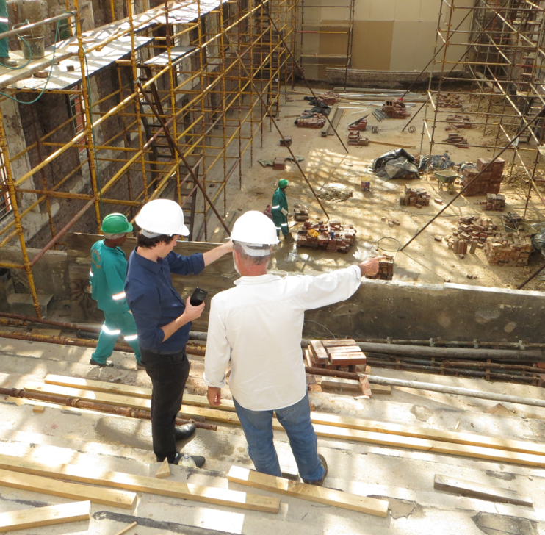
QUALITY
Quality incentives: pay for “first-time-right” outcomes
Bonus only if Completion or Practical Completion occurs with no material defects.
Defect-free handover
NCR / rework control
Bonus if non-conformance reports are closed within agreed timeframes.
Quality gate release
Milestone reward released only once test packs, inspection and documents are accepted.
Post-occupancy performance
Part of the incentive paid after defects liability or performance measures are satisfied.
Do not allow the contractor to earn a delivery incentive while carrying avoidable defects, incomplete records or unresolved quality failures.

Slide 10

Value Engineering (Clause 16)
Contractors can propose changes to Scope / Works Information that reduce cost or improve value.
How it works
Accepted proposals can lead to savings being shared through a value engineering percentage. The Prices are reduced by only part of the saving, allowing the contractor to retain a portion as additional margin.
Why it works
It encourages innovation and proactive suggestions without treating every improvement as a standard compensation event.
Value engineering should improve value – not merely save cost.

Slide 11
Life Cycle Costs as an incentive – promotes long term value
LCC considers the total cost of an asset from design and construction through operation, maintenance, renewal and disposal — not just the initial cost.
1
2
3
4
Reduces total cost of ownership
Improves long-term asset performance
Encourages sustainable, value-driven decisions
Supports better investment outcomes
LCC turns the conversation from lowest construction price to best whole-life value.

Slide 12
FRAMEWORK CONTRACTS
Frameworks: Future work can be the strongest incentive
For frameworks and panels, contractors are often most motivated by access to the next package. The allocation rules should make past performance visible and commercially meaningful.
KPI score
Quality performance
Cost certainty
Safety and environmental performance
Future work
allocation
Responsiveness
Collaboration
Transparent
from the outset
Social value
Delivery against programme
The allocation rule must be transparent and stated from the outset — otherwise it becomes discretion, not an incentive.

Slide 13
CLIMATE AND SOCIAL VALUE
X29 and project-specific ESG incentives
Embodied carbon reduction
Fuel/energy consumption
Recycled material content
Construction waste diverted from landfill
Water consumption
Local employment /skills transfer
Avoid overlap between climate/social KPIs, X20 performance indicators and low-performance damages. Each target should have one commercial consequence.
Drafting caution

Slide 14
INCENTIVE EXAMPLE
Illustrative incentive schedule for quality and delivery
Category
Measure
Target
Frequency
Payment trigger
Completion
Before Completion Date / Practical Completion Date
1-30 days early
Per day achieved
Quality gate passed
Sectional handover
Accepted handover of critical section
By section date
Per section
No material defects
First-time acceptance
Inspections accepted first time
≥ 97%
Quarterly
Audit trail
Defect close-out
Defects closed within agreed time
≥ 95%
Monthly
No repeat NCRs
Programme reliability
Planned activities completed as forecast
≥ 90%
Monthly
Forecast quality
Commercial calibration
Budget impact
Value created
Cash timing
Ceiling cap
Payment timing
The bonus should be lower than the measurable value created for the Client and should be capped.

Slide 15
GOVERNANCE AND CONTRACT MANAGEMENT
Governance safeguards for South African projects
1
Tender stage
2
No double payment
Include the full incentive schedule, caps and exclusions in the tender.
Do not pay for obligations already priced in the contract.
3
Measurement
4
No bypassing claims
Use objective evidence: certificates, test packs, KPIs and dashboards.
Incentives do not replace compensation events, claims or contractual remedies.
5
Certification
6
Disputes
State who certifies and what documentation is required.
Keep the dispute forum and escalation route clear.
Good incentive schemes are as much about clear administration as they are about reward.

Slide 16
How LCC incentivises contractors
NEC contracts encourage collaboration and innovation, allowing contractors to share in savings generated through lower life cycle costs and improved asset performance.
Rewards innovation and value engineering
Encourages durable, high-quality solutions
Focuses on whole-life value, not lowest price
Aligns contractor objectives with client outcomes
Use lifecycle measures only where the output can be measured objectively and connected to contractor decisions.

Slide 17
Six-step process for building the incentive scheme
A high-impact incentive scheme should be simple enough to explain, measure and certify at each assessment date.
1. Define outcomes
Quality, delivery, cost and social value priorities
2. Select levers
Bonus, KPI, gainshare, future work or remedy
3. Set measures
Objective evidence and assessment period
4. Model value
Cap reward below value created for the Client
5. Draft clearly
Target, trigger, exclusions and payment timing
6. Administer visibly
Dashboard, certification and audit trail
Each step should result in a schedule line that can be measured and certified without argument.

Slide 18
Recommended balanced model
For a substantial project, combine a small number of positive incentives with proportionate contractual remedies.
1
Choose the right pricing route
Use NEC Options C/D or equivalent target-cost logic only where cost transparency and governance are available.
2
Reward early, usable delivery
Use X6 or project-specific completion bonus only where earlier use has measurable value.
Simple
measurable
valuable
fair
3
Reward quality outcomes
Use three to five KPIs for first-time acceptance, defects, programme reliability and safety.
4
Use future work carefully
For frameworks, include transparent performance-based allocation rules.
5
Keep remedies proportionate
Use delay damages, low-performance damages or penalties only for clear failures.
Too many KPIs, subjective scoring or overlapping incentives usually weaken rather than improve supplier behavior.

Slide 19
A strong incentive scheme changes contractor behaviour
Incentives work when the commercial reward is tied to an outcome the contractor can materially influence.
Targeted outcome
Objective measure
Verified performance
Commercial reward
Design rule
Reward outcomes that create value and are within the contractor’s influence — not effort that is already paid for in the Prices.
Management message
Good incentives do not replace project management. They make good project management commercially visible.

Slide 20
X20 — Key Performance Indicators
X20 is the most direct performance-incentive mechanism. The Client prepares an Incentive Schedule stating:
The KPI
How it is measured
The target
The measurement period
The amount payable for achieving or exceeding the target
When the incentive becomes payable
A KPI incentive should be objective, auditable and within the contractor’s material influence.

Slide 21
The Contractor receives the stated payment when the KPI target is achieved or improved upon. NEC describes X20 as a mechanism for encouraging positive behaviours and performance.
Suitable KPIs include:
Objective | Possible KPI | Illustrative incentive
Programme | Milestone completed by target date | R250,000
Quality | At least 97% first-time acceptance | R100,000 quarterly
Defects | Fewer than five defects at Completion | R150,000
Programme management | 90% planned activities completed as scheduled | Monthly incentive
Safety | 95% close-out of safety actions within seven days | Quarterly incentive
Social value | Local employment or training target achieved | Fixed payment
Collaboration | Early warnings raised promptly and actions closed | Performance payment
Asset performance | Output, reliability or energy-efficiency target | Graduated payment

Slide 22
Design discipline: do not pay twice
X20 should measure outcomes the supplier can materially influence. It should not reward performance already fully compensated through the Prices.
Practical guardrail
Pay only for measurable added value:
earlier usable completion,
defect-free handover,
better commissioning readiness,
reliable forecasting, or
faster close-out.
Avoid
Bonuses that merely reward compliance with existing baseline obligations, optimistic reporting, or speed that compromises quality and safety.
Design rule: reward outcomes that create value, not effort the contractor is already paid to deliver.

Slide 23
Bonus for early Completion
Under NEC4 ECC and certain other NEC contracts, X6 pays the Contractor a stated amount for each day that Completion occurs before the contractual Completion Date.
1
2
3
4
5
Earlier production
Reduced rental or temporary accommodation
Earlier road, plant or facility availability
Reduced shutdown duration
Earlier revenue generation
Use X6 only where early Completion creates measurable value for the Client, not where it creates merely cosmetic acceleration.

Slide 24
The bonus rate should reflect the actual value of early Completion to the Client, rather than being an arbitrary amount.
The bonus applies against the Completion Date as revised under the contract, including changes resulting from implemented compensation events.
A useful structure could be: R100,000 per calendar day that Completion occurs before the Completion Date, capped at R3 million.
X6 is not included in every NEC4 contract. For example, it is not a standard secondary option under the NEC4 Supply Contract.
For sectional projects, early-completion incentives can also be aligned with important sections where the contract permits this.

Slide 25
Pain/gain share
Target-cost contracts align the contractor’s commercial outcome with the Client’s cost outcome.
Gain share
Final cost below target
Target cost
Pain share
Final cost above target
Applies under
ECC Option C target contract with activity schedule; ECC Option D target contract with bill of quantities; and relevant target options in PSC, TSC and other contracts.
Behavioural effect
Creates gain share where the supplier delivers below target, and pain share where final cost exceeds target.
Common in alliance and collaborative contracts, but only effective where cost transparency and governance are mature.

Slide 26
What target-cost arrangements encourage
Target-cost arrangements encourage the supplier to manage cost, reduce waste and improve delivery decisions.
Manage Defined Cost
Eliminate waste
Develop value-engineering proposals
Manage subcontractors effectively
Notify risks early
Work collaboratively with the Client
Target-cost incentives work best when both parties can see, understand and challenge Defined Cost in real time.

Slide 27
COST AND VALUE
Target contracts: pain / gain share
Target-cost contracts align the contractor’s commercial outcome with the Client’s cost outcome. The parties share the difference between the adjusted target and final cost.
Illustrative share profile
Difference from target
Contractor share
Target cost
Saving up to 5%
30%
Saving greater than 5%
50%
Saving / gain share
Overspend / pain share
Overspend up to 5%
30%
1
Gain share: Contractor shares savings when the final cost is below target.
Overspend greater than 5%
50%
2
Pain share: Contractor shares overspend where final cost exceeds the target.
The share profile should be modelled so that it encourages efficiency without creating defensive behaviour.
3
Behavioural effect: Encourages early risk reduction, cost control, waste elimination and buildability improvement.

Slide 28
Target cost: Pain & Gain
Target at start (total of the Prices)
Target at completion (total of the Prices) adjusted for inflation, if applicable, and compensation events
Contractor’s share of overrun
Contractor’s share of saving
Rand
Note: To encourage value management and to reward the contractor for innovation, the target is not adjusted for any change in the Works Information proposed by the Contractor which results in a saving
Final ‘cost’
(Defined Cost uplifted by the Fee)
Scenario 1 (gain)
Scenario 2 (pain)

Slide 29
Early Contractor Involvement
X22 can incentivise the Contractor during early design and planning by linking reward to better pre-construction outcomes.
Affordable proposal
Reducing forecast construction cost
Buildability
Reducing programme duration
Risk identification
Meeting the Client’s budget
Budget incentive
Payable where completed project is delivered below agreed budget
Where Option C is used for construction, the separate target-cost share mechanism also applies.

Slide 30
Cost optimization benefit of effective incentives
Low Claims and Disputes
High Claims and Disputes
Employer’s Risk High
Management Only
Cost
+
% Fee
F
Cost
Reimbursable + % Fee
Cost
Employer’s Risk
E
Target Cost
Risk/ Reward
C & D
Unit Rates
Re-measure
Employer’s Risk Low
B
A
Lump Sum
Fixed Price
Contractor’s Risk Low
Contractor’s Risk
Contractor’s Risk High
Speed of progress
Fast and agile
Slow and inflexible

Slide 31
X29 and project-specific ESG incentives
NEC X29 places environmental performance on the same contractual footing as cost, time and quality.
Construction waste diverted from landfill
Recycled-material content
Fuel or energy consumption
Embodied carbon reduction
Asset energy performance
Transport emissions
Water consumption
Local employment / skills transfer
Care is needed to avoid overlap between X29, X20 and X17 — each target should have one commercial consequence.

Slide 32
Negative incentives
Positive incentives can be balanced with carefully drafted consequences:
X17: low-performance damages
Disallowed cost under cost-based contracts
Reduced future work allocation
Termination for serious contractual non-performance
X7: delay damages
Correction of Defects
Practical warning
These should not become the main management strategy. NEC generally performs better where suppliers can see a realistic commercial benefit from achieving the Client’s outcomes.

Slide 33
Supporting commercial incentives
Not every incentive has to be a direct bonus. Suppliers can also be motivated through:
Guaranteed or accelerated payment for verified performance
Advance payment under X14 to enable mobilisation
Longer contract periods or extensions
Increased allocation of task orders or work packages
Preferred-supplier status
Reduced retention following milestones
Shared savings from value engineering
Recognition of innovation
Choose incentives that match what the contractor actually values: cash timing, margin, reputation, certainty or future work.

Slide 34
Where incentive practice is moving
Contemporary procurement favours balanced models that combine outcomes, gainshare, collaboration and proportionate remedies.
1
Outcome-based contracting
5
Predictive monitoring
rather than input-based specifications
using project data
2
Collaborative models
6
Continuous improvement
with shared risk and reward
instead of one-off bonuses
3
ESG-linked incentives
7
Behavioural drivers
environmental, social and governance outcomes
trust, fairness and long-term relationships
4
Digital contract management
real-time performance analytics
The best schemes combine positive incentives with clear, proportionate consequences for non-performance.

Slide 35

Successful projects are built on collaboration, trust and the right incentives
Thank you for your time and participation.
Questions and discussions are welcome
Follow ECS on LinkedIn

