Slide 1

Notes:
[Sources]
- NEC4 Supply Contract.pdf, cover/title pages, uploaded file.
- ECS brand guidelines 2026 _Creative Touch_LL.pptx, colours and font guidance, uploaded file.
- ECS Logo Full colour.png, uploaded file.

Slide 2
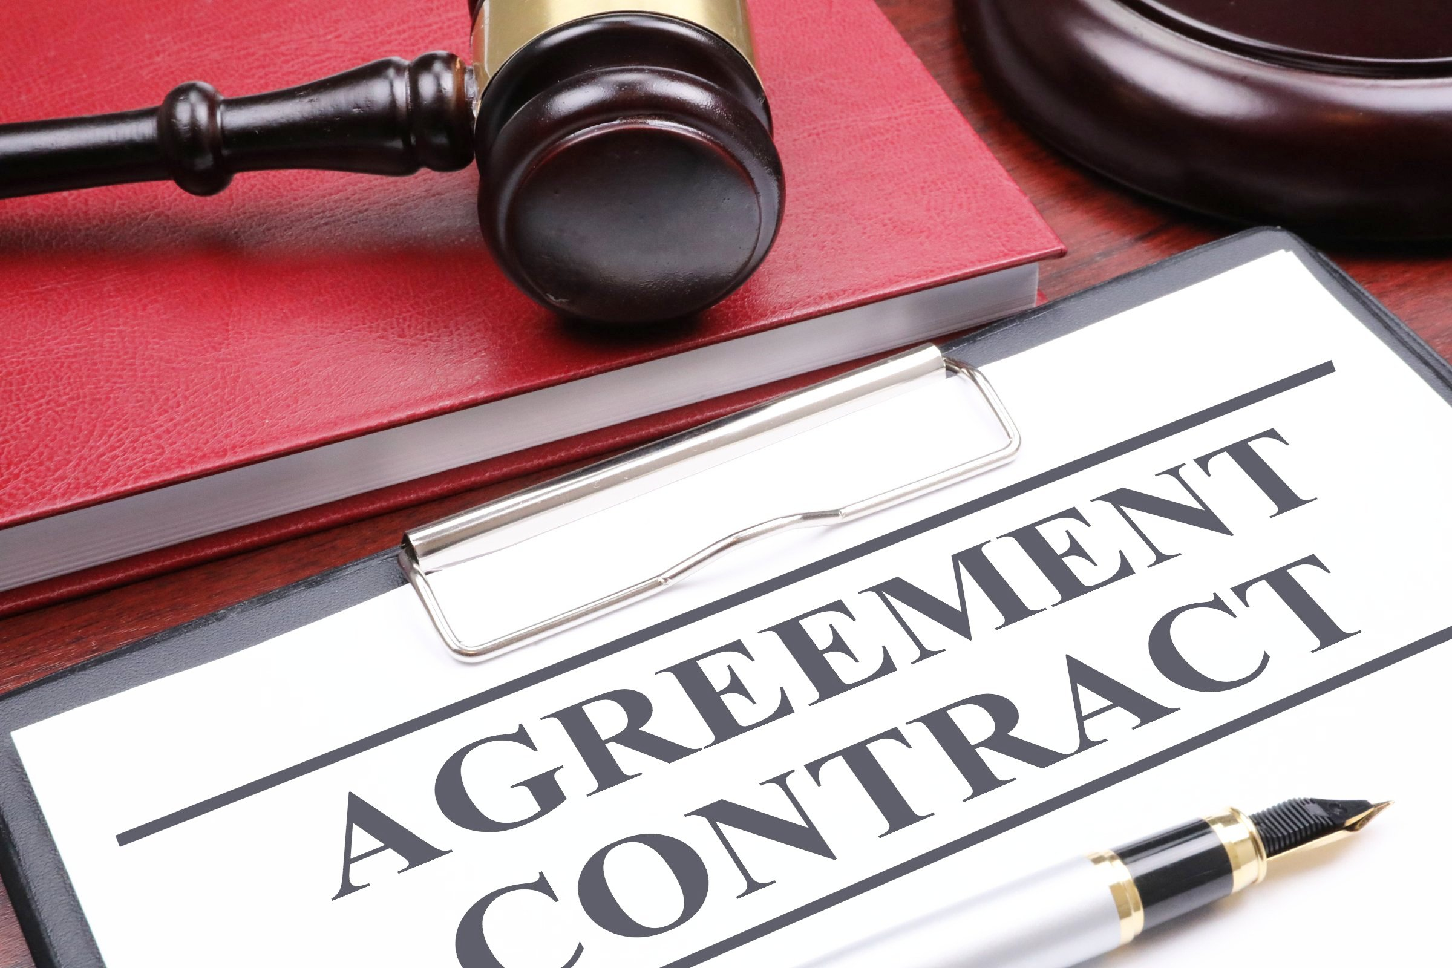

Agenda
Part 1
1
Contract Law Fundamentals
2
Formation of Contracts & Interpretation
3
Breach and Remedies
Part 2
4
NEC4 Overview
5
NEC4 Management (Roles, Early Warnings & Programme)
6
Compensation Events & Risk Allocation
7
Dispute Resolution
8
Key Takeaways
Notes:
[Sources]
- NEC4 Supply Contract.pdf, pages 11-12 (definitions) used as the reference image and clause structure source.
- ECS brand guidelines 2026 _Creative Touch_LL.pptx, colour palette and typography guidance.

Slide 3

01
Part 1 – Contract
Basic Contract overview.
Notes:
[Sources]
- ECS brand guidelines 2026 (colours and typography), uploaded file.
- NEC4 Supply Contract.pdf, uploaded file, used as the substantive source for the section topic.

Slide 4
What is a Contract?
A contract is a binding agreement between two or more parties (natural persons or juristic persons) which confers rights and establishes obligations/duties.
  Natural person= individual
  Juristic person= Legal entity/ company
A contract identifies and regulates the parties’ relationship
It requires the doing of something in exchange of something.
Two types: Oral agreements and Written agreements.
ORAL AND WRITTEN CONTRACTS
Best Evidence Rule: produce the written original contract.
Easier to prove a written agreement – difficult to prove an oral agreement (he said, she said- Hearsay evidence)
“A contract is an ask game, and if it asks for an hour, and I submit to an hour, then it's an hour. When I look at a contract, I look at the obligation - where, when, how long, the compensation. If I agree to it, that's the way it is. I have an obligation. They have an obligation.”
Chuck Berry
Notes:
[Sources]
- NEC4 Supply Contract.pdf, title page and contents pages 1-5, uploaded file.

Slide 5
Requirements for a valid contract?
Consensus
Capacity
Formalities
Cornerstones of a Contract
Freedom of Contract
Sanctity of contract
Good Faith- Clause 10.1
Privity of Contract
Legality
Possibility
Certainty
Steps for formation of a contract
Offer
Acceptance
Agreement
Contract
Notes:
[Sources]
- NEC4 Supply Contract.pdf, title page and contents pages 1-5, uploaded file.

Slide 6
Contract Interpretation
Intention of the Parties
Ordinary and Grammatical meaning of words
Context
What did the parties intend when they entered into the contract?
The contract is read as a whole, considering the wording, context, and purpose of the agreement.
Words can mean different things.
This is why contracts have definitions, to avoid having to interpret what is meant by the use of word in context of the contract.
Most contracts will contain the following “Headings are used for convenience only and shall not be taken into consideration in interpreting a word or phrase”
This is to eliminate that a word cannot be interpreted in context of the heading.
Apart from contracts containing lists of defined terms and excluding headings for purposes of interpretation, many contracts will include provisions on how to deal with matters of interpretation, especially when it comes to inconsistencies or ambiguities
For example: Clause 17:The Project Manager or the Contractor notifies the other as soon as either becomes aware of an ambiguity or inconsistency in or between the documents which are part of the contract.
Notes:
[Sources]
- NEC4 Supply Contract.pdf, pages 11-13 (definitions and communications) and page 24 clause 54.1, uploaded file.

Slide 7
Breaches of Contract
Positive Malperformance
Repudiation
Prevention of Performance
Repudiation is where one party through words or conduct express the intention to no longer be bound by the contract.
Unlawful termination is also a form of repudiation – where a party does not have the right to terminate, but terminates in any event
Positive malperformance relates to the content of the performance made.
Where the debtor duly performs but in an incomplete or defective manner.
Prevention of performance is where one of the parties prevents the other party from performing
This is after the contract has been concluded and generally during the course of the contract
Mora Debitoris
Mora Creditoris
Relates to time for performance (i.e failing to complete the works by the completion date/Time for Completion).
Mora creditoris refers to Creditor’s (i.e employer’s) failure to co-operate timeously with the Debtor in order for the Debtor to perform.
Notes:
[Sources]
- NEC4 Supply Contract.pdf, clauses 14, 20-27 and 93-94, uploaded file.

Slide 8
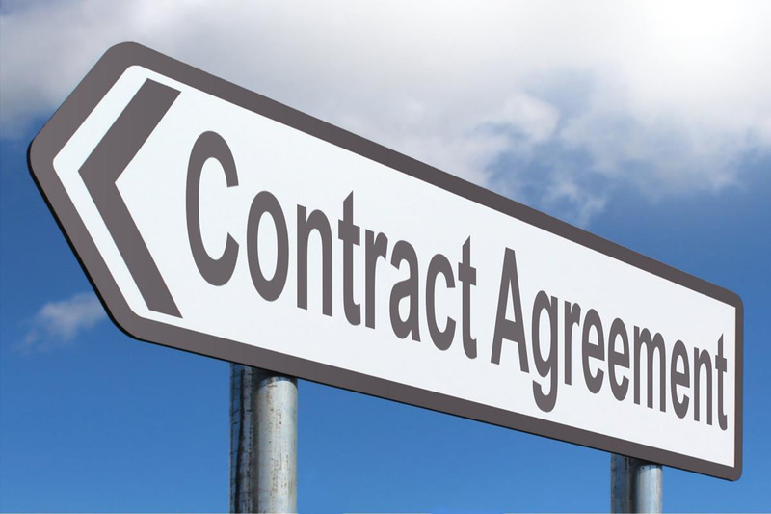
Contract Remedies for breach
Keeping Contract Alive
Compensating the Innocent Party
Exception of non-performance
A claim for specific performance
An interdict.
A claim for contractual damages
A claim for penalties
A claim for interest on amounts owing
NOTES- LAST RESORT
Cancelation is a remedy only available in certain circumstances. The breach must be material – serious enough to justify cancellation.
Notes:
[Sources]
- NEC4 Supply Contract.pdf, pages 33-37 (clauses 90-94 and dispute reference table), uploaded file.

Slide 9
02
Part 2 – NEC4
NEC4 Overview.
Notes:
[Sources]
- ECS brand guidelines 2026 (colours and typography), uploaded file.
- NEC4 Supply Contract.pdf, uploaded file, used as the substantive source for the section topic.

Slide 10

NEC origin
Industry approached ICE(UK) to find a better way; introduce modern project management into conditions of contract
Sir Michael Latham issued the Constructing the Team report
Recommended – use NEC a contract that provides a duty for the Parties to treat each other fairly
A duty of team-work with a range of other collaborative and risk management options

Slide 11

NEC origin
1st contract was called ‘New Engineering Contract’ (1993)
Name changed in 1995 to Engineering & Construction Contract with 2nd edition
NEC3 now just a brand name for contracts published since June 2005
NEC4 is an update of NEC3 issued June 2017
The NEC family provides for all Latham’s recommendations

Slide 12

NEC objectives
Flexibility – any type of contract – all disciplines.
Clarity and simplicity – easily understood
Effective and transparent risk allocation
Stimulus to good management
  The most important objective; every procedure is designed to contribute to rather than detract from the effectiveness for all parties
  foresight applied collaboratively mitigates problems and shrinks risk
  clear division of function and responsibility helps accountability and motivates people
Why NEC is the Best?
Promotes active project management. Written in clear, simple language. Focus on doing, not just disputes. Used globally on major infrastructure projects
This Photo by Unknown Author is licensed under CC BY-SA

Slide 13

Stimulus to effective management
Introduces Project Management into contractual relationships; promotes proactivity – motivates
Single point accountability
  Apply planning and cost management tools
Forecast applied collaboratively – proactive not reactive
Risk allocated to party best able to manage it
Result: Achieve win – win outcome

Slide 14

Why are NEC better contract?
Improves control of time, cost, quality, risk and disputes
Applies strong project management principles
Proven to deliver collaboration, cost savings and quality outcomes
Used on major global projects (e.g. Olympics, Crossrail, Heathrow)
Client Benefits:
Better visibility of risk
Stronger programme control
Early warning of problems
Faster change assessment
Fewer surprise claims
Clear accountability & alignment

Slide 15
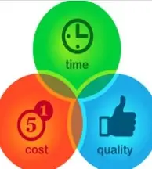
Why NEC Contracts Are Better
Management tool first, legal document second
Proactive approach to:
  Risk
  Time
  Cost
  Change
  Communication
Moves away from blame and claims culture

Slide 16
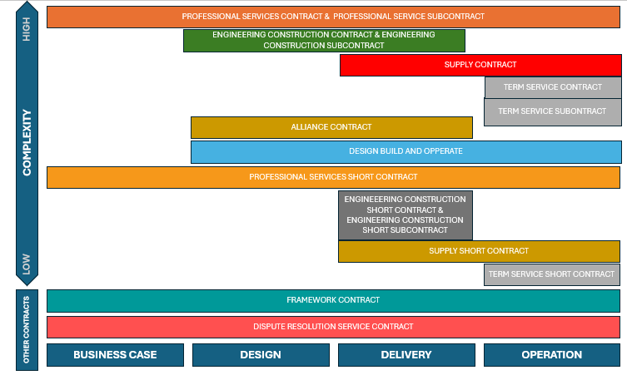
Contracts in NEC4 family

Slide 17
NEC3 vs. NEC4 Key Changes
New Terminology:
NEC3 | NEC4
Employer | Client
Works information | Scope
Risk Register | Early Warning Register
Two fee percentages: direct and subcontracted | One fee percentage
Section 4 (Testing and Defects) | Section 4 (Quality Management)
Section 8 (Risks and Insurance) | Section 8 (Liabilities and Insurance)
He/ his | It/ Its
X4 – Parent Company Guarantee | X4 – Ultimate Holding Guarantee
X12 - Partnering | X12 – Multiparty collaboration

Slide 18
Some other changes…
NEC3 | NEC4
Contractor’s | Contractor’s
Shorter Schedule of Cost Components | Short Schedule of Cost Components
this contract | the contract
key people | key persons
Communication 13 | Includes digital contract management
PM , S, C “notifies” | In some Clauses changed to PM , S, C “informs”
Clause Repairs 82 | deleted
Clause Indemnity 83 | Clause Recovery of costs 82

Slide 19


Agents of the Parties
ECC4 has two agents, Project Manager and Supervisor
PSC4 uses an agent if secondary Option X10 is selected
TSC4 has a Service Manager
SC4 has a Supply Manager
No named agents in the short contracts but main party can delegate to one. No agents in the subcontracts

Slide 20





Roles and responsibilities
Agents have considerable authority
Role defined by the actions which the contract says they take
Act on behalf of the employing party
Assumed they are not constrained
May delegate their actions; not advised
Motivated to act reasonably by presence of the Adjudicator

Slide 21
Adjudicator
Appointed jointly by Parties when forming contract
Only used when dispute arises
Party 1 proposes in enquiry
Fees paid 50/50 by Parties
Party 2 accepts or proposes other
Must be impartial and VERY knowledgeable of NEC contracts

Slide 22
Main drafting principles of NEC4
Minimum number of words; everyday English
Early warning of possible change
Clear division of function and responsibility
Always an up to date and realistic programme of work not yet done
No provision for nominated subcontractors
Each Party stands by information it provides (Scope & Site Information)
Risk allocated in different ways by selection of options
Defects only arise from non-compliance with information provided (Scope)
Communications all flow charted with no open ends
Short payment periods to ease cash flow down the supply chain
Notes:
[Sources]
- NEC4 Supply Contract.pdf, used across the core and option clauses referenced throughout the session.
- ECS brand guidelines 2026 _Creative Touch_LL.pptx and ECS logo image, uploaded files.

Slide 23
NEC4 Key Features
Early Warnings → proactive risk management
Important Qualification
NEC only works if properly managed
Requires:
Timely responses
Strong programmes
Correct use of processes
Poor use = administrative burden
Programme → central management tool
Compensation Events → real-time change control
Clear roles & deadlines → faster decisions
Collaboration + commercial discipline
Notes:
[Sources]
- NEC4 Supply Contract.pdf, used across the core and option clauses referenced throughout the session.
- ECS brand guidelines 2026 _Creative Touch_LL.pptx and ECS logo image, uploaded files.

Slide 24
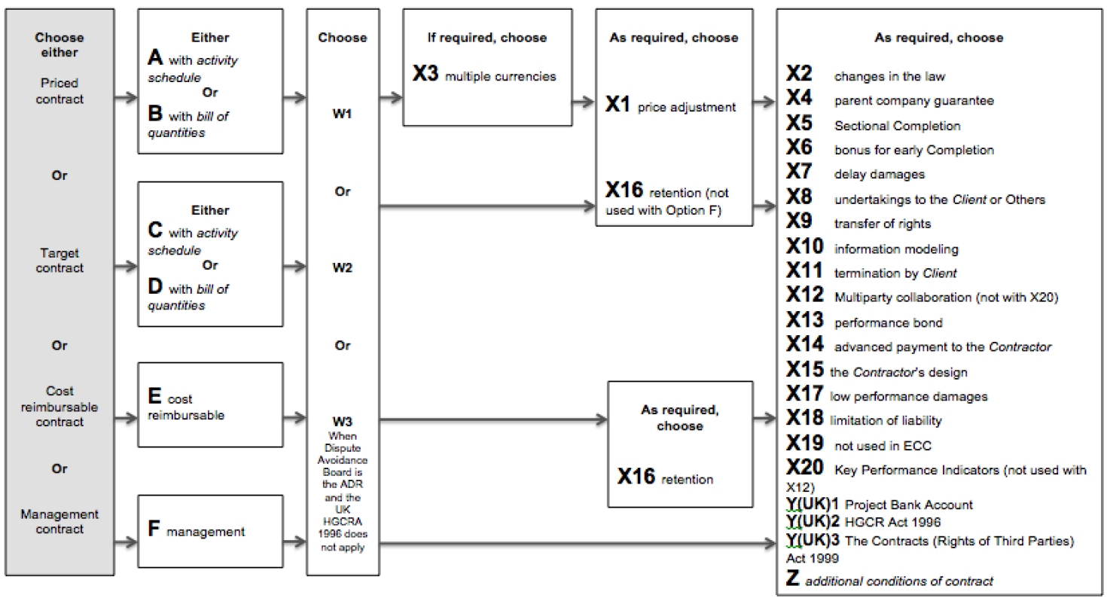
The NEC Contract Structure
TYPES
Main options
Dispute resolution
Secondary Options (new for NEC4: X21, X22 and X29
Works
Services
Supply
Add: Contract Data, Schedule of Cost Components, Scope, Site Information (as appropriate)

Slide 25
Why projects fail
Global top causes of claims and disputes for engineering construction projects
Causes of claims and disputes
% weight
Change in scope
12%
Contract interpretation issues
9%
Contract management and/or administration failure
8%
Design information was issued late
8%
Design was incomplete
7%
Poor management of sub-contractor/supplier and/or their interfaces
7%
Design was incorrect
7%
Physical conditions were unforeseen
6%
Access to site/workface was restricted and/or late
6%
Level of skill and/or experience
6%
Claims ere spurious, over-inflated, opportunistic and/or unsubstantiated
5%
Approvals were late
5%
Cash flow and payment issues
5%
Workmanship deficiencies
5%
Operational performance
4%

Slide 26

Key Takeaways
Contract Law and NEC4 work together to provide both the legal foundation and the practical management framework for successful project delivery.
A contract is legally enforceable when there is agreement, capacity, legality, certainty, and the possibility of performance, creating rights and obligations that bind the parties.
NEC4 promotes proactive contract management, collaboration, and the principle of mutual trust and cooperation to achieve better project outcomes.
Effective contract administration depends on clear communication, accurate records, timely notices, and compliance with contractual procedures.

Slide 27
Key Takeaways
Early Warnings help identify and manage risks before they affect time, cost, quality, or performance.
Compensation Events are NEC4's primary mechanism for managing change and adjusting the Prices and Completion Date fairly and transparently.
Failure to comply with contractual requirements, notice periods, and time bars can result in the loss of contractual rights and increased dispute risk.
Successful projects require parties to understand both their legal obligations under contract law and their contractual responsibilities under NEC4.

Slide 28

Thank You
We appreciate your engagement and feedback
www.ecs.co.za
Notes:
[Sources]
- NEC4 Supply Contract.pdf, used across the core and option clauses referenced throughout the session.
- ECS brand guidelines 2026 _Creative Touch_LL.pptx and ECS logo image, uploaded files.

