Slide 1
NEC Contracts
Programme management and Forensic Schedule Analysis
in NEC Contracts
05 May 2026
Programme Requirements · Compensation Events · Terminal Float · Delay Analysis Approach

Slide 2
01
Introduction &
NEC Philosophy

Slide 3
NEC Contracts – Overview & Philosophy
NEC Contracts
NEC (New Engineering Contract) suite emphasises collaboration, proactive management, and early warning systems
NEC3 ECC (Engineering & Construction Contract) is the most widely used form for major infrastructure projects
Time management under NEC is programme-driven, requiring regular updates and prospective assessments
Compensation events are the mechanism for adjusting time and cost — assessed prospectively, not retrospectively
NEC Evolution
1993
NEC First Edition
2005
NEC3 — widely adopted
2017
NEC4 — enhanced collaboration

Slide 4
02
Programme Requirements
Clause 31 & 32

Slide 5
Programme Content Requirements – What Must Be Shown
NEC Contracts
1
2
3
4
5
6
Starting Date
& Access Dates
Key Dates &
Completion Date
Operations
& Sequence
Float &
Time Risk Allow.
Resource
Statements
Information
Required
Contractual start
and site possession
Sectional and
overall Completion
Order & timing of
all planned work
Contractor-owned
schedule contingency
labour,
plant, materials
When Contractor
needs data/drawings
Critical Forensic Point: An Accepted Programme is the baseline for measuring all Compensation Event impacts. If no programme is accepted, the PM assesses CEs using their own assessment — which may be unfavourable to the Contractor.
NEC vs General Practice: Unlike many traditional contracts, NEC does not just require a programme at tender — it mandates ongoing, updated programmes throughout the project. This proactive approach is fundamental to NEC forensic analysis.

Slide 6
Float Definition
NEC Contracts
Available time for an activity’s Start or finish date to be delayed before it impacts another activity or an important milestone.
Each activity has an early and late date calculated in CPM network. If there is a gap between early date and late date, there is a float.
ES
EF
Activity Duration
(Single Point Estimate, Fixed)
LS
LF
Activity Duration
(Single Point Estimate, Fixed)

Slide 7
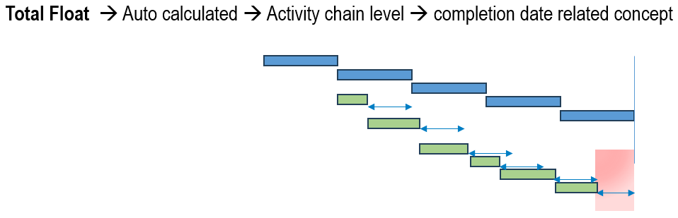
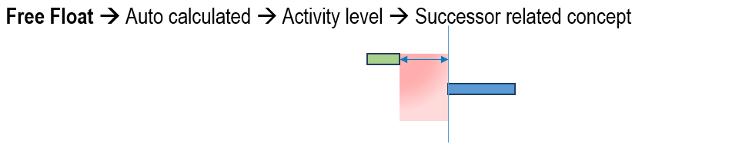
Total Float and Free Float
NEC Contracts
CPM-Driven Float
CPM-Driven Float

Slide 8
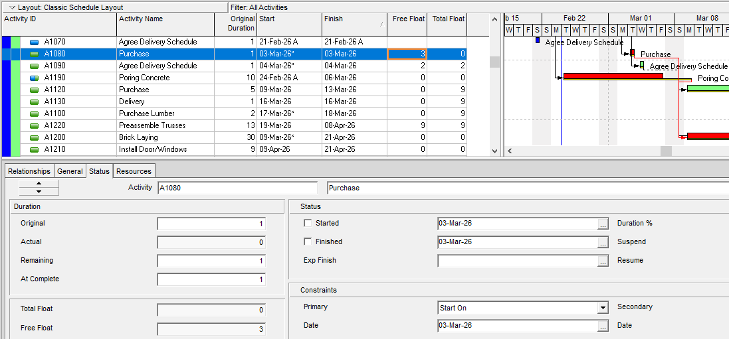
Total Float and Free Float
NEC Contracts
Finish to Start

Slide 9
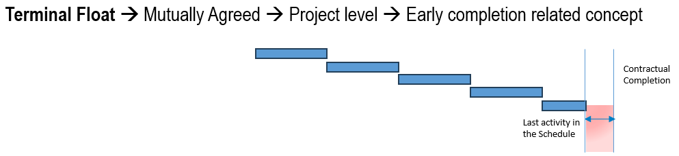
Terminal Float
NEC Contracts
CPM & Contract-Driven Float
Planned Completion Date
(Early Date)
Completion Date
(Late Date)

Slide 10
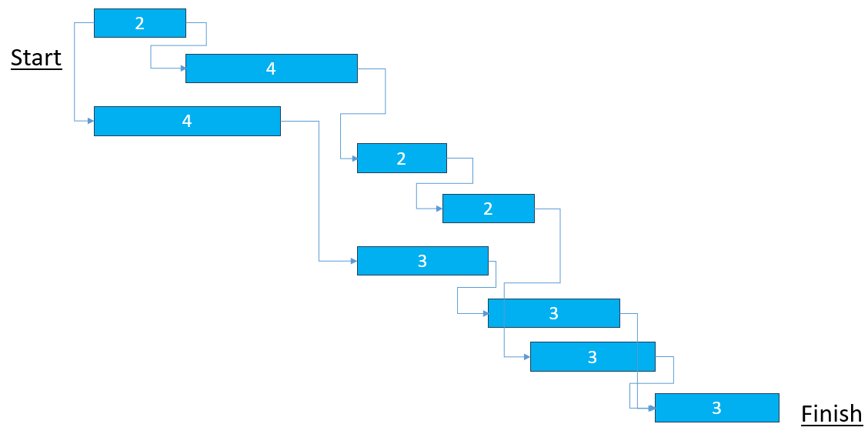
Critical Path and Critical Activity
NEC Contracts

Slide 11
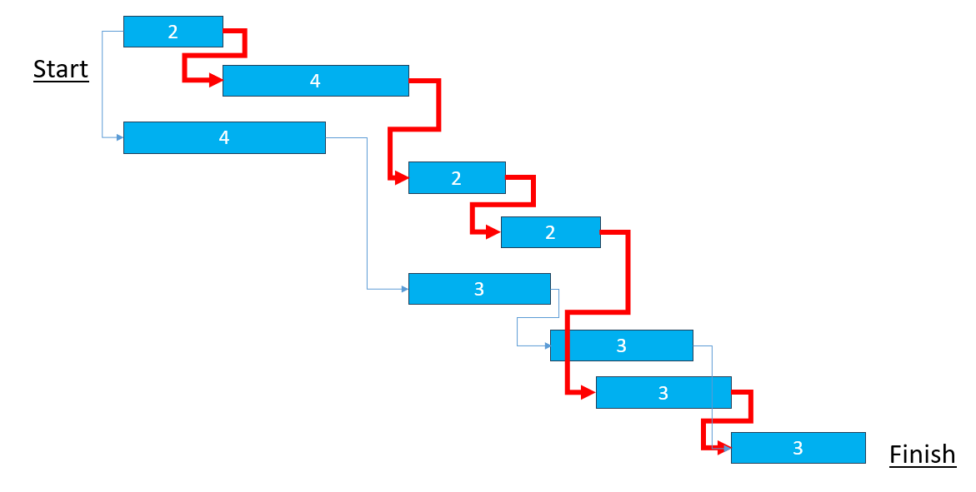
Critical Path and Critical Activity
NEC Contracts

Slide 12
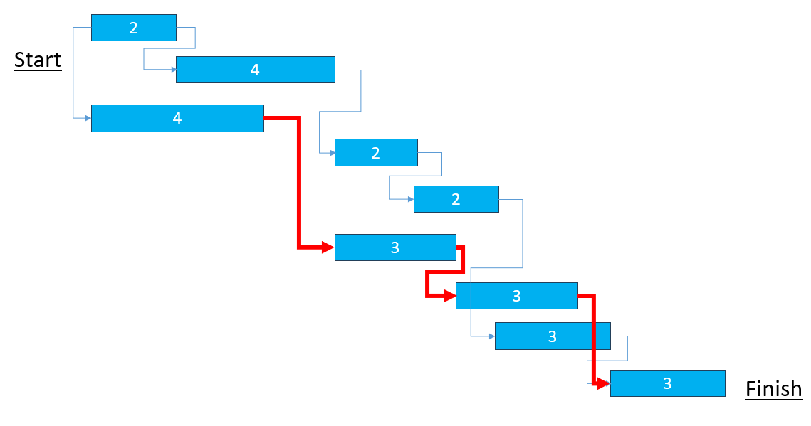
Critical Path and Critical Activity
NEC Contracts

Slide 13
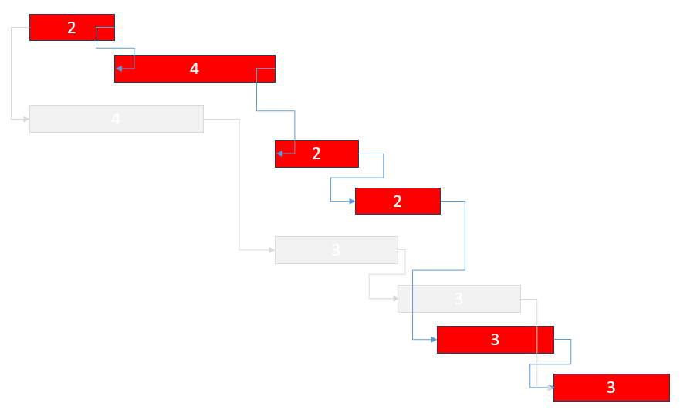

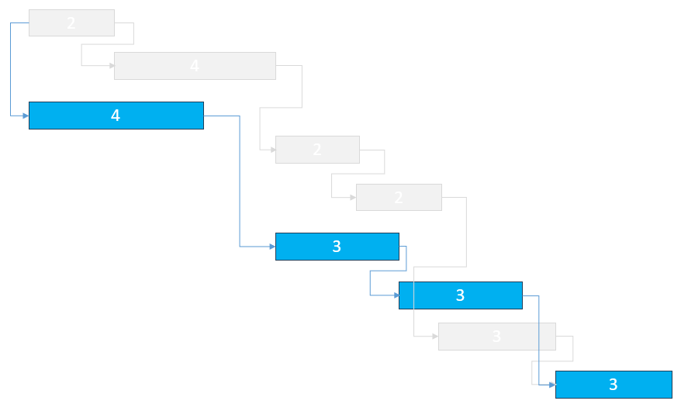
Critical Path vs Critical Activity
NEC Contracts
Path Duration: 2+4+2+2+3+3=16 days
Path Duration: 4+3+3+3 = 13 days

Slide 14
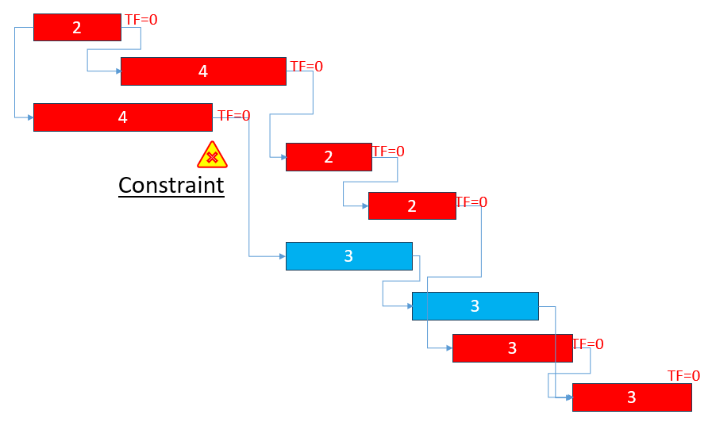
Critical Path vs Critical Activity
NEC Contracts
TF=0
TF=0
TF=0
TF=0
TF=0
TF=0
Activities in this Critical Path have Total Float of zero.
The zero Total Float is found in activities in Critical Path PLUS in one activity with constraint.

Slide 15
NEC Contracts
Starting Date vs Access Date
STARTING DATE
ACCESS DATE
Contractor's obligations begin
Employer's obligation to hand over site
Insurances, programme submission (Cl. 31), early warning duty, design obligations and preliminary costs all activate — even with zero site access.
Failure to give access on the stated date is a compensation event under Cl. 60.1(2) — no need to prove actual delay to the works.
Most of the time, CP starts from this section, so be careful how much work you plan within this period.
Pre-access period (contractor active, off-site)
Construction on site
Starting
Date
Access
Date
Completion
Date
Show both dates: Starting Date = programme data date. Access Date = hard constraint milestone with successor logic.
Model the gap: Pre-access activities (Cl. 31 programme, procurement, design, mobilisation) must be resourced and linked — this period is often on the critical path.
Never absorb silently: If the employer signals late access, issue an early warning immediately. Revising the programme to absorb it forfeits your Cl. 60.1(2) entitlement.
Key Date ≠ Access Date: Key Dates impose obligations on the contractor. Access Dates impose obligations on the employer. Distinguish them clearly in the programme.
01 / 02

Slide 16
Partial Access/Piecemeal Access
NEC Contracts
When the Employer fails to give access on time — either wholly or partially — this triggers a Compensation Event (CE) under Clause 60.1(2)
The Contractor does not need to prove culpability on the Employer's part — it is a strict liability CE.
The Accepted Programme (Clause 31/32) is central to assessing partial access failures:
It must show the access dates the Contractor requires for each area.
If the Employer provides access to Area A but not Area B, and the programme shows the Contractor needed Area B at that time, CE 60.1(2) is triggered for Area B specifically. (So, make sure the access requirements for each area is establish in the CPM network.)
This means a well-resourced, detailed programme is the Contractor's most powerful tool — vague programmes weaken CE entitlement.
Partial ACCESS DATE
A
Contractor's Mitigation Duty
The Contractor cannot simply stand idle — they must re-sequence, redeploy resources, or find productive work elsewhere on the site.
However, if additional cost incurred, CE to recover.
B
C
D

Slide 17
Clause 33.1 — Access to and Use of the Site
NEC Contracts
Cl. 33.1: "The Employer allows access to and use of each part of the Site to the Contractor which is necessary for the work included in this contract. Access and use is allowed on or before the later of its access date and the date for access shown on the Accepted Programme."
What the clause actually means
The critical link to Cl. 60.1(2)
▸ The employer has a positive, unconditional obligation — not a best-endeavours duty — to give access by the stated date.
▸ The "later of" wording is crucial — if the contractor's own programme shows a later access date, the employer gets the benefit of that later date before a CE arises.
▸ "Each part of the Site" means access can be phased. Each part has its own access date, which must be stated in Contract Data Part 1.
▸ Conversely, if the contractor needs access earlier than the Contract Data date and shows this on the programme, the employer is NOT in breach until the Contract Data date passes.
▸ The obligation is to give access AND use — physical entry alone is not enough if the contractor cannot productively occupy and work the area. (Delay and/ or Disruption Claim)
▸ Failure to give access even one day late crystallises the CE — proof of actual delay to the works is NOT required.
THE "LATER OF" TEST — CL. 60.1(2)
Scenario A: Contract Data says 1 Sep. Programme shows 15 Sep. → CE arises only after 15 Sep. (programme date is later — employer benefits).
Scenario B: Contract Data says 1 Sep. Programme shows 1 Aug. → CE arises after 1 Sep. (Contract Data date is later — contractor cannot pull date forward).
03 / 03

Slide 18
NEC Contracts
Access Date
Contractual
Access Date
Accepted Programme
Access Date
Basis of Delay Analysis
Accepted Programme
Access Date
Contractual
Access Date
Basis of Delay Analysis

Slide 19
Completion Date, Sectional Completion Date
NEC Contracts
planned Sec. Completion Date #1
planned Sec. Completion Date #2
starting date
planned Completion Date
Completion Date
Sec. Completion Date #1
Sec. Completion Date #2
Completion is when the Contractor has
done all the work which the Works Information states he is to do by the Completion Date and
corrected notified Defects which would have prevented the Employer from using the works and Others from doing their work.
Sectional Completion:
when the Employer requires parts of the works to be completed before the whole of the works.
The parts are called sections, each of which should be identified in the Contract Data part one, with requirements (predecessors path in CPM) for the work to be done by the completion date of each stated in the Works Information.
*** Accurately and comprehensively modeling all these requirements within the CPM network is critical for ensuring a reliable and effective programme.

Slide 20
Key Dates
NEC Contracts
FS
Key Date:
A date by which the Contractor must achieve a defined Condition — not a completion milestone, but a verifiable state of readiness enabling others to proceed.
FS
PKD
FS
KD
Key Date vs. Completion Date:
Completion Date ends the obligation to provide the whole works. A Key Date is an intermediate constraint — works continue after it.
FS
PKD
FS
Key Date vs. Access Date:
Access Dates impose obligations on the employer to hand over site. Key Dates impose obligations on the contractor to meet a Condition. They run in opposite directions — confusing them in the programme inverts risk allocation entirely.
FS
KD
Key Date vs. Sectional Completion Date:
Sectional completion date triggers take-over, a key date does not.
Sectional completion date triggers delay damages, a key date does not but actual cost.

Slide 21

Key Dates
NEC Contracts
FS
1) Define the Condition precisely
The Condition must be measurable and verifiable — not vague. Ambiguous wording creates disputes over whether the Key Date has been met. Challenge loose drafting at contract award.
FS
PKD
FS
KD
FS
2) Link all predecessors to the KD milestone
Every activity required to satisfy the Condition must terminate at the Key Date milestone with a finish-to-start link. Orphaned activities are invisible to critical/driving path analysis.
PKD
FS
FS
KD
3) Manage via early warning & CE process
Ask your planner to provide the trends or deviation analysis.
4) Recheck logic on every resubmission
Ask your planner to provide the report.

Slide 22
NEC Programme Sequencing
NEC Contracts
Four pillars of effective NEC programme sequencing
01
02
Scope Review & Method Statements
Schedule Quality Checks
Ground every activity in contractual scope and realistic, resource-backed methods.
Apply formal checks like DCMA-14
03
04
Combined Review Workshops
Schedule Basis Document
Schedule collaborative Employer/PM/Contractor workshops to agree interfaces and build audit trails.
Maintain a live SBD to evidence assumptions and support CE assessments.

Slide 23
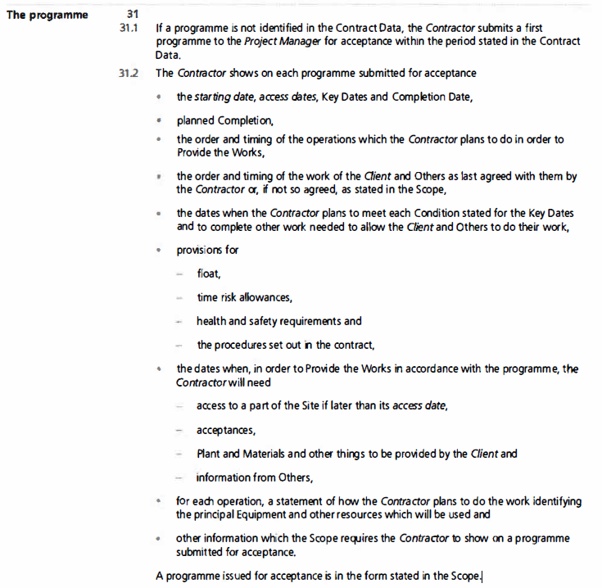
Programme Requirements; What and How
NEC Contracts

Slide 24
What the Scope Should Specify
Programme Form Requirements in Practice
①
Software & File Format
②
WBS & Activity Coding
③
Milestone Conventions
e.g. Primavera P6 (.xer) or Asta PowerProject (.pp). Specify version. Reject .mpp if not required.
Phase codes, activity ID prefixes (e.g. SUP-0010). Standardises structure across revisions.
Access Date milestones coded AC-XXXX (red ◆). Key Dates KD-XXXX (amber ◆). Completion CD-0001 (green ◆).
④
Calendars & Working Days
⑤
Float & Time Risk Allowances
⑥
Programme Narrative
Mon–Fri standard; public holidays listed. Extended/Saturday calendar shown separately if used.
TRA as separate activities (not embedded). Critical path = longest path, shown in red. Float column mandatory.
Minimum 2-page statement per submission: progress, critical path changes, access date status, new TRAs.
Key risk: Failure to include Scope-required programme information is a valid ground for non-acceptance under Cl. 31.3 — and unlike NEC3, this applies to format and form, not just content.

Slide 25
03
Revised Programmes
Clause 32

Slide 26



Revised Programmes – Clause 32 (NEC3 & NEC4)
NEC Contracts
Clause 32.1
  lists what should be included
  this is viewed as the minimal information that requires to be shown
  the Contractor must show factual as-built information in programme updates
  the Contractor may choose to show early warnings, but this should be done in discussion with the Project Manager
It is suggested that compensation events that have not been ‘implemented’ should be shown. If not, it is more likely that the programme would not be accepted (not realistic or practicable)
  these can be labeled as ‘notified compensation events’ (NCEs)
HOW
Clause 32.2
  after instructed by the Project Manager (within the period for reply)
  when the Contractor chooses
  no longer than the interval stated in the Contract Data
When

Slide 27
04
Compensation Events
& Extension of Time

Slide 28



What is Forensic Schedule Analysis?
NEC Contracts
A detailed, fact-based investigation of project schedule data to determine the causes, responsibility, and quantum of delays or disruptions on construction projects.
Identify Causes
Quantify Impact
Allocate Responsibility
Pinpoint specific events and activities that caused schedule delays
Measure the time impact of delays using CPM analysis
Determine which party bears responsibility for each delay event

Slide 29
NEC Contracts
Compensation Events – The NEC EOT Regime
Compensation Events (CEs) under Clause 60 are events which, if they occur, entitle the Contractor to changes in both Prices and Completion Date. Unlike traditional EOT clauses, NEC treats time and money together.
WBS, Logic
Access
Delivery
Stoppage
1
Notify CE
WBS
Within 8 weeks of becoming aware — failure may bar claim
Delayed Work
2
PM Instructs Quotation
Contractor submits quotation within 3 weeks of instruction.
Delayed Work
3
Quotation Submitted
Shows revised programme AND price impact. Programme is mandatory part of CE quotation.
Weather
4
PM Assesses / Accepts
PM has 2 weeks to accept, instruct revision, or make own assessment.
Force Majeure
5
CE Implemented
Prices and Completion Date (and Key Dates) are changed.

Slide 30
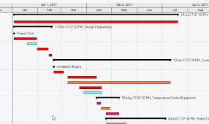
Dividing Date vs Status Date
NEC Contracts
PM’s
Instruction
1
Dividing Date
1
Actual
Forecast (Remaining Work)
Status Date
2
Contractor’s
Notification
Dividing Date
Actual
Forecast (Remaining Work)
Status Date

Slide 31
Dividing Date vs Status Date
NEC Contracts
PM’s
Instruction
Dividing Date
Actual
Forecast
Status Date
Contractor’s Notification
Dividing Date
Actual
Forecast
Status Date

Slide 32
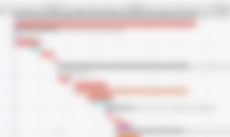
Dividing Date vs Status Date
NEC Contracts
PM’s
Instruction
Dividing Date
Actual
Forecast (Remaining Work)
Status Date
If the Contractor responds late
Dividing Date
C’s Response
Actual
Forecast (Remaining Work)
Actuals after Dividing Date
Status Date

Slide 33
Concurrent Delays
NEC Contracts
Simple Definition: two or more events, from different parties, impact the critical path at the same time.
True concurrency is rare.
NEC does not define concurrent delay in the contract text.
Forensic analysis: critical path at time of CE determines concurrent delay impact.
Contractor typically gets EOT but not costs.
Concurrent Delay – NEC Position
Note: Add a concurrency mechanism to the contract.
1 | 2 | 3 | 4 | 5 | 6 | 7 | 8 | 9 | 10 | 11 | 12 | 13 | 14 | 15 | 16 | 17 | 18 | 19 | 20 | 21 | 22 | 23 | 24 | 25 | 26 | 27 | 28 | 29 | 30 | 31 | 32 | 33 | 34 | 35 | 36 | 37 | 38 | 39 | 40 | 41 | 42 | 43 | 44 | 45 | 46 | 47 | 48 | 49 | 50
Path A – Critical Path
Path A (Impacted by the Employer Event)
6 Day Delay
Path B – Critical Path
6 Day Delay
Path B (Impacted by the Contractor-caused Event)

Slide 34
05
Terminal Float &
Early Completion

Slide 35
Terminal Float – Ownership and Forensic Implications
NEC Contracts
Contractor’s Float
Terminal Float
Planned Completion
Completion Date (CCD)
Delay
Terminal Float
Planned Completion
Completion Date (CCD)

Slide 36
06
Time Risk Allowances

Slide 37
Time Risk Allowances (TRA) – NEC3 & NEC4
NEC Contracts
Definition: Time Risk Allowances (TRAs) are the Contractor's own schedule contingencies explicitly shown in the programme (Clause 31.2 NEC3 & NEC4). They are separate from activity durations and represent the Contractor's assessment of its own risk events that could affect the programme.
What TRAs Cover
What TRAs Do NOT Cover
Forensic Significance of TRAs
Contractor's own productivity risks
Weather within Contractor's risk (below adverse weather threshold)
Subcontractor performance uncertainties
Material delivery lead time variations
Minor design coordination risks (where Contractor-designed)
Normal ground condition variations within expected range
Labour availability fluctuations
Employer risk events (these are Compensation Events)
Force majeure events
Adverse physical conditions beyond expected
Exceptionally adverse weather
PM's instructions and changes
TRAs are NOT a substitute for proper float management
TRAs are Contractor-owned — like activity-level terminal float
Employer CE cannot consume TRA without EOT entitlement
Hidden TRAs (inflated activity durations) mask true criticality

Slide 38
TRA vs Terminal Float
NEC Contracts
TRA
TRA
TRA
Terminal Float
TRA: Activity Level Riks Allowance
Terminal Float: Early Completion of Critical Path compared to Contractual Completion date, project-level float.
* THEY ARE NOT THE SAME.
* IF TRA related risk doesn't happen, Terminal Float can increase.
Planned Completion
Completion Date (CCD)

Slide 39
07
NEC Preferred Delay
Analysis Approach

Slide 40
Prospective vs Retrospective Analysis in NEC
NEC Contracts
PROSPECTIVE (Forward-Looking)
RETROSPECTIVE (Backward-Looking)
NEC's PREFERRED approach for CE assessment
Used when prospective assessment was not done at the time
Assess impact at the time CE is notified / quotation prepared
Applied in disputes where events have already occurred
Based on Accepted Programme at time of CE
Methods: As-Planned vs As-Built, Collapsed As-Built, Window Analysis
Forward-looking: what will this CE do to planned Completion?
NEC does NOT prefer retrospective — but it is the reality in many disputes
Time Impact Analysis (TIA) is the appropriate methodology
Retrospective TIA still possible using contemporaneous programmes
Requires a current, accepted, resource-loaded programme
Collapsed As-Built: 'but-for' — removes delays to see impact
Advantages: aligns with NEC philosophy; contemporaneous evidence
Window Analysis: most robust for NEC due to programme update requirements
Prevents 'benefit of hindsight' assessments
Weakness: less contemporaneous; susceptible to hindsight bias
Both parties assess at same point in time – less dispute
Courts/Adjudicators accept retrospective when prospective not possible
Contractor must show CE delayed planned Completion
Always check: was an accepted programme current at each delay event?

Slide 41
8
Key Takeaways &
Practical Guidance

Slide 42
10 Key Principles for NEC Forensic Schedule Analysis
NEC Contracts
1
Accepted Programme is Everything
6
Window Analysis for Disputes
No accepted programme = no reliable forensic baseline. Always establish programme status at each key event.
For retrospective disputes, Window Analysis using contemporaneous accepted programmes is most robust.
2
Prospective First
7
Time & Cost Together
NEC mandates prospective CE assessment. TIA using the accepted programme at time of CE is the starting point.
NEC CE assessment covers both. Ensure time impact and cost impact are aligned and consistent in the analysis.
3
Notify or Lose
8
Concurrent Delay — Assess Carefully
8-week notification. Check all dates — late notice may bar entitlement.
NEC silent on concurrency. Use forensic analysis to identify true critical path at time of each CE.
4
Protect Terminal Float
9
Early Warning Register
Contractor's terminal float cannot be taken by Employer CEs.
EW records document when risks were known. Use in forensic analysis to assess reasonableness of CE claims.
5
Show TRAs Separately
10
Access Dates
Time Risk Allowances must be explicit in programme. Hidden TRAs distort critical path and CE assessments.
Access dates in the accepted programme supersedes the Contract Data, if later.

Slide 43
NEC Contracts
Challenging Question?
As per Cl. 33.1
Basis of Delay Analysis
Critical Path
Terminal Foat
Accepted Programme
Access Date
Contractual
Access Date
planned Completion Date
Completion Date
As per Cl. 33.1
Basis of Delay Analysis
Critical Path
TF
Delayed
Programme
Access Date
Contractual
Access Date
planned Completion Date
Completion Date
planned Completion Date been impacted, Cl.63.3/63.5 says EOT, but the driving event is not a valid CE, what about the Terminal Float?

Slide 44
NEC CONTRACTS
Thank you
Programme management and Forensic Schedule Analysis in NEC
Questions & Discussion

