Slide 1

Nutrition and Immunity

Slide 2

Introduction
Dana Chapman BSc (Hons) Nutrition Science (mBANT) (CNHC)
Founder and Director of DC Nutrition Ltd
Passion for all things wellbeing – most importantly prevention rather than cure!
Live today so that you are able to enjoy your grandchildren…
Where to find me:
Website: www.dc-nutrition.co.uk
The Spinal Answer: www.spinalanswer.co.uk/
Facebook: DC Nutrition
Instagram: dchapersnutri
Email: dana@dc-nutrition.co.uk

Slide 3

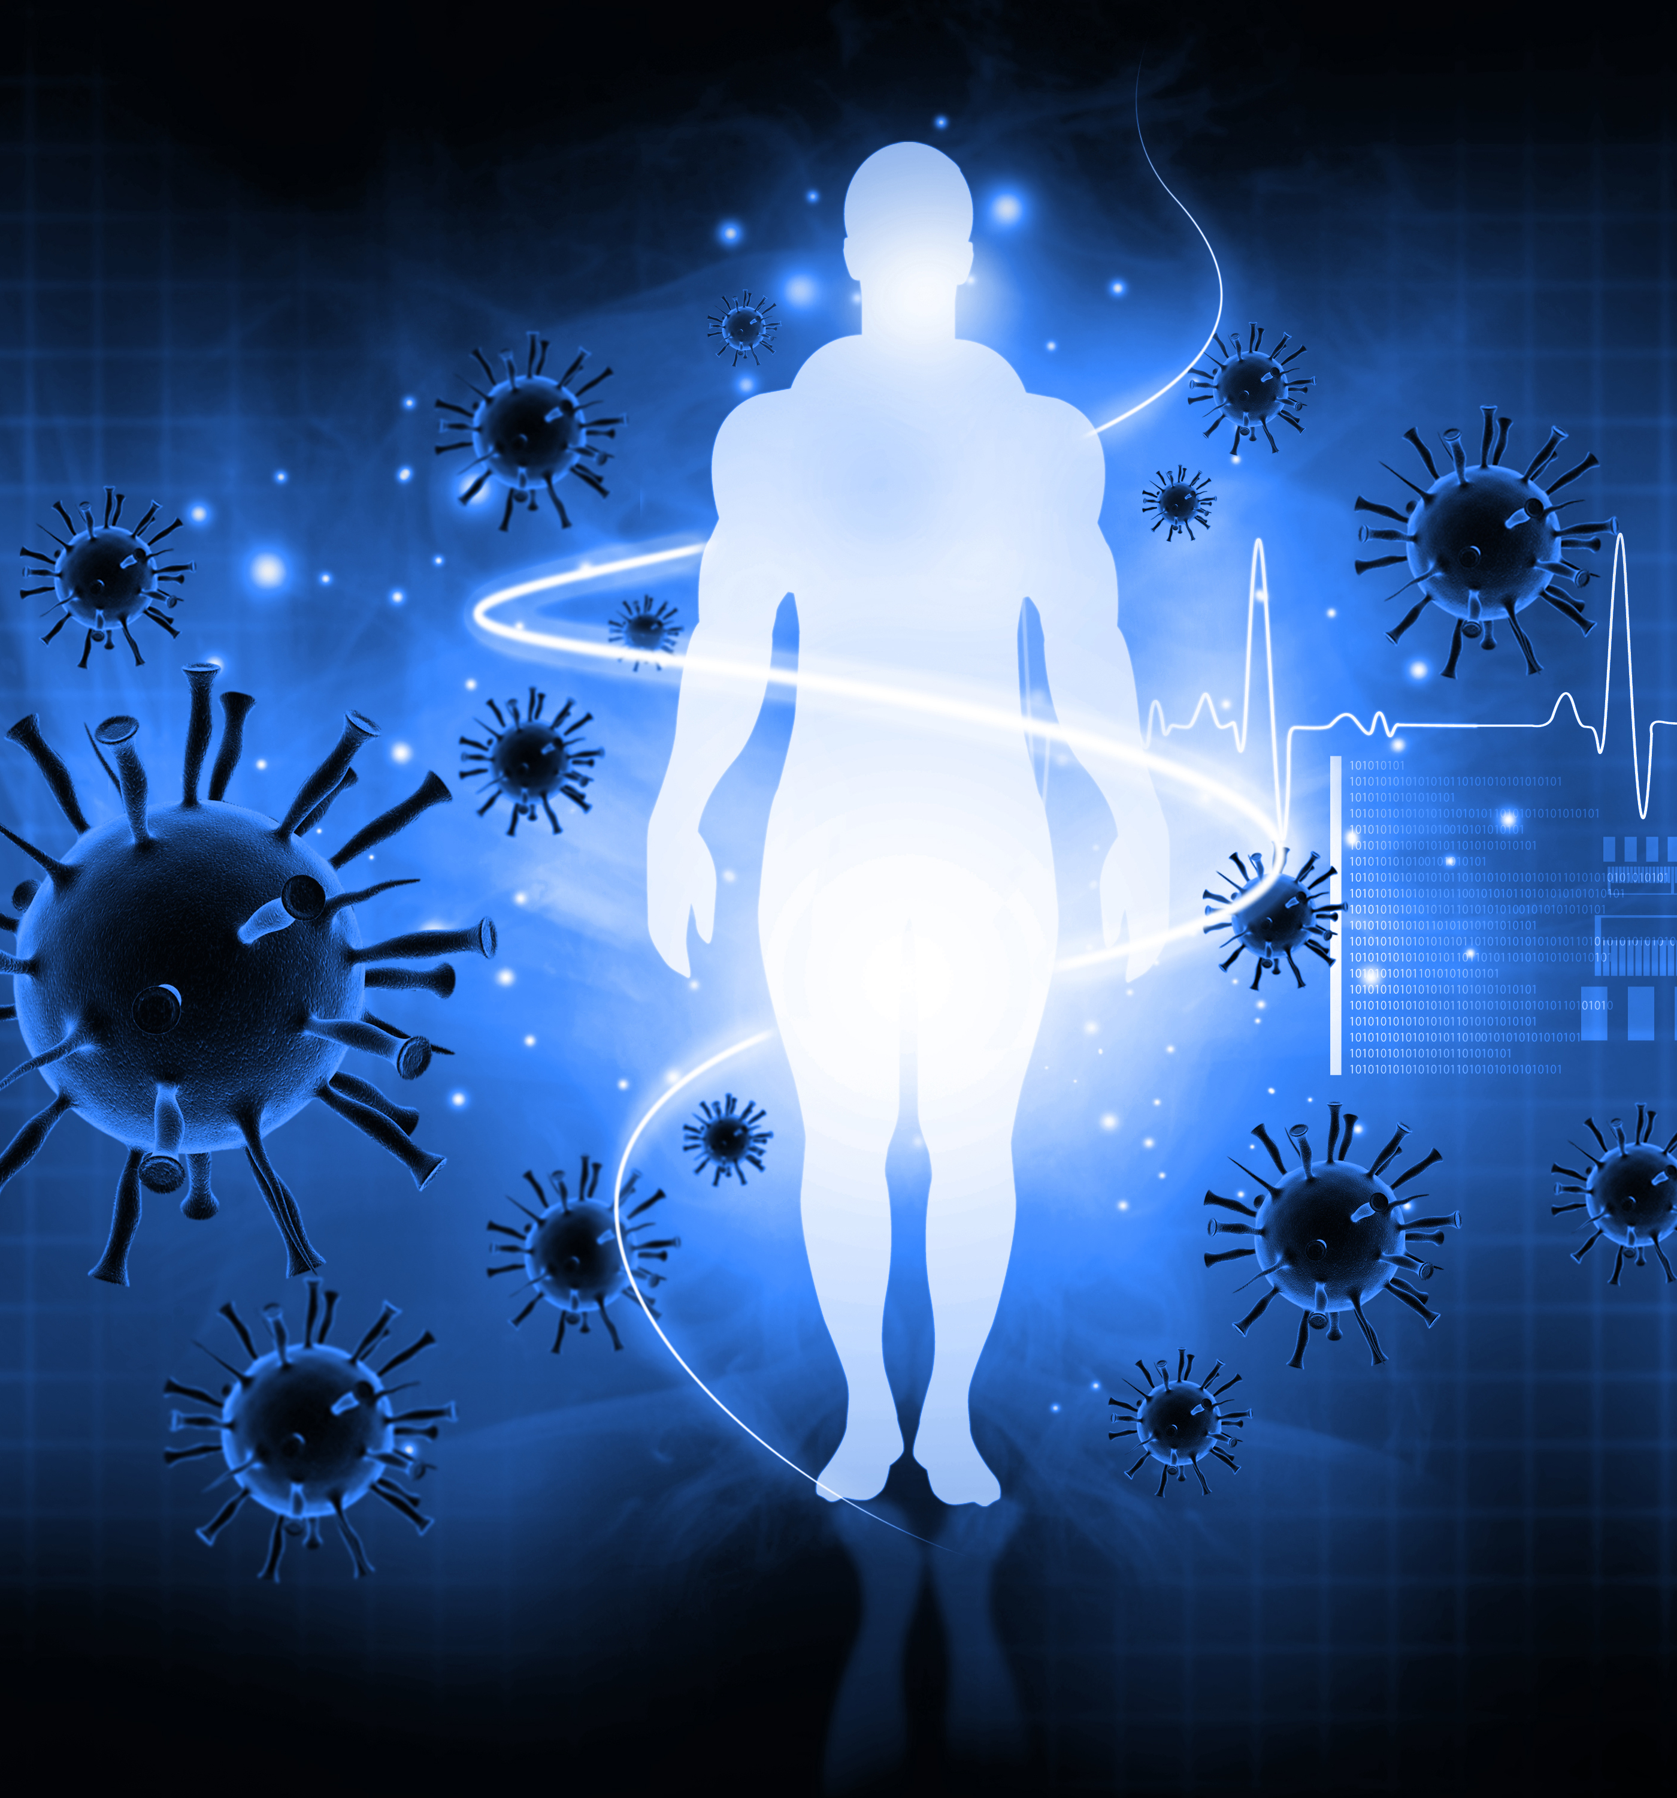
Agenda
The recent pandemic has highlighted the importance of our immune system and it has encouraged many people to re-evaluate their health and lifestyle.
Why is the immune system/ immunity important?
What is the immune system? 3 Parts.
  The role of gut health
  The role of stress
  The role of the environment
What about COVID?
Psychoneuroimmunology
What can we do to optimise our immune system
  Nutrients required to optimise the immune system

Slide 4
Why is immunity important?
For any organism to adapt, survive, and thrive in their environment it needs robust immune defences
There are many threats in our environment (toxins, food, pollution, stress)
Our immune system is intelligent – it quickly responds to changes in our environment, it has memory, it repairs damage to cells
It can become the root cause of ill health (auto-immune disease)

Slide 5

3 parts
Barrier defences – mucous membranes, epithelial tissue of skin, gut, lungs
Innate immunity – inborn powerful general response. Surveys and neutralises pathogens – mounts an inflammatory response
Adaptive immunity - immune system memory bank to act quickly on re-infection

Slide 6
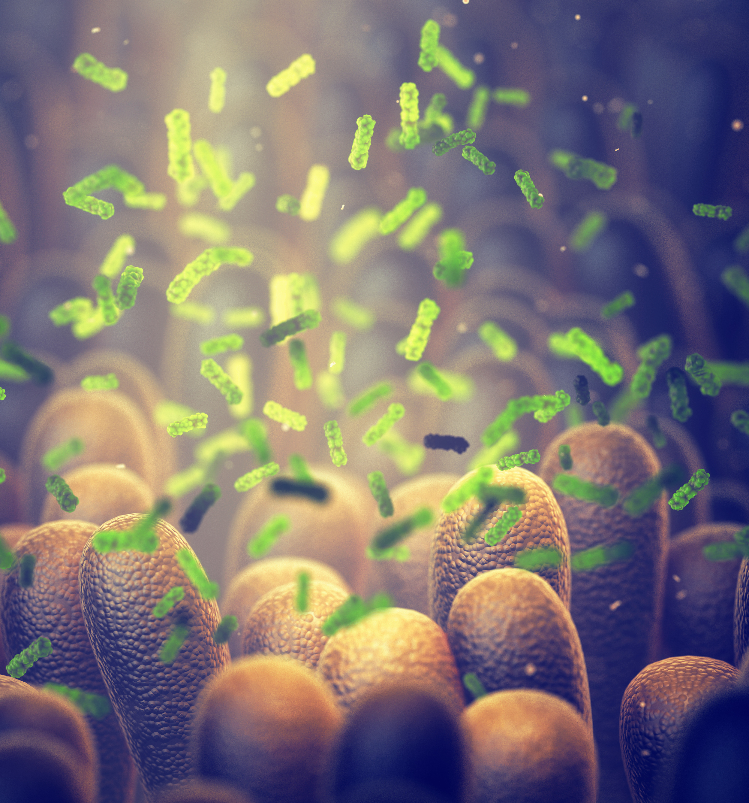
The role of gut health
The gut contains 70% of our immune system
Gut microbiome plays a role in educating the immune system
Intestinal barrier is important for keeping pathogens out, a breakdown of this barrier may lead to disease states(1)
Leaky gut has a strong link to auto-immune related conditions

Slide 7
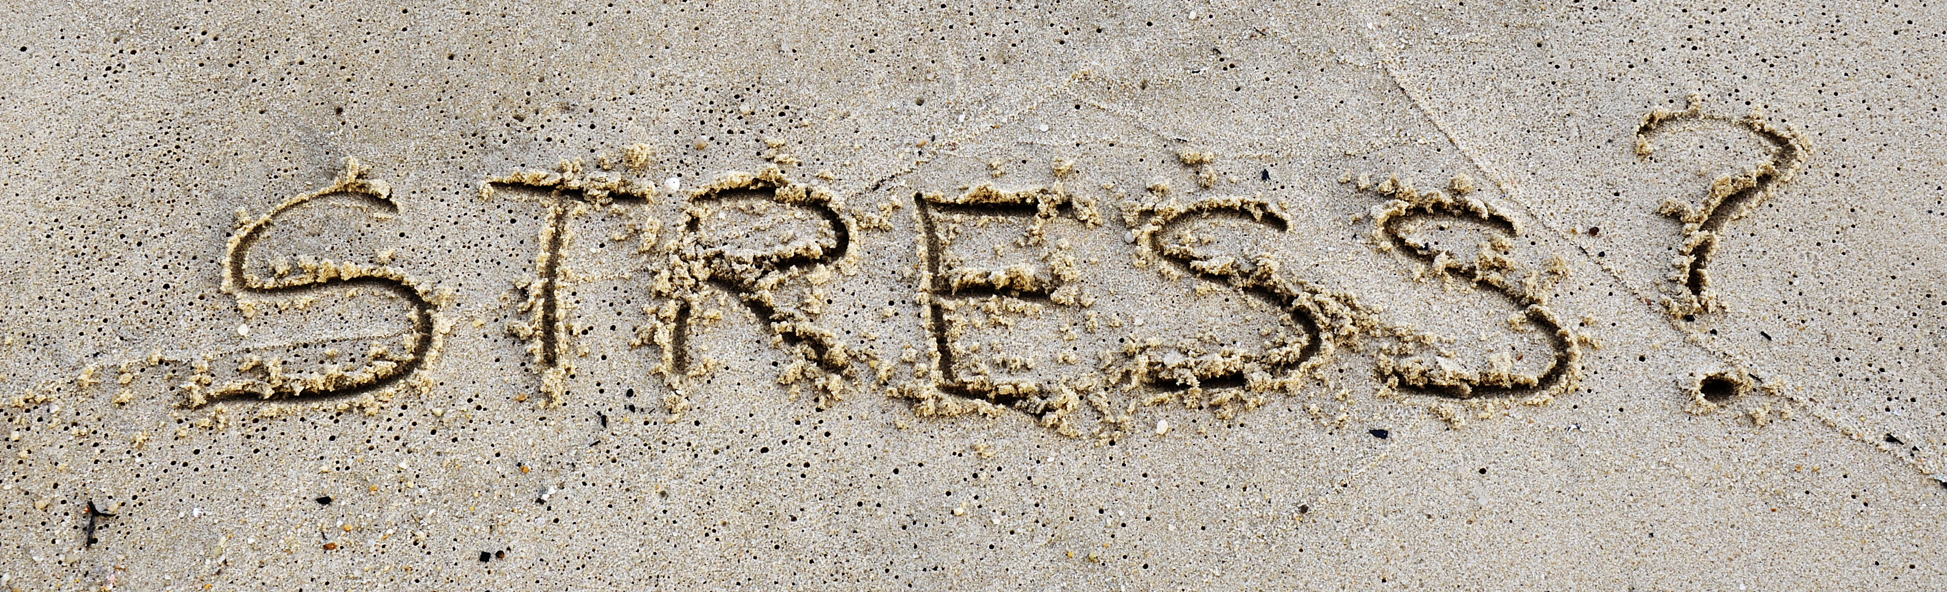
The role of stress
Stress supresses the immune system (2)
Stress comes in more forms than we think: imbalanced blood sugar levels, excessive training, poor nutrition, poor sleep, emotional, financial and every day life
Stress impacts behaviour – alcohol use, poor food choices, change in sleeping patterns
Chronic stress is associated with accelerated aging of the immune system and represents a potent risk factor for the development and progression of a wide range of physical and mental disorders
2. Segerstrom, S. C. and Miller, G. E. (2004) ‘Psychological Stress and the Human Immune System: A Meta-Analytic Study of 30 Years of Inquiry.’, Psychological Bulletin, 130(4), pp. 601–630. doi: 10.1037/0033-2909.130.4.601.

Slide 8

The role of the environment
Our genes load the gun – but the environment pulls the trigger
Increase in mould and EMF exposure
Increased toxin exposure
Histamine intolerance

Slide 9
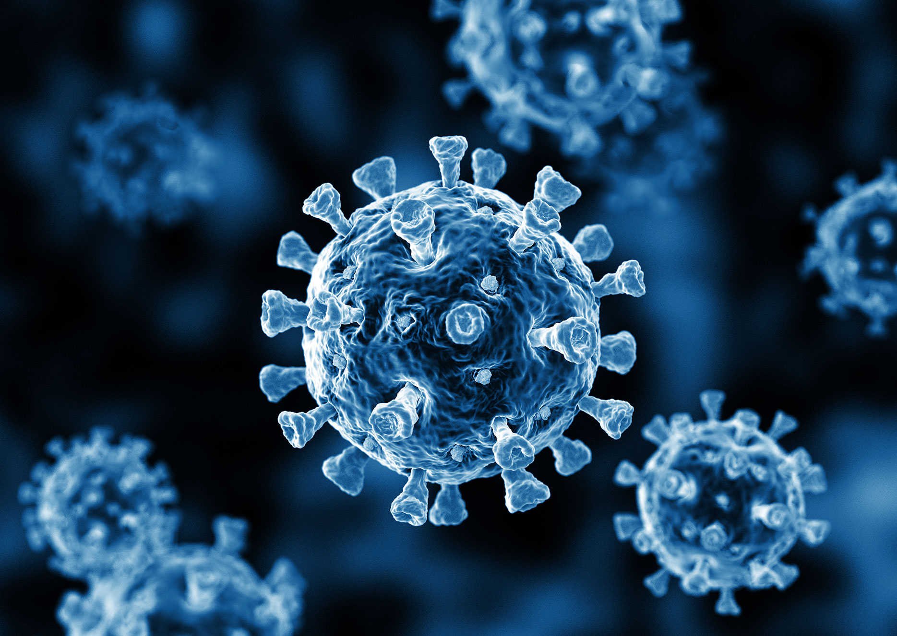
COVID
High risk individuals:
  Typically of older age and/or present with:
  Diabetes (type 1 and type 2),
  Cardiovascular disease, and
  Hypertension,
  Liver cirrhosis
Preliminary data indicate 2–11% of patients with COVID-19 had liver comorbidities (3)
Gastrointestinal symptoms are not uncommon in patients with COVID-19
SARS-CoV-2 indirectly damages the digestive system through a chain of inflammatory responses
changes in the composition and function of digestive tract flora mutually affect the respiratory tract through immune regulation, the so-called “gut-lung axis” (4)
What about Long COVID? “signs and symptoms that develop during or after an infection consistent with COVID, continue for >12 weeks and are not explained by an alternative diagnosis.”
Long COVID symptoms – mild fatigue, respiratory or neurological complaints, loss of smell/ taste, flu like symptoms

Slide 10
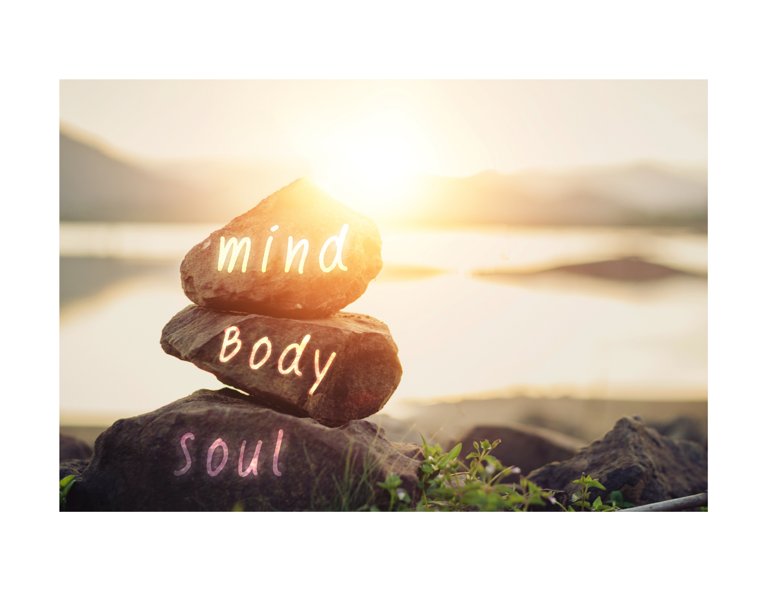
Psychoneuroimmunology
Defined as the study of interactions between behaviour, neural and endocrine function, and immune processes
Our nervous and immune systems are tightly connected
Chronic stress affects the function of the immune system as well as modifies the evolution of a variety of skin diseases (e.g. psoriasis, acne, vitiligo, urticaria) (5)
Emotional stressors have been known to precede onset of psoriasis (5)
Harvard study: embracing community helps us live longer, and be happier (6)
Yale school of public health – those who were disempowered died 7.5 years earlier than those who had an empower – Becker Levi.
5. Musa, S. (2020) ‘Hepatic and gastrointestinal involvement in coronavirus disease 2019 (COVID-19): What do we know till now?’, Arab Journal of Gastroenterology, 21(1), pp. 3–8. doi: 10.1016/j.ajg.2020.03.002.
6. Mineo, L. (2017) ‘Good genes are nice, but joy is better’, The Harvard Gazette, April.

Slide 11
What can we do?

Slide 12
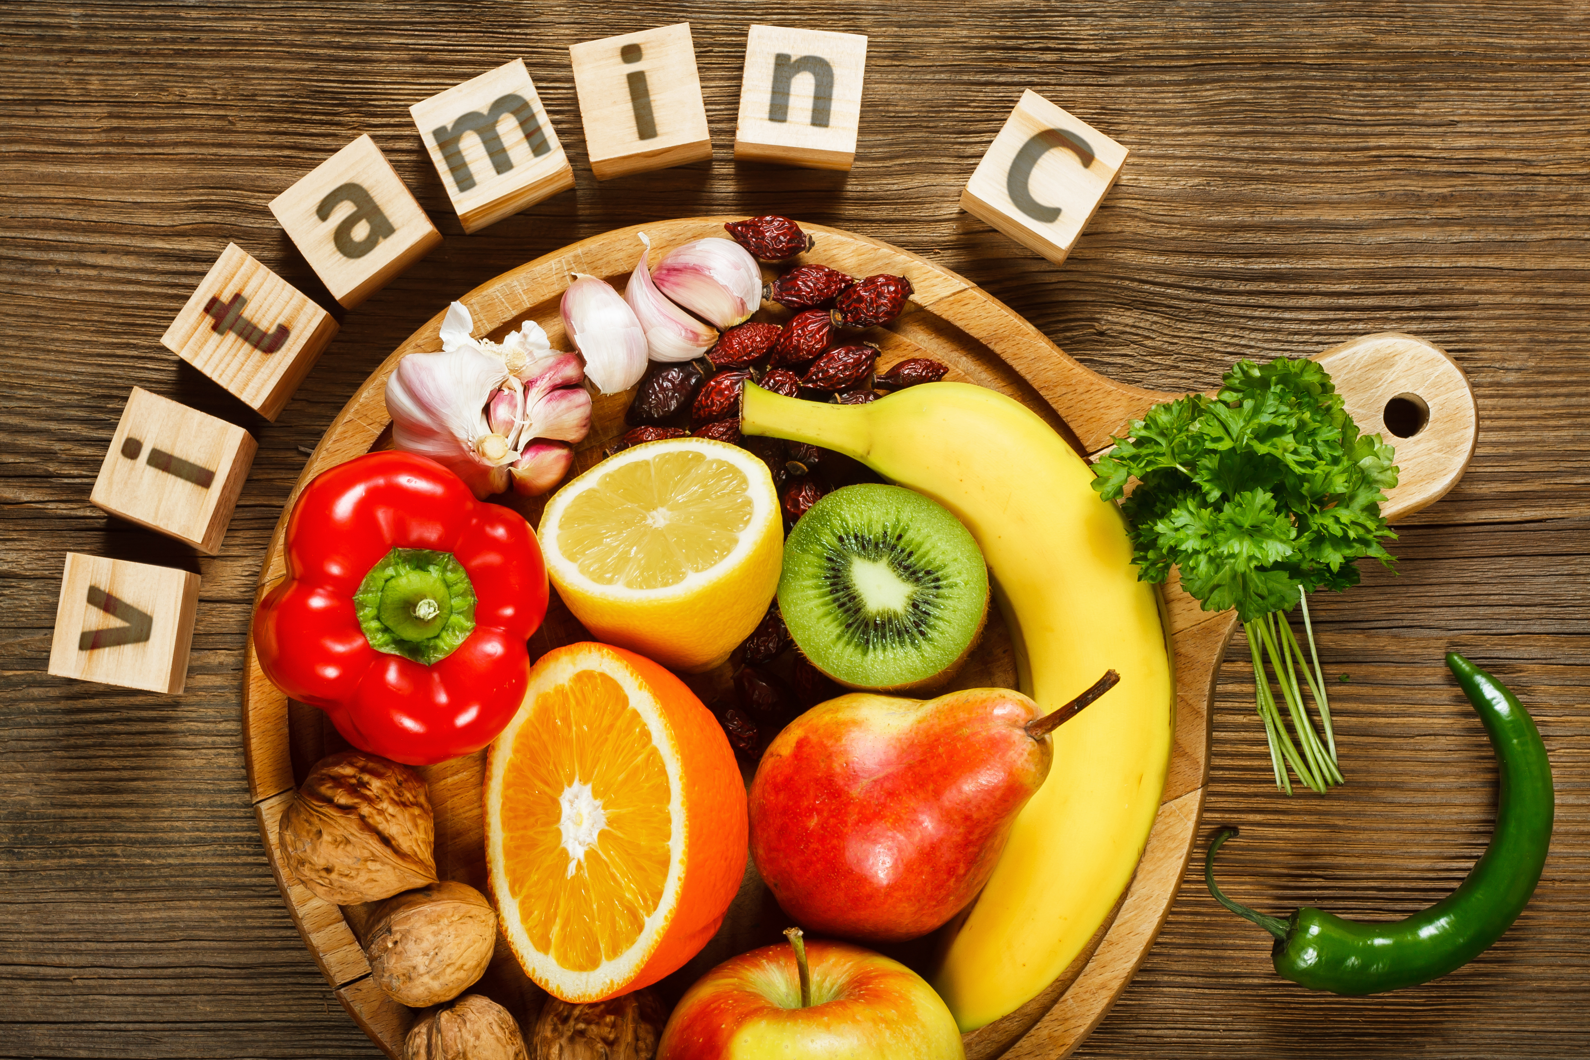
Vitamin C
An antioxidant (promotes healthy aging)
involved in the production of white blood cells and antibodies
Helps synthesize collagen (which reduces especially after menopause)
Necessary for serotonin production
Found in: red peppers, tomatoes, broccoli, brussels sprouts, strawberries, raspberries, blueberries, papaya, pineapple, oranges (I like to think red and purple!)
If ill take up to 3,000 mg per day
Body only absorbs 500mg per hour – so spread dosing out at intervals

Slide 13
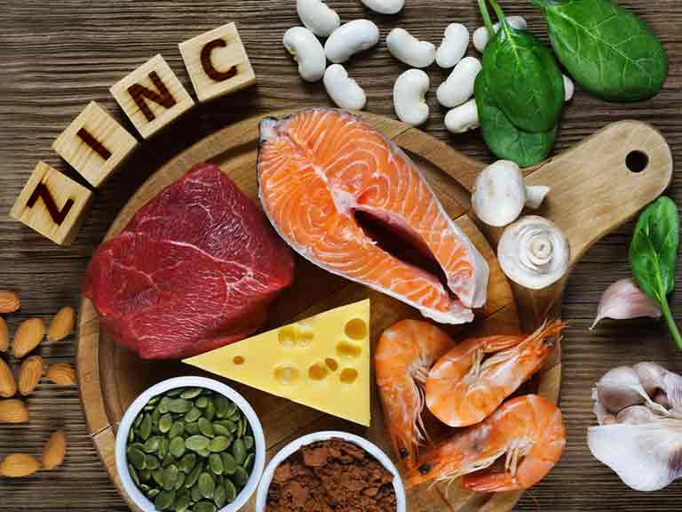
Zinc
Important for over 200 functions in the body:
  Immune function
  Skin health
  Sense of smell, taste and appetite
  Cognition and neurotransmitter balance
  Digestion
  Wound healing
  Serotonin and melatonin production
  Reproductive health
Foods high in zinc include: oysters, beef, lamb, fish, sesame seeds, flax seeds (ground), pumpkin seeds, almonds, oats, cocoa powder, egg yolk, kidney beans, chickpeas, wholegrains.
If you are deficient in zinc it is more difficult to absorb zinc from the foods you eat
Stress depletes zinc!
Signs you may be deficient: white flecks on nails, infertility, hair loss, acne, loss of smell or taste, poor appetite, acid reflux, indigestion or heart burn.
Zinc taste test helps understand deficiency
We require 10mg per day
Supplement if you have had Covid and still haven’t got your sense of smell and taste back!

Slide 14
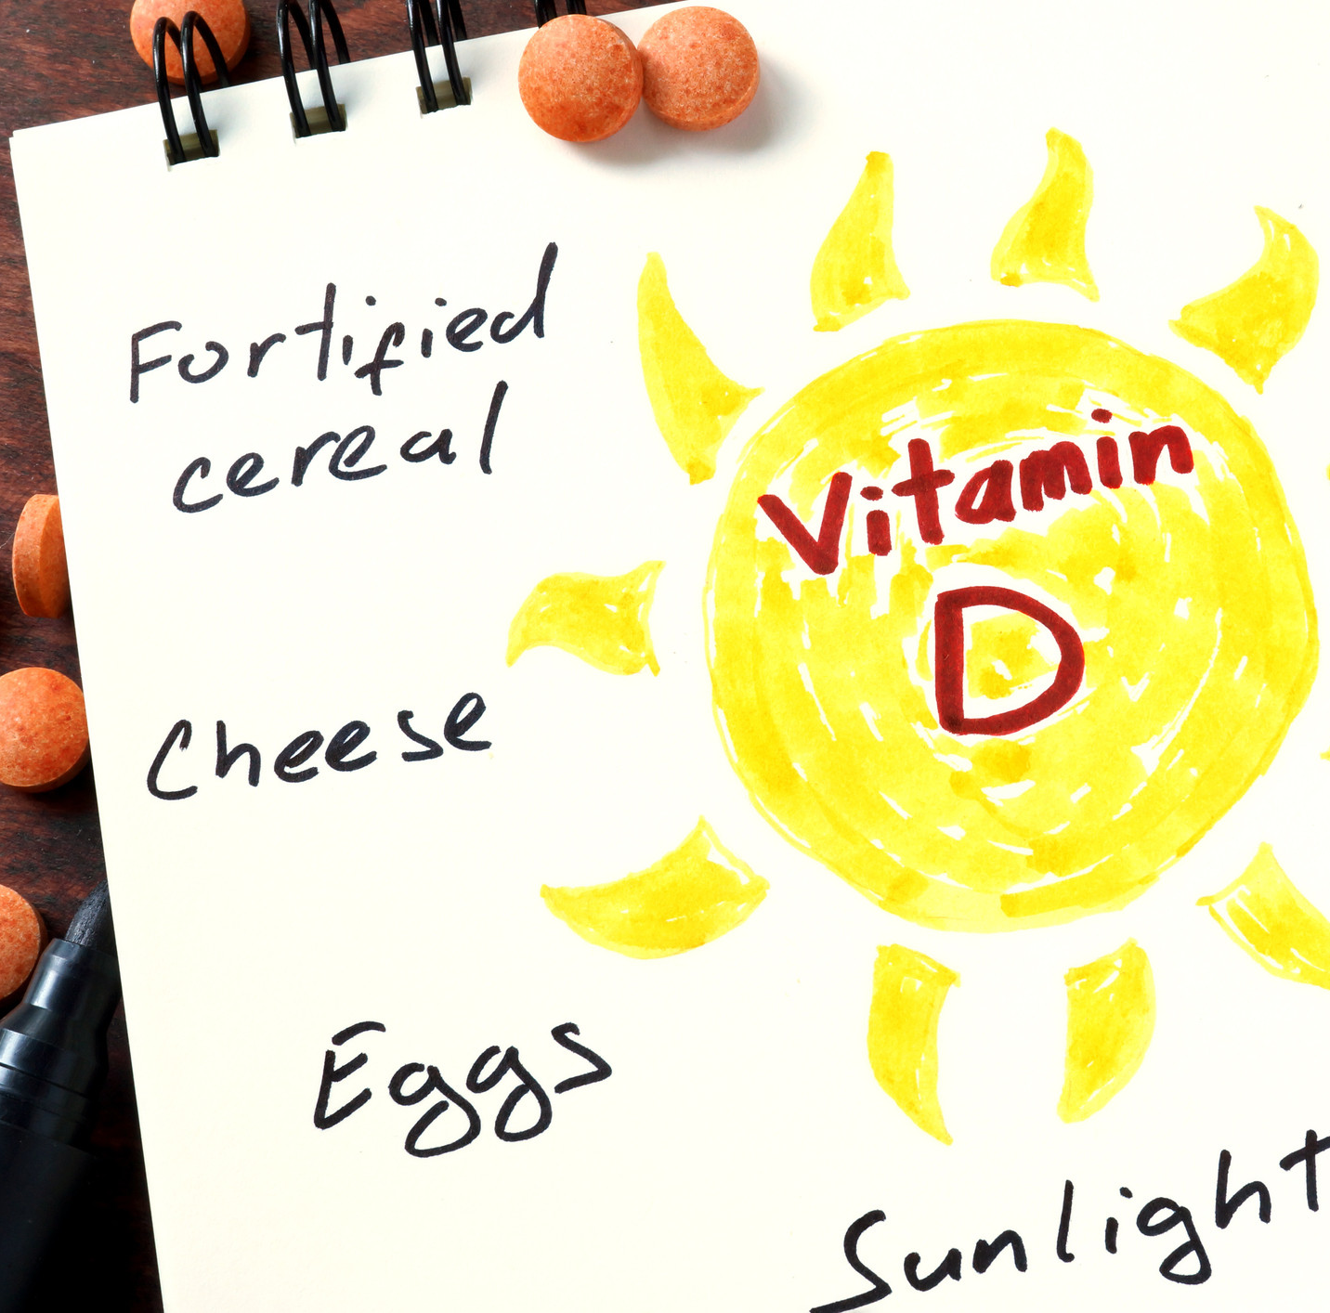
Vitamin D
Vital for immunity
Substantial evidence supports a link between vitamin D deficiency and COVID‐19 severity but it is all indirect (6)
Also important for blood sugar control and bone health
UK population are deficient, especially in winter months
Ask your GP to test your vit D levels!!
20 minutes of sunlight exposure, everyday at mid-day!
Small amount from eggs, salmon and dairy
Low fat diets lead to fat soluble vitamin deficiencies!
7. Musa, S. (2020) ‘Hepatic and gastrointestinal involvement in coronavirus disease 2019 (COVID-19): What do we know till now?’, Arab Journal of Gastroenterology, 21(1), pp. 3–8. doi: 10.1016/j.ajg.2020.03.002.

Slide 15
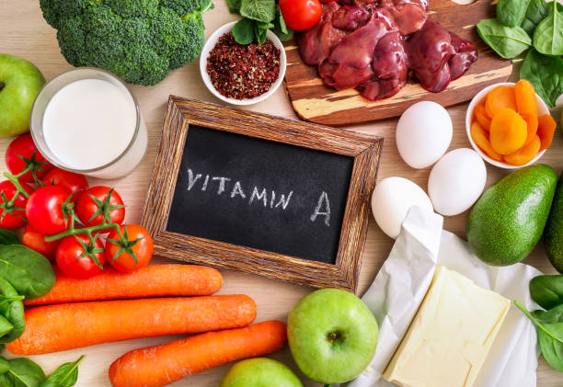
Vitamin A
Necessary for proper functioning of the immune system
Plays a key role in support of immune and inflammatory functions
Maintenance of tissues and bone development
growth
reproduction; bone development; creation of red blood cells.
Researchers believe that vitamin A may be equally important for our immune and inflammatory "braking" system, in which our cells are prevented from becoming overreactive.
Lack of vitamin A increases susceptibility to infections, allergies and reproductive ability
Foods: liver, eggs, salmon, sardines, avocado, sweet potato, carrots, broccoli, green leafy vegetables, peppers, asparagus, tomatoes

Slide 16
Support gut health
Spend time in nature
Reduce stress or build in recovery periods during the day
50 food challenge/ eat the rainbow
Eat resistant starch
Increase fibre intake
Reduce inflammatory load in diet – avoid cooking with vegetable and seed oils, use butter/ ghee and coconut oil, increase oily fish and omega 3’s
Reduce anti-bacterial use! [COVID sanitisation may be setting us up for crisis]

Slide 17
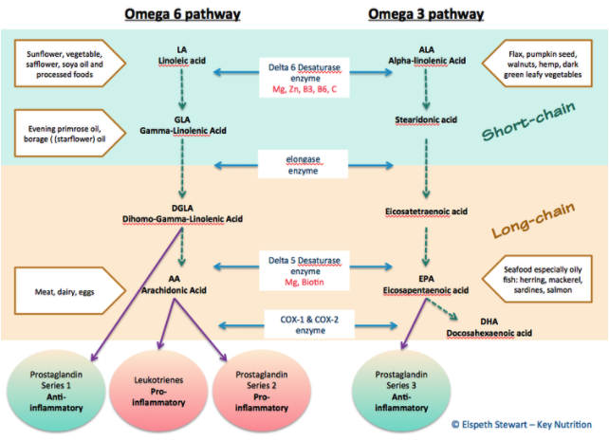
Reduce inflammation
Constant activation of the immune system can lead to chronic inflammation, as can being overweight/ obese
Our diets can perpetuate the situation
Omega 3: omega 6 ratio (ideally 2:1)
Omega 3 is found in oily fish (SMASH: salmon, mackerel, anchovies, sardines and herring). Also in grass fed meat, flaxseeds, chia seeds, pumpkin seeds, walnuts, hemp, dark green leafy vegetables
Reduce omega 6 intake (vegetable/ sunflower oil, soya oil, processed food, non grass-fed meat, dairy)
Vegans and vegetarians strongly consider supplementation! (Bionutri vegan omega 3, Minami omega 3)

Slide 18
Any Questions?
Thank you!
Where to find me:
Website: www.dc-nutrition.co.uk
The Spinal Answer: www.spinalanswer.co.uk/profiles/
Facebook: DC Nutrition
Instagram: dchapersnutri
Email: dana@dc-nutrition.co.uk
Supplements: www.naturaldispensary.co.uk

