Slide 1

Stress and Nutrition

Slide 2
Introduction
Dana Chapman: DC Nutrition (BSc Hons Nutrition Science and qualified NLP practitioner)
Clinic: Spinal Answer (Fulham)

Slide 3
Agenda
Statistics on stress in the workplace
What is stress…?
Signs your body is in a state of stress
How stress affects the body and its functions (e.g. energy, digestion, hormone balance, the brain, nutrient status)
How to support your body through nutrition
Other factors to consider to support you through times of stress

Slide 4
Statistics
74% of UK adults surveyed in 2018 felt so stressed they have been overwhelmed and unable to cope
46% reported that stress contributed to them eating unhealthily or eating too much
29% reported they started drinking, or increased their drinking
Stress is a significant factor in mental health problems such as anxiety and depression
Stress is the root of most modern disease:
depression
OCD
diabetes
alcoholism
hypo and hyperthyroidism
rheumatoid arthritis
Chronic fatigue syndrome
premenstrual tension

Slide 5
What is stress
Stress is the body’s reaction to feeling threatened or under pressure
A physiological reaction
It can be positive – helps achieve, act, move
Stress comes in many forms:
physiological (excessive training, under nutrition)
environmental (food toxins, sugar, food intolerances)
emotional (financial, work related, family, relationships etc.)
Our sympathetic or autonomic nervous system is activated
Prepares the body to fight/ flee/ freeze
Adrenaline and cortisol are released into the blood stream
Brain activity shifts from being able to think clearly and widely (pre-frontal cortex – decision making centre), to a narrow focus (reptilian brain/ amygdala)
Notes:
Pupils dilate, heart starts racing, BP increases, blood is diverted away from non-essential activities (digestion, reproduction) and towards heart and muscles to enable flight.

Slide 6
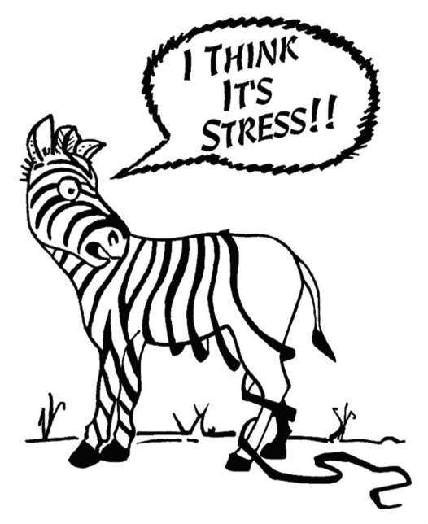
Signs your body is in a state of stress…..
Brain fog
Low mood
Panic attacks
Anxiety
Absent-mindedness
Difficulty making decisions
Poor memory
Agitated and irritable
Inability to complete tasks and lack of motivation
Lack of concentration
Poor sleep
Compromised immune system
Cognitive decline

Slide 7
How stress affects the body and its functions

Slide 8
Stress and the gut
Studies have shown stress decreases levels of beneficial gut bacteria and increases levels of non-beneficial and potentially pathogenic bacteria
Increase in gut permeability (aka – leaky gut)
Reduction in mucosal lining

Slide 9
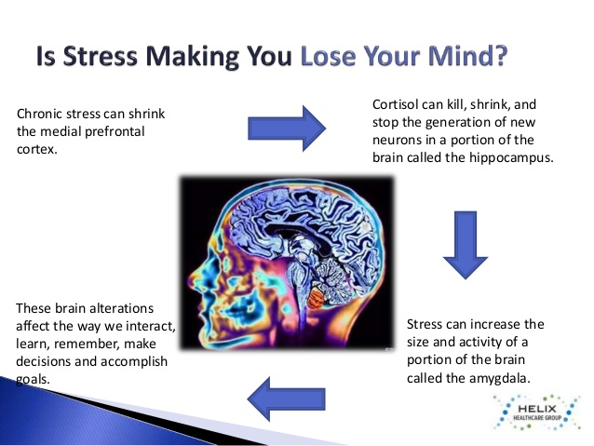
Stress and the brain
Prefrontal cortex is the decision making centre in the brain
Hippocampus is responsible for cognitive function
Amygdala

Slide 10
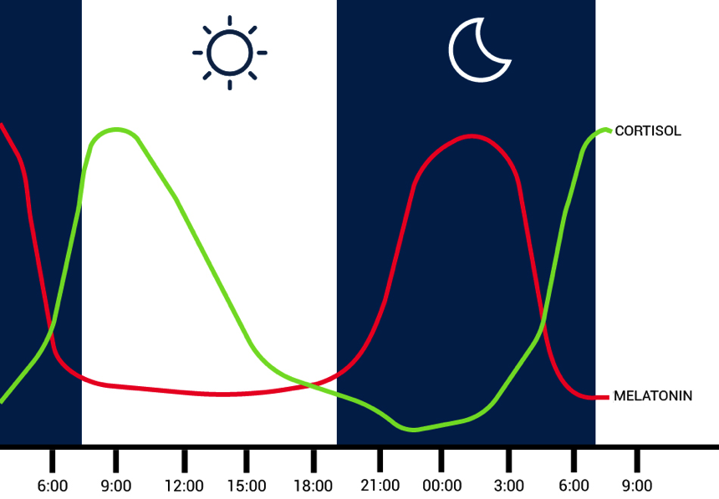
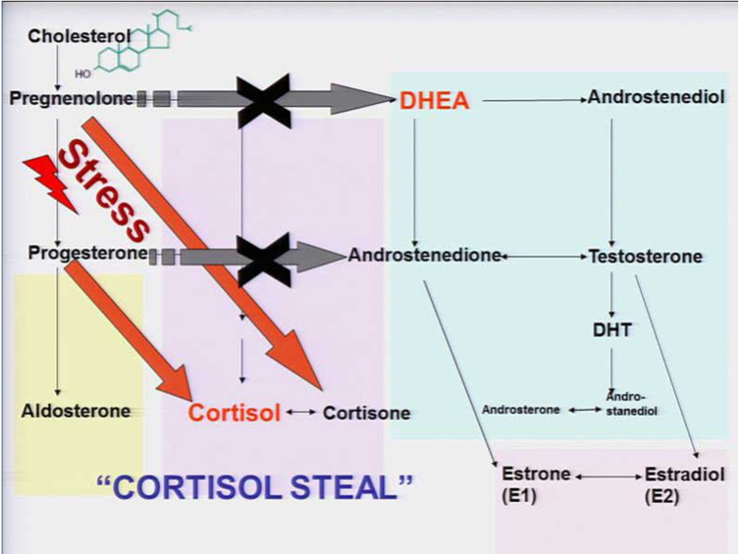
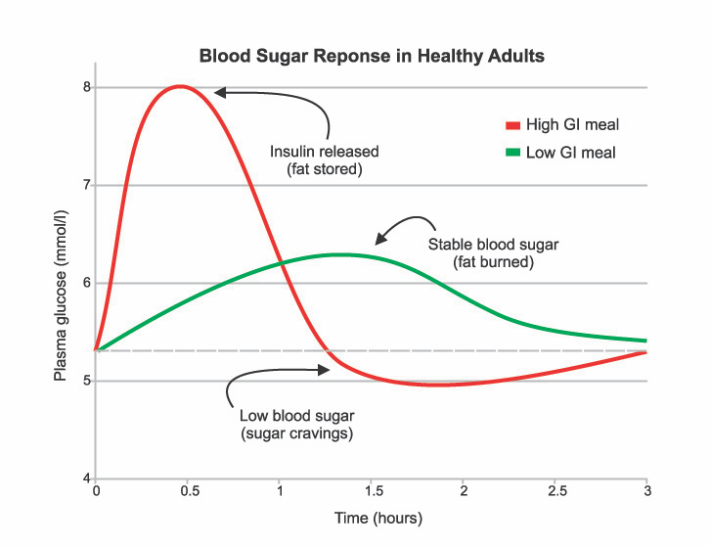
Stress and hormones
Stress impacts melatonin production
Stress increases cortisol production at the cost of sex hormones
Stress increases blood sugar levels – leading to imbalanced blood sugar, potential weight gain and crankiness!

Slide 11
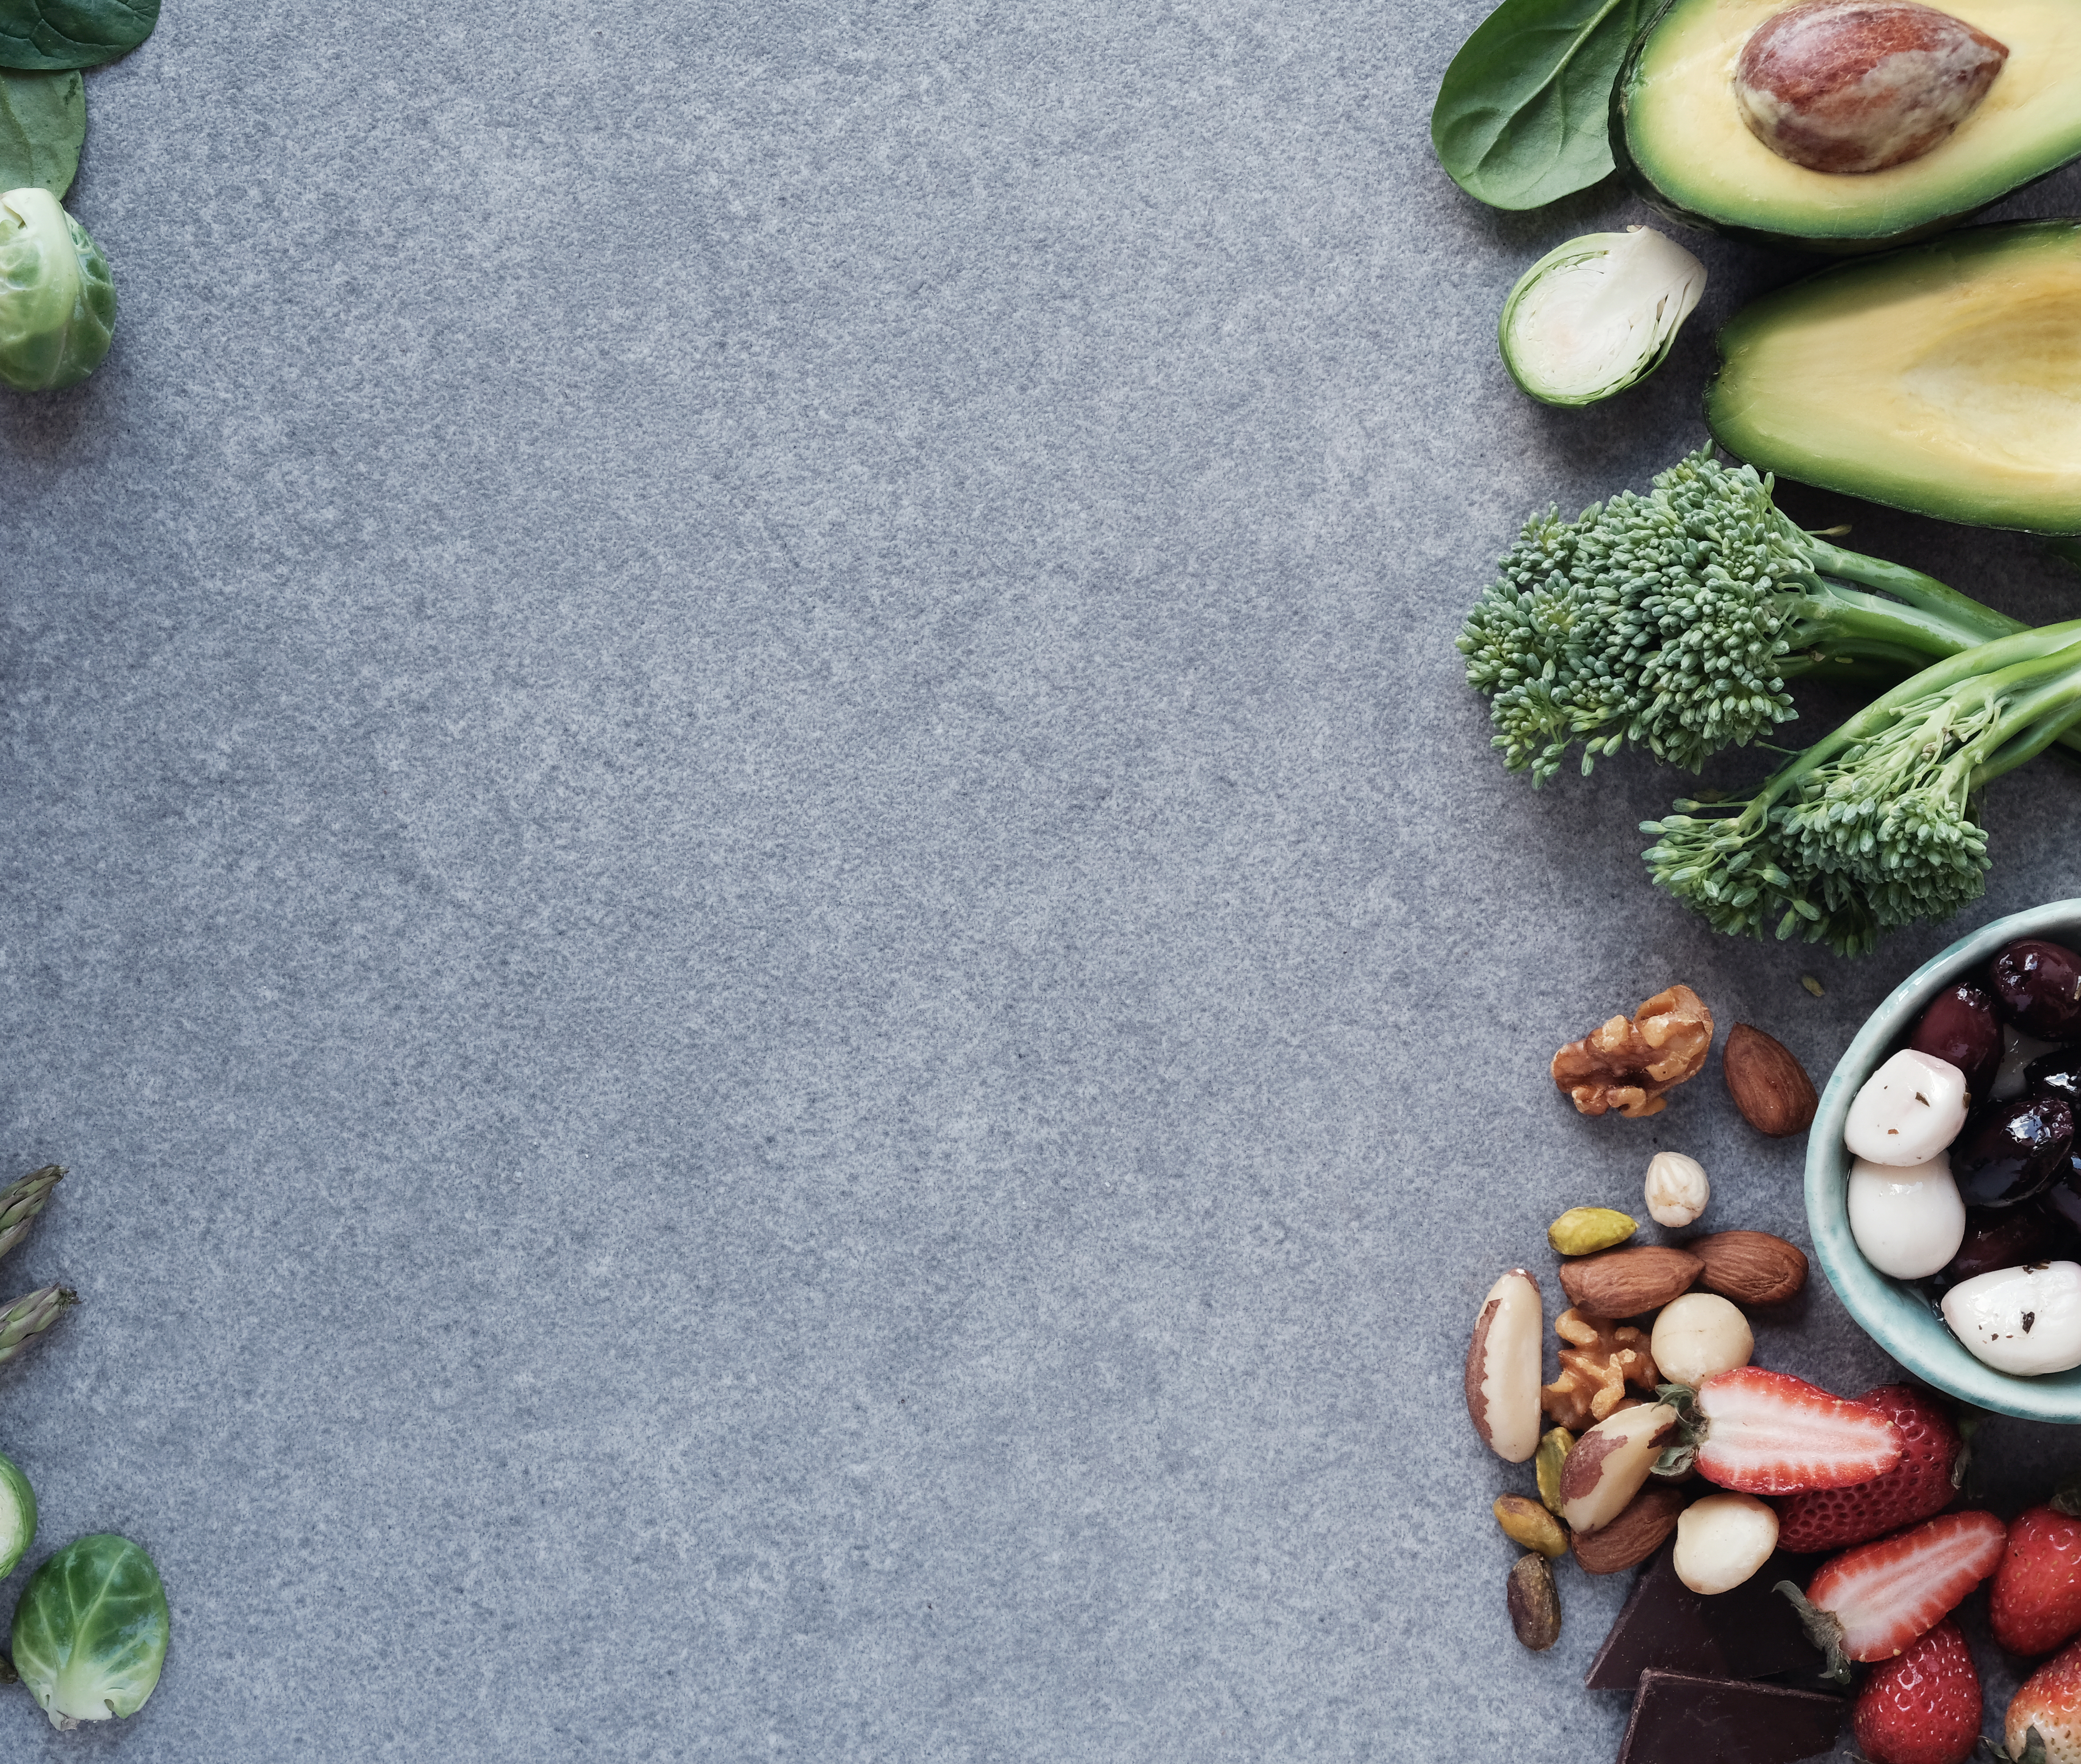
Stress depletes nutrients
Magnesium – natures tranquilizer, needed for over 300 enzymatic processes in the body
Zinc – important for digestion, reproduction, immunity, cognitive function and skin health
Iron – transports oxygen: aka – energy!
Calcium – bone health, blood clotting, muscle contractions, manages acid/ alkaline balance in the blood
Vit B3 – energy production, cellular maintenance and communication, synthesis of cholesterol and fatty acids (brain health)

Slide 12

What can you do?
Perhaps the key word this month should be awareness rather than stress awareness
How often do you check in with yourself?
Do you take a regular moment to pause and reflect on how energised you are feeling, what sort of mood you are in?
How are you communicating with people you care about?
How are you engaging with life, both at work and away from it?
Once you have thought these things through, do you take things a step further and evaluate why??
Notes:
In general we tend to be not very good at looking in the mirror – we are too busy looking after others, I am a victim of this as well, I have small children and a husband who has a very busy job!
Many of us are experts at self-delusion and possibly even denial!

Slide 13
My Stress Audit
What has gotten under your skin? | Pain in the butt tariff | Emotional tariff | Score
Constant zoom calls and meetings | 3 | 3 | 9
Felt overwhelmed with work | 2 | 2 | 4
Felt angry towards children/ spouse | 2 | 3 | 6
Not sleeping well | 3 | 3 | 9
Not eating well | 2 | 1 | 2
Notes:
Stress comes from within - a good example of this is when you’re driving and someone cuts in front of you, one day you may snap and f-bomb the other driver, but other days you’ll just shrug it off and quietly say to yourself – I hope his/ her day improves..
Stress is often about how we deal with it, what is going on internally is often what we express externally. There is a lot of power in recognizing that you should control the things you can control, but let go of things you can’t control.
I’ll give you an example. I am a nutritional therapist, so obviously I place a lot of emphasis on what food is consumed in my household. The Lord has humbled me by giving me a son who is a fussy eater and until recently would never put a vegetable in his mouth (knowingly). I used to get angry and so riled up about it, and I’ll be honest I still do – BUT I have come to the realisation that I can’t force him to do something, he is his own person. And so in this situation I had to understand what is making me angry and I had to recognise what I could control, and what I couldn’t – I’m still working on not sweating what I cannot control in that situation and focus on what I can control.
In column 1 write down all the things that have gotten under your skin in the past 7 days
In column two, give each of the issues a score between one and three (one being a trivial irritation and three being a monumental pain in the backside).
In column three, again put a score between one and three, that reflects the emotional tariff the problem is having on you. Finally, multiply the two scores and place in column four.
This exercise should help you understand where you need to focus your attention….
If you are feeling under the pump and if stress is becoming a challenge, take a moment to understand what is really causing you to feel that way – it is highly unlikely to be a traffic jam!

Slide 14
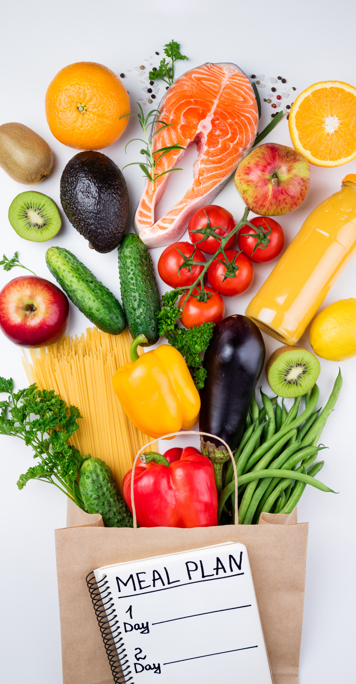
Replete nutrients
Magnesium: Pumpkin seeds, Brazil nuts, halibut, quinoa, spinach, almonds, buckwheat, cashews, pine nuts, white beans, legumes, brown rice
Zinc: Beef, lamb, sesame seeds, pumpkin seeds, nuts; pulses, garbanzo beans, wholegrains, wheatgerm, some vegetables, egg yolk, oysters, haddock
Iron: Green leafy vegetables (spinach, Swiss Chard, etc), cumin; turmeric; asparagus; leeks; lentils; beans; olives; pumpkin seeds.
Calcium: Green leafy vegetables; sesame seeds; sardines or other tinned fish that includes bones; wholegrains; cinnamon; oranges; dairy
B vitamins (especially B3): nuts and seeds, fish, chicken and red mead, beans and lentils, green leafy vegetables
Omega 3 for brain health and function: oily fish, flaxseeds, chia seeds

Slide 15
Other factors
Studies show how: Yoga/ meditation/ Thai chi/ Xi gong are all beneficial to returning the body to parasympathetic state
Get out into nature
Deep breathing exercises – switch you from sympathetic to parasympathetic (3 - 4 - 5 or 4 – 2 – 6)
Exercise (but not too much!) – 30 minutes reduces cortisol
Eat a diet high in nutrients and low in inflammation potential (JERF!)
Sleep hygiene - not new….?
Exposure to sunlight during the day helps melatonin production

