Slide 1

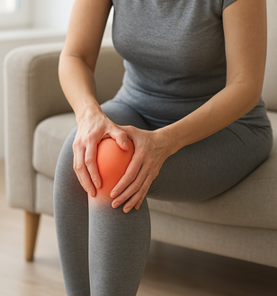
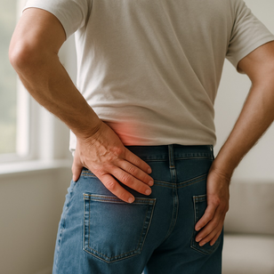

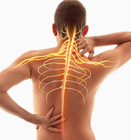
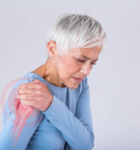
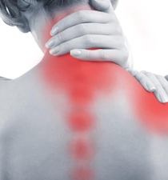
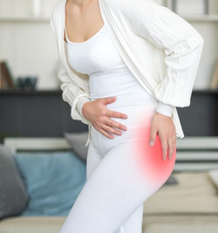

E-BOOK
3 Steps to a Pain-Free Life
– With the body's own power –

Slide 2

Millions of people suffer from back, joint and muscle pain every day. Despite various treatments such as painkillers, physiotherapy and massage, the pain often returns. It can feel hopeless – but there is an alternative. The body has an amazing ability to repair itself, if it is given the right support. In this guide, you will learn three simple steps to help your body recover – naturally, without side effects.

Slide 3
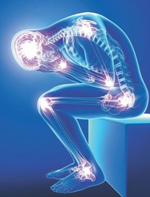
Step 1 – Identify the cause of your pain
The first step is to understand the difference between symptoms and root cause. Many treatments focus on relieving symptoms – such as painkillers. But what is causing the pain in the first place? It could be inflammation, poor circulation, stiffness or injuries that the body has not had time to heal. By identifying the cause, you can start focusing on real healing.
3 Steps to a Pain-Free Life – With the Body's Own Power

Slide 4

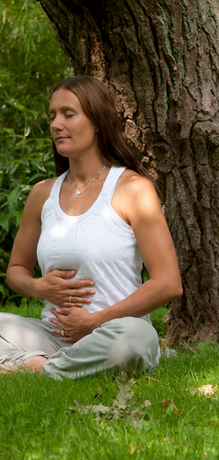
Step 2 – Relieve the body & break the cycle of pain
When the body is in constant tension, stress or pain, it goes into a kind of survival mode. This negatively affects recovery. Here are some simple things you can do to relieve the body:
• Move regularly – even short walks make a big difference.
• Rest and sleep enough – this is when the body heals.
• Eat an anti-inflammatory diet – e.g. vegetables, berries, omega-3.
• Use relaxation – deep breathing, meditation or light stretching.
3 Steps to a Pain-Free Life – With the Body's Own Power

Slide 5
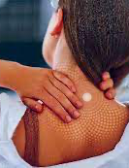
Step 3 – Activate the body's own healing ability
Research shows that the body can regenerate itself – if the stem cells are activated. Stem cells are the body’s own repair cells, but with age their activity decreases. This is where Life Waves patches come in. Our patented patches use light waves (phototherapy) to stimulate the body to activate its own stem cells – without chemicals or side effects. It’s a simple, natural method that you stick directly to the skin and starts working within minutes.
3 Steps to a Pain-Free Life – With the Body's Own Power

Slide 6

Summary and Next Steps
Pain doesn't have to be something you just accept. By understanding the cause, relieving the body and activating your self-healing, you can take a big step towards a life without pain. Life Wave is here to help you every step of the way.
  Want to try our stem cell activating patches?
  Order your first patch here
  Read more about the technology behind Life Wave
3 Steps to a Pain-Free Life – With the Body's Own Power

